Slide 1
The Settlement of the Chesapeake
Virginia & Maryland

Slide 2
SSUSH1 The student will describe European settlement in North America during the 17th century.
a. Explain Virginia’s development; include the Virginia Company, tobacco cultivation, relationships with Native Americans such as Powhatan, development of the House of Burgesses, Bacon’s Rebellion, and the development of slavery.

Slide 3
Virginia
Virginia was the first permanent English colony in North America.
Founded by the Virginia Company
  the Virginia Company was an English firm that planned to make money by sending people to America to find gold & other valuable resources
  They would then ship the resources back to England.
    MERCANTILISM!!!

Slide 4
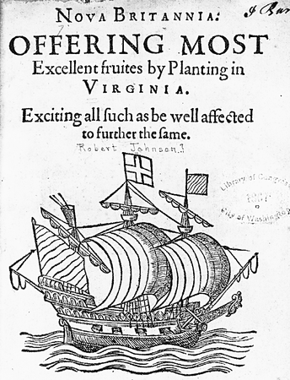
The British wanted to establish settlements along the North Atlantic coast
King James I chartered the Virginia company of London

Slide 5
England Plants the Jamestown “Seedling”
Late 1606 – VA Co. sends out 3 ships
Spring 1607 – land at mouth of Chesapeake Bay
  Attacked by Indians and move on
May 24, 1607 – about 100 colonists (all men) land at Jamestown, along the banks of the James River
  Easily defended, but swarming with disease-causing mosquitoes

Slide 6
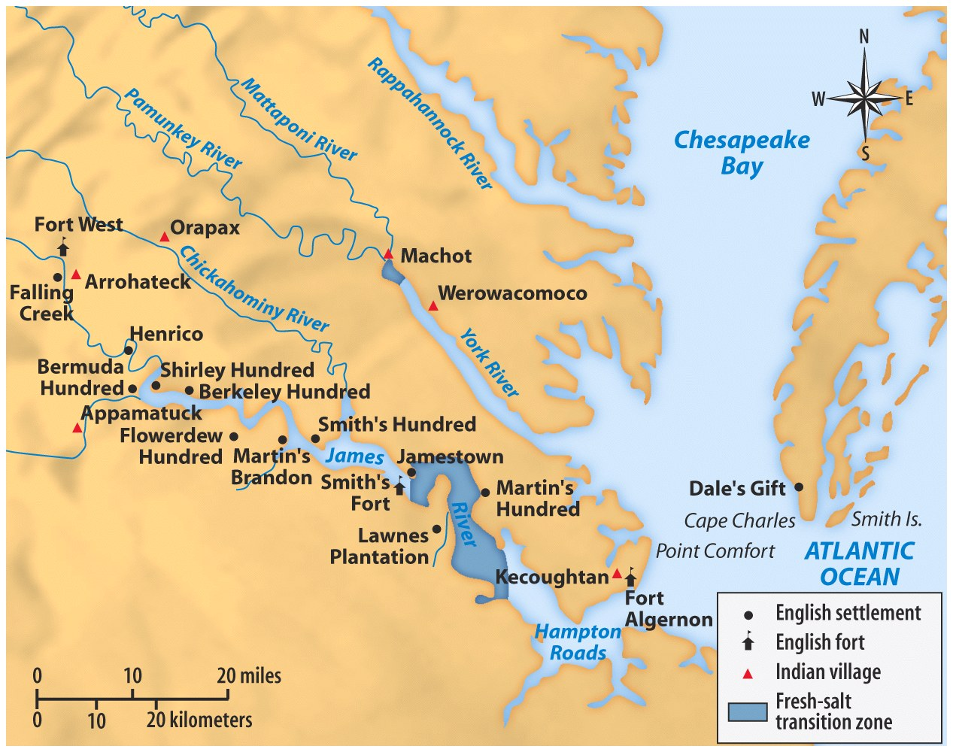


Chesapeake Bay

Slide 7
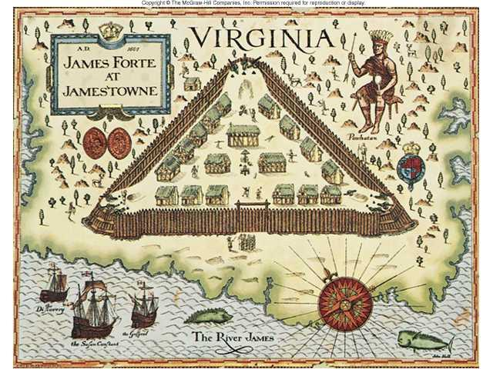
Jamestown Fort & Settlement Map

Slide 8
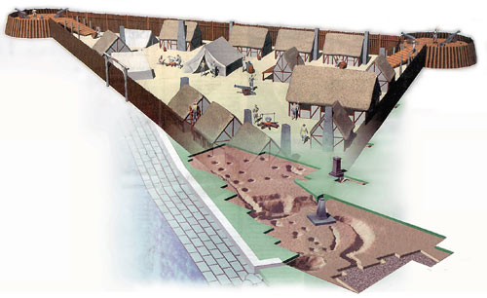
Jamestown Fort & Settlement (Computer generated)

Slide 9
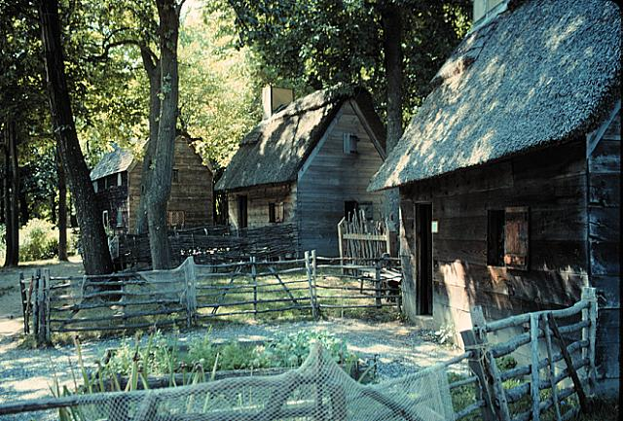
Jamestown Housing

Slide 10
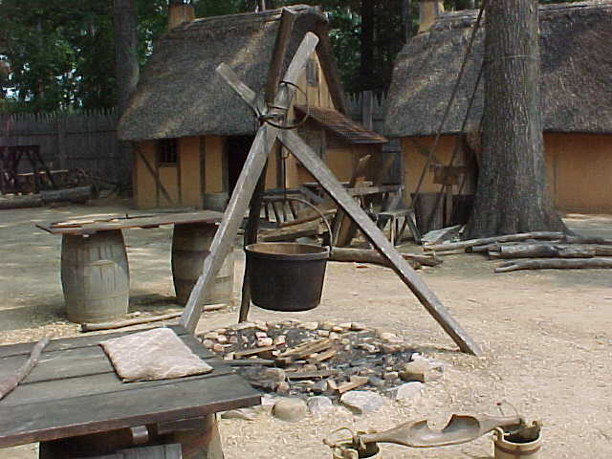
Jamestown Settlement

Slide 11
Jamestown Uncovered
Primary Source Activity

Slide 12
The Jamestown Nightmare
1606-1607 → 40 people died on the voyage to the New World.
1609 → another ship from England lost its leaders and supplies in a shipwreck off Bermuda.
Settlers died by the dozens! Disease and starvation!
“Gentlemen” colonists would not work themselves.
  Game in forests & fish in river uncaught.
Settlers wasted time looking for gold instead of hunting or farming.

Slide 13
Which Virginia Company instructions were the colonists able to carry out? Which instructions were they not able to follow? Explain.
What challenges did the Jamestown colonists face?
How did those challenges affect the colonists’ ability to meet the Virginia Company’s expectations?
Based on what you now know about the first years of the Jamestown settlement, what do you think everyday life was like?

Slide 14
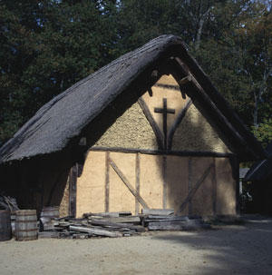
Jamestown Chapel, 1611

Slide 15
The Starving time
  1607: 104 colonists
  By spring, 1608: 38 survived
  1609: 300 more immigrants
  By spring, 1610: 60 survived
  1610 – 1624: 10,000 immigrants
  1624 population: 1,200
  Adult life expectancy: 40 years
  Death of children before age 5: 80%

Slide 16
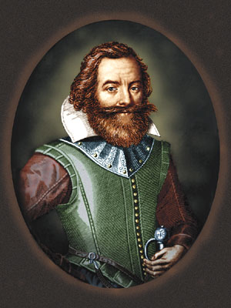
Captain John Smith:
The Right Man for the Job??
There was no talk…but dig gold, wash gold, refine gold, load gold…

Slide 17
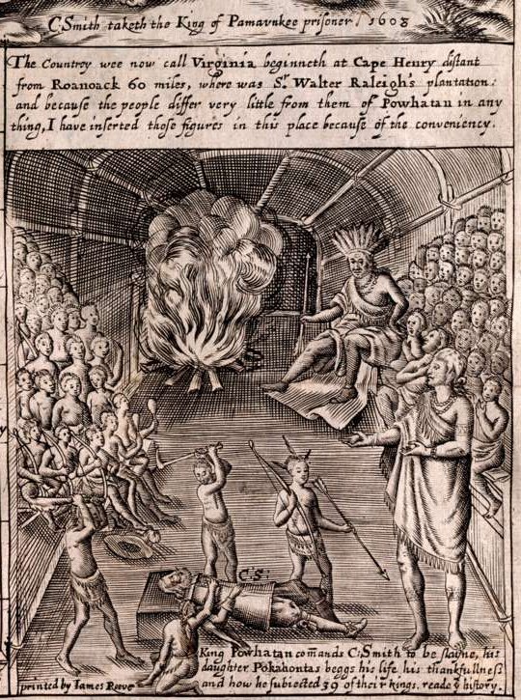
Smith’s Portrayal of the Native Americans

Slide 18
Pocahontas
Pocahontas “saves” Captain John Smith

Slide 19
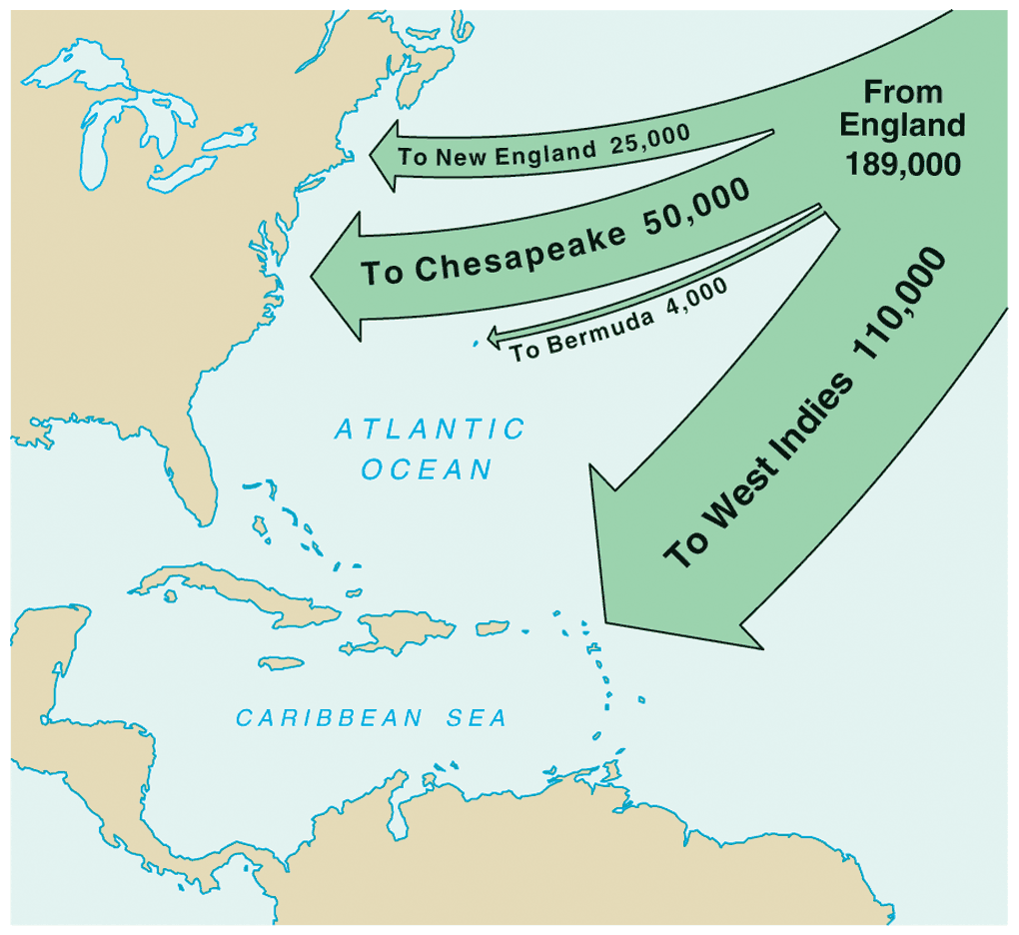
English Migration: 1610-1660

Slide 20
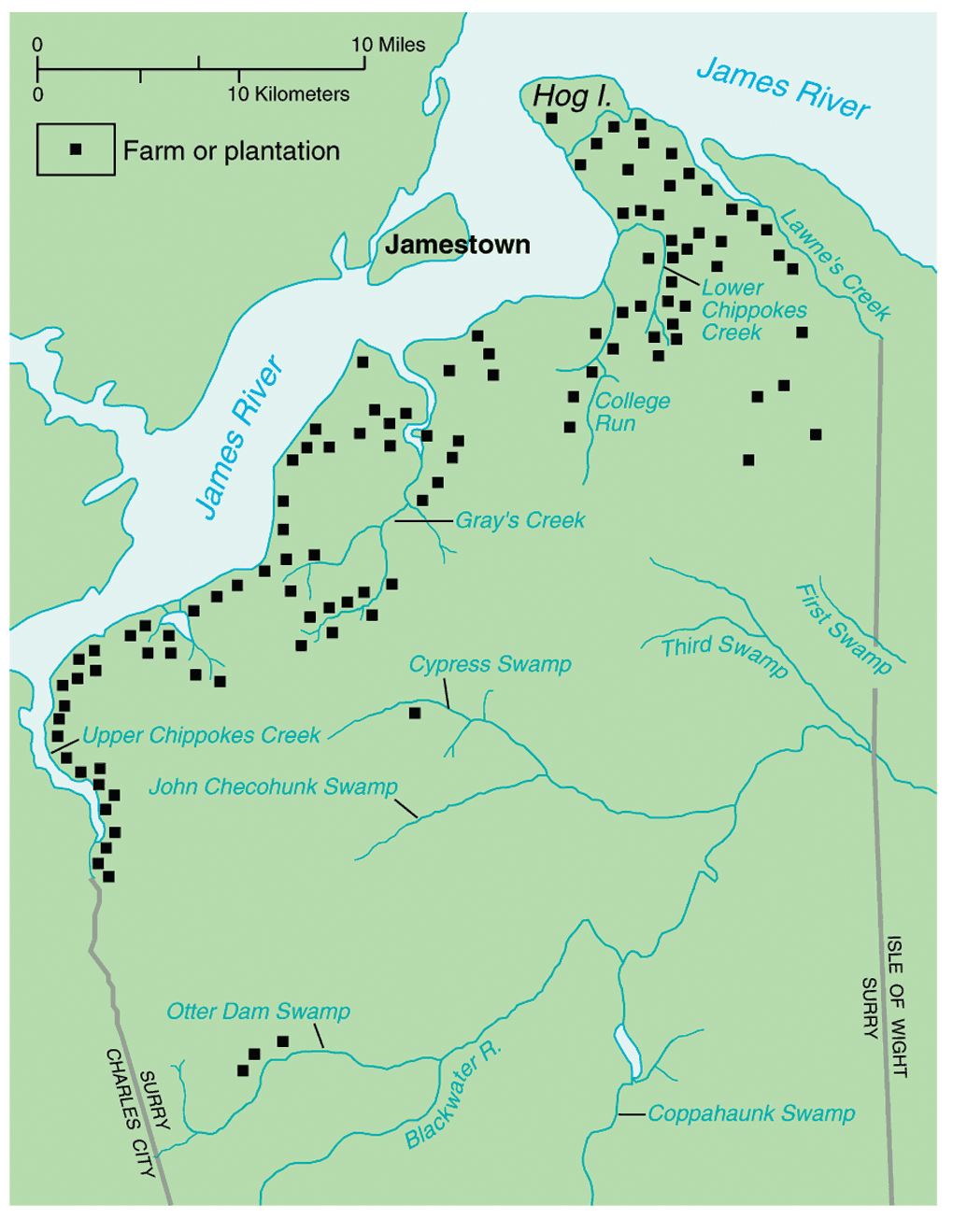
Jamestown Colonization Pattern: 1620-1660
Large plantations > 1000 acres
Widely spread apart > 5 miles

Slide 21
Native Americans - Powhatan
When settlers first arrived from England, they knew they would have to make peace with the Native Americans if they were to survive.
Though there were conflicts between the groups, there were also periods of peace.
But British settlements kept growing and outpaced the growth of the Powhatan.
Fearing they would soon be outnumbered, the Powhatan attacked first hoping to scare the British away.
But the British responded by nearly destroying the Powhatan culture.

Slide 22
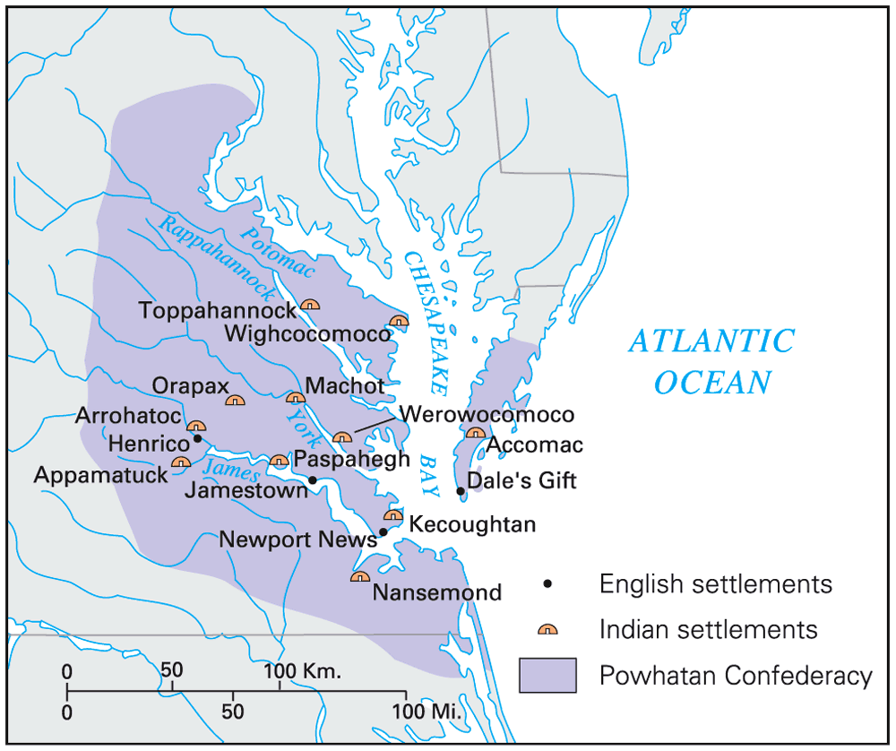
Powhatan Confederacy

Slide 23
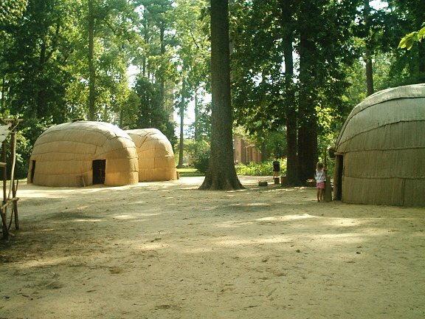
Powhatan Indian Village

Slide 24
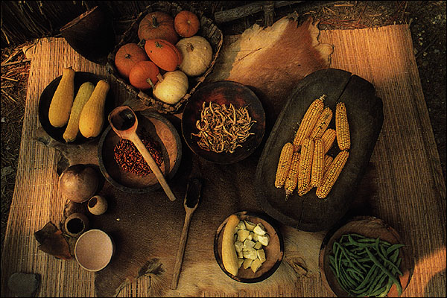
Native American Foods
Three Sister Crops: Corn, Beans, & Squash

Slide 25
Culture Clash in the Chesapeake
1614-1622 →peace between Powhatans and the English.
  1614 peace sealed by the marriage of Pocahontas to Englishman John Rolfe.
1st Powhattan War - 1622-1644 → periodic attacks between Indians and settlers.
  1622 → Indians attacked the English, killing 347 (including John Rolfe)
  Virginia Co. called for a “perpetual war” against the Native Americans.
    Raids reduced native population and drove them further westward.

Slide 26
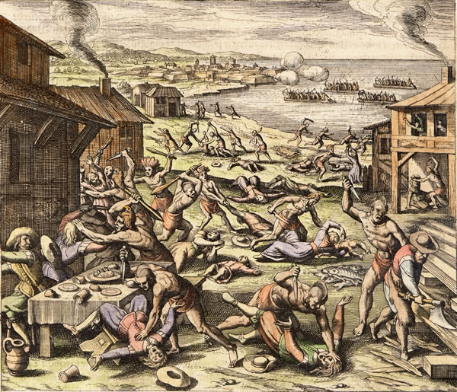
Powhatan Uprising of 1622

Slide 27
Culture Clash in the Chesapeake
1644-1646 → Second Anglo-Powhatan War
  Last effort of natives to defeat English.
  Indians defeated again.
Peace Treaty of 1646
  Removed the Powhatans from their original land.
  Formally separated Indian and English settlement areas!

Slide 28
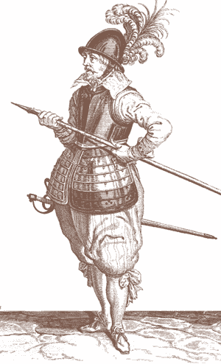
John Rolfe
What finally made the colony prosperous?

Slide 29
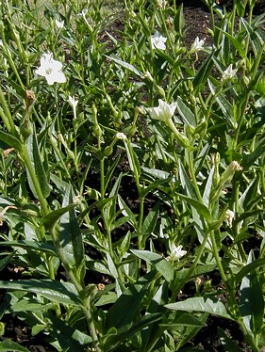
Tobacco
Virginia’s gold and silver.
-- John Rolfe, 1612

Slide 30
Tobacco Cultivation
Virginia's soil and climate is very good for tobacco production.
Europeans did not like Virginia's type of tobacco, so sweeter varieties were brought in from the Caribbean.
Tobacco became the most important export for the Virginia Company and helped Great Britain balance its trade deficit with Spain.

Slide 31
Early Colonial Tobacco
1618 — Virginia produces 20,000 pounds of
tobacco.
1622 — Despite losing nearly one-third of
its colonists in an Indian attack,
Virginia produces 60,000 pounds of
tobacco.
1627 — Virginia produces 500,000 pounds
of tobacco.
1629 — Virginia produces 1,500,000 pounds
of tobacco.

Slide 32
Virginia: “Child of Tobacco”
Tobacco’s effect on Virginia’s economy:
  Vital role in putting VA on a firm economic footing.
  Ruinous to soil when continuously planted.
  Chained VA’s economy to a single cash crop.
Tobacco promoted the use of the plantation system.
  Need for cheap, abundant labor

Slide 33
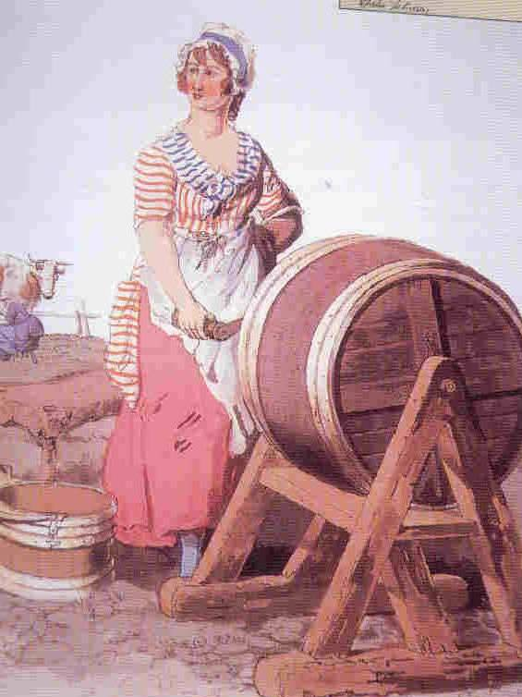
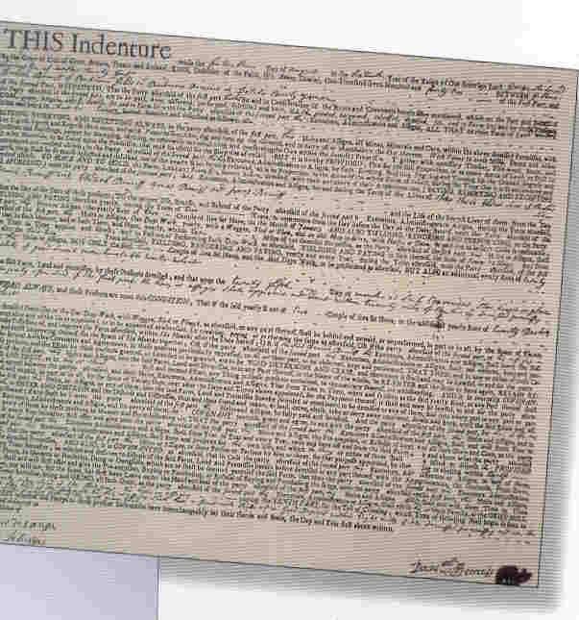
Indentured Servitude
Headright System

Slide 34
Indentured Servitude
Headright system:
  Each Virginian got 50 acres for each person whose passage they paid to the colony
  Also existed in Maryland
  Virginia & Maryland are known as the Chesapeake bay colonies!!

Slide 35
Indentured Servitude
Work for nothing in exchange for passage to colonies
Indenture Contract:
  5-7 years
  Promised “freedom dues” when contract is up
    Few barrels of corn
    Suit of clothing
    Small piece of land
  Forbidden to marry
  1610-1614: only 1 in 10 outlived their indentured contracts!

Slide 36
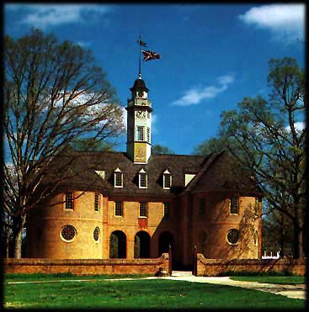
Virginia House of Burgesses

Slide 37
House of Burgesses
The first legislative body in the colonies
The House of Burgesses was made up of men elected by landowners to represent the cities and plantations of Virginia.
Though the governor, the council, or the directors could override its decisions, the House of Burgesses enacted laws and provided a voice in government for landowning Virginian men.

Slide 38
Bacon’s Rebellion
Poor Freemen felt neglected & staged an uprising
  Frustrated
    No land, no women
  Moved west ( to the backcountry)
  Denied the right to vote by VA assembly
While living in the backcountry they are attacked by Native Americans & they want the House of Burgesses to take action.

Slide 39
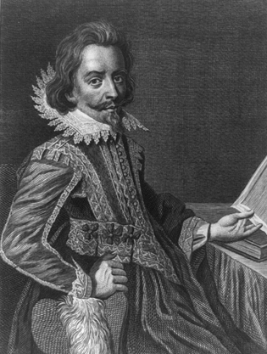
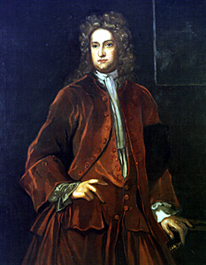
Bacon’s Rebellion
Nathaniel Bacon
  A former indentured servant
  Leads 1000 Virginians in revolt in 1676 against Governor Berkley
Nathaniel Bacon
Governor
William Berkeley

Slide 40
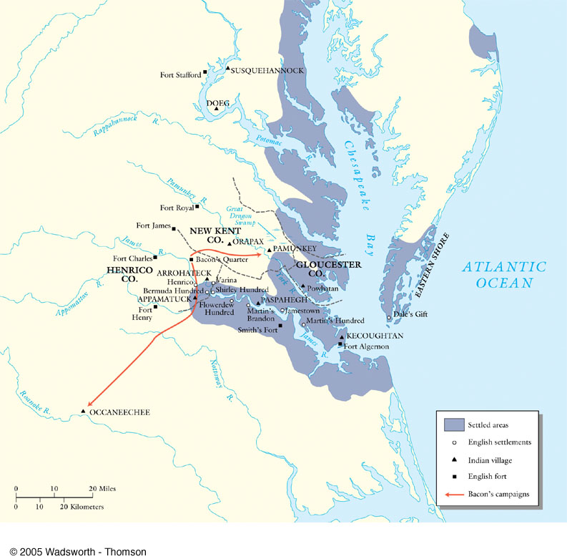
Bacon’s Rebellion: 1676

Slide 41
Bacon’s Rebellion
William Berkeley – governor of VA
  Refuses to stop Indian attacks in west
    Has monopoly on fur trade with Indians
They attack the Natives, whether they are friendly or not.

Slide 42
Bacon’s Rebellion
Governor Berkley is driven from Jamestown.
Jamestown captured and burned
Bacon dies of disease
  Revolt ends

Slide 43
Consequences of Rebellion
Underscores growing class conflict in colonies
  Poor farmers vs. plantation owners
Access to land becomes more readily available
Indentured servitude dies
  Freed servants are dangerous
  Wages rising in England
    English poor less willing to risk life in America
Who will replace them as labor?

Slide 44
Virginia Becomes a Royal Colony
James I grew hostile to Virginia
  He hated tobacco
  He distrusted the House of Burgesses which he called a seminary of sedition.
1624 – He revoked the charter of the bankrupt VA Company.
  Virginia became a royal colony under the kings direct control.

Slide 45
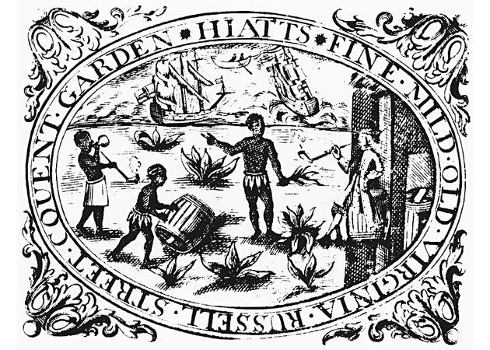
English Tobacco Label
The first Africans arrived in Jamestown in 1619.
  Their status was not clear
  slavery was very important until the end of the 17th century.

Slide 46
17th century Population in the Chesapeake
Why is there a large increase in the black population?

Slide 47
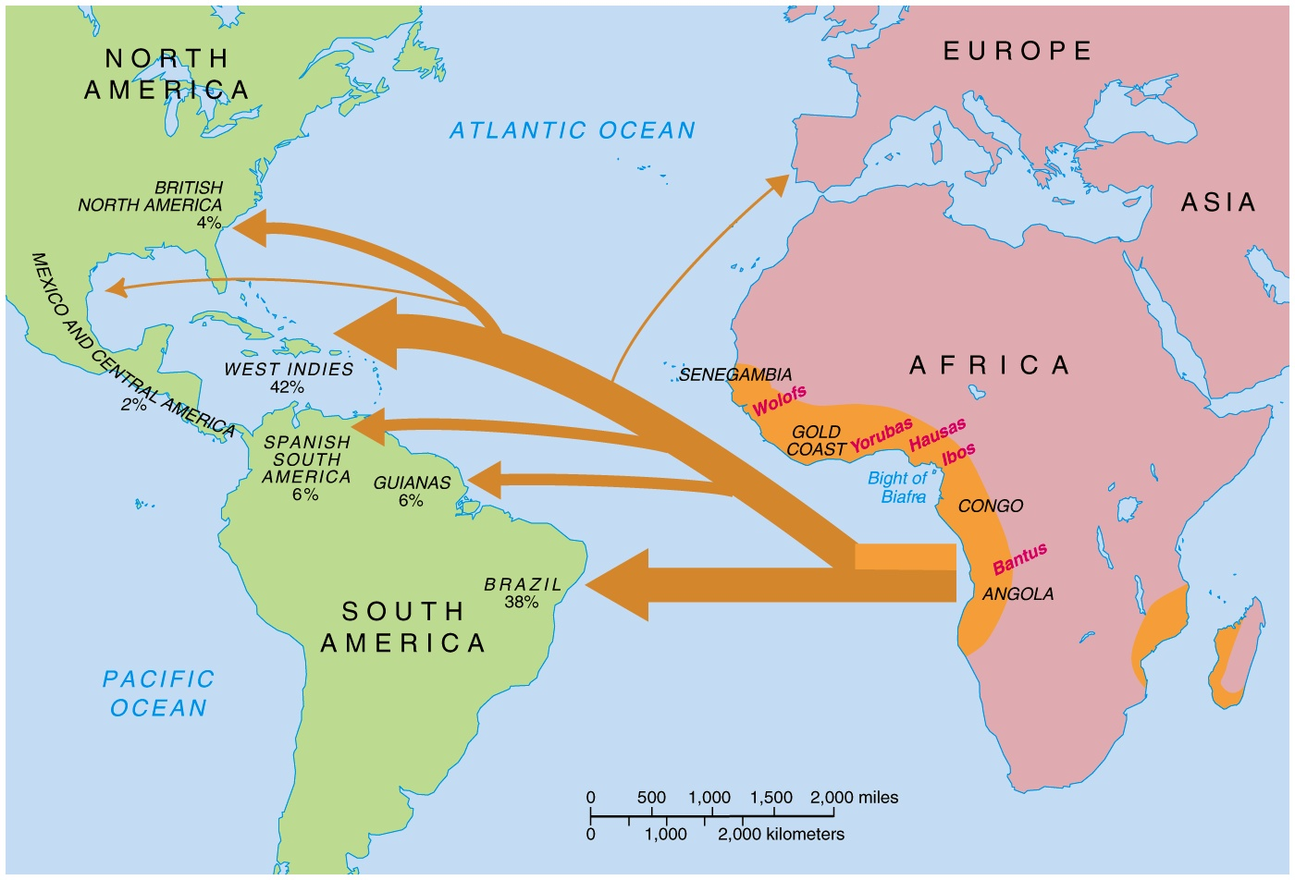
The Atlantic Slave Trade

Slide 48
Maryland: A Catholic Safe Haven
In England, Catholics were being persecuted.
Lord Baltimore wanted to create a colony where Catholics could practice their religion freely.
The King granted Lord Baltimore land North of VA. He named it Maryland.
Since he owned the land, Lord Baltimore was a proprietor & had full authority over the colony.

Slide 49
Maryland: A Catholic Safe Haven
Lord Baltimore hoped to create a Catholic safe haven where Catholics could freely practice their religion.
The Maryland Toleration Act was passed saying that all Christians would be accepted in Maryland.
  It also stated that denying Jesus was a crime punishable by death.

Slide 50
Maryland
Colonists only willing to come to Maryland if they received land
Colonists who did come received modest farms dispersed around the Chesapeake are
  Catholic land barons surrounded mostly by Protestant small farmers
  Conflict between barons and farmers led to Baltimore losing proprietary rights at the end of the 17th Century.
  In the late 1600’s, black slaves began to be imported.

