Slide 1
Chapter 31
The Politics of Boom and Bust
1920-1932

Slide 3
Return of the “Old Guard” Republicans
Warren G. Harding elected in 1920
Characteristics
Easygoing and kind
Hated to say no and hurt feelings
Mediocre intelligence
Ideas/Policies
Return to “normalcy”
Opposed to League of Nations
Low taxes, high tariffs
Immigration Restrictions
Aid to farmers

Slide 4
Cabinet
Secretary of State – Charles Evans Hughes
Brilliant, capable leader
Secretary of Commerce – Herbert Hoover
Success as wartime food administrator
Secretary of the Treasury – Andrew W. Mellon
Very intelligent
Secretary of the Interior – Albert B. Fall, the “Fall Guy”
Scheming anti-conservationist
Attorney General – Harry M. Daugherty
crook

Slide 5
GOP Reaction at the Throttle
Increase of laissez-faire capitalism
Harding appoints four justices
Taft as Chief Justice – more liberal than others
Early 20s – Supreme Court kills Progressive reforms
Killed federal child-labor law
Stripped away gains of labor
Restricted government intervention in economy
Executive Branch
Antitrust laws ignored, weakly enforced
Men sympathetic to business appointed as regulators
Hoover encourages companies to self-regulate
Cooperate with each other to increase profit

Slide 6
Interstate Commerce Act

Slide 7
Interstate Commerce Act
Railroads
Set guidelines → Promoted competition, outlawed discriminatory rate setting.
Both increased gov’t regulatory power
8 hour workday for RR workers
It made the RR’s private again, but encouraged mergers. It empowered the ICC to di

Slide 8
Adkins v. Children’s Hospital (1923)
Overturns Muller v. Oregon, and invalidates women’s minimum wage law
Use 19th Amendment as justification
Women are now legal equals to men, therefore not entitled to special protections
Similar legal arguments today
Are different groups entitled to special legal and social treatment?

Slide 9
Aftermath of War
Government controls disappear
Dismantling of War Industries Board
Esch-Cummins Transportation Act of 1920
Returns control of railroads to private companies
Encourages consolidation
Interstate Commerce Commission will guarantee profitability
Merchant Marine Act of 1920
Shipping Board authorized to sell 1500 ships cheaply/quickly
Hurts US shipping
Labor
Bloody strikes in early 1920s
Railway Labor Board orders wage cut of 12% in 1922
Union membership down by 30% between 1920-1930

Slide 10
Veterans
Lasting benefits from war
Veterans Bureau (1921)
Operate hospitals and provide rehabilitation for disabled
American Legion (Paris, 1919)
Veterans met to share stories
Becomes aggressive lobbying group for veterans’ benefits
Demanded “Adjusted compensation”
Bonus bill passed in 1922 – vetoed by Harding
Adjusted Compensation Act of 1924 – vetoed by Coolidge
Veto overridden, Congress pays out $3.5 billion

Slide 11
America Seeks Benefits Without Burdens
Treaty of Versailles rejected
July 1921 – Congress passes joint resolution declaring war over
League of Nations seen as bad, observers sent to record proceedings
Britain, U.S., and Oil
Rivalry developing between two over Europe and Middle East
Secretary of state Hughes secures agreement for joint exploitation of oil
Naval Build Up
US Navy becomes huge during war
Japan and Britain build own navies in response

Slide 12
Disarmament Conference
Washington D.C. 1921 – 1922
All major powers invited except Communist Russia
Five-Power Naval Treaty
Secretary Hughes submits plan
10 year holiday on construction of battleships
Some to be scrapped
Sets ratio of ships for U.S., Britain, Japan at 5:5:3
US and Britain would not fortify Pacific possessions
Four-Power Treaty
Britain, Japan, and France preserve equality in Pacific
Nine-Power Treaty
Open door policy to continue in China

Slide 13
Effects of Disarmament
Harding achieves some victories
No restrictions on smaller ships
Cruisers, destroyers, submarines created at frantic pace
Hulls of scrapped battleships become worlds first aircraft carriers
Five-Power Treaty gives Japan naval superiority in Pacific
Congress declares Four-Power Treaty not legally binding
Creates false sense of security for Americans

Slide 14
Kellogg-Briand Pact (Pact of Paris)
Created by
Frank B. Kellogg – Calvin Coolidge’s Secretary of State – Nobel Prize
Briand – French foreign minister
Signed by 62 nations
All conflicts to be settled peacefully
War only started for self defense
Results
Fails to provide enforcement measures
Reflects, strengthens Americas false sense of security

Slide 15
Hiking the Tariff Higher
Businesses afraid of a flood of cheap European goods
Congress passes Fordney-McCumber Tariff Law
Tariffs raised from 27%-35%
Harding and Coolidge granted authority over duties
More prone to increasing in favor of business
Problems
Europe in debt to the U.S.
Needs to sell goods to pay back debts
Can’t sell, goods, goes into further debt

Slide 16
Scandal!
1923 – Charles R. Forbes resigns as head of Veterans’ Bureau
Had been laundering money
Over $200 million stolen
Sentenced to 2 years in prison
Teapot Dome Scandal
1921 - Albert B. Fall leases land in Teapot Dome, Wyoming and Elk Hills California to oilmen in exchange for “loan”
Harry F. Sinclair – over $300,000 (bribe amount)
Edward L. Doheny - $100,000 (bribe aboumt)
1929 – Fall sentenced to 1 year in jail
Sinclair, Doheny acquitted
“Fall guy”
Results
Lowers prestige of government
Undermines faith in courts

Slide 17
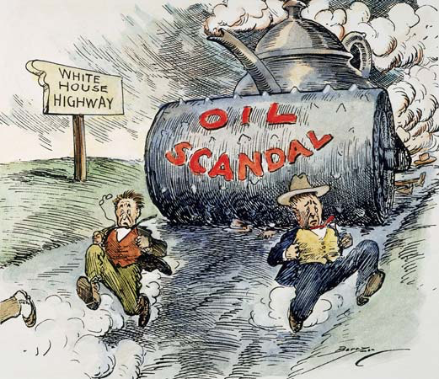

Slide 18
Scandal!
Attorney General Daugherty
Forced to resign after investigation for illegal sale of pardons and liquor permits
President Harding
On national speech tour
Dies in California
Calvin Coolidge becomes president

Slide 19
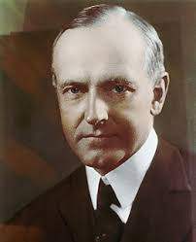
Coolidge
Honest, moral, industrious, frugal
Shy, not an accomplished leader
“hands off” policy
Sought to increase dignity of government
Public quickly forgets scandals due to prosperity

Slide 20
Frustrated Farmers
Wartime Prosperity
Produced most of the food for allied armies
New technology increased production
Foreigners reenter market after war
Overproduction after war causes poverty
Relief
Capper-Volstead Act – exempted farm cooperatives from antitrust prosecution
McNary-Haugen Bill – authorizes gov. to buy up excess production (Vetoed twice by Coolidge)
Farm prices stay down

Slide 21
3-Way Race in 1924
Coolidge easily wins Republican Nomination
Democrats
Split between north and south
Nominate conservative lawyer John W. Davis
Progressives
Nominate Senator LaFollette
Endorsement from AFL and Socialist Party
Platform
Government ownership of rail
Relief for farmers
Anti-trust
Amendment to prevent Supreme Court from overturning laws
Coolidge wins easily
15.7m – 8.4m – 5m

Slide 22
Foreign Policy Floundering
Isolationism during 1920s
US refuses to adhere to World Court decisions
Caribbean and Latin America
Troops withdrawn from Dominican Republic in 1924 after 8 years
Troops in Haiti 1914 – 1934
Troops in Nicaragua 1926-33
Bullies Mexican government to prevent nationalization of oil fields
Latin American resentment builds

Slide 23
Foreign Policy Floundering
International Debt
1914 – America in debt $4 billion, 1922 – America owed $22 billion
Investors loan $10 billion to foreigners during 1920s
Most investment stays in profitable domestic economy
Money loaned to allies
$10 billion loaned to allies during war
Allies protest repayment
Debt already paid with deaths of millions
Their dollars had fueled growth in America
American tariffs made it impossible to make money to pay debt

Slide 24
Unraveling the Debt Knot
America demands repayment of debts
Britain and France place huge reparations on Germany
Germany prints unlimited amounts of paper money
Hyper-inflation insues
Oct. 1923 – loaf of bread costs 480 million marks
1924 – Dawes Plan
Reschedules German repayments
Clears a path for private American loans to Germany
Creates a loop
Germans borrow money to repay France and Britain who repay the U.S.
Nobody gets repaid
Creates enemies in France and Britain

Slide 26
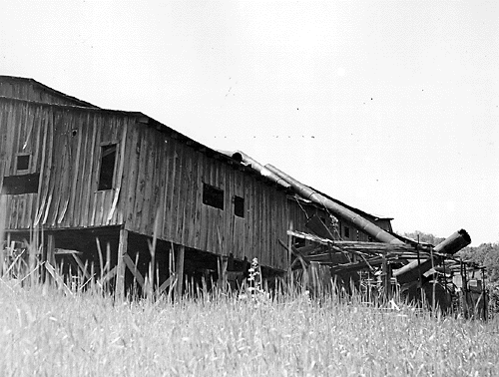
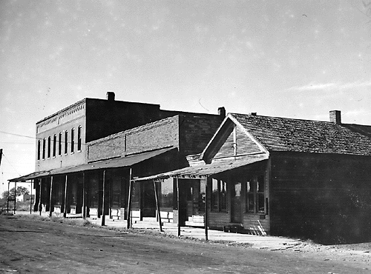
Economic Troubles Prior to the Depression
Consumers in extreme debt
Debt is when you owe someone money – artificial prosperity
Key Industries (textile, steel, coal, railroads) barely making a profit

Slide 27
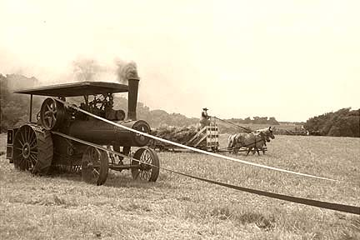
Agriculture Failings
Farmers are the hardest hit by the failing economy
Took out loans for new equipment when prices rose (during the war)
Overproduction - Farmers continue to produce same amount of goods as during war
Crop prices fall more than 40% when the war ends (foreign markets gone)
End of gov’t subsidies
RESULTS:
Many lose their farms because they can’t pay off their loans
Rural banks began to fail as a result

Slide 28
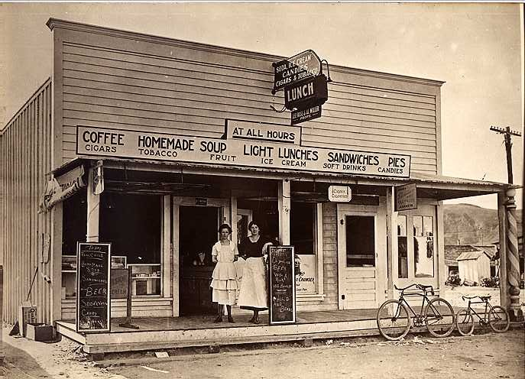
Less Consumption of Goods
Consumers begin buying less:
Rising prices
Stagnant wages
Unequal distribution of wealth
70% of Americans in the 1920’s lived below the standard of living ($2500/year)
The income of the wealthiest 1% increased by 75%, while the nation as a whole increased by only 9%
Too much credit buying in the 1920’s (buy now, pay later)
The 1920’s appeared to be a time of great wealth but in reality, many Americans were living on borrowed money (false sense of prosperity)

Slide 29
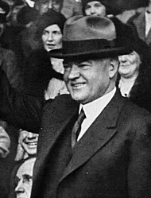
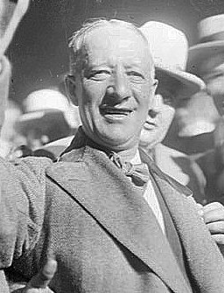
Election of 1928
Herbert Hoover (Republican):
Former engineer
Secretary of Commerce under Harding and Coolidge
--versus--
Alfred E. Smith (Democrat):
Career politician
4-term governor of New York
Hoover had 2 advantages:
The previous years under Republican administrations were viewed as prosperous
Al Smith was Catholic (many Americans still mistrusted Catholics and feared the influence of the pope)
Hoover wins the election

Slide 30
The Triumph of Herbert Hoover, 1928
Herbert Hoover – background in economics
“rugged individualism”
America made great by strong, self-sufficient individuals
Democrats nominate Alfred E. Smith
Against prohibition, urban, Roman Catholic, Irish grandparents
Radio becomes important during campaign
Hoover’s personality impresses
Never elected to office before
Classic rags to riches story
Easily wins election

Slide 31
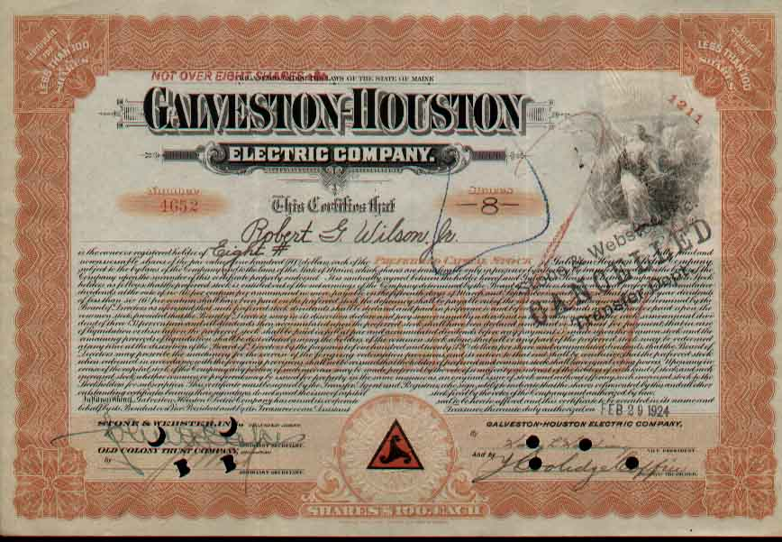
The Dream of Riches in the Stock Market
Many people invest in the stock market during the 1920’s, because stock values were high.
Many engaged in risky transactions:
Speculation-buying and selling stocks while ignoring the risks
Buying on Margin- Buying stock on credit
When the value of stocks fell, they lost their investment and couldn’t pay off their loans

Slide 32
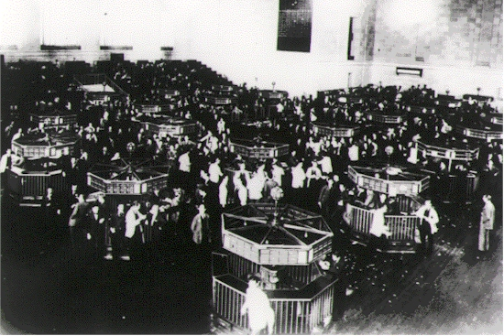
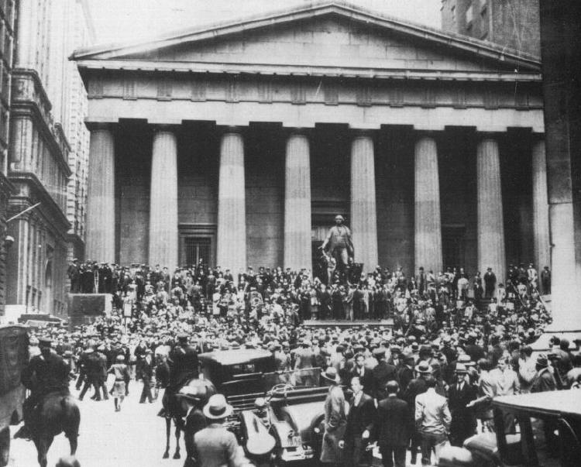
Stock Market Crash
On October 29, 1929 the stock market crashed and a record 16.4 million shares were dumped.
The event became known as “Black Tuesday”
By November, investors had lost $30 billion (amount equal to what the US spent during World War I).
The Crash signaled the beginning of the Great Depression:
The period from 1929 to 1941 in which the economy was in severe decline and unemployment was high
Panic at the NY Stock Exchange
on the day of the crash

Slide 33
The Great Crash Ends the Golden 20s
Lack of foresight
Stock values rise from $27 billion in 1925 to $87 billion in 1929
Unemployment below 4% despite assembly line
Wages up 40% over decade
The Last Straw
British raise interest rates to prevent investment in American businesses
People start selling as quickly as possible to avoid losing profits
Black Thursday, Oct. 23rd 1929 – Massive sell off of stocks begins
Black Tuesday, Oct. 29th, 1929 – 16.4 million shares of stock sold
Normal average is 4-8 million bought and sold
Great Crash – By Nov. 13th Dow Jones average has fallen from 381 to 199.
$30 billion in losses

Slide 34
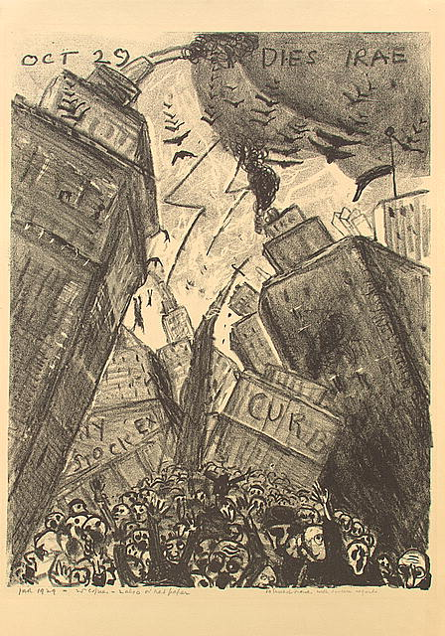
Dies Irae “Days of Wrath”

Slide 35
Hoover’s First Moves
Agriculture Marketing Act (1929)
Help farmers help themselves
Federal Farm Board created
Creates Grain Stabilization and Cotton Stabilization Corporations to bolster prices by buying surpluses
Hawley-Smoot Tariff of 1930
Raises tariff to 60%
Reversed worldwide trend towards reasonable tariffs
Exports decline
Depression deepens
U.S. in economic isolation

Slide 36
Results
By end of 1930
4 million Americans jobless
12 million by 1932
Over 5000 banks collapse by 1932
Lines form at soup kitchens and homeless shelters

Slide 37
Causes
Overproduction
Buying on credit (buy now, pay letter)
Decrease in crop prices
End of gov’t subsidies
Speculation – buying on margin (stocks)
Under-consumption
DEBTS – loaned money to Allies & haven’t been repaid
Black Tuesday (10/29/29) Stock Market Crash

Slide 38
Causes
Overproduction
DEBT
Buying on Credit – (buy now, pay later)
Inflation
Stagnation of wages
Speculation – buying on margin (Stock Market)
Decrease in crop prices
Gov’t stopped providing subsidies to farmers
Uneven distribution of wealth
Black Tuesday 10/29/29 – Stock Market Crashed
Everyone wanted to sell and no one wanted to buy

Slide 39
Causes
Overproduction (Surplus of goods)
Buying on Credit (buy now, pay later)
DEBT
Decrease in farm prices
Subsidies are vetoed (farmers)
Under consumption
Black Tuesday 10/29/29 – Stock Market Crashed

Slide 40
Hoovervilles
Depression a national crisis by 1930
Nowhere to work
Many unemployed
Shanty towns pop up across country
Inhabited by poor and destitute
Unemployed
Called Hoovervilles

Slide 41
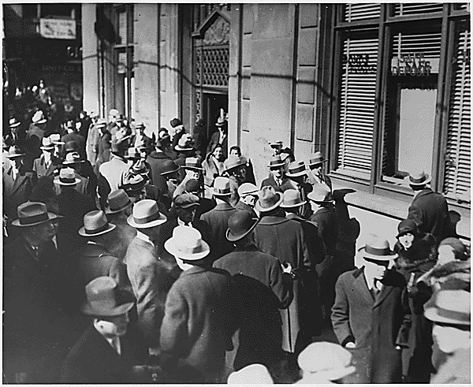
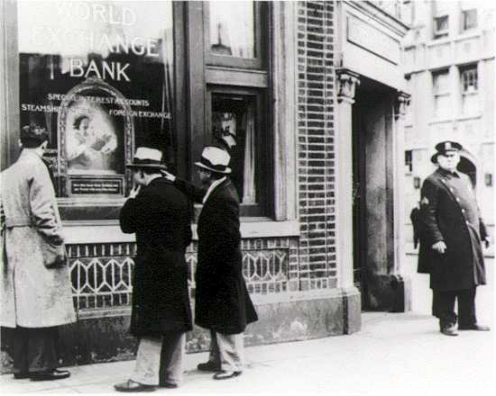
Bank and Business Failings
After the crash, people panicked and rushed to withdraw their money from the banks
The banks had also invested in the stock market and many didn’t have enough cash to make the withdrawals
In 1929, nearly 600 banks had been forced to close.
By 1933, the number had jumped to 11,000 (out of a total of 25,000)
People rushing to withdraw their money from the bank
A guard prevents entry into a prominent NY bank

Slide 42
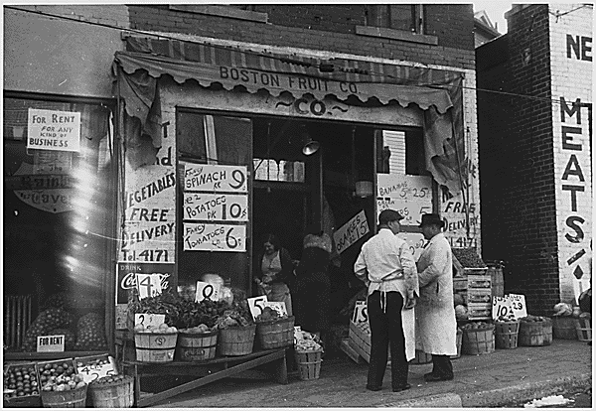
Bank and Business Failings
9 million people lost their savings accounts (no FDIC at this time)
US GNP dropped from $104 billion to $59 billion
90,000 businesses went bankrupt
Unemployment rose from 3 to 25% - ¼ unemployed!
13 million workers lost their jobs
Those that kept their jobs often faced pay cuts and reduced hours

Slide 43
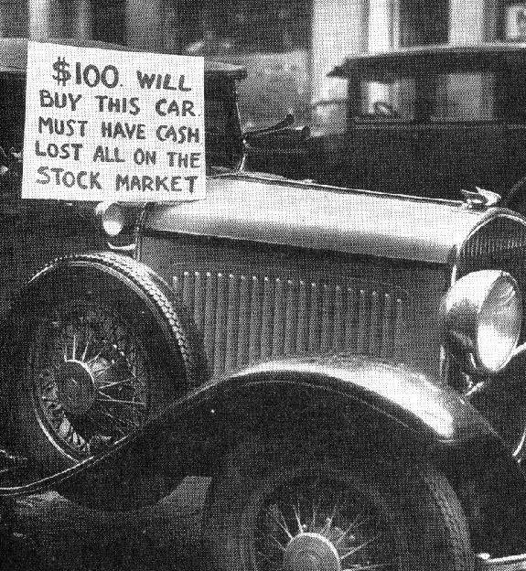
"There was much hardship. Many people sold pencils on the street for 1 penny. Others were so devastated, they committed suicide by jumping out of windows of a skyscraper in New York City."
~Thomas Johnston
Suicides were so frequent that one hotel clerk reportedly asked patrons at check in,
“Is this for sleeping or for jumping?”

Slide 44
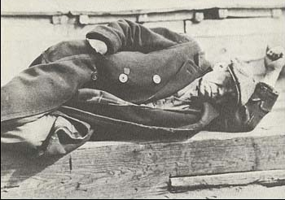
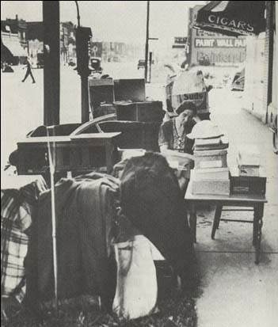
The Depression in Urban Areas
Those living in cities were hit the hardest:
Evicted from homes, forced to live on the streets or in shantytowns
Food shortages (forced to raid the garbage, beg on street corners, wait in government bread lines)
Conditions for minorities were especially bad, because they were already poor (before the depression hit)

Slide 45
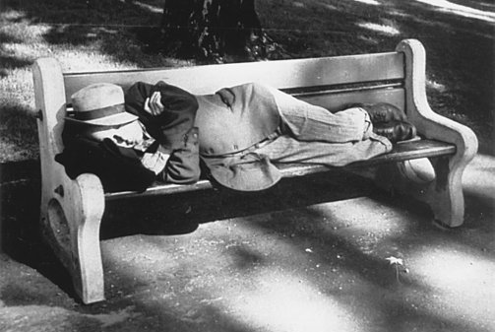

Slide 46
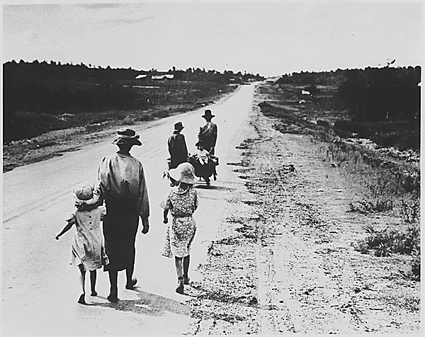

Slide 47
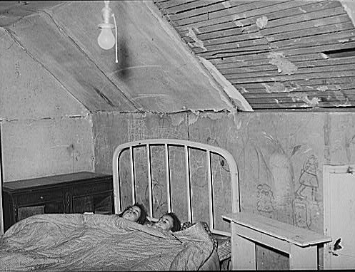
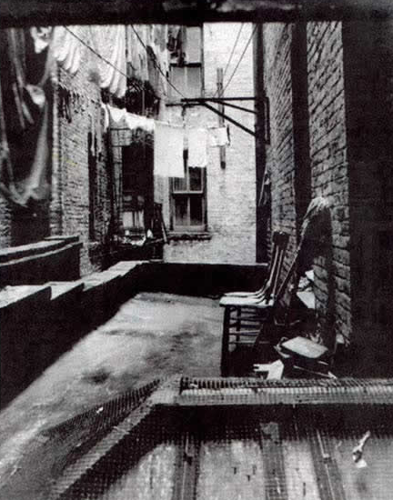

Slide 48
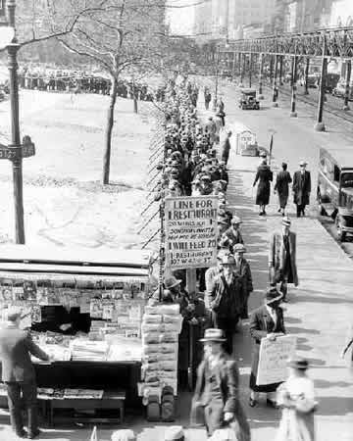
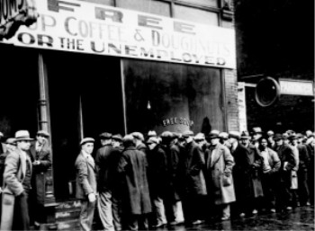
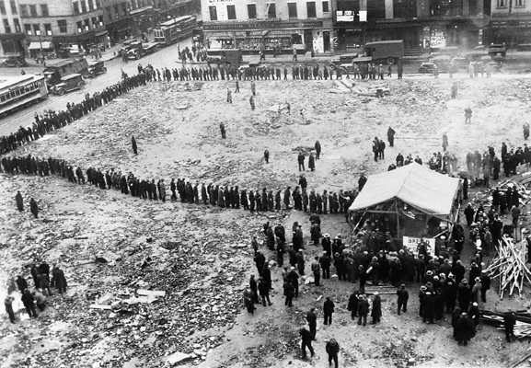
Breadlines

Slide 49
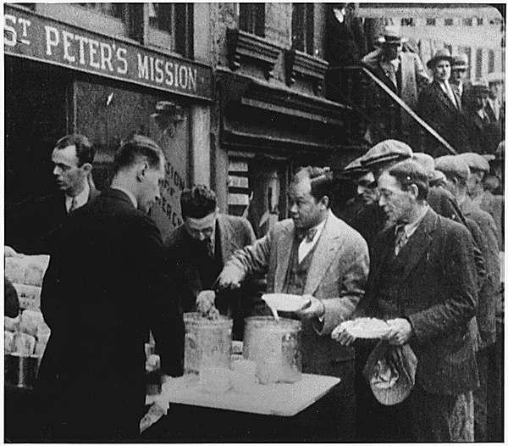
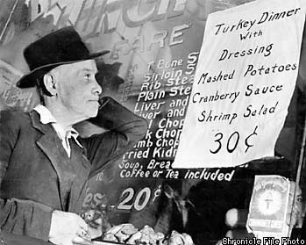

Slide 50
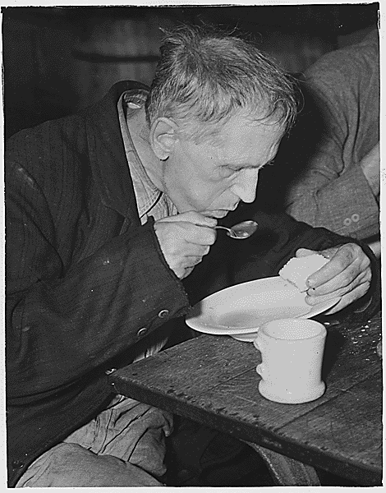
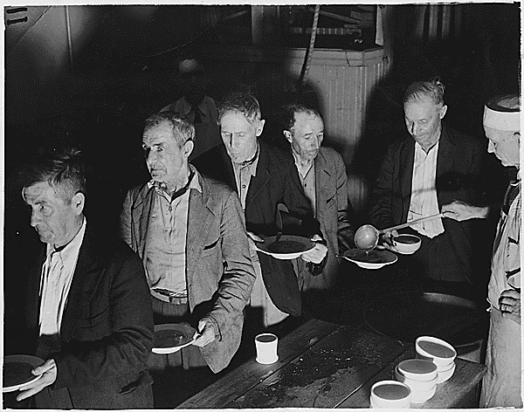

Slide 51
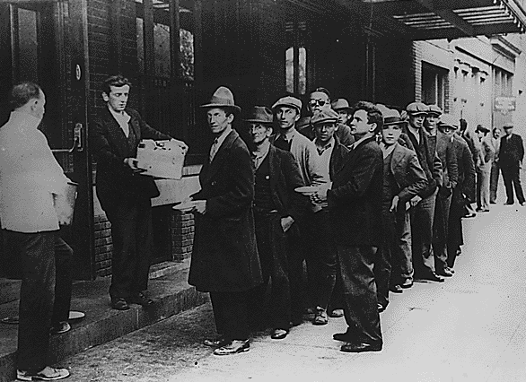
“Two or three blocks along Times Square, you’d see these men, silent, shuffling along in a line. Getting this handout of coffee and donuts, dealt out from great trucks…I’d see that flat opaque, expressionless look which spelled, for me, human disaster. Men…who had responsible positions. Who had lost their jobs, lost their homes, lost their families…They were destroyed men.”
~Herman Shumlin~

Slide 52
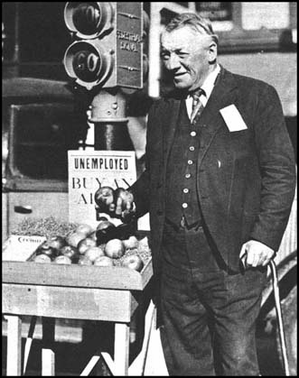
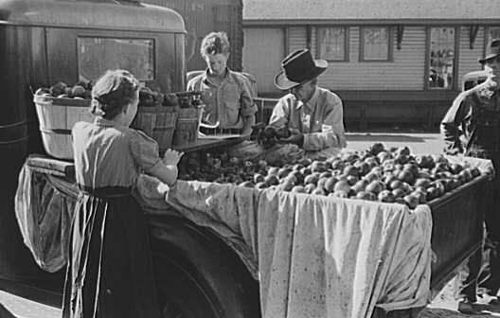
Selling Apples
To avoid panhandling (begging), many farmers and businessmen would sell apples to make their living
There were over 5000 apple sellers in New York City alone.
Fred Bell, a wealthy businessman who was forced to sell apples after the Crash to make even a meager living

Slide 53
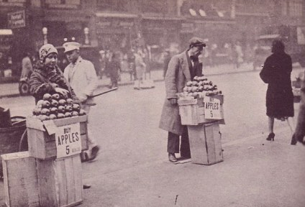
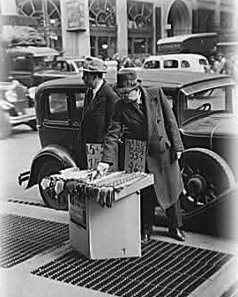
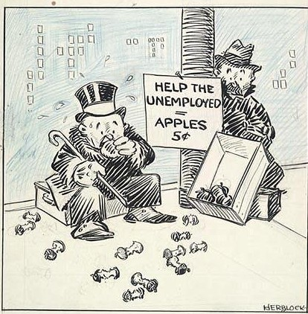
Property of Janet E. Brooks

Slide 54
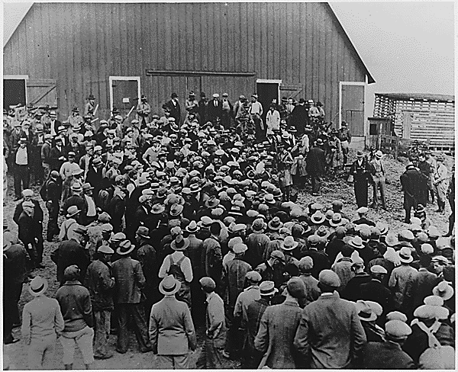
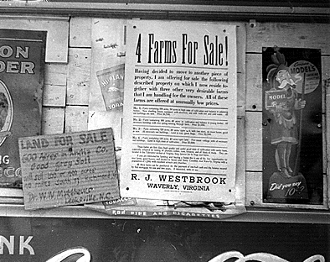
The Depression in Rural Areas
Rural areas had 1 advantage over the cities--the ability to grow their own food
Unfortunately, many lost their farms to foreclosure when they couldn’t pay off their debts
Between 1929-1932, nearly 400,000 farms had been lost to foreclosure

Slide 55
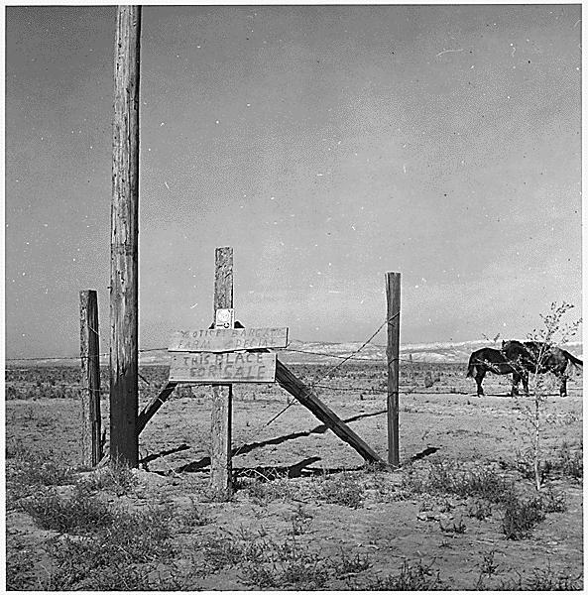

Slide 56
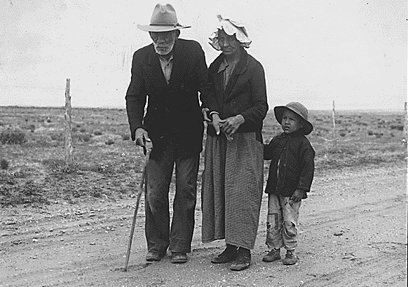
Visiting Family 30 Miles Away

Slide 57
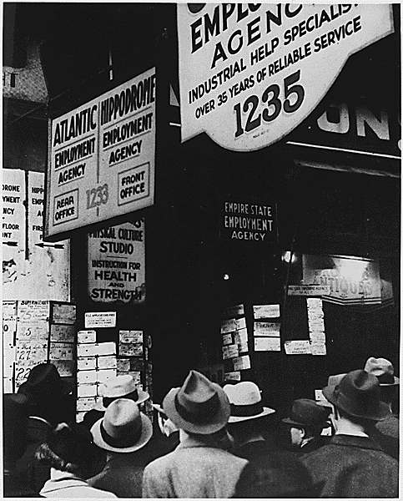
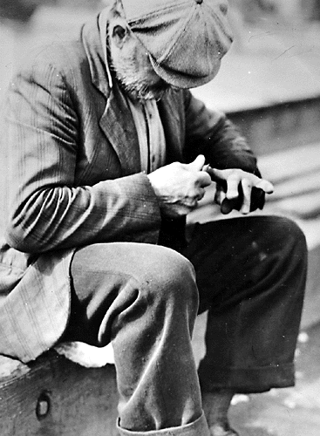
Unemployment
Unemployment Agency
“A Study of an Idle Man”

Slide 58
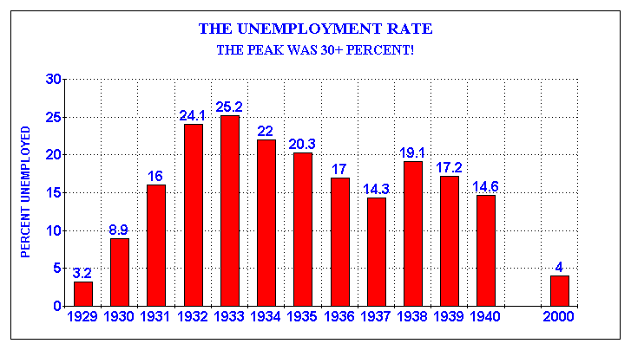

Slide 59
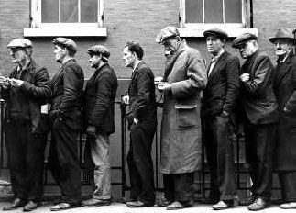
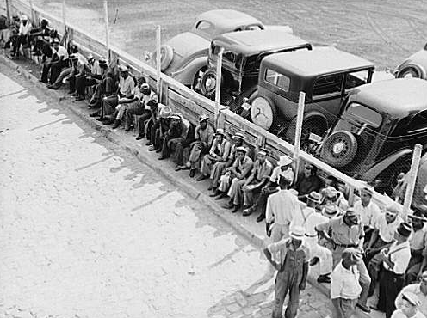
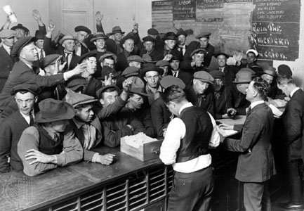

Slide 60
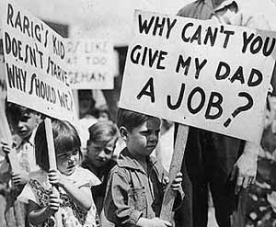
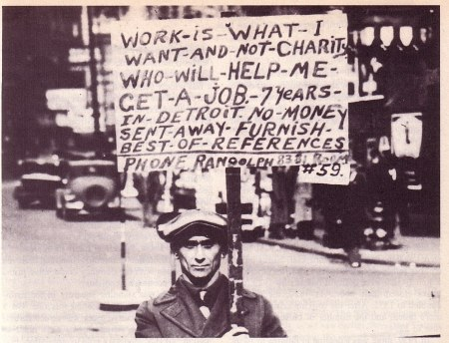

Slide 61
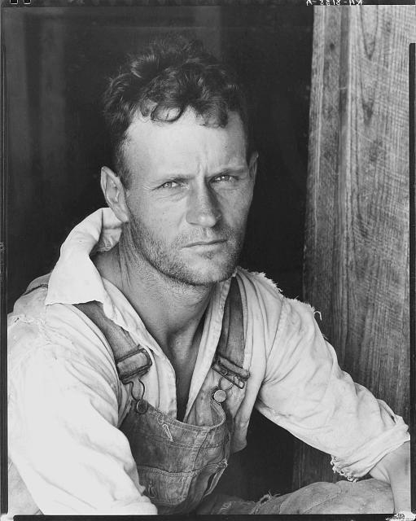
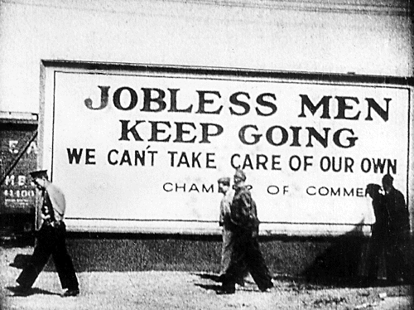
Effect on Families
Men
Felt pressure to provide for their families
Many became discouraged and quit trying or left
2 million men left their families and traveled across the country looking for work or escape---became known as hoboes

Slide 62
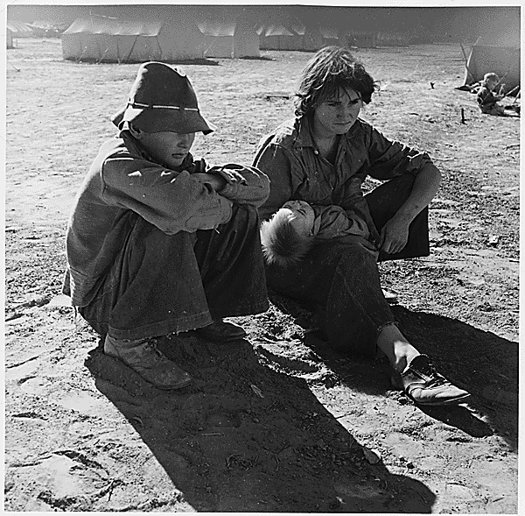
Effect on Families
Women
Many women had to work outside the home for the first time to support their families, while others did what they could at home
often faced more harsh conditions because they were too embarrassed or timid to ask for help

Slide 63
Effect on Families
Children
Lacked proper diet and health care
Less tax revenue caused nearly 300,000 schools to close down by 1933
Many found jobs or left home in search of work or “adventure” (became known as “Hoover Tourists”)

Slide 64
Social and Psychological Effects
Many are demoralized by the hardships they face and lose the will to survive
Suicide rate increased by 30%
More people admitted to mental hospitals
Stop going to the doctor or dentist (because they had no money)
Fewer attend college
Have fewer children (if any at all)
People are more pessimistic in general
For many, the fear of poverty and hardship never disappeared (even today)

Slide 65
Hoover’s Response
No system of direct relief at this time (cash payments provided by the government to the poor)
Hoover believed the government should have a limited role in providing relief-Loans to business
He thought that giving people a handout would weaken their self-respect and morality
Will Rogers summed up the mood of the nation: “If someone bit an apple and found a worm in it”, he joked, “Hoover would get the blame.”

Slide 66
Blaming Hoover
People blamed Hoover for the depression
Developed slang to show their dislike (even hatred) for the president…
“Once upon a time, my political opponents honored me as possessing the fabulous intellectual and economic power by which I created a worldwide depression all by myself.”
~Herbert Hoover~

Slide 67
“Hoovervilles”
Shantytowns became “Hoovervilles”
Newspapers became “Hoover Blankets”
Empty pockets turned inside out became “Hoover Flags”
Armadillos fit for eating became “Hoover Hogs”
Rail cars converted into homes became “Hoover Pullmans”

Slide 68
Hoover Battles the Great Depression
Hoover withdraws $2.25 billion to start projects to alleviate suffering
Hoover Dam on Colorado River
Vetoes Muscle Shoals Bill – later adopted by Tennessee Valley Authority
1932 – Congress establishes Reconstruction Finance Corporation (RFC)
Government lending bank
Stepping away from laissez faire
Critics target Hoover as money goes to corporations
1932 – Norris-La Guardia Anti-Injunction Act
Outlawed anti-union contracts
Forbids federal courts from restraining strikes
Strengthens Unions
Government becoming involved in economic crisis for first time

Slide 69
“Hard Times Are Still “Hoover-ing” Over Us

Slide 70
The Boulder Dam
Hoover still opposed federal welfare, but established building programs to help the economy and create jobs
The Boulder Dam (often called the Hoover Dam) was the most famous of these projects
Created jobs
Provided flood control and regular access to water
Helped economy by improving agriculture
Hoover created other programs as well but it was “too little, too late”

Slide 71
The Bonus Army
In 1932, nearly 20,000 veterans, calling themselves the “Bonus Army,” marched on Washington, D.C.
Marched to support a bill that would give them approximately $500 as a bonus for their service during World War I
The bonus was supposed to be paid to them in 1945, but they argued that it was needed NOW instead of later

Slide 73
The Bonus Army
The bill was struck down and Hoover ordered the marchers to go home--he feared violence
When nearly 2000 refused to leave (mostly those belonging to the Communist party--threatened violence), Hoover called in soldiers who released tear gas into the crowd
An 11-month old was killed, an 8-year old was partially blinded, 2 were shot, and many more were injured
Hatred for Hoover became stronger than ever…
Soldiers set fire to marchers’ camp

Slide 74
Rugged Times for Rugged Individualists
Hoover takes blame for depression
Failed to pass any measures to mitigate effects of depression
Did not believe in government tampering with economy
Felt depression was a natural market corection
Part of the business cycle
Begins to change mind by end of term
Starts taking steps to use government to help people

