Slide 1
Lawbreakers
Prohibition laws violated on large scale
Returning soldiers ignore law
Speakeasies – illegal bars
Bootleggers – illegally produced alcohol
Rumrunners – people from Caribbean or Canada who illegally traded alcohol
Home brew/bathtub gin – produced at home
A.K.A. rotgut – caused blindness and death

Slide 2
The Prohibition period
Led to a rise in gangster warfare as rival mob bosses competed in the bootlegging business.
Though alcohol was illegal, there was still strong demand, which the black market rushed to supply.
The center of this conflict was Chicago, home of Al Capone.

Slide 3
The Rise of Gangsters
Gangs in Cities
Used profit from illegal alcohol to bribe police
Wars between rival gangs
Al Capone
1925 – bootlegger
6 years of gang warfare
“Public Enemy Number One”
Valentine’s Day 1929 – 7 unarmed members of rival gang murdered, no conviction
Eventually arrested for income-tax evasion

Slide 4
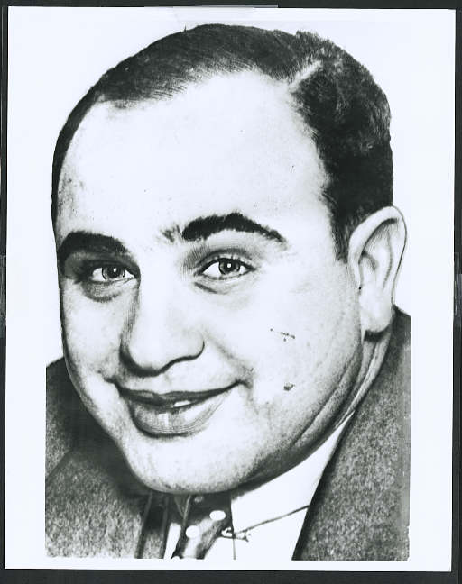
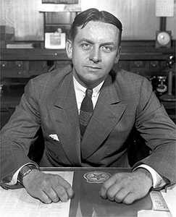
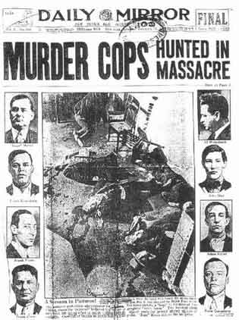
Prohibition
18th Amendment
Volstead Act
Gangsters
untouchables
Al Capone

Slide 5
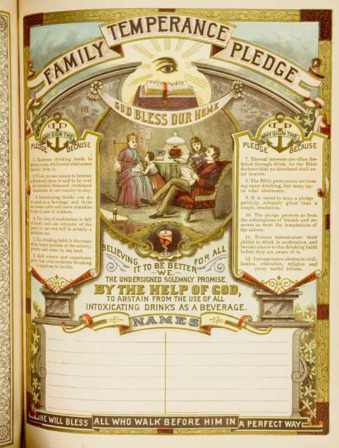
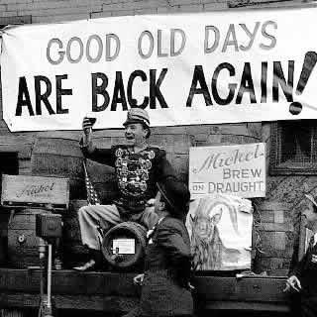
0
in WWI, temperance became a patriotic movement. - drunkenness caused low productivity & inefficiency, and alcohol needed to treat the wounded
a difficult law to enforce... organized crime, speakeasies, bootleggers were on the rise
Al Capone virtually controlled Chicago in this period - capitalism at its zenith…
Prohibition finally ended in 1933 w/ the 21st Amendment
forced organized crime to pursue other interests…

Slide 6
Health and Education
Rockefeller Foundation – wiped out hookworm by 1920s
Life expectancy
1901 – 50 years
1929 – 59 years
States require students to attend school until 16 or 18
1 in 4 graduate by 1920s
John Dewey
Columbia University Professor 1904 - 1930
Progressive education
Learning by doing
Life long learning

Slide 7
Monkey Trial
Fundamentalists attempt to ban teaching of Evolution
Scopes Trial - 1925
Scopes teaches evolution in Dayton, TN
ACLU sends Clarence Darrow to defend Scopes
William Jennings Bryan leads prosecution
Called to stand as expert on Bible
Made to look foolish by Darrow
Dies 5 days after trial
Scopes found guilty, fined $100, never paid
Law repealed in 1967
Results
Fundamentalists ridiculed, but still important
More Christians reconcile science and religion

Slide 8
The Mass-Consumption Economy
Economic Expansion
Secretary of Treasury Andrew Mellon encourages investment
New inventions increase productivity
Assembly line production
Higher standard of living

Slide 9
New Industries
Electric Power replaces steam
More efficient use of workers
Research reduces production costs
Manufacturing expands
Overproduction by late 1920s
Buying on Credit
Allows average people to buy expensive goods
Increases vulnerability of economy

Slide 10
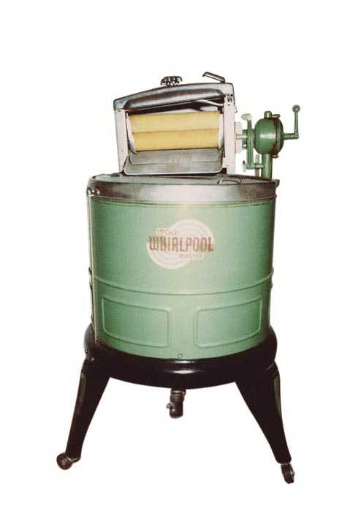
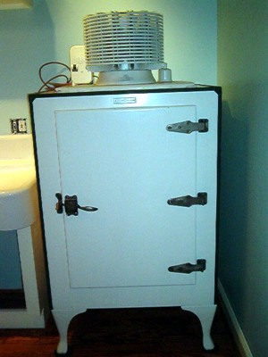
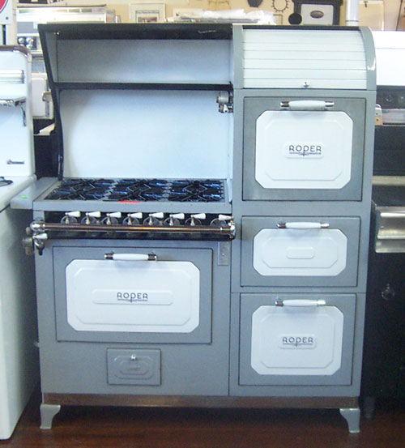
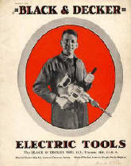
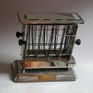
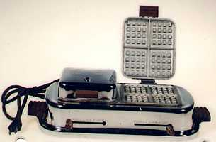
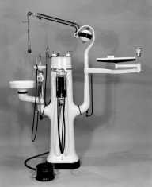
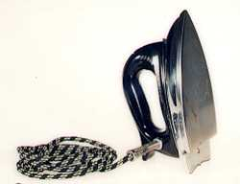
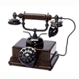
Consumer Economy

Slide 11
Entertainment
Moves from home to public sphere
Tabloids grow in popularity
Advertisers convince people to buy more
Bruce Barton – 1925 – The Man Nobody Knows
Jesus was greatest advertiser of all time
Parables like advertising
Turned 12 lower level managers into world conquering force
Sports
Big business
“Babe” Ruth – baseball becomes popular
Jack Dempsey – first boxer to earn $1 million

Slide 12
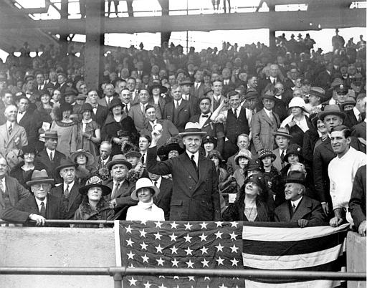
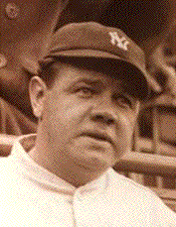
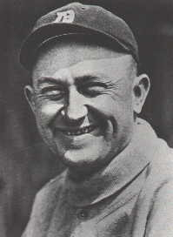
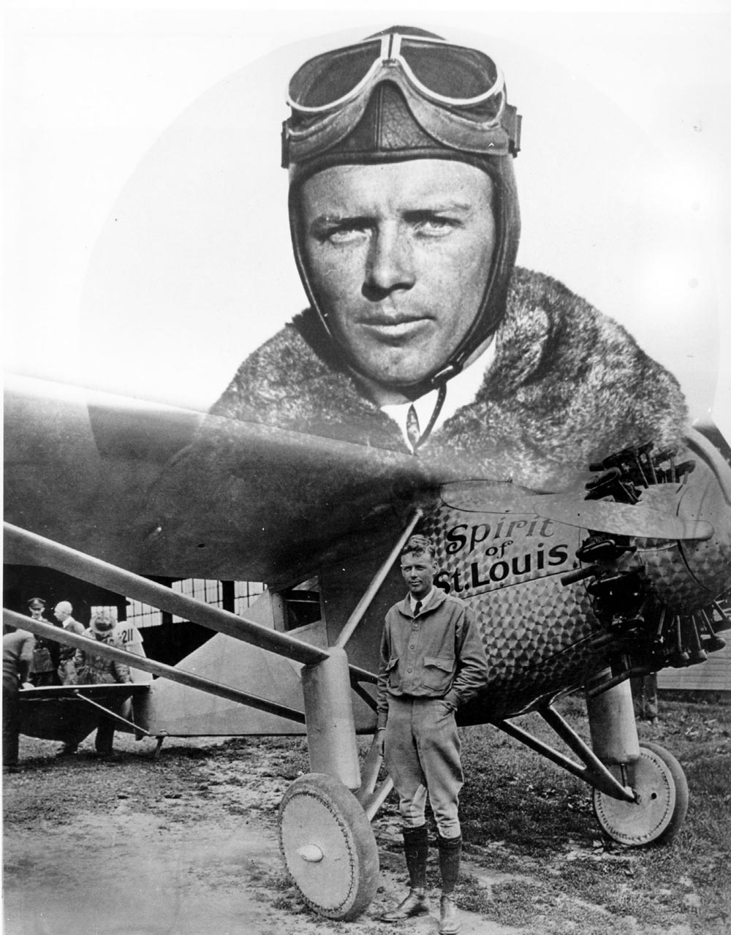
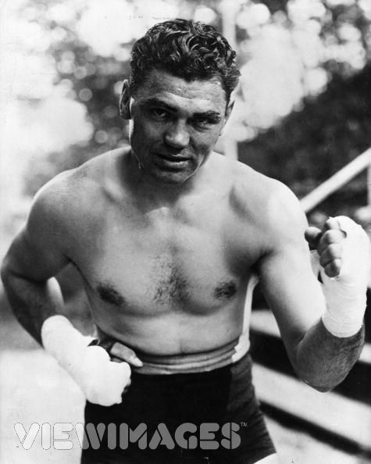
Celebrities
Babe Ruth &Ty Cobb
Charles Lindbergh
The Spirit of St. Louis
Jack Dempsey

Slide 13
Henry Ford, mass production, & the automobile
In the 1920s came the emergence of the automobile as a true replacement for the horse, not just a play thing for the wealthy.
This was made possible by an industrial process called mass production.
Process was popularized by Henry Ford during the manufacture of his Ford Model T
The Model T was designed to be produced in great volume on assembly lines so the cost of each car would be low enough for common people to afford.

Slide 14
Automobiles
Henry Ford
Develops auto industry in 1890s with Ronsom Olds
Invents Model-T
Cheap, mass-produced
Assembly line method very economical
$260 for a Model-T
50,0000 – 1914
20 million - 1930

Slide 15
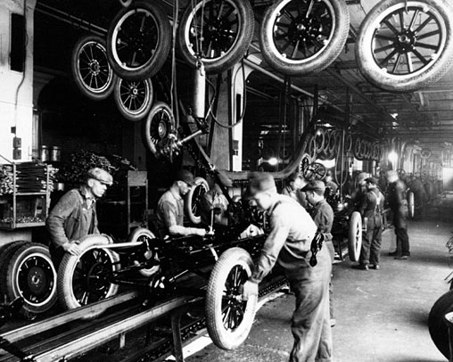

Slide 16
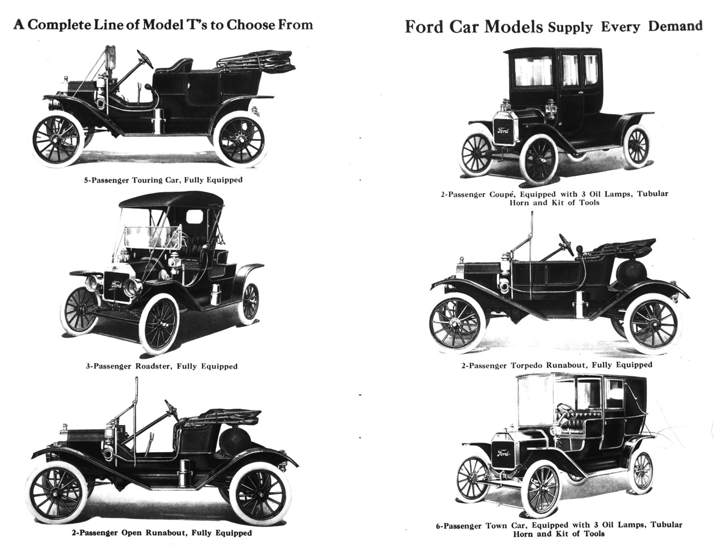

Slide 17
The Gasoline Age
How do automobiles change American Society?
What changes?
What areas of society are affected?
What are positive and negative affects?

Slide 18
Airplanes
Orville/Wilbur Wright
1903 – Kitty Hawk
Charles Lindbergh - 1927
Flies from New York to Paris in 33 hours
Spirit of St. Louis
Wins $25000

Slide 19
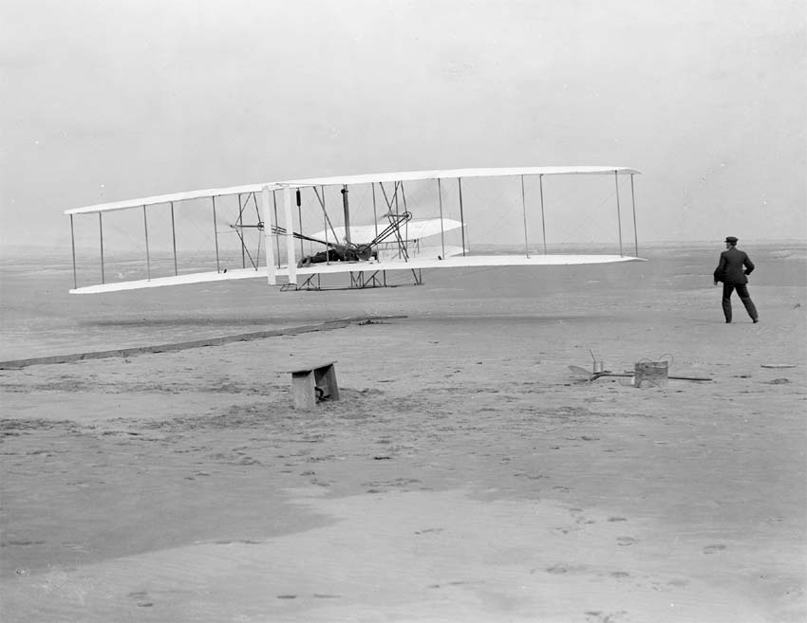

Slide 20
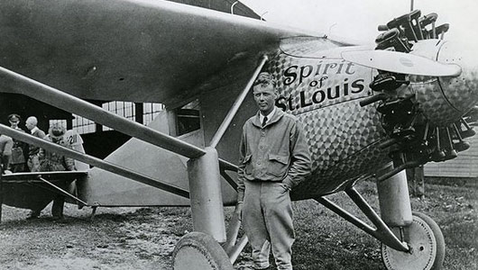

Slide 21
Radio
Invented in 1890s
First voice broadcast in 1906
Music in 1910
KDKA in Pittsburgh becomes first station in 1920
Long distance broadcasts by late 1920s
How will this change culture?

Slide 22
Radio and Movies
People were now able to escape from everyday life.
Radio programs and movies offered Americans hope for a better life and a new way to spend time with friends and family.

Slide 23
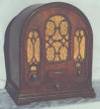
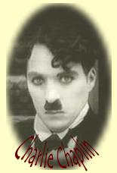
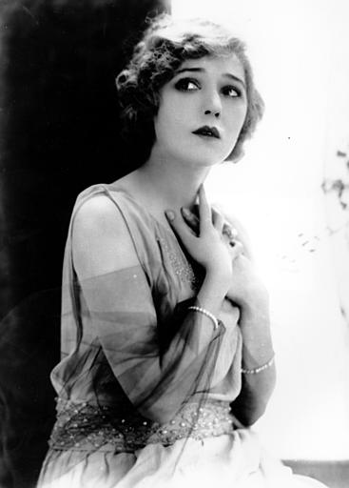
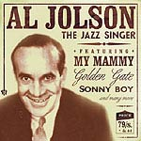
Culture of the Roaring 20’s
Radio
KDKA Pittsburgh
GE, Westinghouse,& RCA form NBC
Silent Movies
Charlie Chaplin
“Talkies”
The Jazz Singer
Starring Al Jolson
Mary Pickford
“America’s Sweetheart”

Slide 24
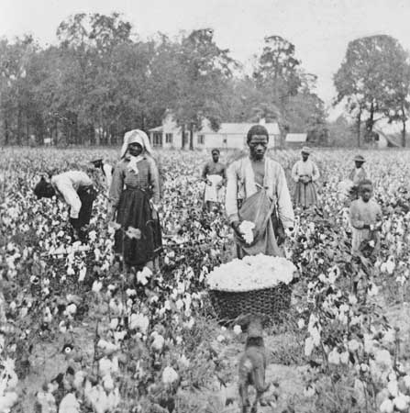
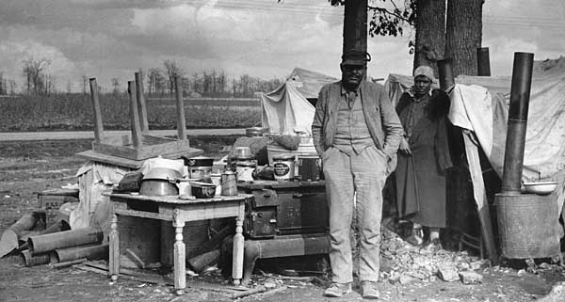
Black and Poor White Americans in this period continued to live in poverty
sharecropping kept them in de facto slavery
1915 - boll weevil wiped out the cotton crop
white landowners went bankrupt & forced sharecroppers off their land

Slide 25
Dynamic Decade
Great Migration
1920 – most Americans live in cities
African Americans move to northern cities
Causes
Decreased cotton prices
Lack of immigrant workers
Increased war manufacturing
Growing KKK
Leads to higher wages, educational opportunities, higher standard of life, racial tension and violence

Slide 26
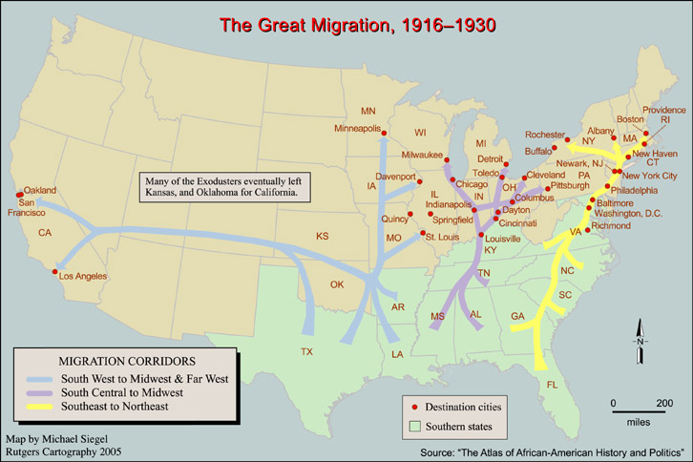
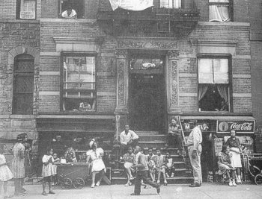
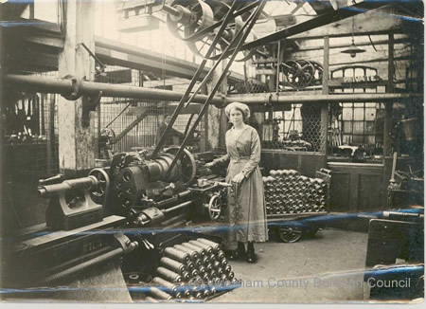
Blacks moved north to take advantage of booming wartime industry (= Great Migration)
- Black ghettoes began to form, i.e. Harlem
within these ghettoes a distinct Black culture flourished

Slide 27
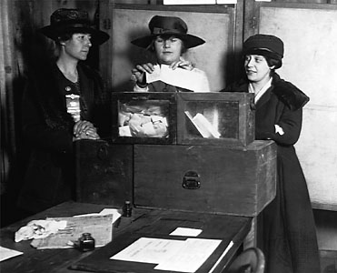
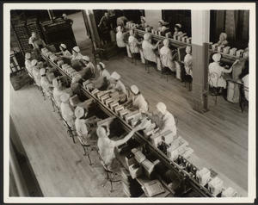
Women
more women worked outside the home
more women went to college and clamoured to join the professions
women didn't want to sacrifice wartime gains - amounted to a social revolt
characterized by the FLAPPER/ "new woman"
(bobbed hair, short dresses, smoked in public...)

Slide 28
Women
Worked in low-paying jobs
Clerks, secretaries
Margaret Sanger – leader of birth control movement
Why?
Alice Paul – National Women’s Party
Campaigns for equal rights amendment

Slide 29
Alice Paul
Organized suffragist parades for the sake of women's rights.
She was a bold woman who was imprisoned three times for her protests and led hunger strikes in prison.
In 1916, Paul formed the National Women's Party, which fought hard for a constitutional amendment that would extend suffrage to women.
In 1920, the 19th Amendment was passed, giving women the right to vote.

Slide 30
Carrie Chapman Catt
A notable leader of the women's suffrage movement in the early 1900s
She and others won women's right to vote by holding meetings, protests, and speaking before government leaders.
Catt held the position of president for National American Woman Suffrage Association in 1900-1904 and 1915-1920.

Slide 31
Sexual Change in the 20s
Sex sells, used in advertising
Flappers – young women who wore shorter dresses, make up, smoked
One piece bathing suits
Sex more common amongst youngsters
New psychological theories
Freud

Slide 32
The Flapper
An image often used in the advertisements of the 1920s.
She was a slim woman with short hair and a short skirt who was free to dance and enjoy her freedom.
While only a small number of women were actually flappers in the 1920s, this image was a powerful and popular symbol of the changing role of women during this time.

Slide 33
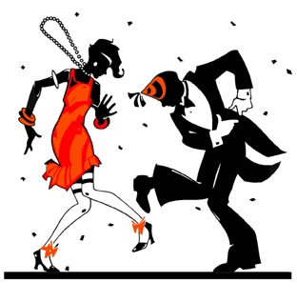
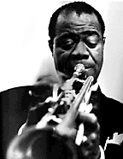
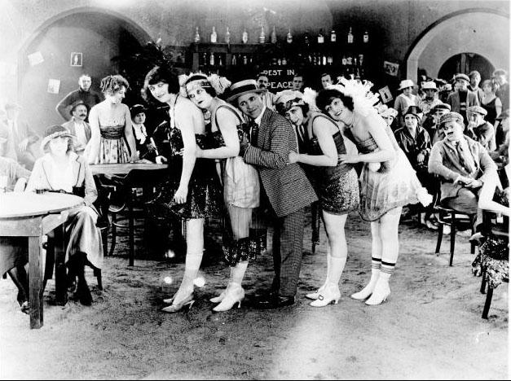
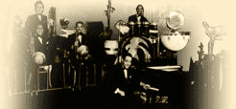
The 20’s is The Jazz Age
The Flappers
make up
cigarettes
short skirts
Musicians
Louis Armstrong
Duke Ellington
Irving Berlin
Writers
F. Scott Fitzgerald
Ernest Hemingway

Slide 34
Cultural Liberation
Know Authors and works
Mencken, Fitzgerald, Hemingway, Lewis, Eliot, O’Neil

Slide 35
Harlem Renaissance
Growth of African-American literature and art
Centered in Harlem, NY
Jazz Music
Started in New Orleans
“Jelly Roll” Morton, Duke Ellington, Bessie Smith, Louis Armstrong
Writers
Langston Hughes, Zora Neale Husrton, Claude McKay
Marcus Garvey
Founded United Negro Improvement Association
Resettlement in Africa
Sponsored businesses to keep money in African American community

Slide 36
Langston Hughes
An African American poet, playwright, and novelist.
His ideas about African Americans greatly influenced the Harlem Renaissance.
The Harlem Renaissance was the name given to the cultural, social, and artistic explosion that took place in Harlem between the end of World War I and the middle of the 1930s.
Not Without Laughter and The Dream Keeper are two of his more well-known pieces of literature.

Slide 37
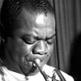
Louis Armstrong, sometimes called ―Satchmo, became known while playing with the Creole Jazz Band and later became one of the biggest stars of jazz music because of his sense of rhythm and his improvisational skills
“What a Wonderful World”
“Hello Dolly”
“Mack the Knife”

Slide 38
Irving Berlin
Irving Berlin created many famous songs for Broadway musicals.
Berlin also wrote patriotic music; his most famous song was "God Bless America.
" He composed all of the music for seventeen movies and twenty-one Broadway musicals.
Tin Pan Alley-Flatiron District NYC
“God Bless America:
“Blue Skies”
“Puttin on the Ritz”
“There's No Business Like Show Business”
“White Christmas”

Slide 39
The Bull Market
Speculation
Hundreds of banks fail annually
Real Estate
Stock Exchange
People invest all money, boom or bust
Stocks on Margin
Small down payment, rest due later

Slide 40
National Finance
Debt
Soaring national debt
1.1 billion in 1914, 24 billion in 1921
Surplus funds used to pay debt
Bureau of Budget created in 1921 to make projections
Taxes
Kept low
Mellon believes high taxes discourage business expansion
Rich will invest in tax-free securities
Lowers taxes on wealthy
Tax burden shifted to middle-class
Results of policy
National debt reduced by $10 million
Critics believe debt should have shrunk quicker
Accused of encouraging bull market

