Slide 1
Chapter 30
American Life in the “Roaring Twenties”
1920-1929

Slide 2
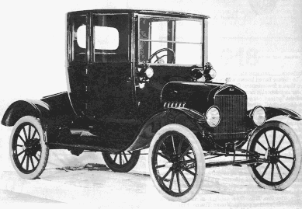
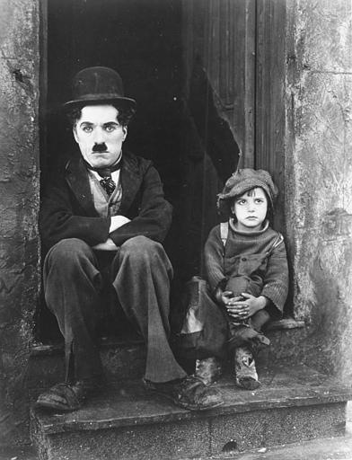
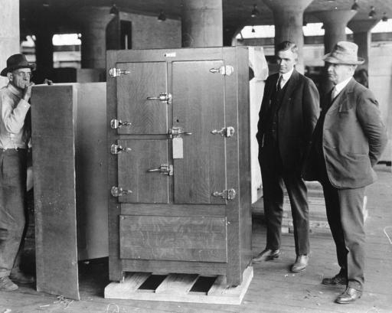
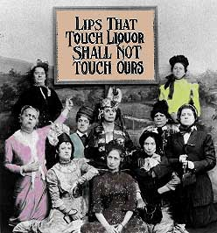
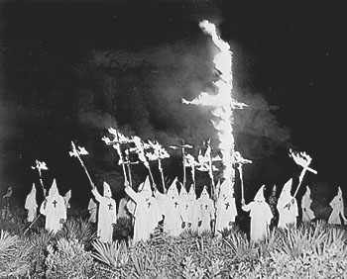
The Roaring 20’s
An era of prosperity,
Republican power,
and conflict

Slide 3
The 1920s was an era of:
extreme economic growth,
an explosion of new products like the automobile.
big social changes
the changing role of women and
the emergence of popular culture and advertising.
political conservatism
a string of Republican presidents
the Red Scare that demonized all liberals and radicals

Slide 4
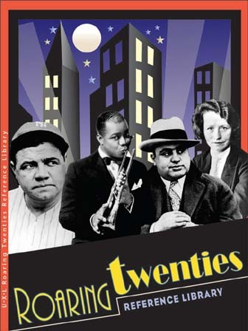
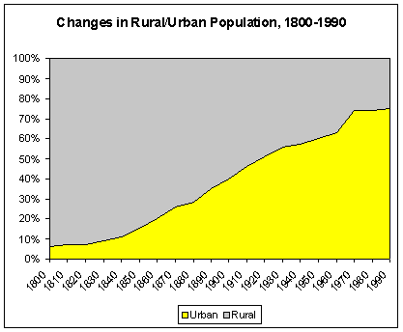
The 1920's was known as the "Roaring 20's", or the "Jazz Age” and a “return to normalcy.”
A period of great change in American Society - modern America is born at this time

Slide 5
Seeing Red
Fears of Russia
Communism
Against American beliefs and values
Capitalism, freedom
Red Scare of 1919 and the Palmer Raids
Strikes lead to call out of federal troops
Attorney General A. Mitchell Palmer jails or deports over 6000 suspected communists
Bombs sent to prominent leaders, including Palmer
Sept. 1920 – Wall St. bombed, 38 killed

Slide 6
Reactions
State Legislatures
States ban advocating violent overthrow of the government
Laws used to prosecute socialists
Unions come under fire
Sacco & Vanzetti
Italian immigrants
Atheists, anarchists, draft dodgers
On April 15, 1920, two men robbed and murdered two employees of a shoe factory in Massachusetts
Convicted of murder July 14, 1921, sentenced to death
After 6 years of appeals they were executed on August 23, 1927.

Slide 7
The new KKK
Who are they?
Anti catholic, black, Jewish, pacifist, Communist, internationalist, evolutionist, bootlegger, gambling, adultery, birth control, etc.
Pro Anglo-saxon, “Native” American, protestant
Resembled older nativist movements
Reaction to red scare, social change, and rise of status of blacks
Mainly found in Midwest and South

Slide 8
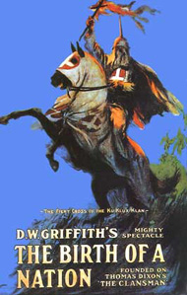
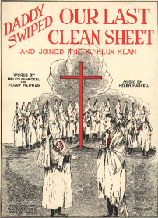
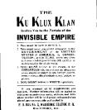
The Ku Klux Klan
Great increase
In power
Anti-black
Anti-immigrant
Anti-Semitic
Anti-Catholic
Anti-women’s suffrage
Anti-bootleggers

Slide 9
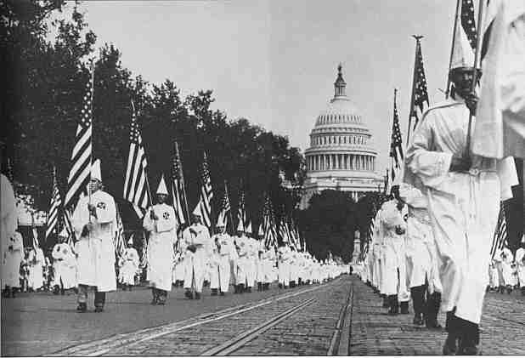

Slide 10
Decline of KKK
5 million members at height in 1925
Appalling tactics turn off average citizens
Burning crosses, lynching, tar/feathering
Embezzlement leads to Congressional investigation

Slide 11
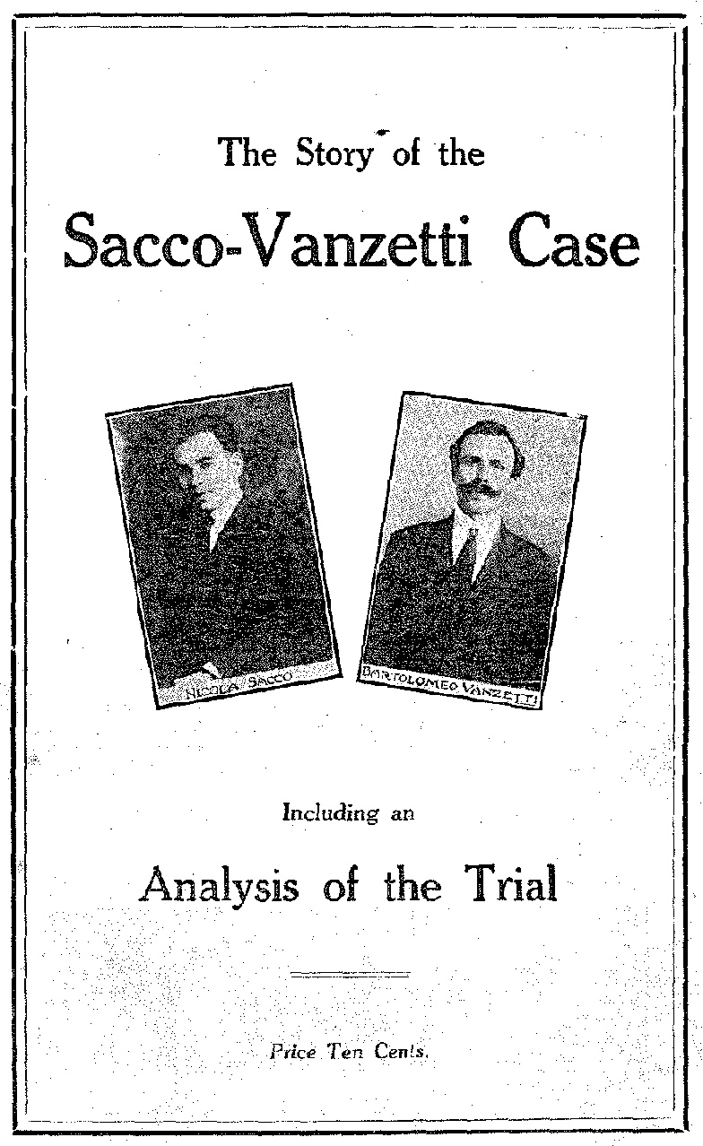
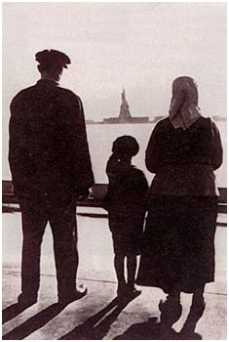
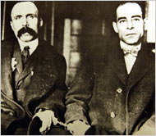
A Society in Conflict
Anti-immigrant
National Origins Act
Discrimination
Sacco-Vanzetti Trial
Italian immigrants
Unfair trial

Slide 12
Stemming the Foreign Flood
Emergency Quota Act of 1921
800000 immigrants arrive from southern/eastern Europe
Restricts immigrants to 3% of people of nationality living in US in 1910
Immigration Act of 1924 (National Origins Act)
Quota cut from 3% to 2%
Based on 1890 census
Japanese prevented from immigration
Canada/Latin America exempted
Criticized as unfair
Quota system abolished in 1965

Slide 13
Results of Immigration Act
Immigration slowed
1931 – more foreigners leave America than arrive
Freedom and opportunity sacrificed
Labor Unions suffer
Difficulty communicating
Ethnic differences played up by factory owners
Cultural Pluralists
Favor Immigration
Horace Kallen
U.S. should be protective area where groups can preserve cultural identity
Randolph Bourne
Interaction between immigrants
Beginnings of “multiculturalism”

Slide 14
The Prohibition Experiment
18th Amendment – prohibited manufacture, sale, transport, and consumption of alcohol
Volstead Act – defines beverages and imposes penalties
Favored in South and West
Keep alcohol out of hands of blacks
End prostitution, corruption, violence
Opposed in East
Large foreign populations in cities

Slide 15
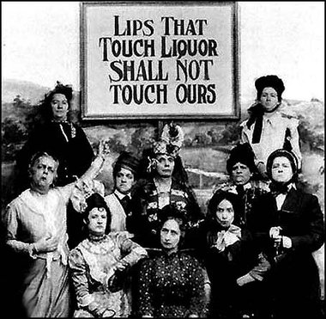

Slide 16
