Slide 1
Chapter 22
The Ordeal of Reconstruction

Slide 2
The Problems of Peace
Questions
What to do with free blacks?
How to reintegrate Southern States?
What to do with Jefferson Davis?
Who is in charge of Reconstruction?
Southern way of life destroyed
Farms destroyed
Slaves freed
Cities burnt
Southerners defiant

Slide 3
Freedmen Define Freedom
Confusing situation for free blacks
Slaves re-enslaved after Union troops leave
Emancipation resisted through legal means
Not valid until declared by local or state courts
Some slave remain loyal to masters
Others pillage land, and property
After full emancipation many blacks leave plantations searching for work/family

Slide 4
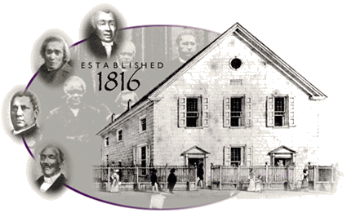
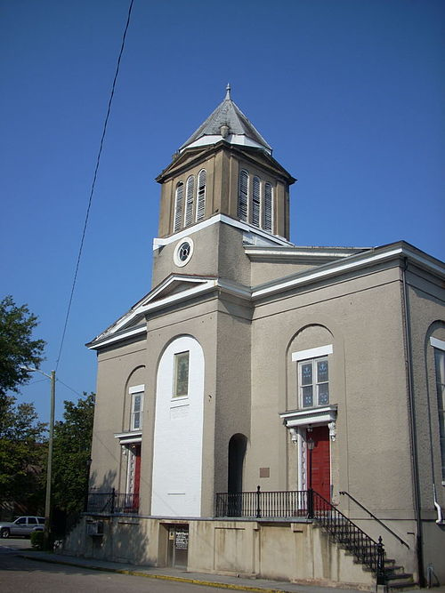
Freedmen Define Freedom
Church becomes focus of black community life
the Black Baptist church grew from 150,000 to 500,000 members
the African Methodist Episcopal Church grew from 100,000 to 400,000 members

Slide 5
Freedmen Define Freedom
Education became important
Prior to emancipation this freedom had been denied
“a schoolhouse would be the first proof of their independence.”
– a member of the N.C. education society

Slide 6
Freedman’s Bureau
Freedman’s Bureau
Established March 3, 1865
Provided food, clothing, medical care, and education to both freedmen and to white refugees.
Headed by General Oliver O. Howard
Train unskilled and uneducated freed Blacks
Teaches 200,000 blacks how to read
Narrows literacy gap

Slide 7
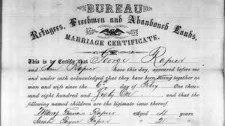
Freedman’s Bureau
Blacks still face discrimination
President Andrew Johnson repeatedly tried to end the Freedman’s Bureau
Freedman’s Bureau allowed to expire in 1872
Attacks by racist whites

Slide 8
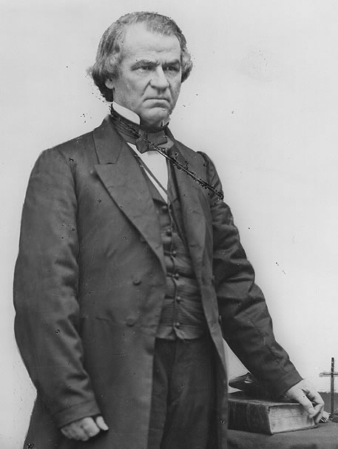
Johnson: The Tailor President
Came from poor and humble background, orphaned, never attended school, apprenticed for a tailor at age 10. Moved to Tenn. at age 17.
Became a stump speaker and the champion of poor whites.
Only Confederate Congressman not to leave Congress after secession
Short temper
Champion of states’ rights and Constitution
He was a misfit in office…

Slide 9
Presidential Reconstruction
10% Plan
Lincoln saw states as never having left Union
Only 10% of voters needed to take an oath to the Union and acknowledge emancipation
Forgiving
Terms: Presidential Reconstruction Plan, Lincoln’s Plan, 10% Plan = same thing
Radical Republicans (Controlled Congress)
Punish the South
Wade-Davis Bill
50% of states’ voters take oath
Stronger demands for emancipation
Pocket-vetoed by Lincoln

Slide 10
Conflict over Reconstruction
Moderate Republicans
Share Lincoln’s view
Radicals
Harshly punish South
Lincoln assassinated
Johnson takes Lincoln’s stand (lenient)
Leading Confederates disenfranchised
Confederate debt absolved
States must ratify 13th Amendment

Slide 11
The Baleful Black Codes
Black Codes: Laws designed to control freed blacks
Keep population as workers in fields
“jumping” labor contracts or walking off job subject to fine
Wages kept very low
No serving on Jury
No renting or leasing land
“idleness” punishable by chain gang

Slide 12
Congressional Reconstruction
Dec. 1865 – Southern states apply for reintegration into Union
Many Republicans disgusted by Democrats and former Confederates wanting to reclaim seats in Congress
Wartime Legislation
Republicans had passed legislation that had favored the north:
Morrill Tariff
Pacific Railroad Act
Homestead Act
Did not want to give up their political advantage

Slide 13
Problems
South would be politically stronger
Blacks now counted as a whole person instead of 3/5
Fear that Democrats would take over Congress and Presidency
Institute national black codes
Erase gains of Civil War
Dec 6, 1865 – Johnson declares:
South had satisfied all of his conditions
In his view the Union was now restored

Slide 14
Johnson v. Congress
Johnson continually vetoes Republican bills
Freedman’s Bureau
Civil Rights Bill
Republicans override Johnson’s Vetoes
Pass the 14th Amendment
All blacks are American Citizens
If citizenship denied to blacks, representatives in Electoral College lowered
Former Confederates barred from office
Federal debt guaranteed/Confederate debt repudiated
States would not be allowed into Union if 14th Amendment not ratified

Slide 15
Swinging ‘Round the Circle with Johnson
1866 Congressional Elections
Johnson wants to reduce number of Republicans in Congress
Gives ‘Round the Circle speeches
Heckled by audiences
Exchanges insults
Denounces radical republicans
Results in even more Republican victories
“Stand by Congress” against the “Tailor of the Potomac”

Slide 16
Republican Principles and Programs
Veto-proof Congress
Unlimited control of Reconstruction
Senate
Charles Sumner leads Radicals
House
Thaddeus Stevens
Radicals want to keep South out of Union until economy and way of life totally changed. Moderates want faster reconstruction
compromise
Leaders of the Radical Republicans
in Congress

Slide 17
Reconstruction by Sword
Reconstruction Act – March 2, 1867
Divides South into 5 military districts
Disenfranchises former Confederates
New guidelines for readmission to Union
All states had to approve 14th Amendment
All states had to guarantee full suffrage of former male slaves
15th Amendment (1869)
Right to vote for black males
Supreme Court rules in ex parte Milligan (1866) military tribunals can’t be used against civilians
Compromise of 1877
Presidential stalemate leads to end of Reconstruction

Slide 18
No Women Voters
Reconstruction Amendments disappoint women’s suffrage advocates
Women had helped blacks gain rights
Women’s rights advocates campaign against 14th and 15th Amendment
Inserted “male” into Constitution for first time

Slide 19
Realities of Reconstruction
Blacks began to organize politically through Union League
Network of political clubs
Educate members
Campaigned for Republicans
Built churches and schools
Recruited militias
Black men gain political office
Hiram Revels and Blanche K. Bruce serve in Congress from Mississippi

Slide 20
Southern Reaction
Southerners hated seeing former slaves elevated
“Scalawags”
Southerners who supported reconstruction
“Carpetbaggers”
Northerners accused of profiteering
Southern governments very corrupt during reconstruction

Slide 21
The Ku Klux Klan
Founded in Tennessee in 1866
Nathan Bedford Forrest
Goal is to intimidate blacks into submission
Prevent minorities from gaining political power
Prevent minorities from gaining wealth
Often resorted to terror and violence
Undermine many of the goals of Reconstruction

Slide 22
Johnson and Impeachment
Radical Republicans angered by Johnson
Get rid of him
Tenure of Office Act passed in 1867
President must have approval of Senate before removing appointed officials
Attempting to keep Edwin Stanton in office
A leftover from Lincoln’s administration, outwardly loyal to Johnson, but serving as a spy for the Radicals.
Johnson fires Stanton in early 1868
Impeached by Republicans

Slide 23
A Not-Guilty Verdict
Johnson not allowed to testify by lawyers
Argued that Tenure of Office Act was unconstitutional
May 16, 1868
Johnson acquitted of all charges by 1 vote
7 Republican Senators vote not guilty
Never elected to political office again
Radicals infuriated
Many feared establishing precedent of removing a sitting president

Slide 24
The Purchase of Alaska
1867 – Secretary of State William H. Seward buys Alaska
$7.2 million paid to Russia
Known as “Seward’s Folly”
Unknown oil reserves

Slide 25
Heritage of Reconstruction
Southerners see Reconstruction as worse than Civil War
Resent destruction of social system
Republican failure?
Life in the South changes little
Blacks oppressed for another century
Until Civil Rights movement

