Slide 1
On your desk:
Your chapter 17 reading questions & a sheet of blank notebook paper.

Slide 2
“Tippecanoe & Tyler too”
Write a paragraph explaining the controversy regarding Tyler taking the presidency in 1841. Be sure to cite specific information from the reading including Tyler’s political party, his beliefs and his party’s platform, as well as public opinion regarding Tyler.

Slide 3
Chap. 19
Drifting toward Disunion

Slide 4
Stowe and Helper
1852 – Harriet Beecher Stowe Publishes Uncle Tom’s Cabin
Hardens abolitionist resolve in North
Sells millions of copies
South says portrayal of slavery wrong and unfair
Widely read in Britain
Turns British people against supporting South
Hinton R. Helper publishes The Impending Crisis of the South
Uses statistics to show that slavery harms non slave holding whites
Both books banned in South, but widely read in North

Slide 5
The Contest for Kansas
Early 1850s – Northerners flood into Kansas
Southerners angry
Election day 1855
“border ruffians” move from Missouri to Kansas
Kansas votes to enter Union as slave state
Free-Soilers set up opposing government in Topeka
Two governments in Kansas
Illegal free gov. in Topeka
Illegitimate slave gov. in Shawnee
1856 – pro-slavery raiders burn part of Lawrence, KS
Violence quickly escalates

Slide 6
“Bleeding Kansas”
John Brown and followers murder five at Pottawatomie Creek
Pro-slavery forces retaliate
“Bleeding Kansas”
Civil War erupts in Kansas in 1856 and continues intermittently until the Civil War.
1857 – Lecompton Constitution drafted
People allowed to vote for slavery or against
Those already holding slaves would be grandfathered in
Free-Soilers boycott election
Constitution passes

Slide 7
Election of 1856
Democrats chose James Buchanan
Untainted by Kansas-Nebraska Act
Experienced
New Republican Party nominates John C. Fremont
Mexican-American War hero
American Party, a.k.a. “Know-Nothing Party” nominates Millard Fillmore
Nativists, anti-Catholic, anti-foreign
Some old Whigs
Accuse Fremont of being Roman Catholic
Buchanan wins

Slide 8
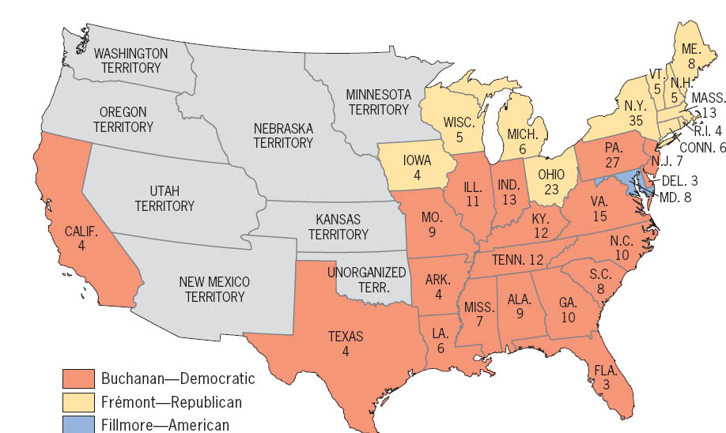
Presidential Election of 1856 (electoral vote by state)
The fateful split of 1860 was foreshadowed. The regional polarization in 1856, shown here, was to be even sharper four years later.
Copyright (c) Houghton Mifflin Company. All Rights Reserved.

Slide 9
Kansas in Washington
Buchanan sympathizes with south
Stephen Douglas calls for fair re-vote
Refuses to accept fraudulent Lecompton Constitution
Democratic Party divides along sectional lines
No national party

Slide 10
“Bully” Brooks
“Bleeding Kansas” debated on Senate floor
Charles Sumner – Massachusetts Senator
Vocal abolitionist, condemns slavery and supporters of slavery
Preston S. Brooks – South Carolina Senator
Sumner insults Senator Butler, Brooks’s relative
Brooks believes Sumner not a gentlemen
Beats him with his cane
Southerners considered him a hero and sent canes to him inscribed with “hit him again”
Northerners responded by saying “no way is left for the North, but to strike back, or be slaves.”
Incident convinces abolitionists that southerners are violent fanatics

Slide 11
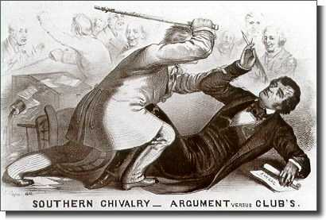
Brooks vs. Sumner

Slide 12
Dred Scott
Slave from Missouri who had lived in Illinois
Dred Scott claimed he should be a free man because he had lived with his master in slave states and in free states.
Sues new master for freedom after old master’s death
Lower court sides in favor of Scott
Missouri Supreme Court overturns decision
Appealed to U.S. Supreme Court
March 6, 1857 – Supreme Court overrules decision
Court rejected Scott’s claim, ruling that no African American––even if free––could ever be a U.S. citizen.
Outlawing slavery violates 5th Amendment
Missouri Compromise ruled unconstitutional

Slide 13
Reaction
Regional tension builds
Abolitionists and bystanders outraged by decision
Southerners ecstatic
Southerners seen as winning argument
President is southern, Supreme Court is Southern, Constitution protects slavery

Slide 14
Panic of 1857
Causes
California gold rush – inflation
Over growing grain
Over-speculation in land/railroads
North hard hit
Calls for higher tariff rate (a new lower tariff had just passed at 20% just months before the crash – lowest rate since War of 1812)
Desperate slogans “Bread or Death” – in urban areas
South not badly hit
Homestead Act passed in 1860
Cheap land for less-fortunate
Opposed by southerners
Opposed by northern industrialists

Slide 15
Congressional Election of 1858
Stephen Douglas of Illinois up for reelection
Opposed by Abraham Lincoln
Slowly climbed political ladder
Had been a successful lawyer in Illinois before running for House
Challenges Douglas to debates
Douglas reputed to be best debater in nation
7 debates scheduled

Slide 16
Lincoln Douglas Debates
Slavery becomes major focus
Freeport
Asks Douglas “if the people of a territory voted slavery down, which side would you support?”
Douglas replies he would support popular sovereignty
Douglas wins Senate race
Answers cause distrust and dislike in the South
Votes against Lecompton
No chance of winning presidency in 1860

Slide 17
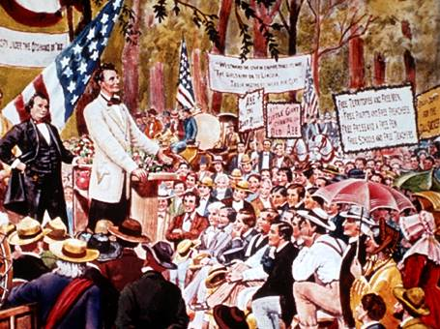
Lincoln Douglas Debates

Slide 18
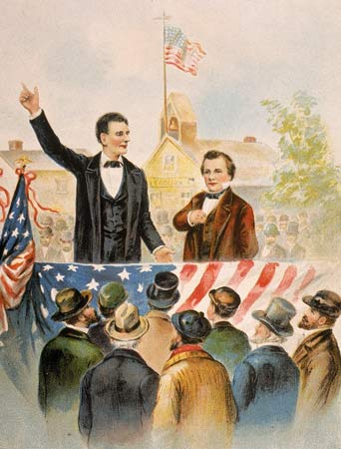
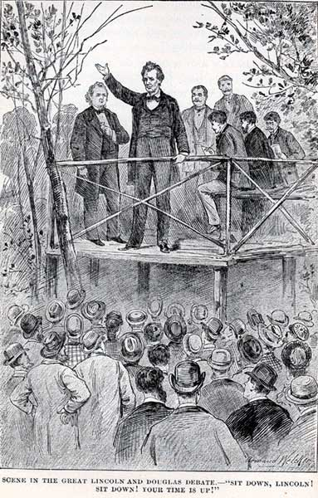

Slide 19
John Brown: Murder or Martyr?
1859 – John Brown plans slave revolt in South
Raids Harper’s Ferry federal arsenal in Virginia
Surrounded and captured by marines under command of Robert E. Lee
Tried, convicted, executed
Becomes a martyr for abolitionists despite violent past
South sees Brown as a typical northerner

Slide 20
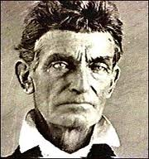
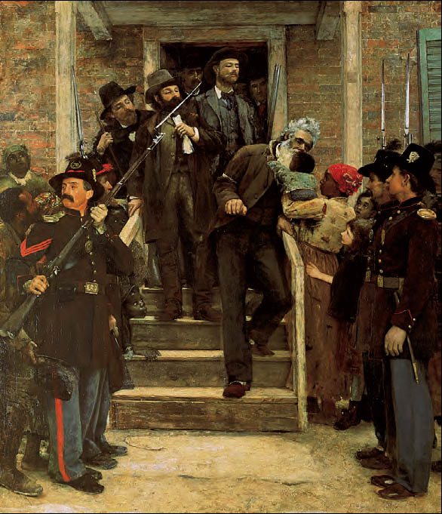
Last Moments of John Brown, by Thomas Hovenden
Sentenced to be hanged, John Brown wrote to his brother, “I am quite cheerful in view of my approaching end, being fully persuaded that I am worth inconceivably more to hang than for any other purpose. . . . I count it all joy. ‘I have fought the good fight,’ and have, as I trust, ‘finished my course.’ ” This painting of Brown going to his execution may have been inspired by the journalist Horace Greeley, who was not present but wrote that “a black woman with a little child stood by the door. He stopped for a moment, and stooping, kissed the child.” That scene never took place, as Brown was escorted from the jail only by a detachment of soldiers. But this painting has become famous as a kind of allegorical expression of the pathos of Brown’s martyrdom for the abolitionist cause.
The Metropolitan Museum of Art, Gift of Mr. and Mrs. Carl Stoeckel, 1897 (97.5) Photograph ©1982 The Metropolitan Museum of Art

Slide 21
Politics leading to war

Slide 22
Antebellum Political Parties
Free Soil | Know Nothing Party | Whigs
Against the extension of slavery Pro-labor (workers) | AKA the American Party Nativism Anti-Immigration Anti-Catholic | Pro-business Divided on Slavery
Republicans | Democrats
Opposed expansion of slavery into new territories/states | States’ Rights Limited Government Divided on Slavery

Slide 23
Crumbling Political Parties
Caught in the sectional strife disrupting all national institutions, the Know Nothing American Party fell apart after 1856.
Antislavery Know-Nothings joined the Republican Party
Southern Know-Nothings joined the Democratic Party
In 1860, remnants of the Know-Nothing Party joined with the old Whigs to form the Constitutional Union Party.

Slide 24
Election of 1860
Democrats fail to nominate a candidate at Convention in Charleston
Southern Democrats nominate John C. Breckinridge
Northern Democrats nominate Stephen Douglas
“Know-Nothings” nominate John Bell
Begin calling themselves Constitutional Union Party
Platform is Constitution and compromise

Slide 25
Republicans
Race between Abraham Lincoln, and William “higher law” Seward
Platform has wide appeal
Non-expansion of slavery
Protective tariff
Immigrants rights
Internal improvements
Free homesteads
Lincoln wins nomination
Southerners threaten secession if Lincoln wins general election

Slide 26
Candidates - 1860
Stephen Douglas (Northern Democratic Party)
Supported popular sovereignty
John Brekinridge (Southern Democratic Party)
Wanted an extension of slavery into western territory
Supported a federal slave code
Stressed state’s rights
John Bell (Constitutional Union Party)
Wanted to find some sort of compromise and preserve the Union
Abraham Lincoln (Republican Party)
Supported protective tariffs
A transcontinental railroad

Slide 27
Election of 1860
 |  | Popular vote in GA | Popular vote Nationally | Electoral College vote
Bell | Constitutional Union Party | 42,886 | 592,906 | 39
Brekinridge | Southern Democrat | 51,893 | 848,356 | 72
Douglas | Northern Democrat | 11,580 | 1,382,713 | 12
Lincoln | Republican | 0 | 1,865,593 | 180

Slide 28
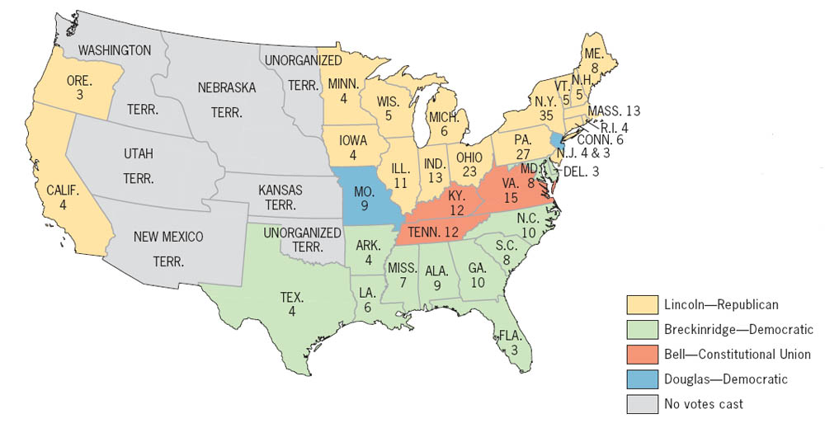
Presidential Election of 1860 (electoral vote by state)
It is a surprising fact that Lincoln, often rated among the greatest presidents, ranks near the bottom in percentage of popular votes. In all the eleven states that seceded, he received only a scattering of one state’s votes--about 1.5 percent in Virginia.
Copyright (c) Houghton Mifflin Company. All Rights Reserved.

Slide 29
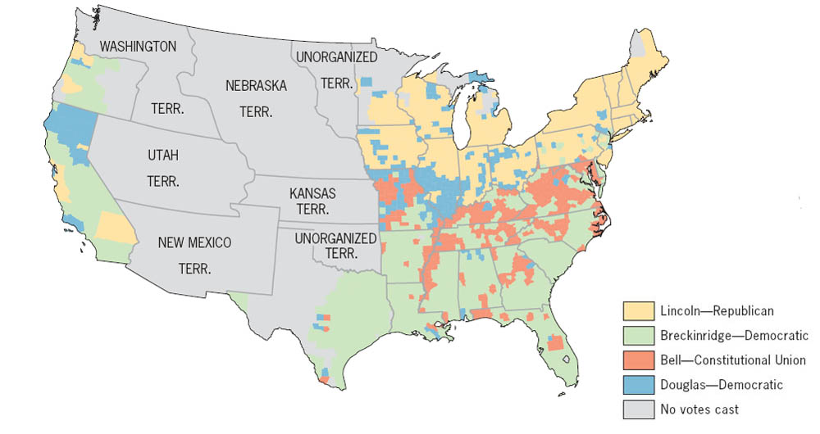
Presidential Election of 1860 (showing popular vote by county)
The vote by county for Lincoln was virtually all cast in the North. The northern Democrat, Douglas, was also nearly shut out in the South, which divided its votes between Breckinridge and Bell. (Note that only citizens of states could vote; inhabitants of territories could not.)
Copyright (c) Houghton Mifflin Company. All Rights Reserved.

Slide 30
Results
Lincoln wins electoral vote
Only 40% of popular vote
Wasn’t on the ballot in South
North goes to Lincoln
South to Breckinridge
Handful of states to Bell and Douglas
Republicans did not control Congress or Supreme Court
Southern states begin to secede however

Slide 31
Secession
December 1860 – South Carolina Secedes
Alabama, Mississippi, Florida, Georgia, Louisiana, and Texas secede within six weeks
Representatives meet at Montgomery in Feb. 1861
Confederate States of America created
Jefferson Davis appointed president
Buchanan does nothing
Needs troops in the west
Leaves issue for Lincoln

Slide 32
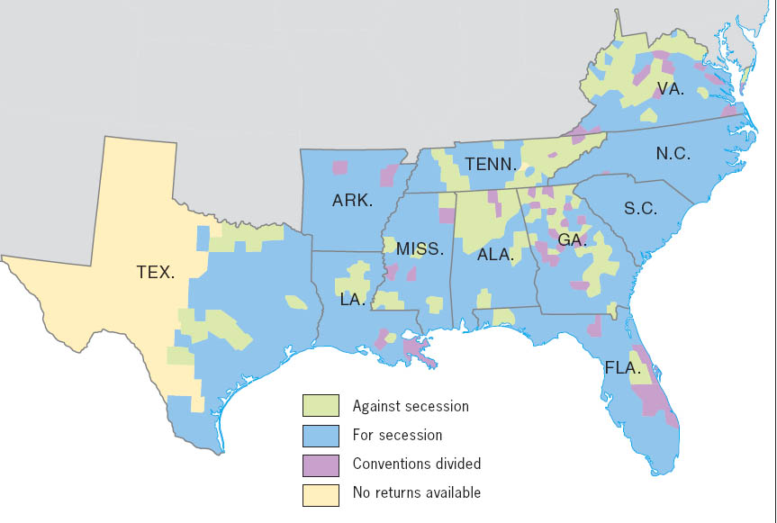
Southern Opposition to Secession, 1860–1861 (showing vote by county)
This county vote shows the opposition of the antiplanter, antislavery mountain whites in the Appalachian region. There was also considerable resistance to secession in Texas, where Governor Sam Houston, who led the Unionists, was deposed by secessionists.
Copyright (c) Houghton Mifflin Company. All Rights Reserved.

Slide 33
The last compromise
James Henry Crittenden of Kentucky proposes Crittenden Compromise
Bans slavery north of 36 30’
Extends line to Pacific
Pop. Sov. South of line
Slavery protected in existing territory
Lincoln opposes Crittenden Compromise
Goes against Republican platform

Slide 34
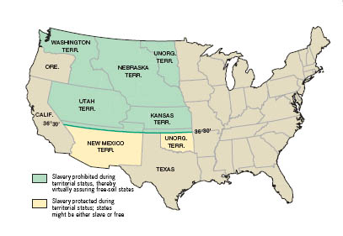
Proposed Crittenden Compromise, 1860
Stephen A. Douglas claimed that “if the Crittenden proposition could have been passed early in the session [of Congress], it would have saved all the States, except South Carolina.” But Crittenden’s proposal was doomed--Lincoln opposed it, and Republicans cast not a single vote in its favor.
Copyright (c) Houghton Mifflin Company. All Rights Reserved.

Slide 35
The end of Union
Southern states fear rights as slaveholding states were threatened by growing Republican Party
South hoped to further strengthen economy
Believed they could successfully revolt
European support if war broke out
Other states secede after inauguration of Lincoln
Unwilling to compromise
Both sides prepare for war

Slide 36
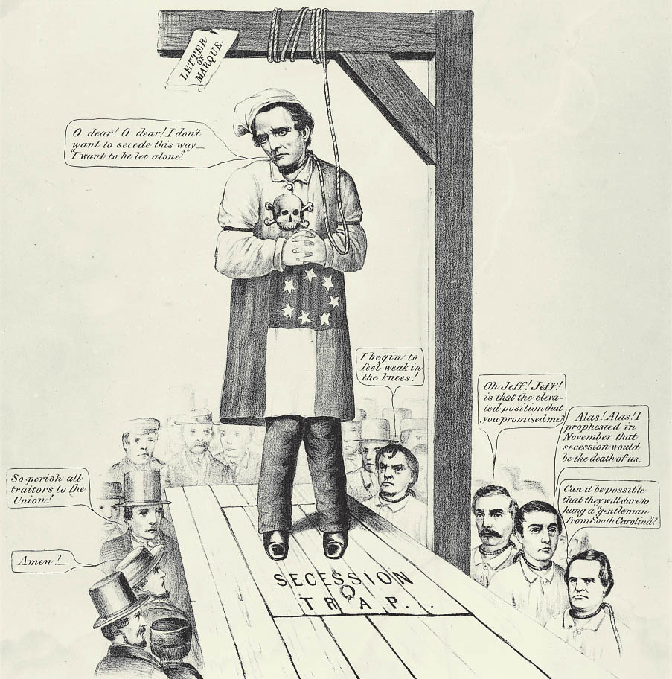
Jeff Davis on His Own Platform, or The Last “Act of Secession,” c. 1861
This northern cartoon expressed the sentiment of many people north of the Mason-Dixon line that secession was a self-defeating move, doomed to failure.
Chicago Historical Society

Slide 37
Critical Thinking Activity: Events leading to secession
Choose 5 of the following events and put them in a ranked list based on their importance in causing the Southern states to secede from the Union in 1860-1861.
For each event:
give a short summary of what happened
the significance of the event, and most importantly
an explanation of why you placed the event in the position that you did on your ranked list.
Compromise of 1850
publication of Uncle Tom's Cabin by Harriet Beecher Stowe
Kansas-Nebraska Act
events in "Bleeding Kansas"
decision in the Dred Scott case
John Brown's raid on Harper's Ferry
the election of Abraham Lincoln

