Slide 1
Chapter 18
Renewing the Sectional Struggle

Slide 2
Popular Sovereignty
Treaty of Guadalupe Hidalgo ends Mexican-American War
Restarts slavery debate
National support for Democrats and Whigs begins to erode
1848 – Polk decides not to run
Democrats nominate Lewis Cass
1812 Veteran
Known as the “father” of popular sovereignty

Slide 3
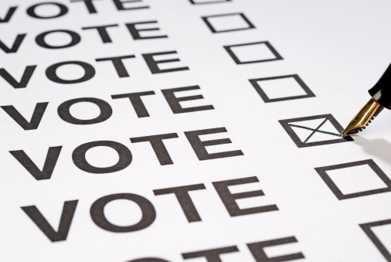
Popular Sovereignty
Popular sovereignty—
doctrine stated the sovereign people of a territory, under general principle of the Constitution, should themselves determine status of slavery

Slide 4
Popular Sovereignty
Had persuasive appeal:
Public liked it because it accorded with democratic tradition of self-determination
Politicians liked it because it seemed a comfortable compromise between:
Free-soilers' bid to ban slavery in territories
Southern demands that Congress protect slavery in territories
Popular sovereignty tossed slavery problem to people in various territories
Advocates hoped to dissolve slavery from a national issue to a series of local issues
Yet, popular sovereignty had one fatal defect:
Might spread blight of slavery

Slide 5
Election of 1848
Whigs nominate Zachary Taylor
Hero of Buena Vista
Avoids major issues (wouldn’t commit himself on issue of slavery’s extension)
Abolitionists create Free Soil Party
No expansion of slavery, federal aid for internal improvements, free government homesteads for settlers
Nominate Martin Van Buren
Major parties don’t address slavery
Taylor wins by small margin

Slide 6
Election of 1848
Taylor's wartime popularity:
1,360,967 popular and 163 electoral votes
Cass:
1,222,342 popular and 127 electoral votes
Van Buren
291,263 ballots and diverted Democratic strength from Cass in critical state of New York

Slide 7
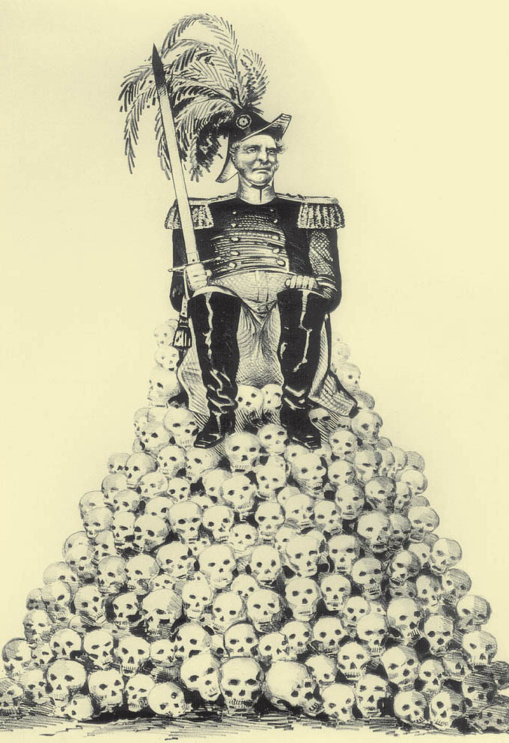
General Zachary Taylor (1784–1850)
This Democratic campaign cartoon of 1848 charges that Taylor’s reputation rested on Mexican skulls.
Collection of The New-York Historical Society

Slide 8
49ers
Gold discovered near Sutter’s Mill, California in 1848
Thousands flood into state
Few strike gold
Most reliable profits made by those who mined the miners:
Charged outrageous rates for laundry & other services
California drafts Constitution
Applies for statehood as a free state
Issues?

Slide 9
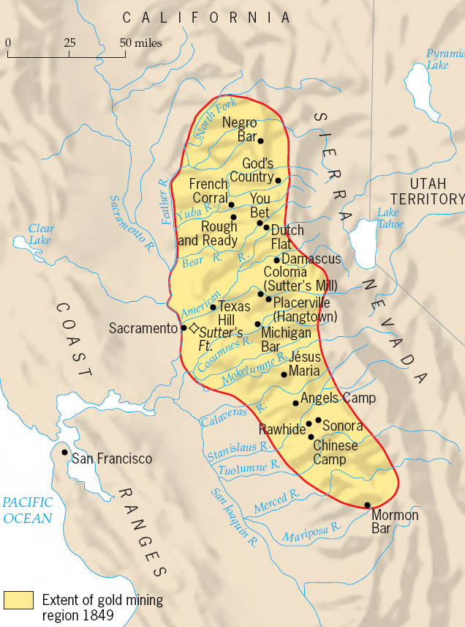
California Gold Rush Country
Miners from all over the world swarmed over the rivers that drained the western slope of California’s Sierra Nevada. Their nationalities and religions, their languages and their ways of life, are recorded in the colorful place names they left behind.
Copyright (c) Houghton Mifflin Company. All Rights Reserved.

Slide 10
Sectional Balance
1850 the south is relatively well-off:
Southerner as president
Southern majority in cabinet and Supreme Court
15/15 balance in Senate
Equal number of free and slave s
Free California upsets balance
Slavery ban looming in D.C.
Underground railroad frees thousands of slaves
Harriet Tubman frees over 300 slaves
South Demands a strict fugitive slave law

Slide 11
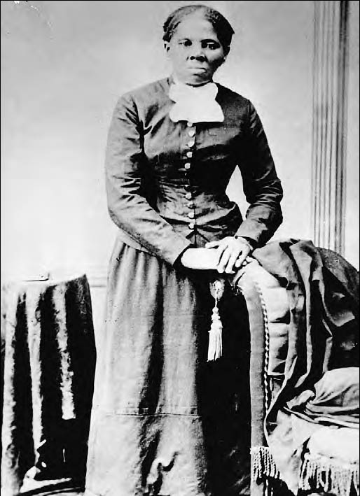
Harriet Tubman, Premier Assistant of Runaway Slaves
John Brown called her “General Tubman” for her effective work in helping slaves escape to Canada on the Underground Railroad. During the Civil War, she served as a Union spy behind Confederate lines. Although illiterate, she worked after the war to bring education to the freed slaves in North Carolina.
The Granger Collection

Slide 12
Twilight of the Senate Giants
Henry Clay – Great Compromiser, 73
Urges concessions from North and South
Supported by Stephen Douglas
John C. Calhoun – Great Nullifier, 88, dying of TB
Pleads for states’ rights
Wants a stricter Fugitive slave law
Return of political balance (2 presidents?)
Daniel Webster
New land would not support slavery
7th of March speech (1850) moves North towards Compromise
Supported the fugitive slave law as a concession to the south
Seen as a traitor by some for ignoring issue of slavery

Slide 13
Deadlock on Capitol Hill
New politicians – “Young Guard”
Purify Union
William Seward – New York Senator
No concessions for slavery
No compromise
Christians must adhere to “higher law”
Taylor falls under influence
Compromise bills vetoed

Slide 14
Breaking the Logjam
1850 – Taylor dies
V.P. Millard Fillmore takes over
Believes in compromise
Signs a series of bills known as Compromise of 1850
Clay, Webster, Douglas speak on behalf of compromise
South hates it, but eventually agrees

Slide 15
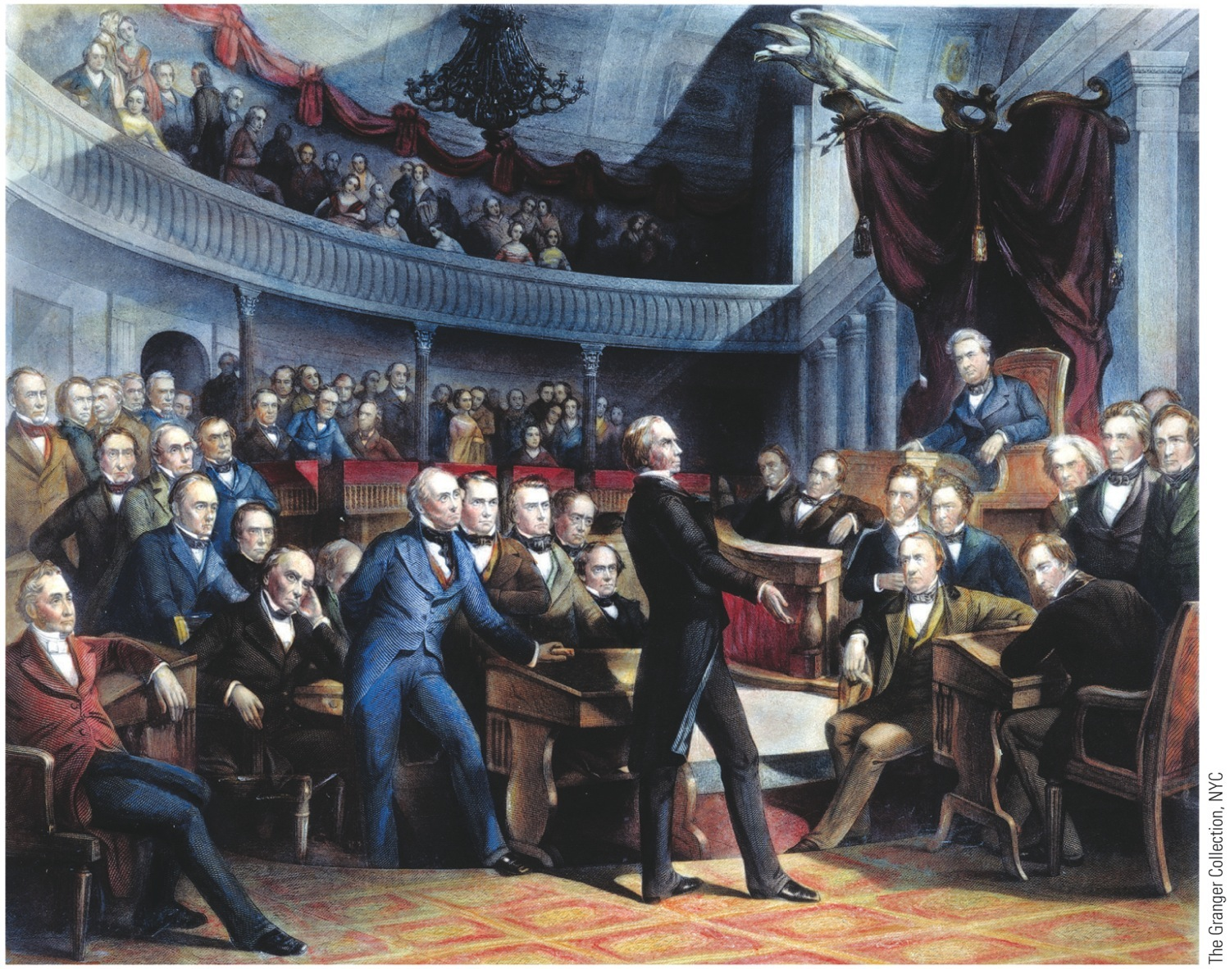
p388
Notes:
Henry Clay Proposing
the Compromise of
1850 This engraving
captures one of the
most dramatic moments
in the history of the
United States Senate.
Vice President Millard
Fillmore presides, while
on the floor sit several of
the “Senatorial Giants”
of the era, including
Daniel Webster, Stephen
A. Douglas, and John C.
Calhoun.

Slide 16
Compromise of 1850 (NORTH)
North gets better end of the deal
California admitted as free state
Texas loses disputed to territory to New Mexico and Oklahoma
No slave trade in DC
Slavery still legal

Slide 18
Compromise of 1850 (SOUTH)
Popular sovereignty in Mexican Cession
Opens land closed by Missouri Compromise
Opens new land to slavery on paper
Texas gets $10 million for land given to New Mexico
Fugitive Slave Law of 1850
Fleeing slaves could not testify on own behalf
Federal Commissioner who handles case gets $5 if slave freed, and $10 if not
People ordered to help capture slaves had to
Northerners pledge not to follow law
Angers both sides

Slide 19
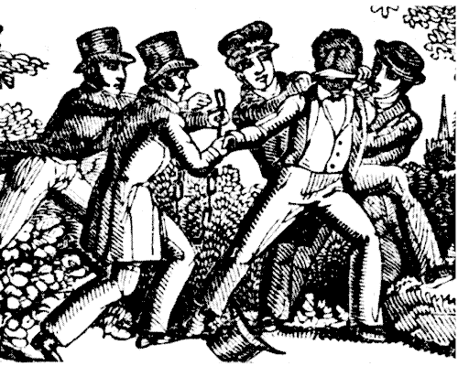
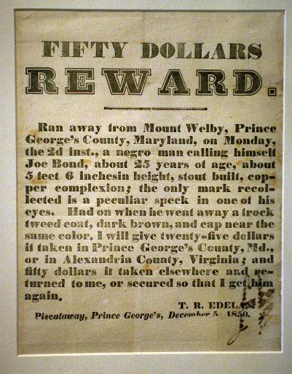
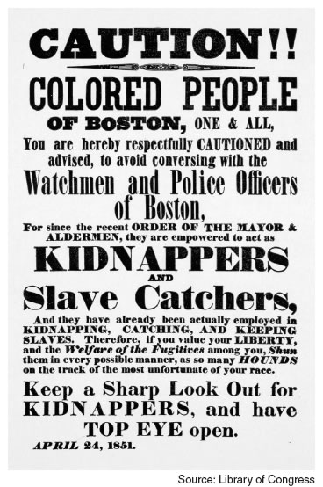
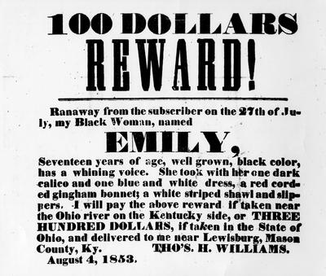
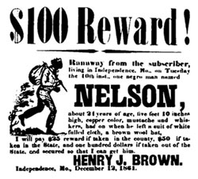
Fugitive Slave Act

Slide 20
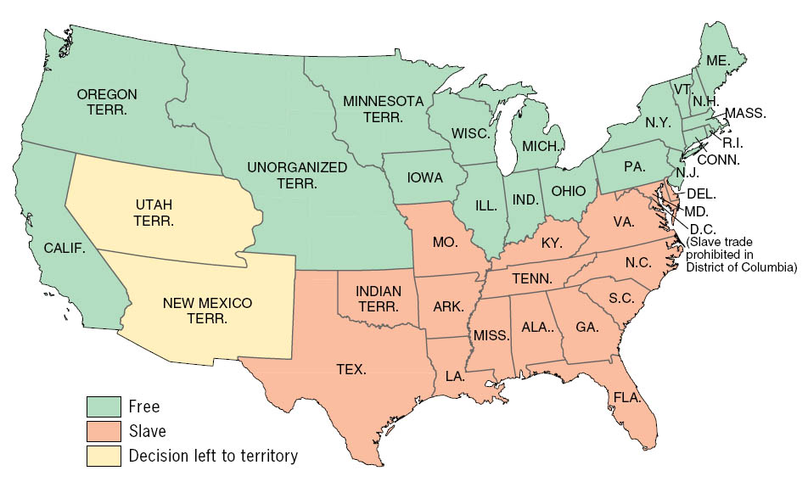
Slavery After the Compromise of 1850
Regarding the Fugitive Slave Act provisions of the Compromise of 1850, Ralph Waldo Emerson declared (May 1851) at Concord, Massachusetts, “The act of Congress . . . is a law which every one of you will break on the earliest occasion--a law which no man can obey, or abet the obeying, without loss of self-respect and forfeiture of the name of gentleman.” Privately he wrote in his Journal, “This filthy enactment was made in the nineteenth century, by people who could read and write. I will not obey it, by God.”
Copyright (c) Houghton Mifflin Company. All Rights Reserved.

Slide 21
Defeat of the Whigs
1852 – Democrats can’t agree on candidate
Dark Horse Franklin Pierce nominated
Weak and indecisive figure
War injuries caused him to be known as “Fainting General”
Enemyless because he was inconspicuous
A prosouthern northerner, he was acceptable to slavery wing of Democratic Party

Slide 22
Defeat of the Whigs
Whigs nominate “Old Fuss and Feathers”
Winfield Scott, War of 1812, Mexican-American War
Both parties claim Compromise of 1850
Whigs split between northern abolitionists and southerners
Pierce wins in landslide
Pierce won with 254 electoral vote to 42;
Popular count was closer: 1,601,117 to 1,385,453
National Political alignments end
Sectionalism takes over

Slide 23
The Stirrings of Empire
Pierce attempts to emulate Polk
Cabinet filled with southerners, including Jefferson Davis
July 1856 – William Walker takes control of Nicaragua
Legalizes slavery
Overthrown by coalition of Latin American states
Gives credence to “Slavocracy” theory

Slide 24
Cuba
Spain refuses to sell Cuba to U.S.
US attempts to to take Cuba twice
Spain captures U.S. steamer Black Warrior
U.S. diplomats meat in Ostend, Belgium
Ostend Manifesto
Secret manifesto
Urged US will offer $120 million to Spain
If Spain refused, US justified in seizing Cuba
Northerners outraged by “secret” document
South will not get Cuba
Major embarrassment for Pierce
More fuel for “Slavocracy” fire

Slide 25
Asia
President Tyler sends Caleb Cushing to China on goodwill mission
Chinese welcome U.S. trade to counter growing British influence
U.S. – China trade flourishes
Missionaries seek to save souls
Kindles resistance
President Fillmore supports Commodore Matthew Perry to open trade with Japan in 1854
Treaty of Kanagawa formally opens trade with Japan
Begins Japanese trend towards modernization and imperialism

Slide 26
Pacific Railroad
California and Oregon difficult to reach
Transcontinental railroad must be built
Southerners demand southern route
Best route through Mexico
Organized territory
Gadsden sent to Mexico
Purchases land for $10 million
Known as “GADSEN PURCHASE”
Completes the Southern Border of the U.S.
Northern route would be less effective
Mountains and Indians
North wants to organize Nebraska Territory

Slide 27
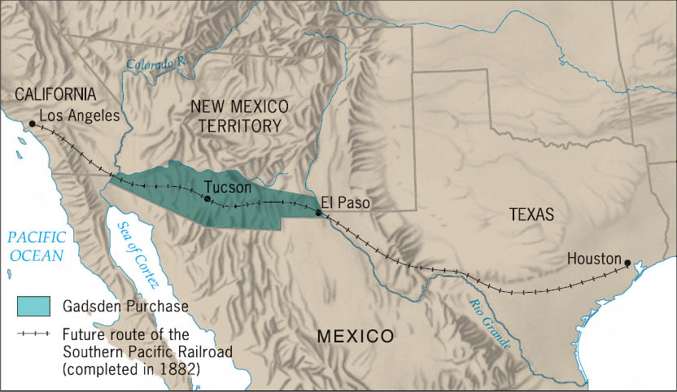
The Gadsden Purchase, 1853
The Gadsden Purchase, whereby the United States acquired more Mexican territory along the planned route of the Southern Pacific Railroad, was controversial for its use of federal tax money for an arguably private venture.
Copyright (c) Houghton Mifflin Company. All Rights Reserved.

Slide 28
Kansas-Nebraska
Kansas-Nebraska Act
Slavery in Kansas-Nebraska to be decided by popular sovereignty
Concession to South in return for giving up railroad
Would violate Missouri Compromise
Southerners back bill
Kansas might become slave state
Northerners rally against bill
Douglas uses influence to force bill through

Slide 29
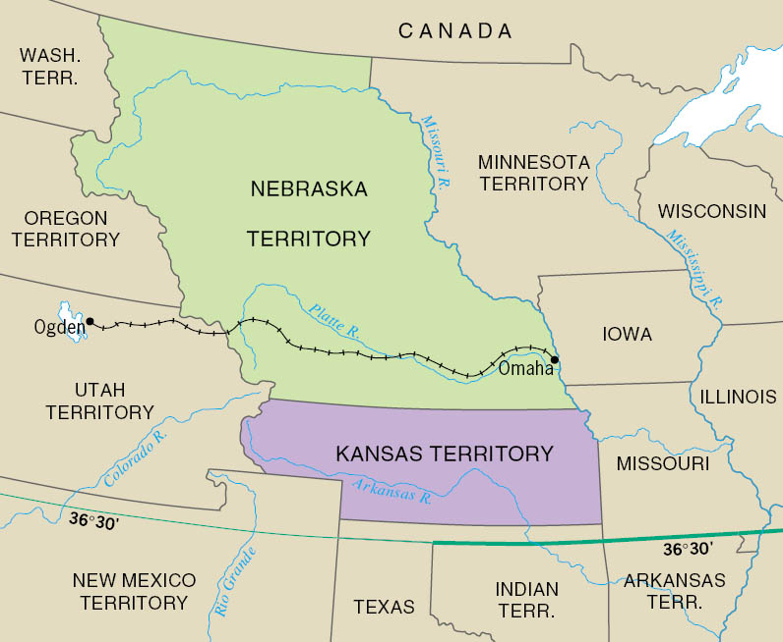
Kansas and Nebraska, 1854
The future Union Pacific Railroad (completed in 1869) is shown. Note the Missouri Compromise line of 36° 30' (1820).
Copyright (c) Houghton Mifflin Company. All Rights Reserved.

Slide 30
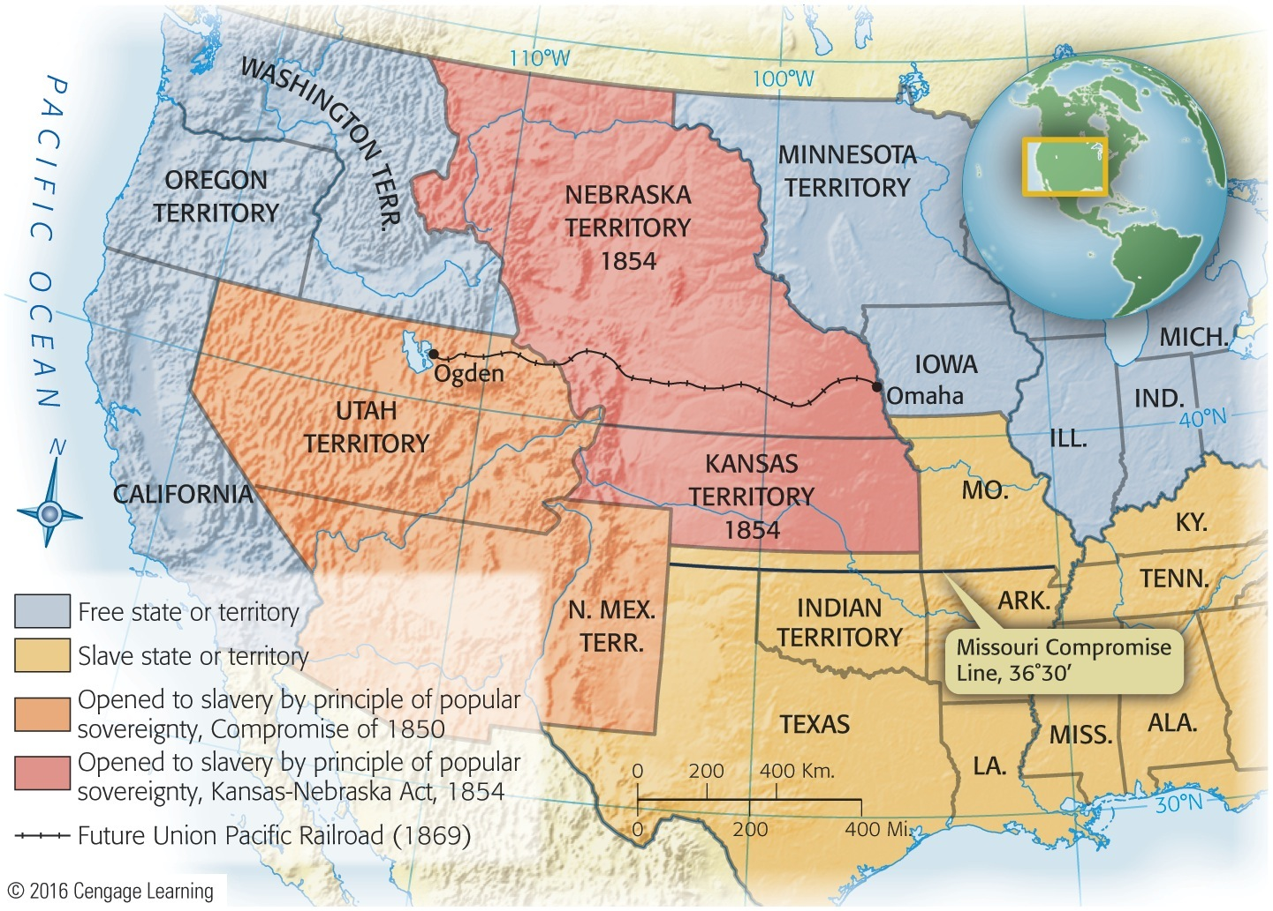
Map 18-7 p396
Notes:
Map 18.7 Kansas and Nebraska,
1854 The future Union Pacific
Railroad (completed in 1869) is shown.
Note the Missouri Compromise line
of 36° 30' (1820). © 2016 Cengage Learning

Slide 31
Consequences
Kansas-Nebraska repeals Missouri Compromise
Wrecks Compromise of 1850
Expansion of slavery becomes issue again
Northerners refuse to continue enforcing fugitive slave law
Democratic Party splits after 1856
No president for next 28 years
Nation moves towards Civil War

Slide 32
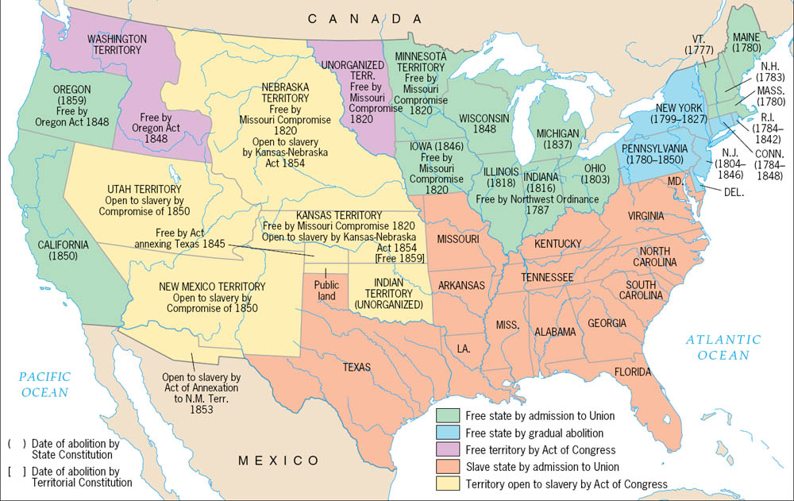
The Legal Status of Slavery, from the Revolution to the Civil War
Copyright (c) Houghton Mifflin Company. All Rights Reserved.

