Slide 1
Chapter 17
Manifest Destiny and its Legacy

Slide 2
Trends in Antebellum America: 1810-1860
New intellectual and religious movements.
Social reforms.
Beginnings of the Industrial Revolution in America.
Re-emergence of a second party system and more political democratization.
Increase in federal power → Marshall Ct. decisions.
Increase in American nationalism.
Further westward expansion.

Slide 3
“Manifest Destiny”
First coined by newspaper editor, John O’Sullivan in 1845.
".... the right of our manifest destiny to over spread and to possess the whole of the continent which Providence has given us for the development of the great experiment of liberty and federaltive development of self-government entrusted to us. It is right such as that of the tree to the space of air and the earth suitable for the full expansion of its principle and destiny of growth."
A myth of the West as a land of romance and adventure emerged.

Slide 4
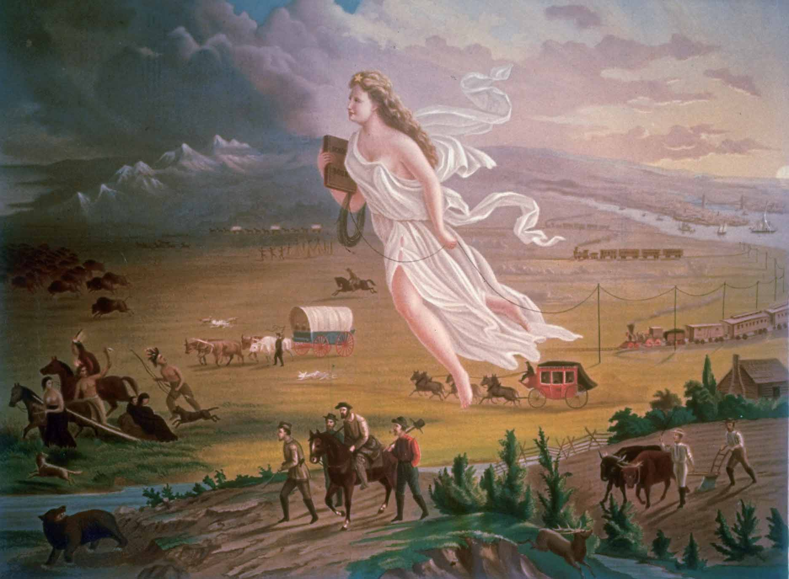
“American Progress” by John Gast, 1872

Slide 5
“Tyler too”
Henry Clay, Daniel Webster
Whig Leaders
Pro-bank, pro-tariff, pro-infrastructure
Planned to control WHH
Dies of pneumonia after 4 weeks
John Tyler becomes president
Wealthy Virginian
Does not agree with Whigs
More of a southern democrat

Slide 6
John Tyler continued
Whig platform
Financial reform – independent treasury
Tyler signs
New B.U.S.
Tyler vetoes
New tariff
Tyler vetoes
Modified tariff – 32% (1832 levels)
Tyler signs
Whigs refer to Tyler as “his accidency”
Cabinet resigns, except Webster

Slide 7
Tensions with Britain
Federalist party gone
Anti-British sentiment high
2 wars
British viewed Americans as uncivilized
War of words in magazines
US borrows money from English banks
Panic of 1837 causes English banks to fail
Americans supply arms to Canadian rebels
American steamer Caroline attacked by British
1841 – British offer slaves from Creole asylum in Bahamas

Slide 8
The issue of Maine
Aroostook War
Canadian and American lumberjacks skirmishing
Cause: The expulsion of Canadian lumberjacks in the disputed area of Aroostook by Maine officials.
1842 – Lord Ashburton sent to negotiate treaty
Webster-Ashburton Treaty
Fixes boundary of Maine and Canada
Gives U.S. Mesabi Range in Minnesota
Iron rich

Slide 9
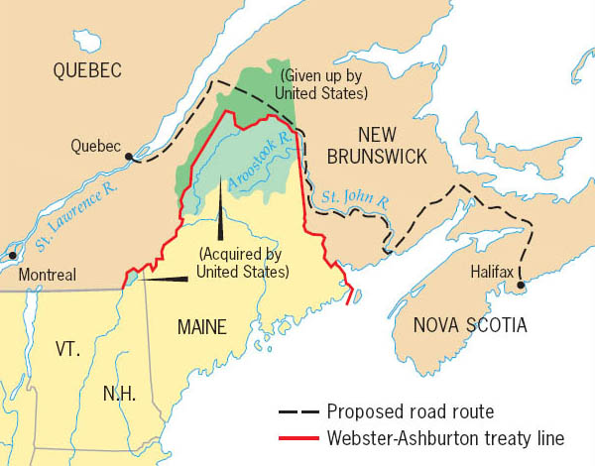
Maine Boundary Settlement, 1842
Understanding the ease with which American forces would be able to cross the frozen St. Lawrence River during the winter months, the British Empire in Canada sought to build a road between Halifax and Quebec to aid their defenses. As the territory chosen crossed ambiguously held American land, a small scale conflict between British and American lumberjacks nearly spiraled out of control into war before being reigned in by a joint diplomatic effort.
Copyright (c) Houghton Mifflin Company. All Rights Reserved.

Slide 10
The Question of Texas

Slide 11
Key Figures in Texas Independence, 1836
Sam Houston (1793-1863)
Steven Austin (1793-1836)

Slide 12
The Republic of Texas

Slide 13
Remember the Alamo!

Slide 14
Davey Crockett’s Last Stand

Slide 15
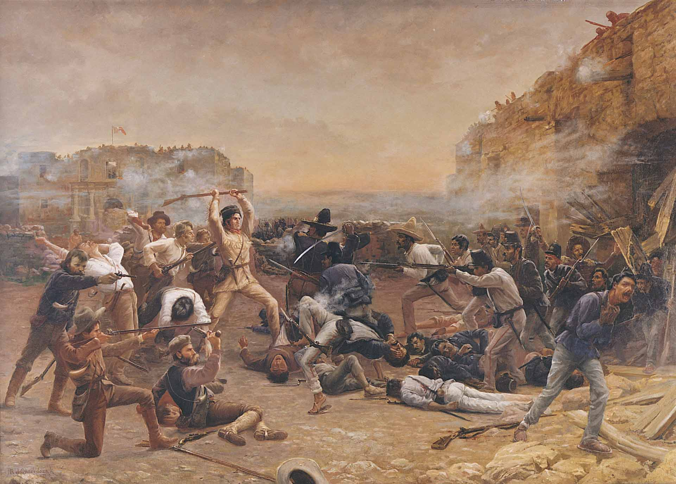
The Battle of the Alamo

Slide 16
The Question of Texas
Texas signs treaties after 1838
Hoped to secure a defensive shield of protection
France, Holland, Belgium
A concern for the U.S.
Fears of a British alliance
Would undermine Monroe Doctrine
Undercut Southern cotton
Stand-still
North wants no expansion of “slavocracy”
Annexation would likely cause war with Mexico
Britain supports independent Texas
Texas would boost cotton production, and territory

Slide 17
Overland Immigration to the West
Between 1840 and 1860, more than 250,000 people made the trek westward.

Slide 18
Oregon Territory
Stretches from Northern California to 54’ 40’
Claimed by England and U.S. in 1840s
British colonists and Hudson’s Bay Company control territory north of Columbia River
Americans populate area south of river, and it had been explored by Lewis and Clark
Thousands of settlers travel west over Oregon Trail in 1840s
Becomes a major political issue

Slide 19
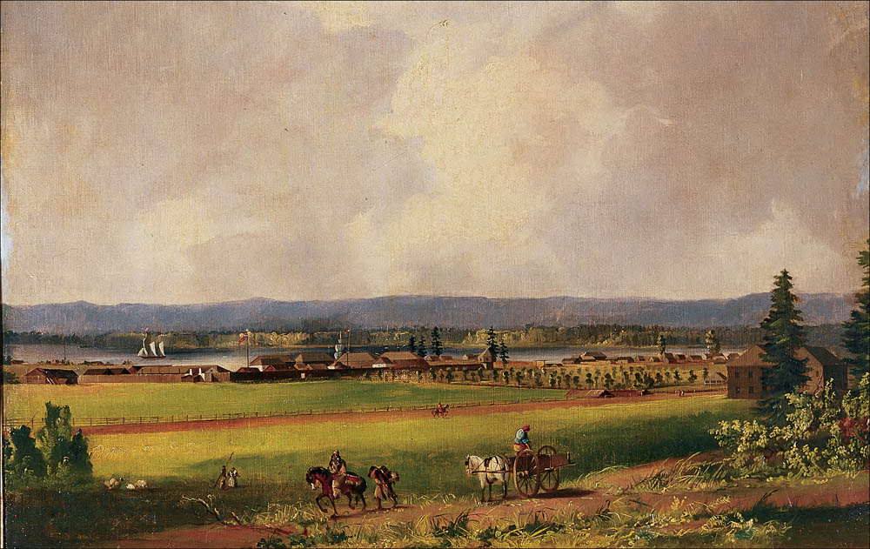
Fort Vancouver, Oregon Country, c. 1846
Fort Vancouver, on the Columbia River near its confluence with the Willamette River, was the economic hub of the Oregon Country during the early years of settlement. Founded as a Hudson’s Bay Company fur-trading outpost, the fort was handed over to the Americans when Britain ceded the Oregon Country to the United States in 1846.
Beinecke Rare Book and Manuscript Library, Yale Collection of Western Americana

Slide 20
The Oregon Trail – Albert Bierstadt, 1869

Slide 21
Trails Westward

Slide 22
The Election of 1844
Henry Clay
Popular Whig
Runs on standard Whig platform
Flip-flops on issue of Texas
James K. Polk
“dark horse” candidate
Speaker of the House
Governor of Tennessee
Known as “Young Hickory”
Advocates “Manifest Destiny”

Slide 23
Texas Annexation
James K. Polk wins election of 1844.
“Mandate for manifest destiny”
Texas invited to become 28th state
Mexico protests
America had stolen Texas

Slide 24
Polk’s Presidency
4 point plan
Lower tariff
Restore independent treasury
Finalize Oregon border
Annex California
Achieves plan in 4 years
Does not seek reelection

Slide 25
Problem solving
Tariffs lowered from 32% to 25%
New tariff leads to upswing in economy
Restores independent treasury in 1846
Oregon
England says 42 latitude
U.S. says 54’ 40’, then 49
More Americans than British already in territory
British propose treaty solidifying border at 49th parallel, excluding Vancouver
Proposal accepted by Senate

Slide 26
The trouble with Mexico
Polk wants California
U.S./Mexico relations bad
Mexico recalls foreign minister after Texas annexation
Defaults on $3 million payments to U.S.
Texas claims border is Rio Grande
Mexico says Nueces
U.S. sends John Slidell to Mexico City to buy California for $25 million
Mexican government refuses to talk

Slide 27
American blood on American soil?
Jan 13, 1846 – Zachary Taylor ordered to march 4000 men from Nueces to Rio Grande
Defend U.S. territory
April 25, 1846 – News reaches Washington
Mexican troops cross Rio Grande
16 Americans killed
Polk pushes for declaration of War
Spot Resolution – Abraham Lincoln demands to know where blood was shed
Not convinced area is U.S. Territory
Congress declares war

Slide 28
The War
Polk hopes to beat Mexico badly, gain California, and end war
Stephen W. Kearny and John C. Femont lead 1700 troops in Southwest
Bear Flag Revolt
Zachary Taylor “Old Rough and Ready”
Moves in to Mexico, defeats 20000 with 5000 at Buena Vista
Winfield Scott
Captures Mexico City

Slide 29
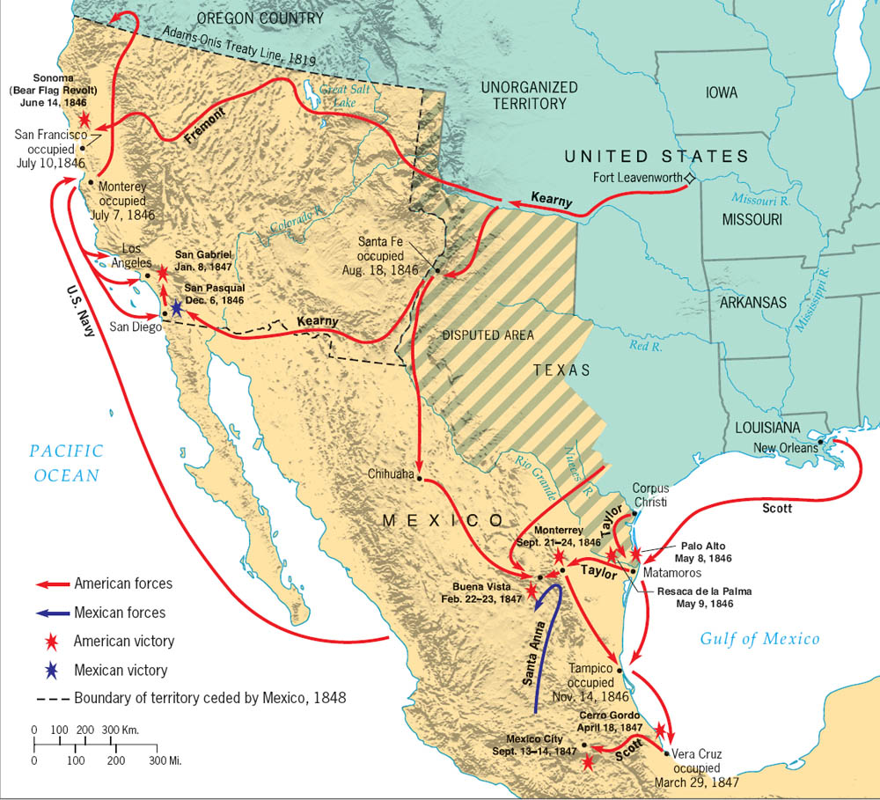
Major Campaigns of the Mexican War
The Mexican War's decisive campaign began with General Winfield Scott's capture of Vera Cruz and ended with his conquest of Mexico City.
Copyright (c) Houghton Mifflin Company. All Rights Reserved.

Slide 30
Peace Treaty
Nicholas Trist sent to negotiate an armistice for $10000
Santa Anna takes money, builds defenses
Trist recalled, but refuses
Treaty of Guadalupe Hidalgo – Feb. 2, 1848
America gains all Mexican Territory from Texas to California north of Rio Grande
Mexican Cession
U.S. pays $15 million
$3.5 in Mexican debt absolved
Problems back home
Whigs clamoring for end to war
Some want to annex Mexico
Treaty passes 38-14

Slide 31
Consequences
America loses 13000 soldiers
Disease
Robert E. Lee, Ulysses S. Grant, others gain combat experience
International respect increases
Inflames problems of sectionalism

Slide 32
The Wilmot Proviso
Slavery would never exist in Mexican Cession
Passes House twice, defeated in Senate
Changes debate about War from territorial expansion to slavery
Congress will never answer question “Will we have slavery in Mexican Cession?”
Civil War will begin in 1860

Slide 33
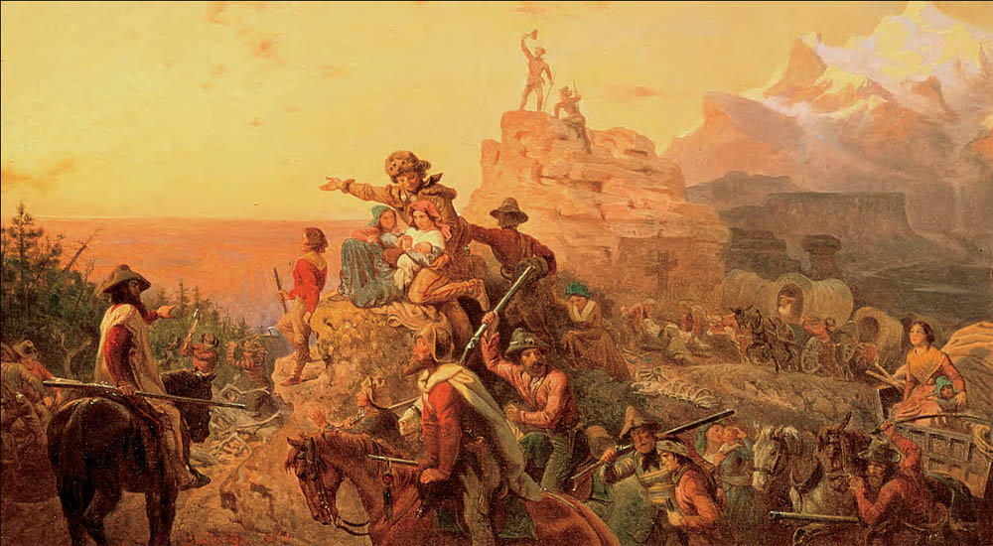
Westward the Course of Empire Takes Its Way
This romantic tribute to the spirit of Manifest Destiny was commissioned by Congress in 1860 and may still be seen in the Capitol.
Smithsonian American Art Museum, Washington DC/ Art Resource, NY

