Slide 1
Antebellum Revivalism & Reform
Chapter 15 - The American Pageant
The Ferment of Reform and Culture
^{1790–1860}

Slide 2
The Rise of Popular Religion
In France, I had almost always seen the spirit of religion and the spirit of freedom pursuing courses diametrically opposed to each other; but in America, I found that they were intimately united, and that they reigned in common over the same country… Religion was the foremost of the political institutions of the United States.
-- Alexis de Tocqueville, 1832

Slide 3
Reviving Religion
Religion, 1790-1860:
Church attendance still regular ritual for ¾ of 23 million Americans in 1850
Alexis de Tocqueville declared there was “no country in the world where the Christian religion retains a greater influence over the souls of men than in America.”
Yet religion of this era was not old-time religion of colonial days.
How was it different? What had changed?

Slide 4
Reviving Religion
Rationalist ideas of French Revolutionary era softened older orthodoxy:
Thomas Paine's The Age of Reason (1794) declared churches were “set up to terrify and enslave mankind, and monopolize power and profit.”
Many Founding Fathers, including Jefferson and Franklin, embraced Paine's liberal Deism

Slide 5
Reviving Religion
Deism:
Relied on reason rather than revelation
On science rather than Bible
Rejected concept of original sin
Denied Christ's divinity
Yet Deists believed:
In Supreme Being who created knowable universe
Who endowed human beings with capacity for moral behavior

Slide 6
Reviving Religion
Deism reflected continuing religious debate over free will and human salvation:
Overtime, many Protestants downplayed Calvinist emphasis on predestination and human depravity
Instead stressed essential goodness of human nature
Proclaimed belief in free will and possibility of salvation through good works
Pictured God not as stern Creator but as loving Father

Slide 7
Reviving Religion
Such ideas flourished among Methodists, Baptists, & Unitarians
Affected Presbyterians & Congregationalists too
Religious ferment propelled wave of revivals in early 1800s in Second Great Awakening

Slide 8
1. The Second Great
Awakening
“Spiritual Reform From Within” [Religious Revivalism]
Social Reforms & Redefining the Ideal of Equality
Temperance
Abolitionism
Education
Asylum & Penal Reform
Women’s Rights

Slide 9
“The Pursuit of Perfection”
In Antebellum America

Slide 10
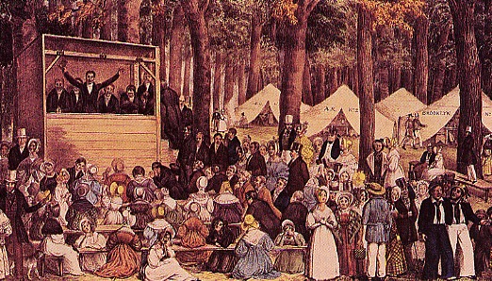
Second Great Awakening Revival Meeting

Slide 11
Reviving Religion
Second Great Awakening spread on frontier by huge “camp meetings”:
Up to 25,000 people would gather for several days to listen to an itinerant preacher
Thousands of spiritually starved souls “got religion”
Many of “saved” soon backslid into former sinful ways
Revivals boosted church attendance

Slide 12
Reviving Religion
Stimulated a variety of humanitarian reforms
Missionary work in Africa, Asia, Hawaii, and in West with Indians
Methodist & Baptists reaped most abundant harvest of souls:
Both stressed personal conversion, relatively democratic control of church affairs, and rousing emotionalism
Peter Cartwright (1785-1872) best known of Methodist “circuit riders” or traveling frontier preachers

Slide 13
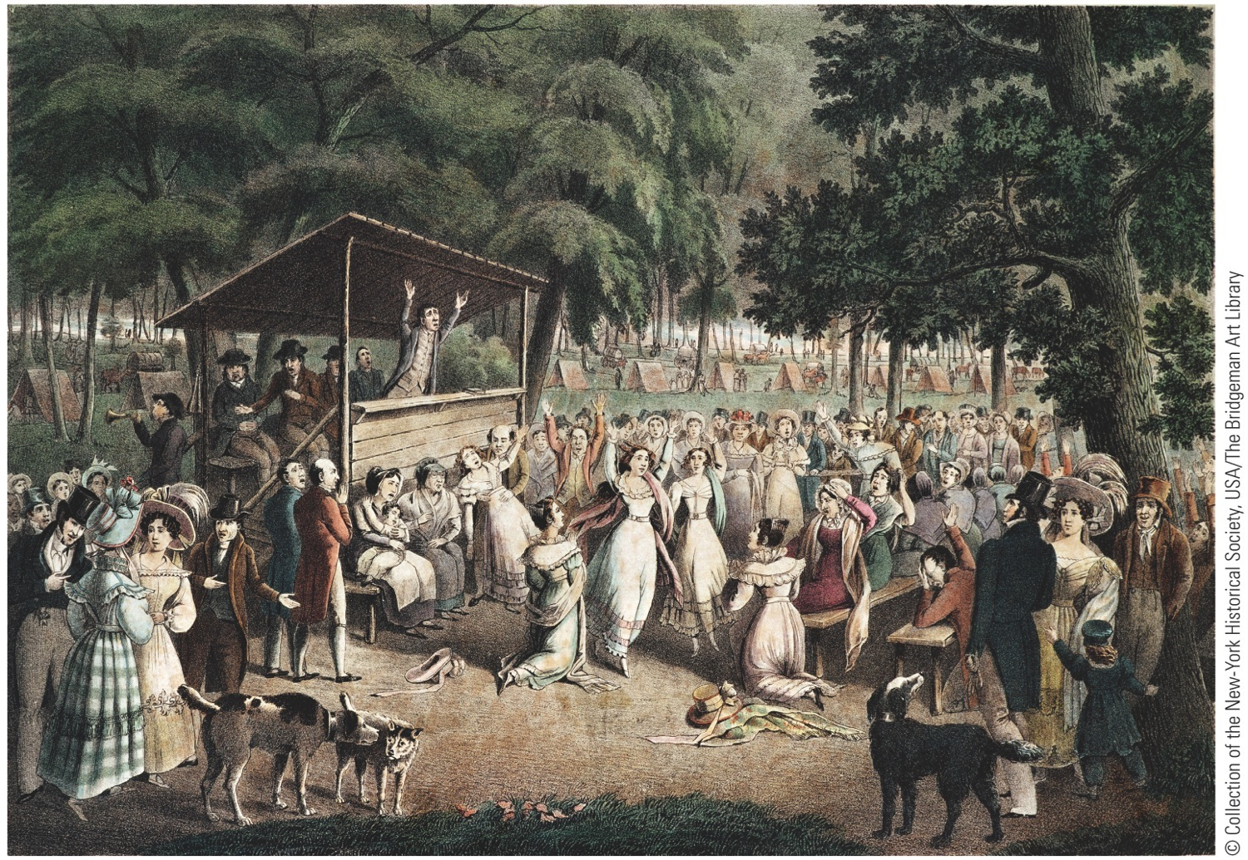
Notes:
Religious Camp Meeting, by
J. Maze Burbank, 1839 At
huge, daylong encampments,
repentant sinners dedicated
themselves to lives of personal
rectitude and social reform.
Fire-and-brimstone preachers
like the one depicted here
inspired convulsions, speaking
in tongues, and ecstatic singing
and dancing among the
converted. Out of this religious
upheaval grew many of the
movements for social
improvement in the pre–Civil
War decades, including the
abolitionist crusade.

Slide 14
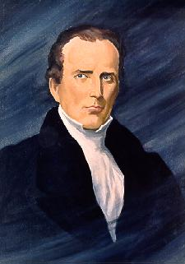
Charles G. Finney (1792 – 1895)
The ranges of tents, the fires, reflecting light…; the candles and lamps illuminating the encampment; hundreds moving to and fro…;the preaching, praying, singing, and shouting,… like the sound of many waters, was enough to swallow up all the powers of contemplation.
“soul-shaking” conversion

Slide 15
Charles Grandison Finney
greatest of revival preachers:
Had deeply moving conversion experience
Led massive revivals in Rochester and New York City in 1830 and 1831
Preached a version of old-time religion, but was also an innovator:
Devised “anxious bench” where repentant sinners could sit in full view of congregation
Encouraged women to pray aloud in public

Slide 16
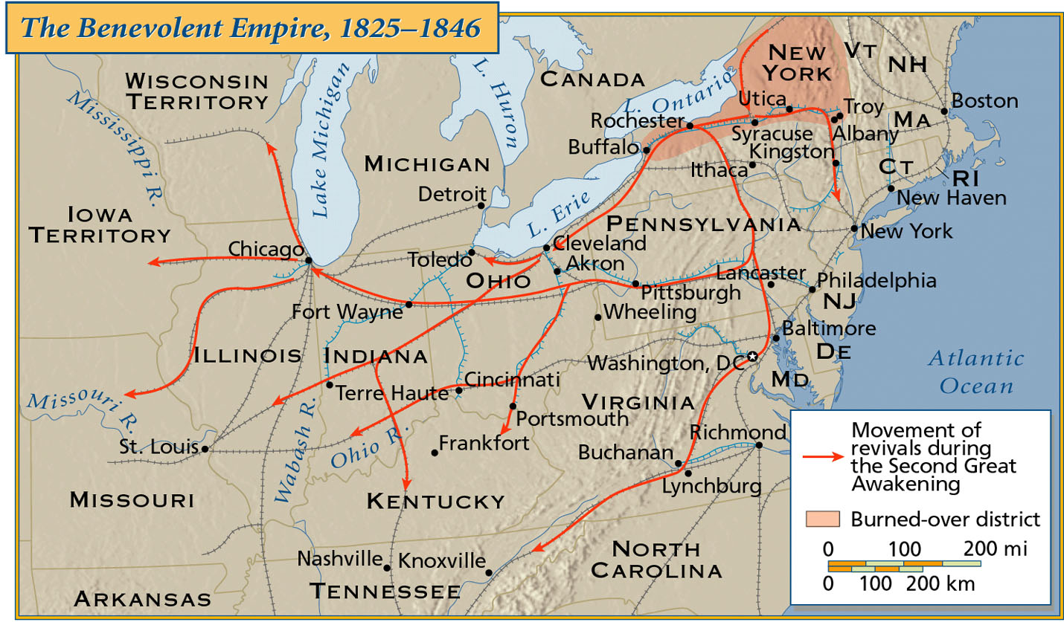
“The Benevolent Empire”: 1825 - 1846

Slide 17
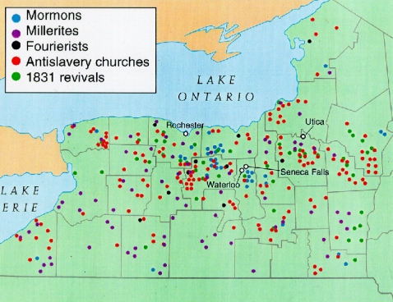
The “Burned-Over” District in Upstate New York

Slide 18
Burned Over District
Western New York so blistered by sermonizers preaching “hellfire and damnation,” it came to be known as Burned-Over-District

Slide 19
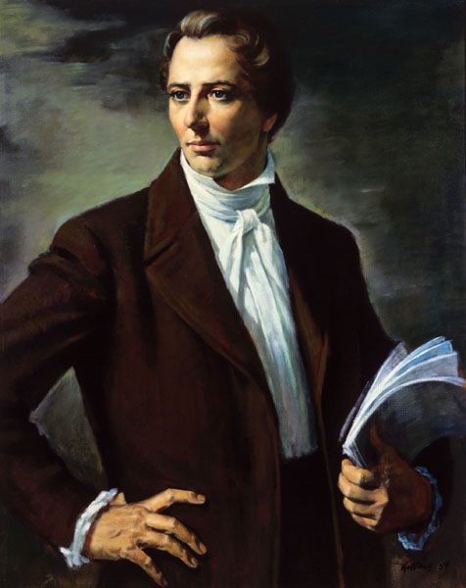
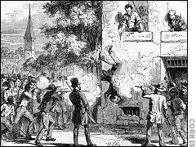
The Mormons (The Church of Jesus Christ of Latter-Day Saints)
1823 → Golden Tablets
1830 → Book of Mormon
1844 → Murdered in Carthage, IL
Joseph Smith (1805-1844)

Slide 20
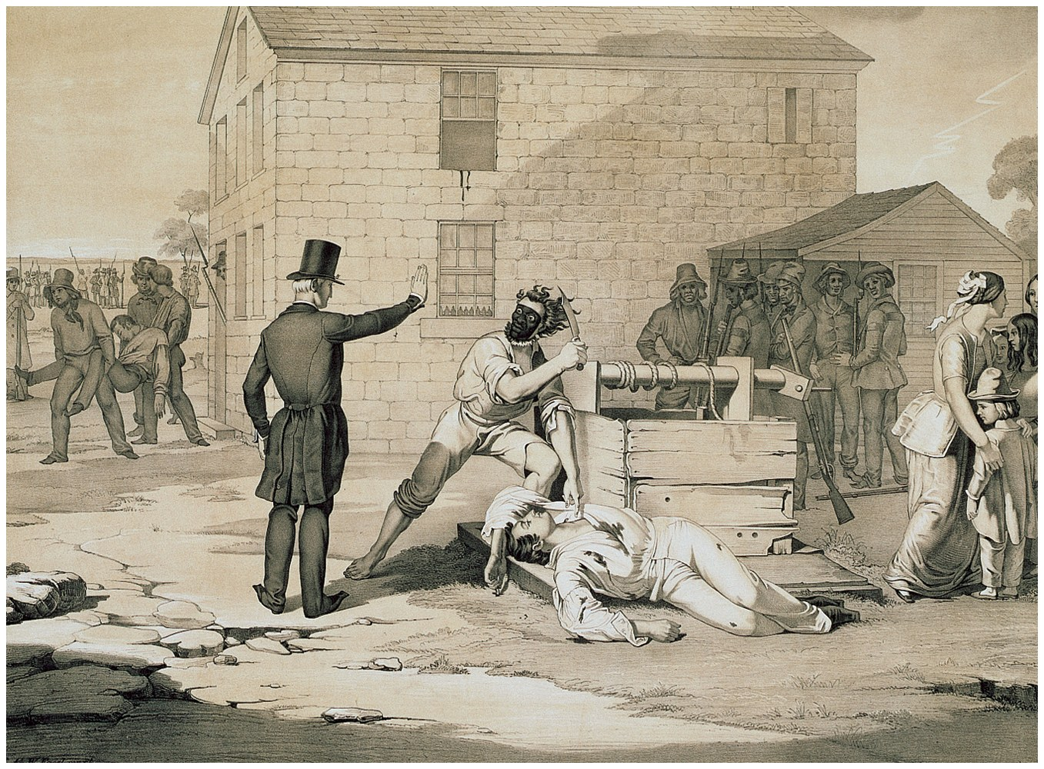
Violence Against Mormons

Slide 21
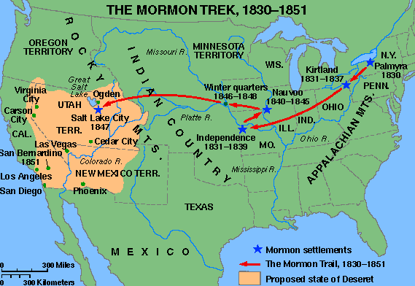
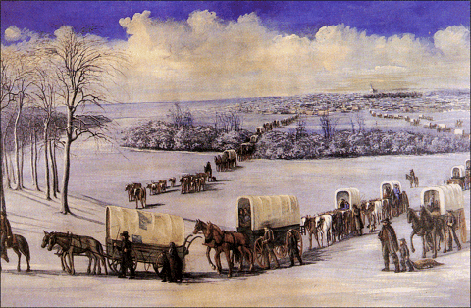
The Mormon “Trek”

Slide 22
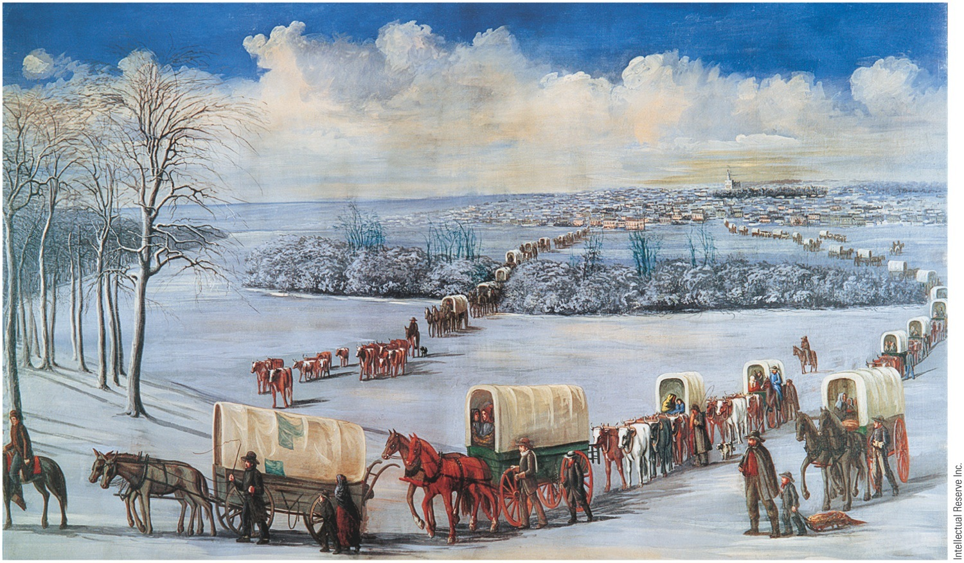
Mormon Trekkers Crossing the Mississippi on the Ice Driven out of Illinois after the murder
of founder Joseph Smith in 1844, the Mormons wintered near Council Bluffs, Iowa Territory, before
beginning the long overland trek to Utah.
Notes:
Mormon Trekkers Crossing the Mississippi on the Ice Driven out of Illinois after the murder
of founder Joseph Smith in 1844, the Mormons wintered near Council Bluffs, Iowa Territory, before
beginning the long overland trek to Utah.

Slide 23
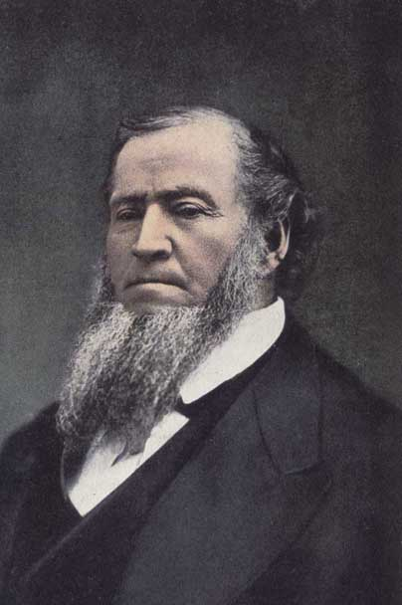
The Mormons (The Church of Jesus Christ of Latter-Day Saints)
Deseret community.
Salt Lake City, Utah
After the murder of Joseph Smith, Brigham Young took over leadership.
Brigham Young (1801-1877)

Slide 24
The Mormons
In 1850s many dedicated Mormons made 1,300 mile trek across plains pulling two-wheeled carts
Under Young's disciplined management, community became prosperous frontier theocracy and cooperative commonwealth
Young married as many as 27 women and begot 56 children
Population grew with thousands of immigrants from Europe, where Mormons had flourishing missionary movement

Slide 25
The Mormons
Crisis developed when U.S. Government unable to control Young, who had been made territorial governor in 1850:
Federal troops marched in 1857 against Mormons
Fortunately quarrel settled without serious bloodshed
Mormons had problems with anti-polygamy laws passed by Congress in 1862 and 1882:
Marital customs delayed statehood for Utah until 1896

Slide 26
Mother Ann Lee (1736-1784)
The Shakers
If you will take up your crosses against the works of generations, and follow Christ in the regeneration, God will cleanse you from all unrighteousness.
Remember the cries of those who are in need and trouble, that when you are in trouble, God may hear your cries.
If you improve in one talent, God will give you more.

Slide 27
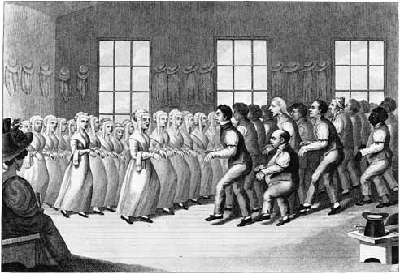
Shaker Meeting

Slide 28
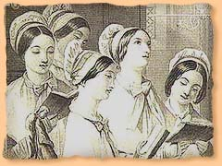
Shaker Hymn
'Tis the gift to be simple, 'Tis the gift to be free, 'Tis the gift to come down where you ought to be, And when we find ourselves in the place just right, 'Twill be in the valley of love and delight. When true simplicity is gained To bow and to bend we shan't be ashamed, To turn, turn will be our delight, 'Till by turning, turning we come round right.

Slide 29
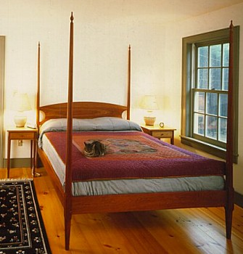
Shaker Simplicity & Utility

Slide 30
2. Transcendentalism
(European Romanticism)
an American literary, political, and philosophical movement of the early nineteenth century
They were critics of their contemporary society for its unthinking conformity, and urged that each person find, in Emerson's words, “an original relation to the universe.”

Slide 31
Transcendentalism
Transcendentalism:
Resulted from liberalizing of straight-laced Puritan theology
Rejected prevailing empiricist theory of John Locke that all knowledge comes through senses
Truth, rather, “transcends” senses: it cannot be found by observation alone
Every person possesses an inner light that can illuminate highest truth, and indirectly touch God

Slide 32
Transcendentalist Thinking
Man must acknowledge a body of moral truths that were intuitive and must TRANSCEND more sensational proof:
The infinite benevolence of God.
The infinite benevolence of nature.
The divinity of man.
They instinctively rejected all secular authority and the authority of organized churches and the Scriptures, of law, or of conventions

Slide 33
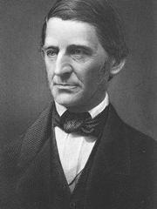
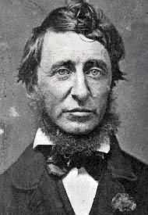
Transcendentalist Intellectuals/Writers Concord, MA
Ralph Waldo
Emerson
Henry David
Thoreau
Nature (1832)
Resistance to Civil Disobedience (1849)
Self-Reliance (1841)
Walden (1854)
“The American Scholar” (1837)

Slide 34
Transcendentalism
Best known transcendentalist was Ralph Waldo Emerson (1803-1882):
Most thrilling effort was “The American Scholar”:
Delivered at Harvard College in 1837
Intellectual declaration of independence
Urged American writers to throw off European traditions and delve into cultural riches surrounding them
Stressed self-reliance, self-improvement, self-confidence, optimism, and freedom

Slide 35
Transcendentalism
Henry David Thoreau (1817-1862):
Condemning a government that supported slavery, he refused to pay his Mass. poll tax
Walden: Or Life in the Woods (1854):
His two year life on edge of Walden Pond
Epitomized romantic quest for isolation from society's corruptions
His essay “On the Duty of Civil Disobedience” (1849):
Influenced Mahatma Gandhi to resist British rule in India
Influenced Martin Luther King, Jr.'s ideas about nonviolence

Slide 36
The Transcendentalist Agenda
Give freedom to the slave.
Give well-being to the poor and the miserable.
Give learning to the ignorant.
Give health to the sick.
Give peace and justice to society.

Slide 37
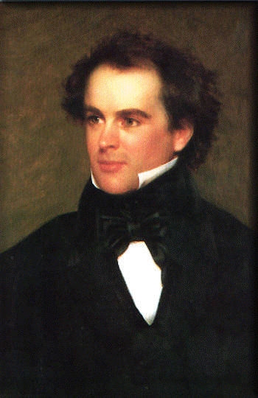
A Transcendentalist Critic: Nathaniel Hawthorne (1804-1864)
Their pursuit of the ideal led to a distorted view of human nature and possibilities: * The Blithedale Romance
One should accept the world as an imperfect place: * Scarlet Letter * House of the Seven Gables

Slide 38
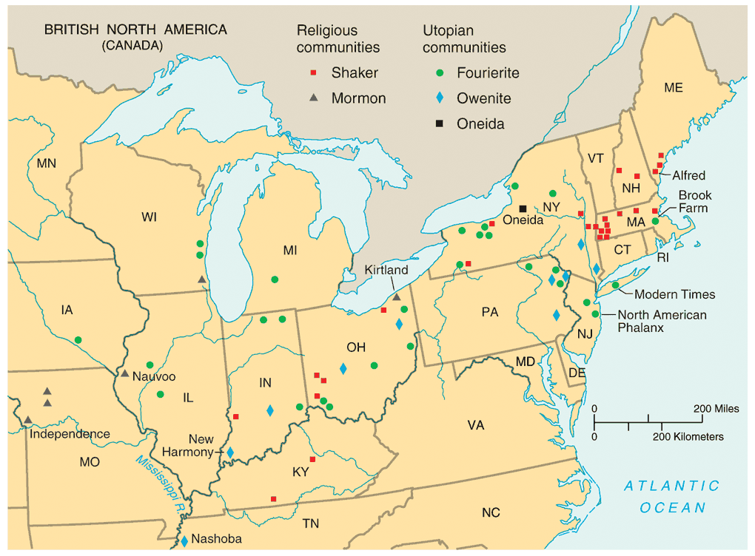
3. Utopian Communities

Slide 39
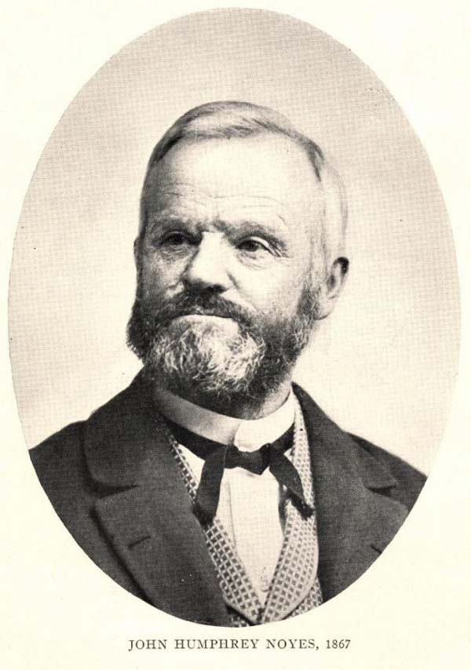
The Oneida Community New York, 1848
Millenarianism --> the 2nd coming of Christ had already occurred.
Humans were no longer obliged to follow the moral rules of the past.
all residents married to each other.
John Humphrey Noyes (1811-1886)
carefully regulated “free love.”

Slide 40
Secular Utopian Communities
Individual Freedom
Demands of Community Life
spontaneity
self-fulfillment
discipline
organizational hierarchy

Slide 41
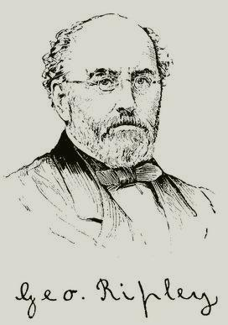
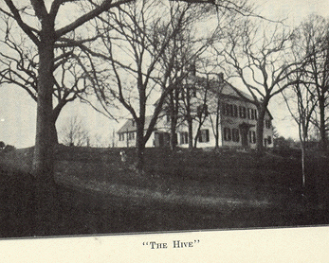
George Ripley (1802-1880)
Brook Farm West Roxbury, MA
Brook Farm, Mass. started in 1841 with about 20 intellectuals committed to transcendentalism:
Destroyed by fire, adventure in “plain living and high thinking” collapsed in debt

Slide 42
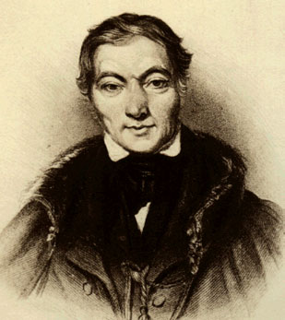
Robert Owen (1771-1858)
Robert Owen founded communal society of 1,000 people in 1825 at New Harmony, Indiana
“Village of Cooperation”

Slide 43
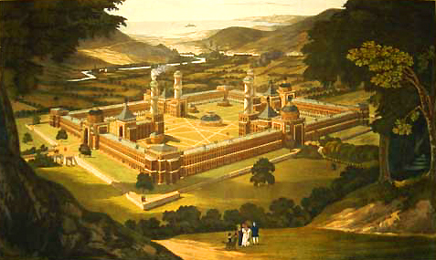
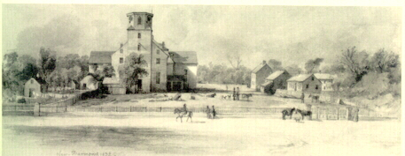
Original Plans for New Harmony, IN
New Harmony in 1832

Slide 44
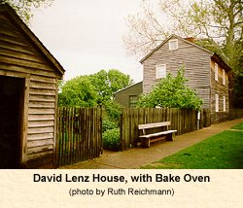
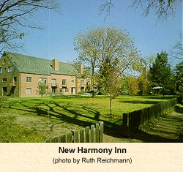
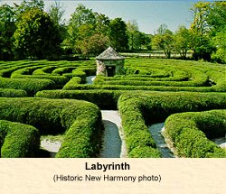
New Harmony, IN

Slide 45
An Age of Reform
Reformers:
Most were intelligent, inspired idealists, touched by evangelical religion:
Dreamed of freeing world from earthly evils
Women prominent in reform, especially for suffrage:
Reform provided opportunity to escape home and enter public arena

Slide 46
An Age of Reform
Imprisonment for debt continued to be a nightmare:
Criminal codes in states were softened:
Number of capital offenses reduced
Brutal punishments slowly eliminated
Idea that prisons should reform as well as punish—hence “reformatories,” “houses of correction,” and “penitentiaries” (for penance)
Insane still treated with cruelty
Many chained in jails or poor house

Slide 47
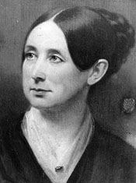
4. Penitentiary Reform
Dorothea Dix
(1802-1887)
1821 → first penitentiary founded in Auburn, NY
Possessed infinite compassion and will-power
Travelled 60,000 miles in 8 years to document firsthand observation of insanity and asylums

Slide 48
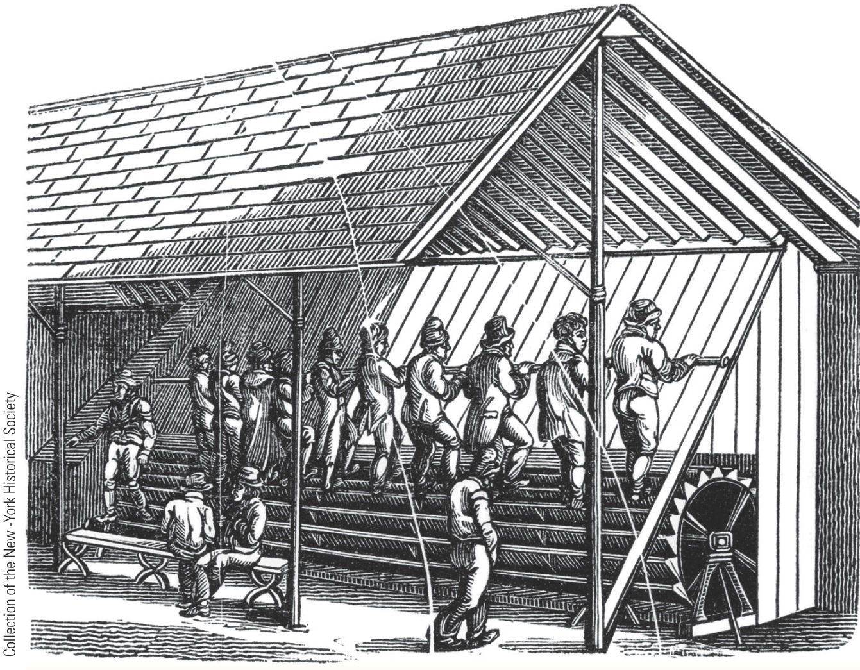
The Stepping Mill, Auburn Prison, New York, 1823
Dorothea Dix believed that idleness was a scourge and prescribed rigorous exercise regimens for prisoners. At the experimental prison in Auburn, chained prisoners were obliged to turn this wheel for long periods of time.
Notes:
(left) The Stepping Mill, Auburn Prison, New York, 1823; (right) Portrait of Dorothea Dix by
Samuel Bell Waugh, 1868 Reformers like Dorothea Dix believed that idleness was a scourge and
prescribed rigorous exercise regimens for prisoners. At the experimental prison in Auburn, chained
prisoners were obliged to turn this wheel for long periods of time.

Slide 49
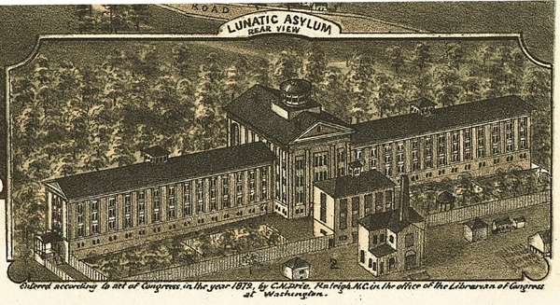
Dorothea Dix Asylum - 1849

Slide 50
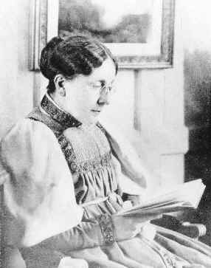
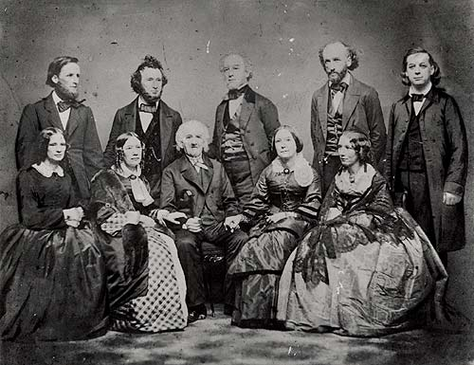
5. Temperance Movement
1826 - American Temperance Society “Demon Rum”!
Frances Willard
The Beecher Family

Slide 51
Annual Consumption of Alcohol

Slide 52
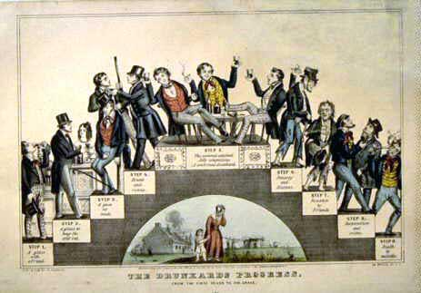
“The Drunkard’s Progress”
From the first glass to the grave, 1846

Slide 53
Temperance Movement
Maine Law of 1851:
Banned manufacture & sale of intoxicating liquor
Others states followed Maine's example
By 1857, a dozen states passed prohibition laws
Clearly impossible to legislate thirst for alcohol out of existence
On eve of Civil War, prohibitionists had registered inspiriting gains
Less drinking among women

Slide 54
Temperance Movement
People should drink less alcohol, or alcohol should be outlawed altogether.
Movement increased the size of Protestant religious organizations and their influence in western and rural sections of the country.
Women played an important role, which laid the foundation for the women’s movement.

Slide 55
7. Educational Reform
Religious Training → Secular Education
MA → always on the forefront of public educational reform * 1st state to establish tax support for local public schools.
By 1860 every state offered free public education to whites. * US had one of the highest literacy rates.

Slide 56
Educational Reform
By 1860 nation counted only 100 public secondary schools—and nearly a million white adult illiterates.
Black slaves in South were legally forbidden to receive instruction in reading and writing.
Free blacks in both North and South were usually excluded from schools.

Slide 57
Educational Reform
All children should be required to attend free schools supported by taxpayers and staffed by trained teachers.
Movement established education as a right for all children and as a state and local issue it improved the quality of schools by requiring trained teachers.
More schools open, creating more jobs for women.

Slide 58
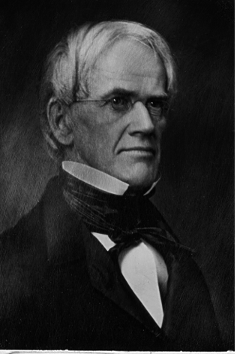
Horace Mann (1796-1859)
“Father of
American Education”
children were clay in the hands of teachers and school officials
children should be “molded” into a state of perfection
discouraged corporal punishment
established state teacher- training programs

Slide 59
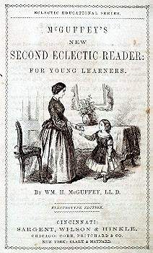
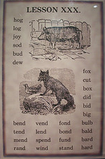
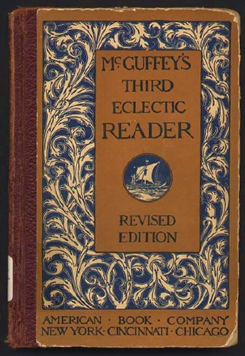
The McGuffey Eclectic Readers
Used religious parables to teach “American values.”
Teach middle class morality and respect for order.
Teach “3 Rs” + “Protestant ethic” (frugality, hard work, sobriety)

Slide 60
Educational Reform
Higher education for women:
Frowned upon in early decades of 1800s
Women's education was to be in the home
Prejudices prevailed that too much learning injured brain, undermined health, and rendered a young lady unfit for marriage

Slide 61
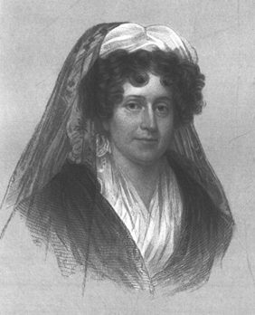
Women Educators
Troy, NY Female Seminary
curriculum: math, physics, history, geography.
train female teachers
Emma Willard (1787-1870)
1837 → she established Mt. Holyoke [So. Hadley, MA] as the first college for women.
Mary Lyons (1797-1849)

Slide 62
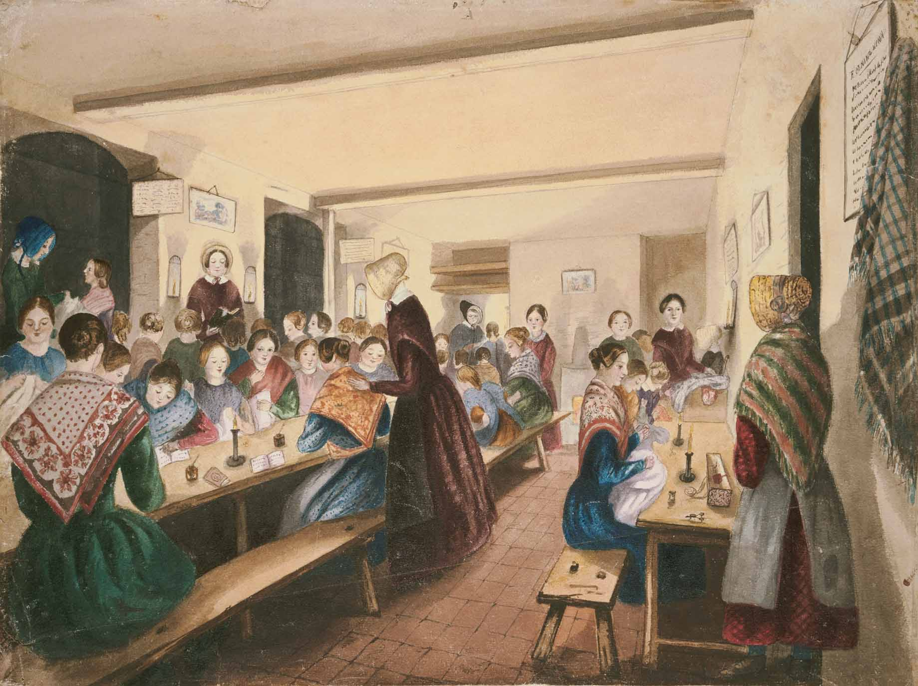
A Female Seminary

Slide 63
7. “Separate Spheres” Concept
“Cult of Domesticity”
A woman’s “sphere” was in the home (it was a refuge from the cruel world outside).
Her role was to “civilize” her husband and family.
An 1830s MA minister:
The power of woman is her dependence. A woman who gives up that dependence on man to become a reformer yields the power God has given her for her protection, and her character becomes unnatural!

Slide 64
Early 19c Women
Unable to vote.
Legal status of a minor.
Single → could own her own property.
Married → no control over her property or her children.
Could not initiate divorce.
Couldn’t make wills, sign a contract, or bring suit in court without her husband’s permission.

Slide 65
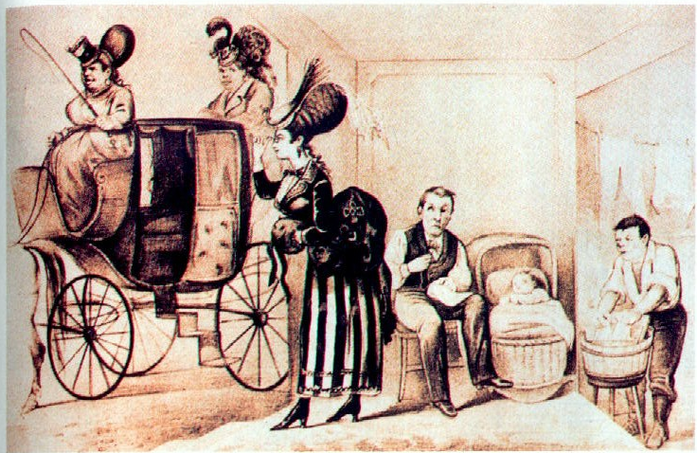
What It Would Be Like If Ladies Had Their Own Way!

Slide 66
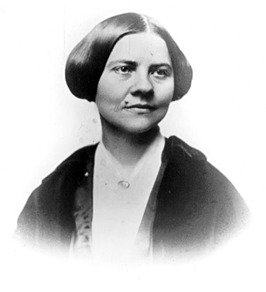
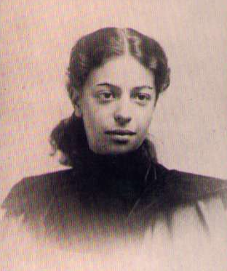
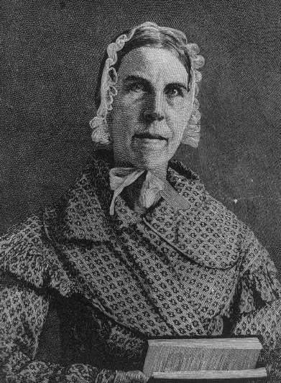
Cult of Domesticity = Slavery
The 2nd Great Awakening inspired women to improve society.
Lucy Stone
Angelina Grimké
Sarah Grimké
American Women’s Suffrage Assoc.
edited Woman’s Journal
Southern Abolitionists

Slide 67
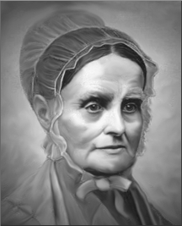
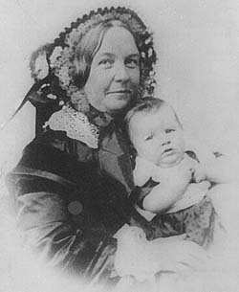
8. Women’s Rights
1840 → split in the abolitionist movement over women’s role in it.
London → World Anti-Slavery Convention
Lucretia Mott
Elizabeth Cady Stanton
1848 → Seneca Falls Declaration of Sentiments

Slide 68
Women’s Rights
Woman's Rights Convention at Seneca Falls, New York in 1848:
Stanton read a “Declaration of Sentiments”:
In spirit of Declaration of Independence— “all men and women are created equal”
One resolution formally demanded ballot for women
Seneca Falls meeting launched modern women's rights movement
Crusade for women's rights eclipsed by campaign against slavery

Slide 69
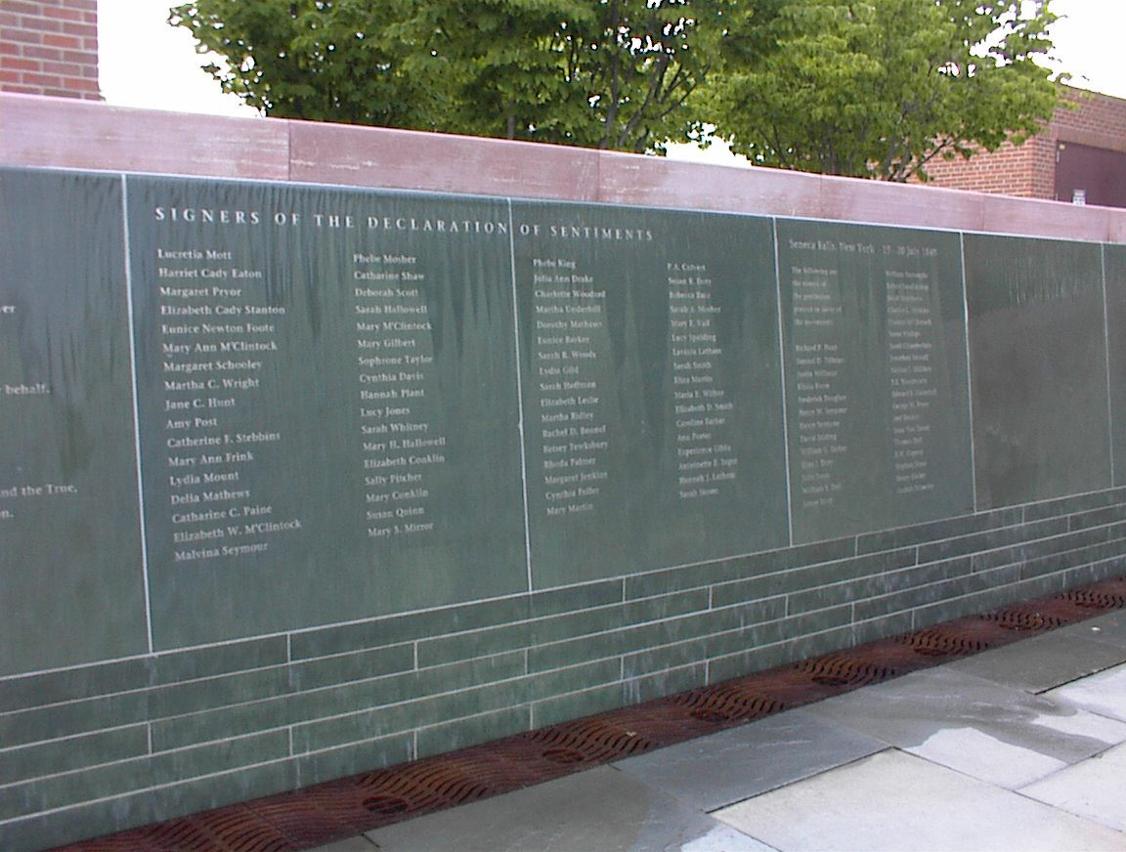
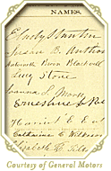
Seneca Falls Declaration

Slide 70
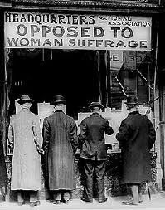
Not Everybody was in agreement…

Slide 71
Women in the Work Place…
The Lowell textile mills employed a workforce which was about ¾ female; (unique at the time)
actively participated in early labor reform
70-80 hours a week
Young Women
Dirty air

Slide 72
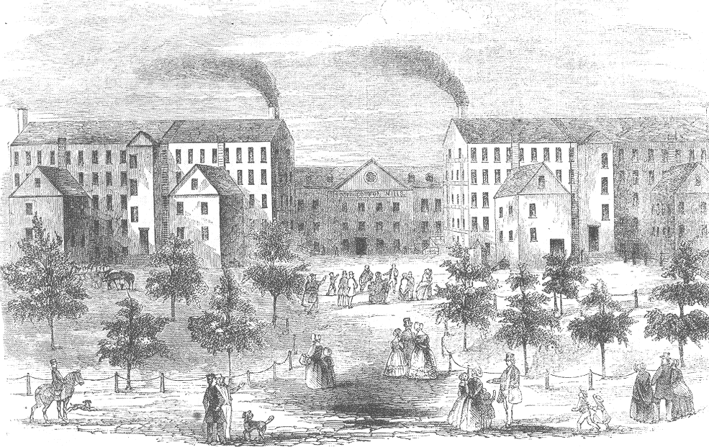

Slide 73
Labor Unions Arise
Women organize labor unions
They want better working conditions
Higher Pay
More Respect
Leads to Strikes

Slide 76
Abolition Movement

Slide 77
Bellwork:
Read the primary source. What point is the author trying to make?
“I am aware that many object to the severity of my language; but is there not cause for severity? I will be as harsh as truth and as uncompromising as justice. On this subject, I do not wish to think or speak, or write, with moderation. No! No! Tell a man whose house is on fire, to give a moderate alarm; tell him to moderately rescue his wife from the hands of the ravisher; tell the mother to gradually [remove] her babe from the fire into which it has fallen – but urge me not to use moderation in a cause like the present. I am in earnest – I will not equivocate – I will not excuse – I will not retreat a single inch – AND I WILL BE HEARD.”
- From the Liberator, January 1, 1831

Slide 78
9. Abolitionist Movement
Abolition wasn’t a new idea
Our founding fathers knew that a nation based on the principles of liberty and equality would have difficulty remaining true to its ideals if it continued to enslave human beings.
Argument that slavery was a sin.

Slide 79
Abolitionist Movement
1816 → American Colonization Society created (gradual, voluntary emancipation.
British Colonization Society symbol

Slide 80
Abolitionist Movement
American Colonization Society wanted to create a free slave state in Liberia, West Africa.
– what were the problems with this idea?
No real anti-slavery sentiment in the North in the 1820s & 1830s.
Gradualists
Immediatists

Slide 81
Abolitionist Movement
slavery should be abolished
enslaved African Americans should be freed immediately, without gradual measures & without compensation to former slave owners.

Slide 82
Abolitionist Movement
Slavery and its expansion became an important political issue.
Women played an important role.

Slide 83
William Lloyd Garrison (1801-1879)
Slavery undermined republican values.
Immediate emancipation with NO compensation.
Slavery was a moral, not an economic issue.
He printed an antislavery newspaper – The Liberator

Slide 84
The Liberator
Premiere issue → January 1, 1831

Slide 85
The Tree of Slavery—Loaded with the Sum of All Villanies!

Slide 87
Sarah and Angelina Grimke “Grimke Sisters”
Southern women
Grew up in South Carolina
Went to Philadelphia, PA
lectured publicly throughout the northern states about the evils of slavery they had seen growing up on a plantation.
Their public careers began when Garrison published a letter from Angelina in his newspaper.

Slide 88
Grimke Sisters
Sent Garrison a personal letter –
“The ground upon which you stand is holy ground,” she told him, “never-never surrender it . . . if you surrender it, the hope of the slave is extinguished.” Agitation for the end to slavery must continue, Angelina declared, even if abolitionists are persecuted and attacked because, as she put it, “This is a cause worth dying for.”
wrote an Appeal to the Christian Women of the Southern States –
“I know you do not make the laws,” she wrote, “but I also know that you are the wives and mothers, the sisters and daughters of those who do.”
Both lived to see the end of slavery

Slide 89
Black Abolitionists
David Walker (1785-1830)
1829 → Appeal to the Coloured Citizens of the World
Fight for freedom rather than wait to be set free by whites.

Slide 90
Frederick Douglass (1817-1895)
A former slave
Gave eloquent speeches on behalf of equality for African Americans, women, Native Americans, and immigrants.
He later published autobiographies and his own antislavery newspaper

Slide 91
Frederick Douglass (1817-1895)
1845 → The Narrative of the Life Of Frederick Douglass
1847 → “The North Star”

Slide 92
Sojourner Truth (1787-1883) or Isabella Baumfree
1850 → The Narrative of Sojourner Truth

Slide 93
Harriet Tubman (1820-1913)
Helped over 300 slaves to freedom.
$40,000 bounty on her head.
Served as a Union spy during the Civil War.
“Moses”

Slide 94
Leading Escaping Slaves Along the Underground Railroad

Slide 95
The Underground Railroad

Slide 96
The Underground Railroad
“Conductor” ==== leader of the escape
“Passengers” ==== escaping slaves
“Tracks” ==== routes
“Trains” ==== farm wagons transporting the escaping slaves
“Depots” ==== safe houses to rest/sleep

