Slide 1
Civil War

Slide 2
Inauguration Day
Inauguration day was originally on March 4, four months after election day, but this was changed to noon on January 20 by the Twentieth Amendment in 1933.

Slide 3
The Menace of Secession
March 4, 1861 – Lincoln inaugurated after sneaking in to Washington D.C.
Promises no war unless provoked
Top goal is preserving and restoring Union
Geographically U.S. can’t be split
Question of national debt and federal territory
Split U.S. would allow Europe to gain foothold in Americas

Slide 4
South Carolina Assails Fort Sumter
Most forts in South had surrendered to Confederacy
Sumter and Pensacola had not
Surrounded by Confederate troops, low on supplies
Lincoln attempts resupply
South informed ships only carrying provisions
April 12, 1861 – South begins 34 hours of shelling Fort Sumter
Fort surrenders

Slide 5
Response to Sumter
Northerner’s outraged by attack
Lincoln calls for 75000 volunteers
So many show up that some are turned away
April 19, and 27th – Lincoln calls for blockade
Initially ineffective, but gradually tightened
South claims Lincoln waging aggressive war
Virginia, Arkansas, Tennessee, and N.C. secede from Union
Confederate capital moved to Richmond, VA

Slide 6
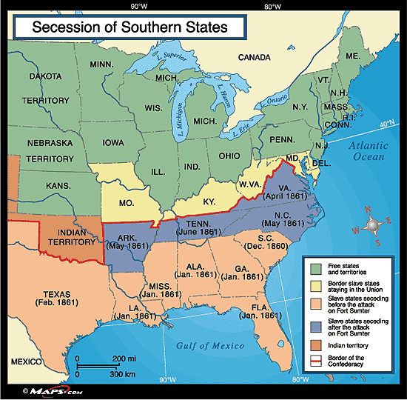

Slide 7
Brother’s Blood and Border Blood
Border states (Missouri, Kentucky, Maryland) crucial to both sides
Population more than half of the Confederacy
Doubled manufacturing capacity of Confederacy
Increased supply of horses and mules by half
Still slave states
Lincoln declares martial law in Maryland
Occupies West Virginia and Missouri
Emphasizes war is to save Union, not free slaves

Slide 8
Five Civilized Tribes (Oklahoma)
Most Cherokee, Creek, Choctaw, Chickasaw, and Seminole side with South
Some own slaves
Confederacy agrees to pay tribes and give representation in Confederate Congress
Some Cherokee and most Plains Indians are pro-North
After war, moved to reservations

Slide 9
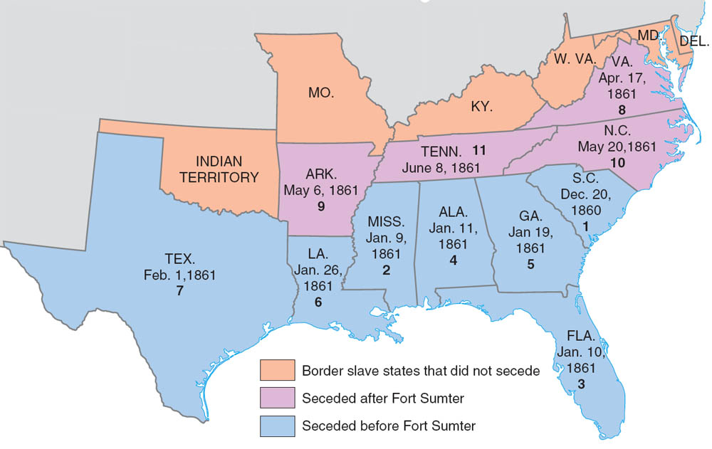
Seceding States (with dates and order of secession)
Note the long interval--nearly six months--between the secession of South Carolina, the first state to go, and that of Tennessee, the last state to leave the Union. These six months were a time of terrible trial for moderate Southerners. When a Georgia statesman pleaded for restraint and negotiations with Washington, he was rebuffed with the cry, “Throw the bloody spear into this den of incendiaries!”
Copyright (c) Houghton Mifflin Company. All Rights Reserved.

Slide 10
Brother vs. Brother
Southerners volunteer for Union
50,000 men from Western Virginia
300,000 men from Border States
Northerners volunteer for Confederacy
Mary Todd Lincoln has 4 brothers fighting for Confederacy

Slide 11
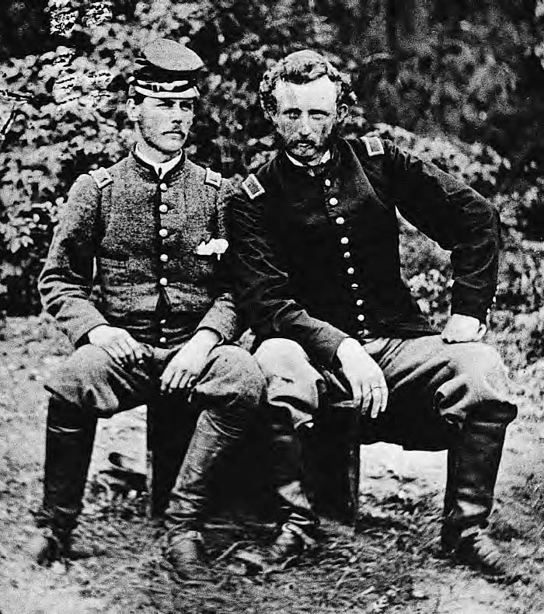
Friendly Enemies
The man on the right is George Armstrong Custer. The youngest general in the Union army, this brilliant young officer survived the Civil War only to lose his life and that of every soldier under his command to Sioux warriors at the Battle of the Little Bighorn in 1876--”Custer’s Last Stand.” The man on the left is a Southern soldier and prisoner of war. He and Custer had been classmates at West Point.
Library of Congress

Slide 12
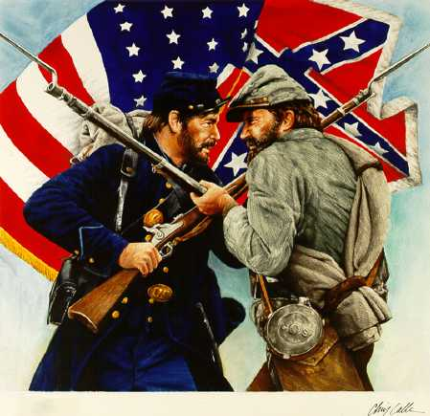

Slide 13
Sectionalism

Slide 14
Resources: North versus South

Slide 15
The Balance of Forces
South has many advantages
Only needs to fight a defensive war
Most talented military officers
Robert E. Lee, Thomas “Stonewall” Jackson
Military-style education as children
Many attended military schools
Disadvantages
Shortage of factories
Begin to develop as war wages
Shortage of supplies, despite developing factories
Planters refuse to switch from cotton to food
Less than 30% of railroad mileage
North quickly captures or destroys 20% of that

Slide 16
The North
Huge economy
More than 70% of railroad mileage
¾ of national income
Self-sufficient in food production/industry
Greater population of military aged men
22 million in North/9 million in Confederacy
Expanding immigrant population
1/5 of Union Army foreign born
Not as well trained
Control of sea

Slide 17
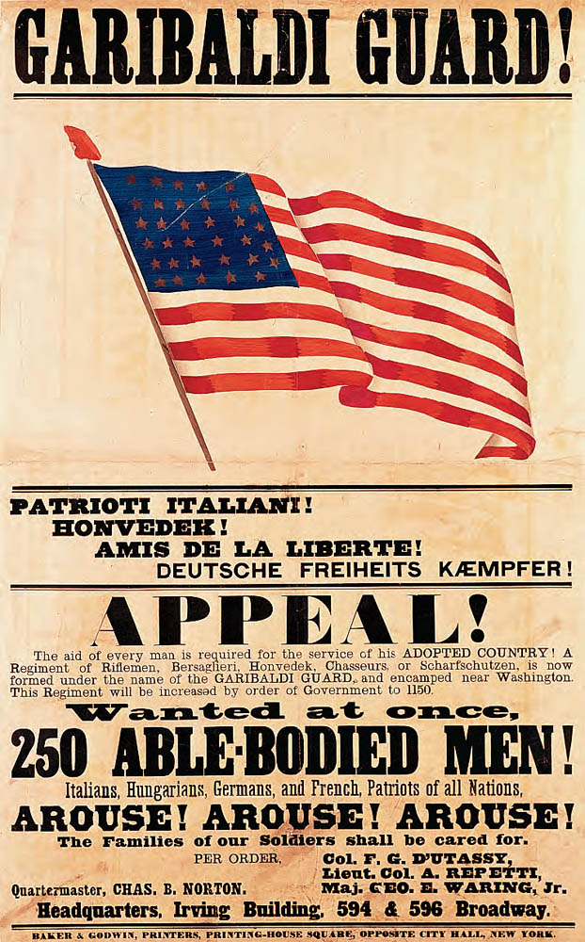
Recruiting Immigrants for the Union Army
This poster in several languages appeals to immigrants to enlist. Immigrant manpower provided the Union with both industrial and military muscle.
Collection of The New-York Historical Society

Slide 18
Dethroning King Cotton
South depends on foreign intervention
Europeans pro-north/anti-slavery
Public opinion would not support intervention
Uncle Tom’s Cabin
Shortage of Cotton?
England and France have huge stores of cotton
Overproduction
By 1862 supplies run low
North begins sending captured cotton to Europe
India and Egypt begin producing cotton
Europe needs northern wheat more than southern cotton

Slide 19
The Decisiveness of Diplomacy
South still hopes for foreign intervention
1861 – Union warship intercepts British ship Trent
Removes Confederate diplomats
Britain threatens war
Lincoln releases prisoners
British sell warships to Confederacy
1862 – C.S.S. Alabama escapes blockade
Takes on weapons and crew in Britain
Disrupts Union merchant shipping
Charles Francis Adams convinces Britain to stop building ships for Confederacy
May someday be used against Britain

Slide 20
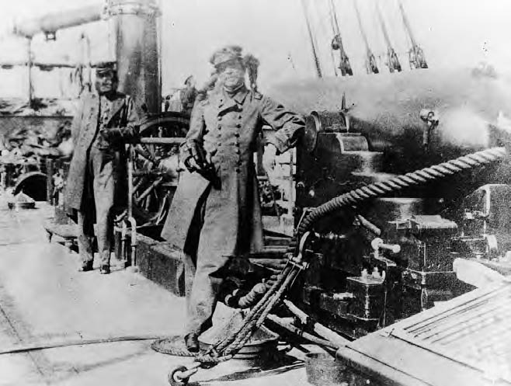
On the Deck of the Alabama
Captain Raphael Semmes leans jauntily against a deck gun aboard his fearful Confederate raider. The Alabama sank sixty-four Union ships before it was sunk by the USS Kearsarge off the coast of Cherbourg, France, in June 1864.
U. S. Navy

Slide 21
Foreign Flare-Ups
Britain builds 2 Laird rams
Built for ramming wooden Union ships
U.S. threatens war if ships sold to Confederacy
Kept for Royal Navy
Confederate agents plot to burn cities along Canadian border
Several incursions into Canada
Napoleon III installs puppet government in Mexico under Austrian Archduke Maximilian
Violation of Monroe Doctrine

Slide 22
President Davis vs. President Lincoln
South creates Confederacy
States have ability to secede
Difficult to get states to send troops to other states
Jefferson Davis unpopular and overworked
Lincoln leads established strong gov.

Slide 23
Limitations on Wartime Liberties
Lincoln acts as a tyrant
Proclaims illegal blockade of South
Proclaims acts without Congressional consent
Occupies border states with federal troops
Pays $2 million to three individuals for “war purposes”
Suspends habeas corpus
Intimidates voters in Border States
Confederacy refuses to sacrifice states rights
South handicapped by disunion

Slide 24
Volunteers and Draftees: North and South
Numerous volunteers at first
Congress passed first conscription law (1863)
Angers poor
Rich can hire a substitute by paying $300 to Congress
Riots in large cities, i.e. New York City
Volunteers compose 90% of Union Army
Few deserters
South has to resort to draft year before North
Owners of 20 or more slaves exempt

Slide 25
The Economic Stresses of War
Morrill Tariff Act passed
Raises rates by 5-10%
War soon causes greater increases
Income tax introduced
Washington issues $450 million worth of paper money
“Greenbacks”
Quickly sinks to 39cents per gold dollar
Treasury issues $2.6 billion in bonds
National Banking Act
Creates standard currency
Banks can buy gov. bonds and issue paper money

Slide 26
The South
Customs duties cut off by blockade
$400 million worth of bonds sold
Increased taxes
10% on farm produce
Opposed by states
Runaway inflation
Prints $1 billion worth of paper money
9000% inflation
Confederate dollar worth only 1.6 cents at end of war

Slide 27
The North’s Economic Boom
North emerges from Civil War more prosperous than before
New factories
Formation of a millionaire class
Many suppliers use shoddy equipment
Cardboard for shoe soles
Mechanization increases
Sewing machines/standardized sizes
Mechanical reapers
Petroleum discovered in PA in 1859
New industry created

Slide 28
Women’s Gains
Take jobs left by men
Pose as men to join army
400 women
spies
Nursing becomes respected occupation
Clara Barton
Union Nurse
Founded Red Cross in 1881
Dorothea Dix
Union Nurse
Improved conditions in asylums
Sally Tompkins
Runs Richmond infirmary for wounded Confederates
Awarded rank of Captain

Slide 29
A Crushed Cotton Kingdom
South ruined by war
Transportation collapses
Supplies become scarce
By end of war South claims 12% of national wealth as opposed to 30%
Per capita income down to 2/5 that of Northerners

Slide 30
The War

Slide 31
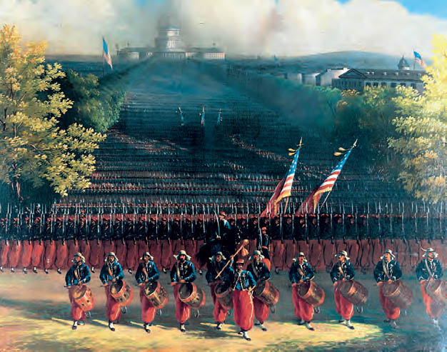
The Army of the Potomac Marching up Pennsylvania Avenue, Washington, D.C., 1861
In this painting, Union troops parade before the Battle of Bull Run. Colorfully uniformed, they are a regiment of Zouaves, who adopted the name and style of military dress from a legendarily dashing French infantry unit. But bright uniforms were not enough to win battles, and these troops were soon to be routed by the Confederates.
West Point Museum, United States Military Academy

Slide 32
Bull Run Ends the “Ninety-Day War”
Lincoln and northerners expect to end war within 90 days
Expect that first battle will be overwhelming Union Victory
July 21, 1861 – Northern army approaches Bull Run
Overconfident, larger force
Spectators from Washington gather to picnic/watch battle
Union forces initially successful, until arrival of Southern reinforcements
Bull Run ends in Southern victory
Shows war will not be short and easy
Boosts confidence of Confederacy

Slide 33
“Tardy George” McClellan and the Peninsula Campaign
George B. McClellan – Commander of Army of the Potomac
Believes he is outnumbered by Confederate forces
Unwilling to take risks
Keeps army in Washington for months until ordered by Lincoln
Plans to land at Yorktown, and move up Peninsula to Richmond
Union reinforcements dispatched to chase down Jackson
Lee counterattacks, bottles up forces on Peninsula
Union retreats, prepares for total war

Slide 34
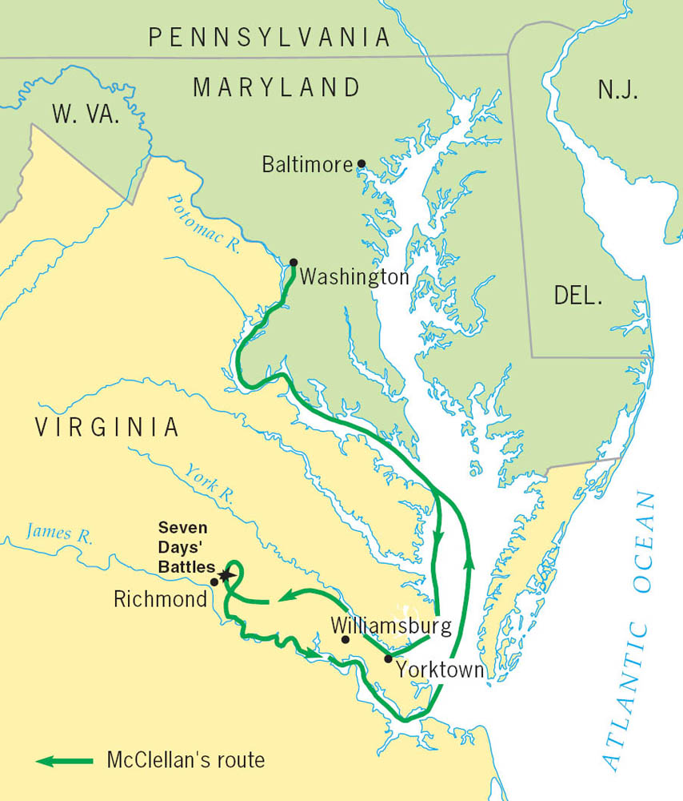

Slide 35
Strategy
What strategies did the North & South use during the war?

Slide 36
“Anaconda Plan”
Evident that war will not be quick
Union needs new strategy
Suffocate South through blockade
Free southern slaves to undermine economy
Seize control of Mississippi to cut Confederacy in half
Further segment Confederacy through campaigns in Georgia and the Carolinas
Capture Richmond
Always attack largest Confederate armies
Victory through attrition

Slide 37
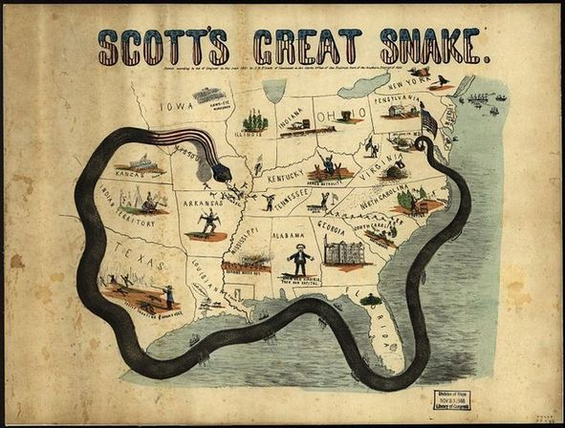

Slide 38
The War at Sea
Britain recognizes blockade
Blockade-Running becomes profitable business for Southern and British merchants
Battle of Hampton Roads
C.S.S. Virginia (captured U.S.S. Merrimack) plated with iron.
U.S.S. Monitor – Northern iron clad
Battle for 3 hours – inconclusive
Battle makes headlines around world
Britain and France immediately halt all construction of wooden warships

Slide 39
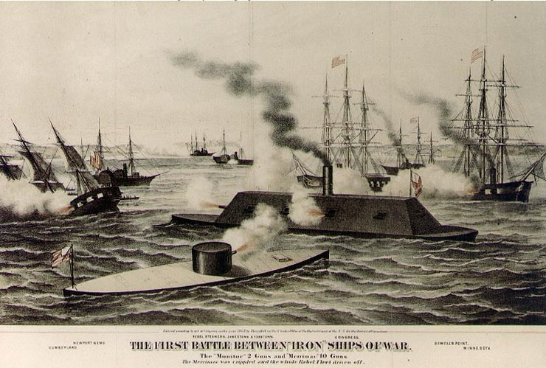

Slide 40
The Pivotal Point: Antietam
2nd Battle of Bull Run – Lee defeats Union Army again
Hopes to push North and win war
Persuade border states to secede
Gain foreign support
McClellan discovers Lee’s plan
Intercepts Confederate Army at Antietam Creek
Sept. 17. 1862 – bloodiest day of fighting
Decisive Union victory
Hopes for foreign intervention fade
Lincoln announces plans for Emancipation Proclamation

Slide 41
Emancipation Proclamation
Delivered Jan. 1, 1863
Frees slaves in seceded states
not border states
Not in areas of Confederacy already conquered by Union
War now has moral dimension
Many soldiers desert from Union Army
Slave begin sneaking away from plantations
South claims North trying to incite slave rebellion

Slide 42
Emancipation Proclamation
Delivered Jan. 1, 1863
Frees slaves in seceded states
not border states
Not in areas of Confederacy already conquered by Union
War now has moral dimension
Many soldiers desert from Union Army
Slave begin sneaking away from plantations
South claims North trying to incite slave rebellion

Slide 43
Blacks Battle Bondage
Blacks no allowed in army at beginning of war
Policy changes as men run low
10% of Union Army by war’s end
Southerners refuse to recognize black soldiers as P.O.W.s
Executed or massacred
Fort Pillow
Blacks leave plantations when territory conquered
Trail Union Army

Slide 44
Lee’s Last Lunge at Gettysburg
After Antietam Burnside takes over Union Army
Defeated in frontal assault at Fredericksburg, Dec. 13, 1862
“Fighting Joe” Hooker takes command
Defeated at Chancellorsville
Jackson killed by own men
Lee plans northern invasion
Intercepted at Gettysburg by Meade
July 1-3 – Decisive Union victory
Pickett’s Charge
Gettysburg Address

Slide 45
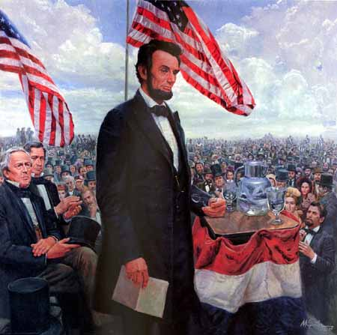
Gettysburg Address
November 16, 1863
dedication of a military cemetery at the Gettysburg battlefield four months after the battle occurred
Speech about our great country and how we needed to finish the war
Americans respond jubilantly across the country

Slide 46
Gettysburg Address
Four score and seven years ago our fathers brought forth on this continent, a new nation, conceived in Liberty, and dedicated to the proposition that all men are created equal.
Now we are engaged in a great civil war, testing whether that nation, or any nation so conceived and so dedicated, can long endure. We are met on a great battle-field of that war. We have come to dedicate a portion of that field, as a final resting place for those who here gave their lives that that nation might live. It is altogether fitting and proper that we should do this.
But, in a larger sense, we can not dedicate -- we can not consecrate -- we can not hallow -- this ground. The brave men, living and dead, who struggled here, have consecrated it, far above our poor power to add or detract. The world will little note, nor long remember what we say here, but it can never forget what they did here. It is for us the living, rather, to be dedicated here to the unfinished work which they who fought here have thus far so nobly advanced. It is rather for us to be here dedicated to the great task remaining before us -- that from these honored dead we take increased devotion to that cause for which they gave the last full measure of devotion -- that we here highly resolve that these dead shall not have died in vain -- that this nation, under God, shall have a new birth of freedom -- and that government of the people, by the people, for the people, shall not perish from the earth.
Abraham Lincoln November 19, 1863

Slide 47
The War in the West
Ulysses S. Grant commands western armies
Wins at Fort Henry, and Fort Donelson
Secures northern Mississippi
Loses at Shiloh
1862 – David Farragut seizes New Orleans
Vicksburg – July 4, 1863 – captured by Grant
Completes Union conquest of Mississippi

Slide 48
Sherman Scorches Georgia
After Vicksburg
Grant moves east, captures Tennessee
General William Tecumseh Sherman
Ordered to march through Georgia
Captures and burns Atlanta
Clears a mile wide path of destruction from Atlanta to Savannah
“I beg to present you as a Christmas gift the City of Savannah, with one hundred and fifty guns and plenty of ammunition, also about twenty-five thousand bales of cotton.” -Sherman

Slide 49
The War Comes to Georgia
By 1863, many Georgians were disheartened, as the death rate of soldiers grew due to battle and disease.
Poor and middle class Georgians were drafted into the war. Wealthy families paid people to go to war as their substitutes.
Inflation and shortages of goods hurt morale on the home front.
In 1864, the Union army under General William Tecumseh Sherman entered north Georgia with plans to take Atlanta and then Savannah.
The battles and Sherman’s march through Georgia left the state in ruins by the winter of 1864-65.

Slide 50
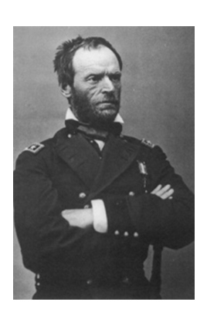
General Sherman

Slide 51
The Campaign for Atlanta
Sherman's army started out with 112,000 men
Sherman's immediate goal was to capture Atlanta
The Confederate General Johnston only had 60,000 men
General Joseph Johnston’s Confederates fought a series of defensive battles as Sherman’s army moved south toward Atlanta.
During the summer the first battles were fought in Dalton, Resaca, and New Hope
Johnston low on supplies had to retreat but burned down bridges and blocked roads

Slide 52
The Campaign for Atlanta
It caused Sherman's march to slow.
In June, Sherman's army attacked Kennesaw Mountain.
The CSA won at Kennesaw Mountain.
Jefferson Davis replaced General Johnston with General John B. Hood
In July, Hood fought against Sherman and lost 11,000 men in two days

Slide 53
Battle of Atlanta
General John Hood led the Confederates at the Battle of Atlanta, July 20-22. By early September, Sherman moved into Atlanta.
Atlanta was captured by the Union on Sept 2, 1864
Atlanta was set on fire November 15th
Lincoln was in danger of losing the 1864 election against Democratic Party platforms (principles) that opposed emancipation and sought peace with the South. Sherman’s capture of Atlanta helped Lincoln win reelection.

Slide 54
The Campaign for Atlanta
The strategy of "laying waste to the land" was in full force in Georgia by November 1864.
On November 16th Sherman began his March to the Sea

Slide 55
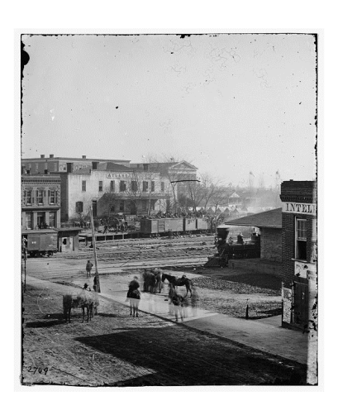
Soldiers on boxcars at Railroad Depot

Slide 56
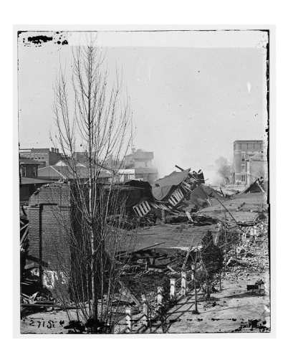
Ruins of Train Depot

Slide 57
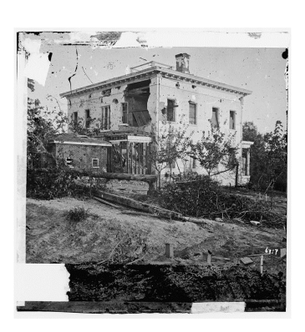
A Shell Damaged Home

Slide 58
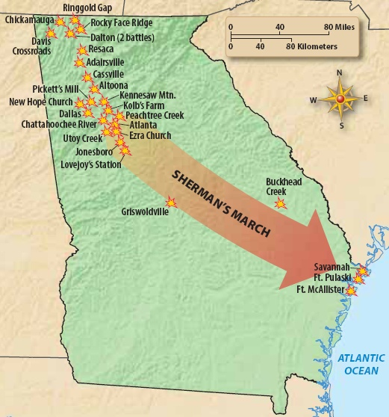

Slide 59
Sherman’s “March to the Sea”
During this march 60,000 soldiers cut a path 60 miles wide on a 300 mile trip from Atlanta to Savannah.
Savannah was captured on December 25th 1864
Sherman gave the city of Savannah and 25,000 bales of cotton to President Lincoln as a Christmas Present

Slide 60
Election of 1864
Republicans and War Democrats form Union Party
Nominate Lincoln
Democrat Andrew Johnson chosen as VP
Copperheads and Peace Democrats nominate McClellan
News of victories in New Orleans and Atlanta arrive near election day
Lincoln wins Electoral College easily

Slide 61
Lincoln’s Second Inaugural Address
March 4, 1865
Lincoln speaks to the nation about the war and putting the country back together in his 2nd term
Lincoln expressed sorrow that the states had not been able to resolve their differences peacefully
Urged Americans not to seek revenge on slaveholders and their supporters/military
Addressed the major issues in the country at the time

Slide 62
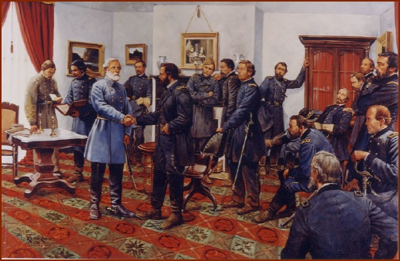

Slide 63
Grant Outlasts Lee
Grant has numerical superiority
More than 100000 in army
Lee has less than 70000
The Wilderness Campaign
Running engagement in northern Virginia
Grant loses 50000 – 60000
Lee loses around 30000
Public outraged by loses
Demand relief of Grant
Lincoln refuses.
Grant captures Richmond
Lee surrenders at Appomattox Courthouse in April 1865

Slide 64
Martyrdom of Lincoln
April 14, 1865 – Lincoln shot in the head at Ford’s Theater by John Wilkes Booth
Remembered only for good deeds
Tyrannical acts of wartime president forgotten
South cheers death of Lincoln
Bad news for South during reconstruction

Slide 65
Aftermath
Civil War cost 600000 men
$15 billion in costs
Slavery ended
Strengthens federal government

