Slide 1
Chapter 8
America Secedes from the Empire

Slide 2
2nd Continental Congress
Philadelphia, May 10, 1775
Gov until 1780 Articles of Confederation
Raised army/navy
George Washington appointed head of army
Bought supplies
Olive Branch Petition (July 1775)
Drafted Declaration of Independence (July 1776)
Drafted Articles of Confederation

Slide 3
George Washington
Losing record in battles
Charismatic personality
Political decision
Not from New England
From largest colony
Counted on by peers to check “excesses of masses”

Slide 4
Thomas Paine and Common Sense (1776)
Common Sense
Pamphlet published Feb. 14, 1776
Over 120000 copies circulated
Arguments
Nowhere in universe did small body control larger one
Why should Britain control America?
King – “Royal Brutte of Great Britain”
Embraced independent republic
Moves Congress towards independence

Slide 5
Jefferson’s Explanation of Independence
June 7, 1776 – Richard Henry Lee motions for independence
Congress appoints committee to prepare formal statement
Jefferson, Franklin, John Adams, Robert Livingston, Roger Sherman
July 2, 1776 – Lee’s Resolutions adopted

Slide 6
Declaration of Independence
“natural rights”
Justification of right to revolt
Tyrannical actions by King George III
Provisions condemning slave trade removed before publication
Impact
Appeal to colonists
Appeal to foreign nation
Foreshadows later conflict
All men are created equal
Inspires other revolutionary movements

Slide 7
Patriots and Loyalists
Loyalists – Loyal to King
Redcoats – British soldiers
Tories – named after dominant party in Britain
Patriots – American Rebels
Whigs – named after opposition party
“radical whigs”
Contending for support
Both sides needed supporters
Many colonists neutral
Patriot Army harasses loyalists
Convinces many to join cause

Slide 8
Key Battles
Washington Crosses the Delaware
Had been defeated at New York City in 1776
Retreats to Delaware
Dec. 26, 1776 – crosses Delaware, attacks Trenton, NJ
Surprises and captures 1000 Hessian mercenaries
Moves on and defeats garrison at Princeton
Important morale boosting victories

Slide 9
Saratoga
British General Burgoyne attempts to invade New York from Canada (1777)
Surrounded at Saratoga, north of Albany
Forced to surrender in October to Horatio Gates
Results
Turning point of war
Boosts morale
Demonstrates British ineffectiveness in subduing countryside
Convinces French to aid colonies

Slide 10
France
Benjamin Franklin
Arrives in 1776 to negotiate treaty
Dresses in common clothes
1777 – British offer home rule
Result of Saratoga
Franklin plays on French fears of quick end to war
Feb. 6, 1778 – France signs alliance with America
Both sides would fight until United States free, and both sides agree to terms
Results
First official recognition of American independence
Military aid for Patriot’s army
Revolution becomes global war

Slide 11
Marquis de Lafayette
French nobleman
Sympathizes with American cause
Ordered not to interfere by French gov.
Sails to America disguised as woman in 1777
Begins training U.S. soldiers and assisting generals

Slide 12
The life of a Continental Soldier
Joined army for 1-3 year enlistment term
Often asked to stay on longer
Problems with pay
Paid by states whenever money was available
Soldiers from different states paid different amounts
Short on supplies
States responsible for supplying soldiers
Rarely enough food, ammunition, or clothing
Strong belief in cause of Independence

Slide 13
Valley Forge (winter 1778)
Conditions terrible
Cold, snowy winter
Roads impassable
No supplies
Soldiers die from exposure, starvation
By end of winter 2500 U.S. soldiers dead
Despite harsh conditions Washington begins intense training program with von Steuben and Lafayette
Continental Army emerges as well trained fighting force

Slide 14
Yorktown
General Cornwallis retreats to Yorktown to await reinforcements
British navy beaten by French Navy
Washington marches army 300 miles from New York
Surrounds Cornwallis
British surrender Oct. 19, 1781

Slide 15
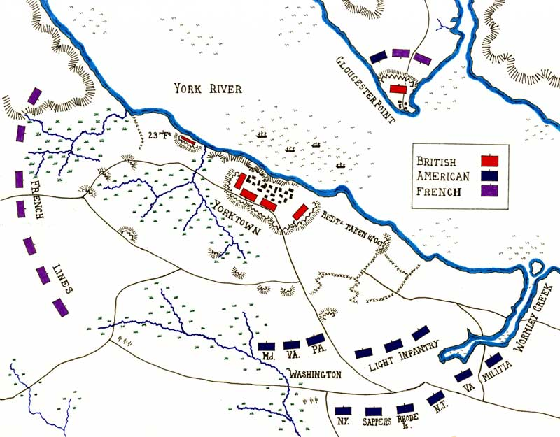

Slide 16
Peace at Paris
Years of war have made Britain weary
Losing to French in India and Caribbean
Gibraltar about to fall to Spain
Whigs take over gov. in 1782
Peace negotiations
Franklin, John Adams, John Jay – represent America
Ordered not to make a separate peace

Slide 17
Negotiations
France
Promises Gibraltar to Spain
Gibraltar holding
Promises trans-Allegheny (Ohio Valley) to Spain
Wanted to bottle Americans up east of Allegheny mountains
John Jay secures treaty with British
Believes France will betray American interests

Slide 18
Treaty of Paris 1783
British Concessions
Independence for United States
Land to Mississippi River in west, Great Lakes in North, and Florida to South
Americans retain share of Newfoundland fisheries
American Concessions
No persecution of loyalists
Congress was to recommend confiscated property be restored
Debts to British creditors would be paid

Slide 19
New Nation Legitimized
Forgiving Treaty
British want to end America/France alliance
Want to continue trade
Whigs more friendly to American cause
Separate Peace
France approves peace treaty
Costly war, failure to deliver promises to Spain
Aftermath
America created
British defeated, in debt
France bankrupt, headed toward revolution

