Slide 1
Westward Expansion

Slide 2
Westward Expansion
Webquest
Go to my website:
bhsharris.weebly.com

Slide 3
Impact on Native Americans
As settlers moved farther west, Native Americans felt the impact.
Many Native American tribes were forced to relocate to reservations (parcels of land set aside by the federal government for the N.A.’s)

Slide 4
Clash on the Plains
The Federal government tried to pacify Plains Indians by signing treaties with “chiefs” of various “tribes” at Fort Laramie (1851) and at Fort Atkinson (1853)
Treaties marked beginnings of reservation system in the West:
Established boundaries for territory of each tribe
Attempted to separate Indians into great “colonies” to north and south of a corridor of intended white settlement
White treatymakers:
Misunderstood both Indian government and Indian society

Slide 5
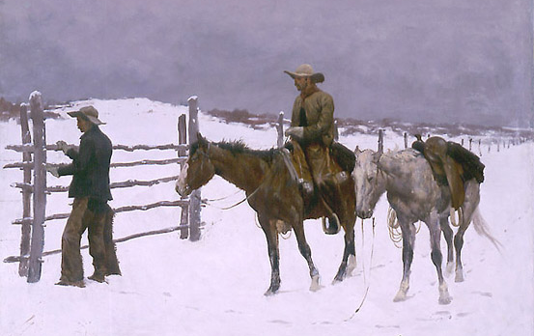
c. Describe the growth of the western population and its impact on Native Americans with reference to Sitting Bull and Wounded Knee.
Americans moved westward in the 1860s to become ranchers, miners, and farmers.
The settlers began to encroach on Native American hunting grounds and broke numerous treaties
How would fences
that were constructed
by farmers and ranchers
affect Native Americans?

Slide 6
Westward Movement
In 1862, Congress passed laws making it easier for people to get land out West, greatly increasing the number of western settlers in the years following the Civil War.
In 1889, Congress agreed to open central Oklahoma territory to settlement.
The Oklahoma Land Rush – over 50,000 people gathered at the border waiting for the gunshot officially opening the territory.

Slide 7
Movement Westward
What technological inventions made western farming possible?
One of the big industries in the west became cattle ranching.
Those in Texas learned cattle ranching techniques from the Mexicans who lived there.
Cowboy hats and chaps were both examples of dress adopted from Mexicans by the western settlers.

Slide 8
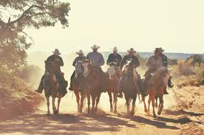
Cowboys
Who were the cowboys?
Men
Women
White
African Americans
Mexicans

Slide 9
Clash on the Plains
In 1860s federal government intensified policy and herded Indians into still-smaller confines:
Principally “Great Sioux reservation” in Dakota Territory and Indian Territory (present-day Oklahoma)
Indians surrendered ancestral lands:
When they received solemn promises from Washington:
They would be left alone
They would be provided food, clothing, and other supplies
Regretfully, federal Indian agents often very corrupt

Slide 10
Sand Creek Massacre
U.S. forces surprised five hundred Cheyenne at Sand Creek, killing roughly 270 Native Americans, most of whom were women and children.

Slide 11
Battle of Little Bighorn
When news of Sand Creek spread, other Native American tribes became enraged. Fighting continued on the Plains.
1874 Sioux, Cheyenne, & Arapaho Indians took to the warpath, inspired by Sitting Bull.

Slide 12
Battle of Little Bighorn
In 1876, US colonel Custer tried to suppress the tribes and return them to the reservation by surprising the Sioux at the Battle of Little Bighorn.
Sioux warriors quickly surrounded and outnumbered the troops – killing Custer & 200+ troops. ---→ known as Custer’s Last STAND.

Slide 13
Surrender
By 1877, both the Sioux & Cheyenne surrender to US troops.
Sent out to reservations in Dakota’s and Oklahoma.

Slide 14
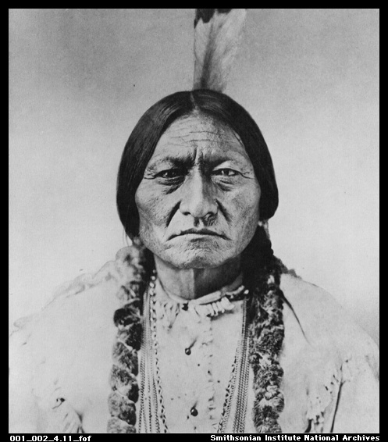
Wounded Knee
By the late 1880s most western Indian tribes had been resettled onto reservations
Sitting Bull, a Sioux Chief, who helped defeat Custer at the Little Big Horn, had moved onto a reservation and began performing the “Ghost Dance” which his followers believed would bring back the buffalo, and make the settlers disappear
Sitting Bull is ordered to stop, but refuses and is killed while being arrested
Along with 13 others.

Slide 15
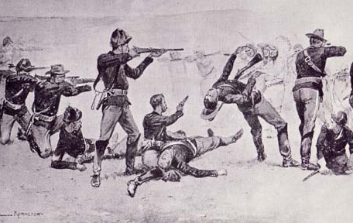
Wounded Knee
Many of Sitting Bulls followers fled the reservation after his death and camped at Wounded Knee Creek with other Sioux
The U.S Calvary, which was sent to escort the Sioux back to the reservation, attempted to disarm them and a fight broke out

Slide 16
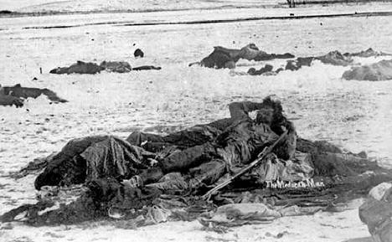
Wounded Knee
In the massacre that followed, nearly 200 Sioux men, women and children were killed
Many of the injured froze to death
Wounded Knee led many to question the treatment of Native Americans, and was the last major resistance by Native Americans

Slide 17
Reservations
Dawes Severalty Act (1887):
Misbegotten offspring of movement to reform Indian policy
Reflecting forced-civilization view of reformers:
Act dissolved many tribes as legal entities
Wiped out tribal ownership of land
Set up individual Indian family heads with 160 free acres
If Indians behaved like “good white settlers,” they would get full title to holdings as well as citizenship in 25 years

Slide 18
Reservations
Former reservation land not allotted to Indians under Dawes Act:
Sold to railroads and white settlers
With proceeds used by federal government to educate and “civilize” native peoples:
Government-funded Carlisle Indian School in Pennsylvania where Native American children were:
Separated from their tribes
Taught English
Inculcated with white values and customs

Slide 19
Reservations
Dawes Act:
Struck directly at tribal organization:
Tried to make rugged individualists out of Indians
Ignored traditional reliance of Indian culture on tribally held land
By 1900 Indians had lost 50% of the 156 million acres they held (see Map 26.2)
Forced-assimilation doctrine of Dawes Act remained cornerstone of government policy for decades

Slide 20
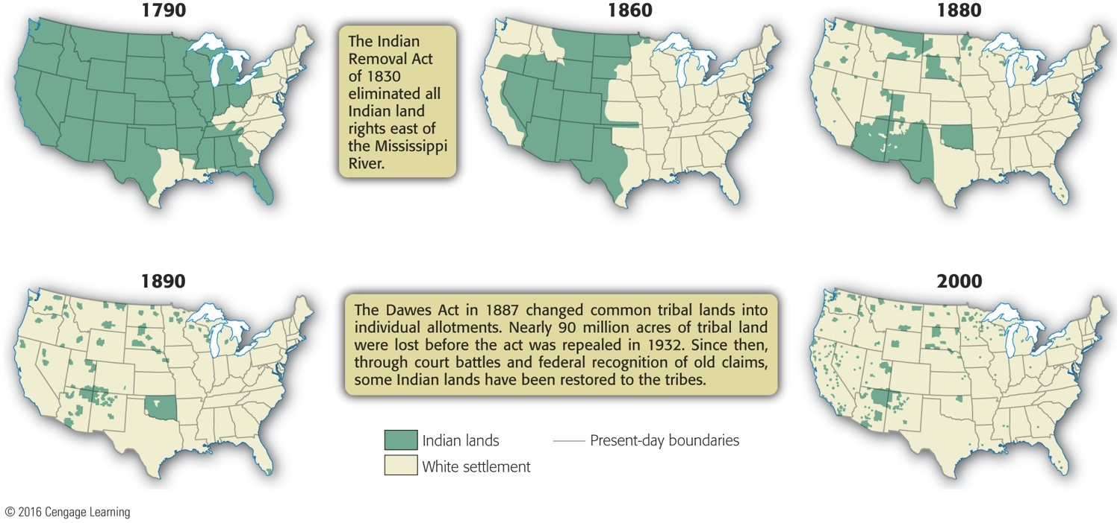
Map 26-2 p581
Notes:
Map 26.2 Vanishing Lands Once masters of the continent, Native Americans have been squeezed
into just 2 percent of U.S. territory. © 2016 Cengage Learning

Slide 21
Reservations
Indian Reorganization Act (“Indian New Deal”) of 1934:
Partially reversed individualistic approach
Tried to restore tribal basis of Indian life
Indian population started to recover slowly:
Total number reduced by 1887 to about 243,000—the results of bullets, bottles, bacteria
Census of 2000 counted more than 1.5 million Native Americans, urban and rural

Slide 22
Beef Bonanzas and the Long Drive
Problem of cattle marketing on Plains:
How to get cattle to market:
Solved by transcontinental railroads
Cattle could now be shipped live to stockyards
Under “beef barons” like Swifts and Armours:
Highly industrialized meatpacking business sprang into existence as a main pillar of economy
In gigantic stockyards at Kansas City and Chicago, meatpackers shipped fresh products to East Coast in newly perfected refrigerator cars

Slide 23
Beef Bonanzas and the Long Drive
Spectacular feeder of new slaughterhouses was “Long Drive”
Texas cowboys (black, white, and Mexican) drove herds of 1,000 to 10,000 cattle over unfenced and unpeopled plains to a railroad terminal
Beasts grazed en route on free government grass
Favorite terminal points were flyspecked “cow town”
Steer was king in Cattle Kingdom richly carpeted with grass. Lush grass made Long Drive profitable
1866-1888, more than four million cattle moved by Long Drive

Slide 24
Beef Bonanzas and the Long Drive
Railroads made Long Drive, and railroads unmade Long Drive
Same rails that bore cattle from open range brought out homesteaders and sheepherders:
Intruders too numerous to be cut down by cowboys
Terrible winter of 1886-1887 left thousands of cattle starving and freezing
Overexpansion and overgrazing took toll, as cowboys slowly gave way to plowboys
Only escape for stockmen was to make cattle-raising a big business and avoid perils of overproduction

Slide 25
Beef Bonanzas and the Long Drive
Breeders learned:
To fence their ranches and lay in winter feed
Import prize bulls; produce fewer and meatier animals
To organize: Wyoming Stock-Growers' Association (1880s) virtually controlled state and its legislature
Heyday of cowboys:
Equipment of cowhand served useful purpose
Could justifiably boast of his toughness
Bowlegged Knights of Saddle became part of American folklore
Many cowboys were blacks, who enjoyed freedom of open range

