Slide 1
Chapter 23, 24, and 25
The Gilded Age
Part 2

Slide 3
Philosophies of Wealth
Rockefeller – Wealth comes from God
“Acres of Diamonds” – Rev. Russell Conwell
Christian Duty to become rich
Carnegie – Gospel of Wealth
Wealthy have moral duty to spread wealth
Public works projects
Social Darwinism
Survival of the fittest
People at top of business their because they are best adapted
During this time there is conspicuous consumption of wealth…

Slide 4
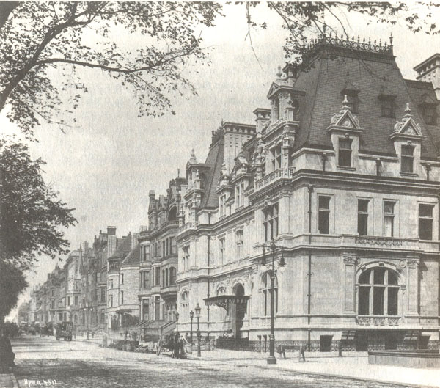
5th Avenue in NY
Became a street of the wealthy

Slide 5
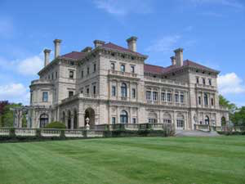
Vanderbilt's Mansion

Slide 6
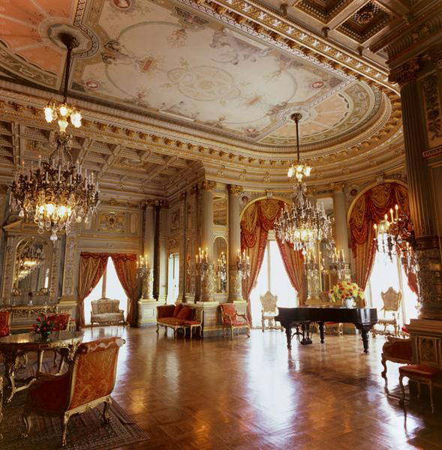
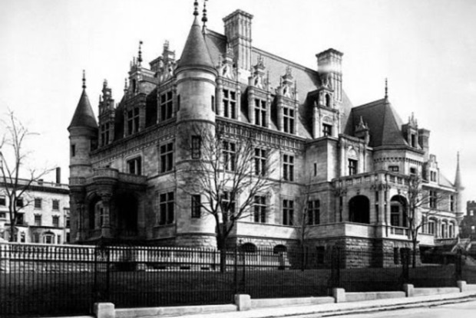
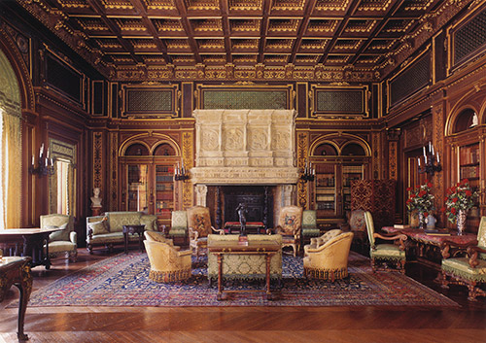
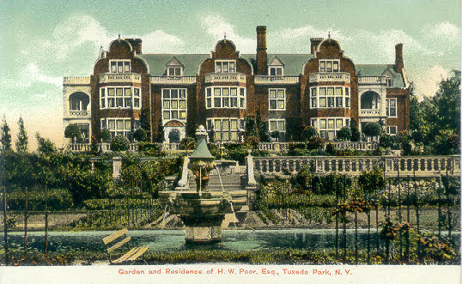

Slide 7
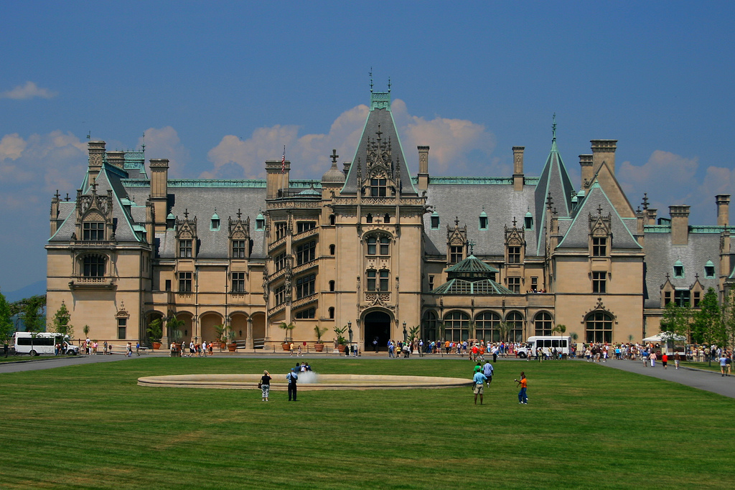

Slide 8
The Plutocracy
Supreme Court rulings mean businesses largely unregulated
Corrupt businessmen bribe state legislators
Corporate Lawyers get corporations classified as legal entities with full rights under the 14th Amendment
Wealthy business owners running things by late 1800s

Slide 9
Tackling the Trusts
Sherman Anti-Trust Act (1890)
Attempt to outlaw trusts and monopolies
Forbids “combinations”
“pools” or cartels, interlocking directorates, holding companies
Ineffective
Difficult to prove combinations exist
No enforcement power
No ability to actually control trusts until 1914

Slide 10
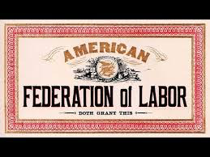
The Birth of Unions
Out of the challenging working and living conditions that faced workers arose labor unions.
Labor unions are organizations of workers formed to protect the interests of its members.
Strikes were main form of protest

Slide 11
Early Strikes Ineffective
Employers hated the unions & took measures against them.
Threatened to fire employees who joined unions
forced them to sign contracts agreeing not to join unions
Turned to courts to have strikes stopped.
Sometimes turned to violence.
Troublesome workers were “black listed”
Company towns where workers paid in “scrip” only useable at company store

Slide 12
Labor Limps Along
National Labor Union (1866)
Lasts 6 years, 600000 members
Demanded arbitration of worker complaints and 8 hour work day
Destroyed by Depression of 1873
Knights of Labor (1881)
Originally secret society
Sought workers’ cooperatives, better conditions, and 8 hour work day
Leader Terence V. Powderly gains 8 hour work day in some places
Successful strike against Gould’s Wabash Railroad causes membership to soar to 750000

Slide 13
The Rise of Labor Unions
The American Federation of Labor (AFL) is started in 1886.
Group of small independent unions
The AFL focused on wages, working hours, & working conditions.
The AFL is still in existence today

Slide 14
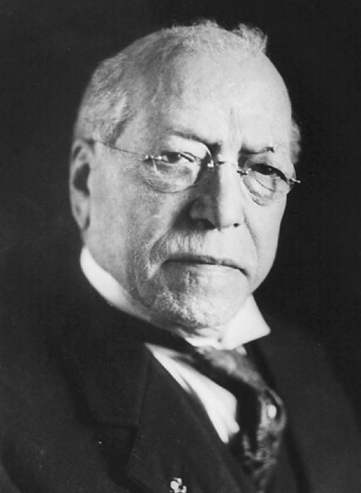
Samuel Gompers
Samuel Gompers was the first leader of the AFL.
The AFL used the economic pressures of:
strikes (refusal of an employee to work until employers meet certain demands)
boycotts (refusal to buy or pay for certain products or services in hope of forcing the producers to change their policies.

Slide 15
American Federation of Labor
The AFL also believed in collective bargaining and mediation.
Collective bargaining is negotiating as a group instead of individually to increase your bargaining power.
Mediation is when a neutral third party (in some cases, the gov’t) gets involved to help negotiate a settlement.
The AFL also called for closed shop workplaces – workplaces that would only hire union workers.

Slide 16
American Federation of Labor
Union dues used to build funds to help workers last through strikes
Only allowed skilled craftsmen
Membership rose to 500000 – 3% of labor force
Criticized as being “labor trust”
Labor Day (1894) – symbolic victory
Slow growth due to massive immigration

Slide 17
Industrial Unrest
Employers hated the unions & took measures against them.
Threatened to fire employees who joined unions
forced them to sign contracts agreeing not to join unions
Turned to courts to have strikes stopped.
Sometimes turned to violence.
Troublesome workers were “black listed”
Company towns where workers paid in “scrip” only useable at company store

Slide 18
Unhorsing the Knights of Labor
May Day Strikes in 1880s hurt public image
Reputation as communist begins to grow
Haymarket Square Incident
Chicago, 1886
Strikers mix with anarchists
Bombing kills seven, public blames union
Eight anarchists arrested, five sentenced to death
Pardoned by gov. John Altgeld in 1892
Knights of Labor membership declines

Slide 19
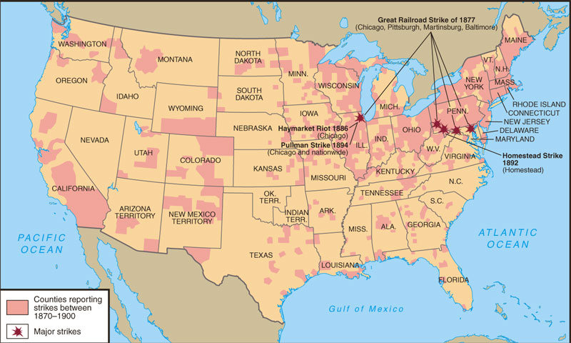
The U.S. experienced an “era of strikes” from 1870-1890
The Great RR Strike of 1877 shut down RRs from WV to CA & resulted in 100s of deaths
The Chicago Haymarket (1886) demand for an 8-hr day led to mob violence & led to the death of the Knights of Labor
The Homestead Strike (1892) resulted from a 20% pay cut at one of Carnegie’s steel plants

Slide 20
1894 Pullman strike
Although there were numerous strikes & protests that received national attention, the Pullman Strike became the most recognized.
A delegation of employees went to railroad-car industrialist George Pullman, to protest the laying off of workers.
Pullman responded by firing three of the labor representatives.
In 1894 the American Railway Union, led by Eugene Debs, called for a boycott against the Pullman Company (IL) who manufactured railroad cars.

Slide 21
1894 Pullman strike
Over 120,000 workers went on strike.
Because the strike effected U.S. mail delivery, the federal gov’t got involved and President Cleveland sent in U.S. troops and ordered the strike to end.
The ARU collapsed as a Union as a result of government intervention
The Pullman Strike established a precedence for factory owners to appeal to the courts to end strikes.

Slide 22
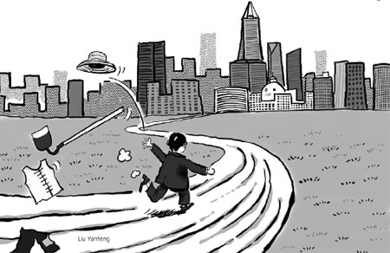
Urban Growth
Between the end of the Civil War & the beginning of the 1900’s, U.S. cities grew rapidly.
Between 1870 and 1900 US population doubles
In the west, new towns grew up along rail lines.
- Many immigrated from China in hopes of making $$$ working on the rail lines.
In the east, established cities grew due to industrialization as people left farms and moved to the cities.
By the end of the 1880s, nearly 80 percent of New Yorkers were foreign born.

Slide 23
Urban Growth
Cities grow outward and upward
Electric Trolley allows cities to expand beyond walking distance
Louis Sullivan – Chicago, 1880s
Inventor of skyscraper
Use of steel, concrete, and elevators
“form follows function.”

Slide 24
From farms to cities
More jobs, higher paying jobs, excitement
Plumbing, telephones
Department stores
Marshall Field’s in Chicago, Macy’s in New York
Mail Order catalogs
Sears and Montgomery Ward send goods to rural locations

Slide 25
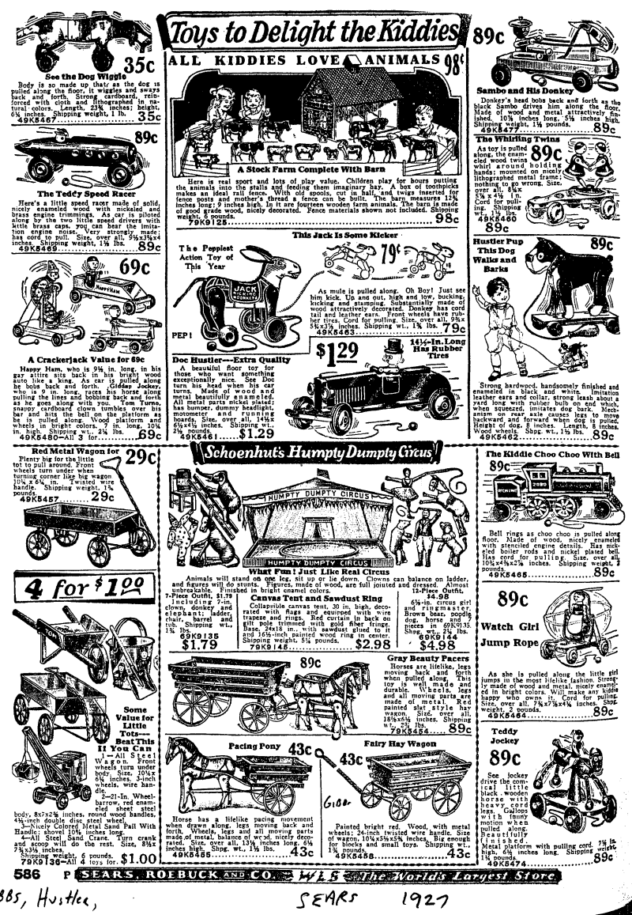
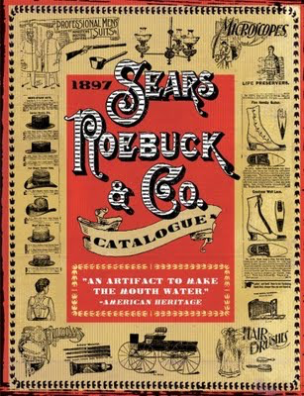

Slide 26
