Slide 1
Period 9: Reagan through W. Bush
Reagan - Reaganomics
Domestic policy – Supply Side Economics and Debt!
Foreign Events – Contras, Cold War, Star Wars!
George Bush - A Thousands Points of Light!
Domestic policy – Tax Increases, Americans with Disabilities
Foreign Events – Persian Gulf War
Clinton – Years of Prosperity
Domestic policy – Don’t Ask Don’t Tell, NAFTA
Foreign Events – NATO in Bosnia, Africa
George W. Bush – Age of Terrorism
Domestic policy – Patriot Act
Foreign Events – War in Afghanistan and Iraq
Trends of the latter 20th centuries – immigration, cultural diversity, role of women, globalization, etc.

Slide 2
The 80’s and Ronald Reagan 1981 – 1989
“Freedom is never more than one generation away from extinction. We didn't pass it to our children in the bloodstream. It must be fought for, protected, and handed on for them to do the same.”
- Ronald Reagan

Slide 3
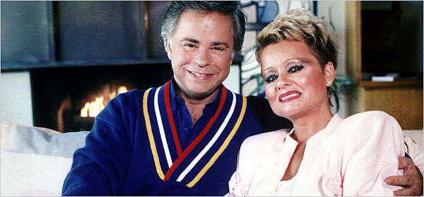
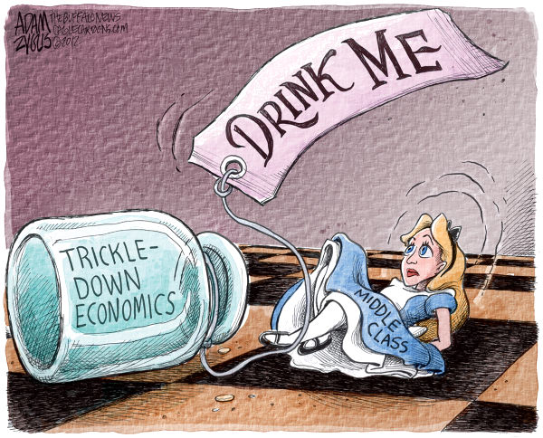
Reagan – Domestic Activity
Rise of the “moral majority” (Conservative, Christian, upper class voters “yuppies”) and dissatisfaction with Carter – Reagan able to win.
Moral Majority or Religious Right – pro conservative values (anti feminism, gay rights, abortion, etc.).
His philosophy: Lower taxes, reduce size and power of federal government, cut spending on social programs.
Supply-side economics (Reaganomics) - cuts in taxes would create economic growth that would bring in more tax revenue (it is very controversial as to whether this worked or not…).
Massive military spending led to large deficits (deficit spending) - added $2 trillion to the national debt.
Deregulation of Industry – lessened government role in large corporations and banks.
Evangelists – Jim and Tammy Bakker (sex scandal and accounting fraud)

Slide 4
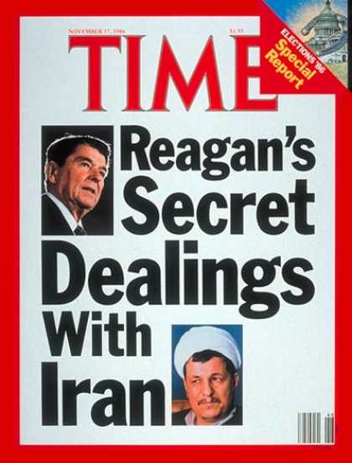
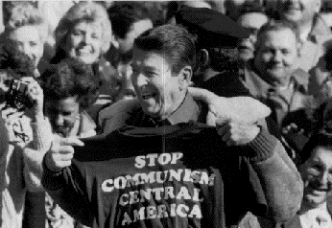
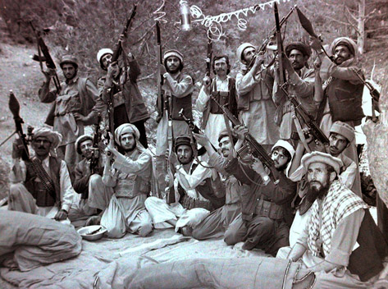
Reagan – Foreign Events
The Middle East and Latin America
Covertly supported and helped finance Iraq (putting Saddam Hussein in power) in the Iran-Iraq War from 80-88.
Covertly supplied weapons to the Mujahedeen against Soviet Invasion in Afghanistan (largest covert war in US History)!
Contras – a series of CIA led coups in Latin American nations to contain the spread of communism (Nicaragua – the Sandinistas, El Salvador, Grenada).
Iran-Contra Scandal (1985) - Weapons were sold to Iran in return for the Iranians help in releasing hostages held in the Middle East.
Money made was then given to the Contras - Reagan claimed to not know anything.

Slide 5
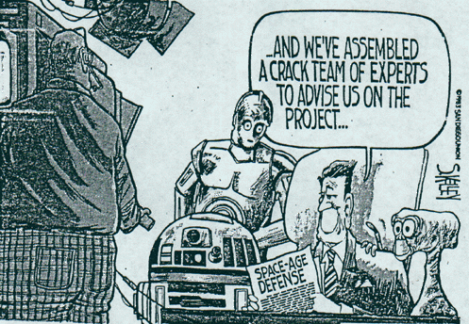
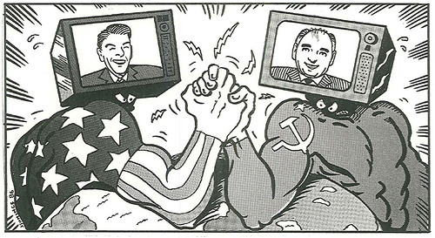
Reagan – Foreign Events
The Cold War
Referred to the Soviet Union as the "evil empire" and "the focus of evil in the modern world."
New Arms Race - used deficit spending to create mass amount of weapons and bombs (created the Strategic Defense Initiative (SDI) or “Star Wars”).
Gorbachev (USSR leader) sought an end to the Cold War because the Soviets could not afford the military spending
Glasnost (openness of media) & Perestroika (restructuring the economy) were meant to revive the Soviet economy
INF Treaty banned a certain type of offensive nuclear missiles.
Call for Gorbachev to “tear down that wall.”

Slide 6
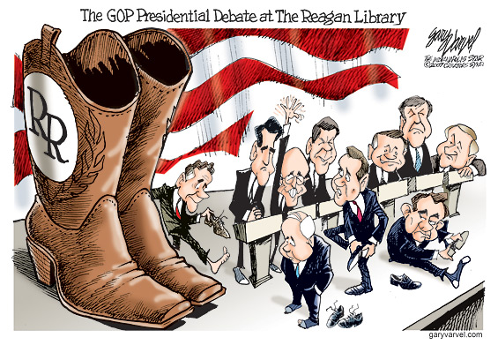
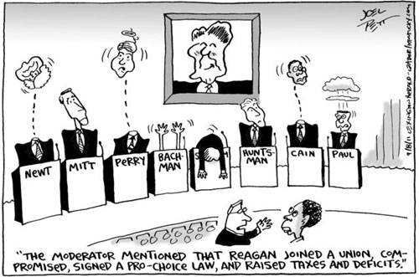
Reagan – the Legend vs. the Reality

Slide 7
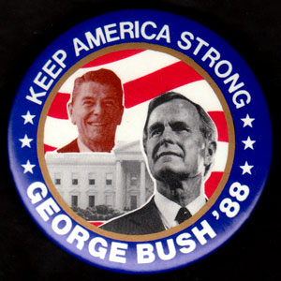
The End of the Cold War/Middle East Conflicts and George Bush Sr. 1989 – 1993
“I will keep America moving forward, always forward, for a better America, for an endless enduring dream and a thousand Points of Light. This is my mission, and I will complete it.” - George H. W. Bush

Slide 8
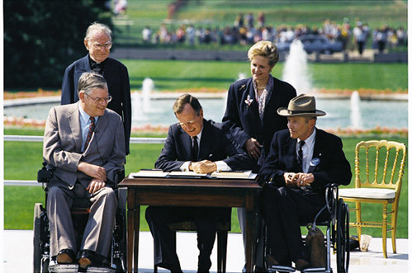
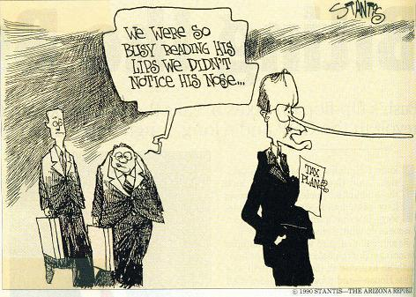
Bush Sr. – Domestic and Foreign Activity
Domestic
Ran on continuing more of Reagan-esque polities.
Faced a huge debt issues due to military spending – forced Bush to raise taxes when he stated he would not.
“Read my lip, no new taxes.”
Passed the Americans with Disabilities Act – prohibited discrimination on citizen’s with mental or physical disabilities.
Due to taxes and waning conservativism – losses popularity.
Foreign
USSR collapses – Europe is re-united and must rebuild East Europe.
Tiananmen Square massacre – pro democracy student movement crushed by Chinese Government (illustrates China is still holding hard to communist practices).

Slide 9
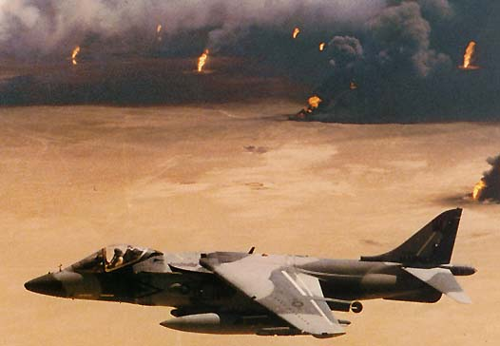
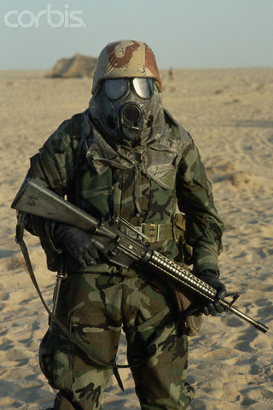
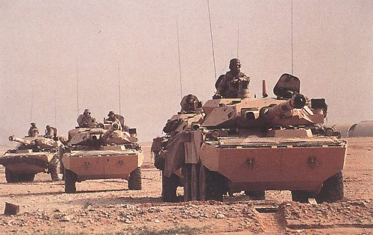
Bush Sr. – Persian Gulf War
Two years after the Iran-Iraq War Stalemate – Saddam Hussein (Iraqi leader) invades Kuwait.
In the meantime…Osama Bin Laden creates Al Qaeda (Islamic fundamentalist group - goal is to eliminate Western influence in the Middle East).
Neighbor nation, Saudi Arabia, calls for US assistance (to keep oil flowing to the west).
US with UN backing performed air attacks on Iraq.
Instated Operation Desert Storm – land invasion of Iraq and liberated Kuwait (lasted days).
Very few casualties – Iraq left Kuwait and accepted a cease-fire agreement.
Saddam Hussein left in power to be monitored by UN forces…

