Slide 1
Liberalism Conservatism
____________________________________________
Support social programs
Gov’t should regulate the economy
Higher taxes (especially on the wealthy)
Support free speech and privacy
More welfare programs
Pro-Choice
Gun Control
Gov’t can solve problems
Regulation of Industry
Less strict immigration policies
Distrust of gov’t regulations
Free enterprise
Less federal control, more state’s rights
Oppose higher taxes
Less welfare programs
Pro-Life
Right to bare arms
Gov’t creates problems
De-regulation
Strict immigration policies

Slide 2
Liberalism Conservatism
____________________________________________
More diversity makes country better
Less strict immigration
Gov’t should regulate the economy
Don’t want people to regulate social behavior.
Believe in more social programs
Help the poor
Want gun control
High Taxes (esp. on rich)
Pro-Choice
Regulation of industry
Distrust the power of gov’t
Against gov’t regulation of economy
Believes in free enterprise
Oppose High Taxes
Believes in dividing the power of gov’t – idea of “state’s rights” over a strong federal gov’t.
Small gov’t
Religion is vital
Less New Deal style programs
Freedom to bare arms
Pro-Life
De-regulation

Slide 3
Liberalism Conservatism
____________________________________________
Gov’t regulation of the economy
Help disadvantaged Americans
Higher Taxes (esp. for wealthy)
Welfare programs
Diverse society
Strong supporters of free speech & privacy
Gov’t REGULATION of businesses (Industry)
GUN Control
Pro-Choice
Believes gov’t helps problems
Opposed high taxes
Less Gov’t regulation
Religious faith is important to sustain society
Support police powers
Gov’t should be split into 2 parts – Weak federal – more “state’s rights”
Pro – 2nd Amendment
Pro-Life
FREE ENTERPRISE Economy
Believes Gov’t causes problems

Slide 4
Liberalism Conservatism
____________________________________________
Gov’t should regulate economy
Big Gov’t
Gov’t should protect the less wealthy from large corporations
High Taxes (esp. the Rich)
Social Freedom
Social Programs
Support of the Welfare State
Military Cut backs
In favor of GUN CONTROL
Pro-Choice
Regulate industry
Gov’t power should be divided into branches
Idea of more “States Right’s”
Lower Taxes
Laissez-faire
Traditional beliefs – religion is important
Support of 2nd Amendment
Believe in military spending
Pro-Life
Support of law enforcement
De-regulation

Slide 5
Liberalism Conservatism
____________________________________________
Big Gov’t
Against Gov’t intervention in social behavior and religion
Social programs – the welfare state
Strong gov’t economic involvement
High Taxes (esp. the wealthy)
Federal gov’t should play active role in helping disadvantaged Americans
Want a more diverse country
Higher gov’t regulations
Socialism/Communism (extreme)
Gun-Control
Pro-Choice
Smaller Gov’t – Separation of Powers – “State’s Rights”
Strong religious beliefs
Less social programs – reduce the welfare state
Laissez-faire
Free enterprise
Less taxes
Strong immigration policies
De-regulation (believe regulation will restrict citizens rights)
Social enforcement to regulate social behavior
Facism (extreme)
Pro 2nd Amendment
Pro-Life

Slide 6
Liberalism Conservatism
____________________________________________
More gov’t intervention
Wealth redistribution
High Taxes (esp. for the wealthy)
Protection from large corporations
Gov’t regulation
Social programs
Support “free speech” & “privacy”
Separation of Church & State
Cut military spending
WANT gun-control
Pro-Choice
Large defense budget
Small gov’t
Gov’t divided between two levels – “State’s Rights”
Checks & Balances
Less regulation on the economy
Free enterprise
Oppose high taxes
Gov’t intervening in people’s lives kills the American Dream
Church & Religion are important
Traditional family values
De-regulation
Encourage personal investment
Pro 2nd Amendment
Pro-Life

Slide 7
The New Right and
the Reagan Revolution

Slide 8
WHY WERE PEOPLE
DISCONTENTED IN 1980?
■
■
■
■
■
■
■
1970’s Economic Stress
Inflation: hurts middle class
Nixon briefly tried price and wage
controls – worked in short run,
but removed and economy tanked
2 major oil crises: hit automobile
suburban culture hard and fueled
more inflation
Stagflation: unemployment and
inflation went up together while
wages fell behind – very unusual.
Escalating property taxes:
suburban homeowners → tax
protest – resent paying taxes they
perceive as going to “special
interests”
Reaction to social reform,
affirmative action, school prayer
■
■
■
■
Christian Right led by Falwell’s
“Moral Majority” – Conservative
Christian groups become for GOP
what unions used to be for
Democrats.
Sunbelt: South & West have more
clout – more religious and
traditional
Rustbelt: old industrial, New Deal
liberal & union heartland de-
industrializing.
Foreign Policy debacles: Vietnam,
Iranian Hostage Crisis – hurt
liberals

Slide 9
Roe v. Wade Mobilizes Conservatives
■
■
■
■
In Roe v. Wade (1973), the
Supreme Court ruled that state
laws restricting abortion violated a
woman's constitutional right to
privacy.
The issue of legalized abortion
helped galvanize the rise of the
Christian Right in the 1970's and
1980's.
In the wake of the sexual
revolution and the women's
liberation movement, many
conservatives sought to restore
"traditional family values".
Roe v. Wade catalyzed the
formation of a number of enduring
political organizations.

Slide 10
Phyllis Schlafly and the ERA
■
■
■
■
■
One item on the agenda of social
conservatives in the 1970's was the defeat
of the Equal Rights Amendment.
Many felt that felt that "traditional family
values" had been undermined by the
women's liberation movement.
Others were repelled by what they
believed was intervention by the state into
the private sphere.
The campaign to stop ratification, led by
activist and self-described homemaker
Phyllis Schlafly, demonstrated the
financial and political capabilities of the
emerging New Right.
ERA died in 1982, just three votes short of
passage.

Slide 11
Text of Proposed ERA
■
■
■
Section 1. Equality of
rights under the law shall
not be denied or abridged
by the United States or by
any State on account of
sex.
Section 2. The Congress
shall have the power to
enforce, by appropriate
legislation, the provisions
of this article.
Section 3. This
amendment shall take
effect two years after the
date of ratification.

Slide 12
The Christian Right
■
■
■
The growth of evangelical
Christianity in the 1970's reflects
the concern for what many
perceived as a decline in
traditional moral values.
By 1978, 40% of Americans
described themselves as "born
again," including President
Carter.
The divisive issues pervading
American politics, including
abortion and women's rights,
contributed to the proliferation of
evangelical political
organizations.

Slide 13
Televangelism
■
■
Evangelical television
programming enjoyed a
rising level of influence
and viewership throughout
the 1970's and 1980's.
Charismatic
"televangelists" like Jerry
Falwell, Jim Bakker,
Jimmy Swaggert, and Pat
Robertson delivered
rousing sermons that
resonated with disaffected
evangelicals and translated
into political action.
Jim and Tammy Faye Bakker

Slide 14
Intellectual Foundations of Modern
Conservatism: Goldwater
■
■
Senator Barry Goldwater is
widely regarded as the
Father of Modern
American Conservatism.
Goldwater's libertarian
orientation often put him
at odds with the social and
moral agenda of the
Reagan Administration
and the Christian Right by
the 1980's.

Slide 15
Who was Ronald Reagan?
B Movie Actor & GE “Pitchman”
One time liberal who turned “friendly”
witness during HUAC hearings of McCarthy
era
Elected governor of California in 1965-1974
Sought presidency in 1976
“The Great Communicator”
■
■
■
■
■

Slide 16
Before National Politics
Goldwater speech 1964

Slide 17
“The Speech”
■
■
■
Reagan's televised 1964 "A
Time for Choosing" speech
on behalf of the Goldwater
campaign propelled the actor
from corporate spokesman to
conservative champion.
Reagan outlined the goals of
the modern conservative
movement: smaller
government, lower taxes,
personal autonomy, and more
aggressive policy toward
Communist states.
He implies that liberal
policies represent a dangerous
shift toward socialism, even
drawing parallels between
Lyndon Johnson and Karl
Marx.

Slide 18
Election of 1980
■
■
Throughout the campaign,
Reagan questioned Carter's
competence, while Carter
tried to cast him as a
dangerous extremist.
The election came down to a
single televised debate in
October 1980. Reagan closed
the debate with the
campaign's signature
refrain, "Are you better off
now than you were four
years ago?"

Slide 19
Reagan Landslide
■
■
The election ended in a
landslide victory of
Ronald Reagan and the
first Republican majority
in the Senate since 1952.
Dismal voter turnout
suggested disaffection
and apathy toward the
political process as the
1970's came to an end and
the "Reagan Revolution"
began.

Slide 20
Election of 1980

Slide 21
Realignment
New Deal Coalition
Reagan Coalition
■
■
■
■
■
■
Democratic South
African-Americans
Union members
Urban North
Immigrant/newer ethnic
groups
Farmers
■
■
■
■
■
■
■
Midwest small towns
Wealthiest Americans
Hawks on foreign policy
Blue Collar in North and
Midwest (union and non-
union)
White Southerners
Evangelicals
Yuppies

Slide 22
The Reagan Revolution Begins
■
■
■
Following his overwhelming
victory Reagan and his political
allies began an effort to reverse
the political legacy of the New
Deal and Great Society.
Reagan was able to capitalize
on the new conservative
national sentiment with a
simple message: low taxes,
smaller government, and strong
national defense.
In addition to delivering a
clear, concise agenda, Reagan
conveyed a sense of optimism
and accessibility that earned
him the title "The Great
Communicator."

Slide 23
A Dramatic Start to the Reagan
Presidency
■
■
■
In 1981, Reagan enjoyed
high public approval and
success in implementing
his campaign promises.
Immediately following his
inauguration, Iranian
terrorists released the
American hostages after
444 days of captivity.
Congress enacted
legislation to reduce tax
rates by 25% over three
years, cut social spending,
and advance the goal of a
balanced budget by 1984.

Slide 24
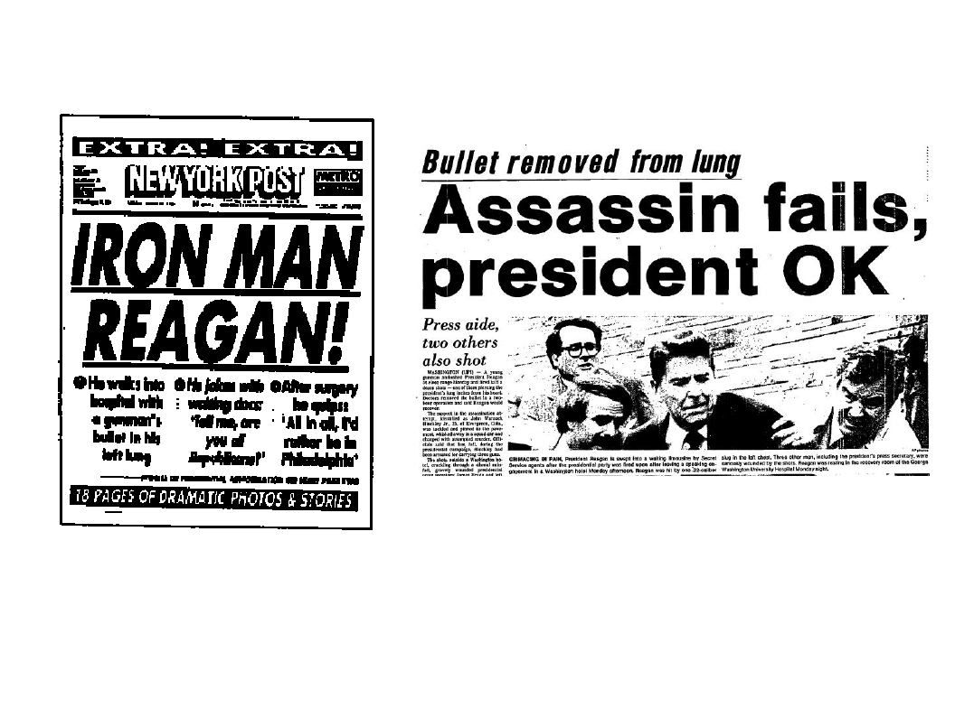
A Dramatic Start to the Reagan Presidency
•
On March 30, 1981, Reagan survived an assassination attempt by John
Hinckley, Jr. who shot the president in an effort to impress actress
Jodie Foster. Reagan was more badly injured than the administration
reported, but he remained optimistic and his approval rating reached
73%.

Slide 25
A Dramatic Start to the Reagan
Presidency
■
In 1981, Reagan appointed the first female Supreme Court Justice
Sandra Day O'Connor. Although she identified herself as a moderate
Republican, foes of abortion and the ERA condemned her appointment
to the bench.

Slide 26
Reagan Agenda: Limited
Government & Deregulation
“Government is not the solution to our problems,
government is the problem.”
Ronald Reagan, First Inaugural Address

Slide 27
The Reagan Agenda
Supply Side Economics (trickle down?)
Tax Cuts
Major Cuts in Entitlement Programs (social
welfare of Great Society)
✓
✓
✓

Slide 28
What did “Limited Government” Mean
in Reagan’s Agenda?
■ Deregulation
of the economy: Airlines,
television, telephone systems, public
utilities
■ Environment “Reforms”
■ “Get government off the back of
American business and people.”

Slide 29
What Else Did “Limited
Government” Mean?
Civil Rights: Justice Dept now actively opposes
1970’s busing to attain racial desegregation;
opposes affirmative action
Social Security Reform
Voting Rights Act extension: Reagan
Administration fought against extension (Congress
passed it anyway)
Vetoed Medical and Family Leave Act repeatedly
Attempted to Restrict abortion access to welfare
recipients, women in military and in foreign aid
programs.
■
■
■
■
■

Slide 30
Recession and Rebound
■
In 1982, the worst recession since the Great Depression
occurred. ****

Slide 31
The Deficit and the National Debt
■
■
■
The hike in defense spending, and vastly reduced tax revenues resulted
in a skyrocketing federal budget deficit .
By 1988, the interest alone on the national debt reached 14% of the
annual budget and the United States became the world's biggest
debtor.
Reagan’s goal to balance the budget by 1984 became unfeasible.

Slide 32
Foreign Policy Agenda
Restore US prestige internationally through
building up US defenses
Massive weapons build-up
Missiles placed in western Europe
SDI (“Star Wars Defense System”
■
■
■
■

Slide 33
Defense Spending Increases
■
■
■
One facet of Reagan's
ideological outlook was the need
to bolter America's defense
capability.
Despite vowing to dramatically
reduce taxes and government
spending, the Reagan
Administration increased
military spending by over 50%
between 1981 and 1988.
Reagan emphasized the
increasing military capability of
the USSR. He acknowledged the
expense of the military buildup,
but insisted it was vital to
national security.

Slide 34
Star Wars
■
■
■
■
In 1983, President Reagan proposed
his Strategic Defense Initiative as an
additional check on Soviet nuclear
capability.
Reagan envisioned space-based
missile defense technology capable of
striking down nuclear weapons before
they reached the United States.
"Wouldn't it be better to save lives
than to avenge them?"
The press derisively dubbed the plan
"Star Wars", and many believed it was
unfeasible due to the enormous
expense and technical innovation that
it would require to become
operational.

Slide 35
Foreign Policy: Cold War
USSR = “Evil Empire”
Escalated tension in first term with missile
systems and rhetoric
1985 (Gorbachev premier)
Summits & arms talks resume
Personal Diplomacy
“Mr. Gorbachev tear down this wall!”
■
■
■
■
■
■

Slide 36
Foreign Policy: Global Issues
“Reagan Doctrine” = support Freedom
Fighters (anti-communists)
■
■
Nicaragua, Guatemala, El Salvador
■
■
■
■
Invasion of Grenada
Panama, arrest strong man president
Arm groups fighting USSR in Afghanistan
CIA involvement

Slide 37
The Iran-Contra Affair
Read the article & Identify the 5 W’s.
Who
What
When
Where
Why????

Slide 38
The Reagan Administration’s NSC arranges secret arms for
Iran to fund covert military aid to Contra (anti communist)
forces in Nicaragua’s civil war. (In violation of US Law)
NSC Iran-
Contra point
man Oliver
North testifies
before
Congress.

Slide 39
The Iran Contra Scandal
Private US $
Foreign Gov’t $
Contras
Swiss bank
accounts;
controlled
by North
$$$
Hostages
Iran
weapons
US
Israel
weapons

Slide 40
Reagan Public Approval Ratings

Slide 41
THE BOTTOM LINE:
SUCCESS?
■
■
■
■
Major Recession 1981-
1983
Huge leap in
concentration of
wealth
Homelessness, poverty
Huge deficits (from
$70 billion to $270
billion in 1983)
■
■
■
But inflation did not
resume
By 1983 consumer
spending increased-
spurred by tax cuts?
Was it policies or an
overall shift in global
economy…?

Slide 42
Lasting Legacies
Power base of Southern and Western States increasingly
evident in National politics.
Republican Party becomes dominant party of last 25
years of century
Power of the organized Christian Right in Republican
Party
Deregulation of business, growth stimulated, but
inequality increased
Increased burden on state and local governments to
provide social welfare programs
■
■
■
■
■

