Slide 1
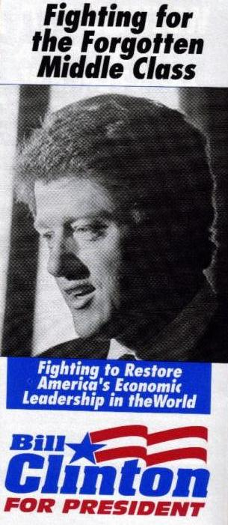
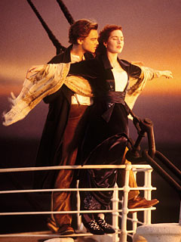
The 90’s and Bill Clinton 1993 – 2001
“It turns out that advancing equal opportunity and economic empowerment is both morally right and good economics, because discrimination, poverty and ignorance restrict growth, while investments in education, infrastructure and scientific and technological research increase it, creating more good jobs and new wealth for all of us.” - William J. Clinton

Slide 2
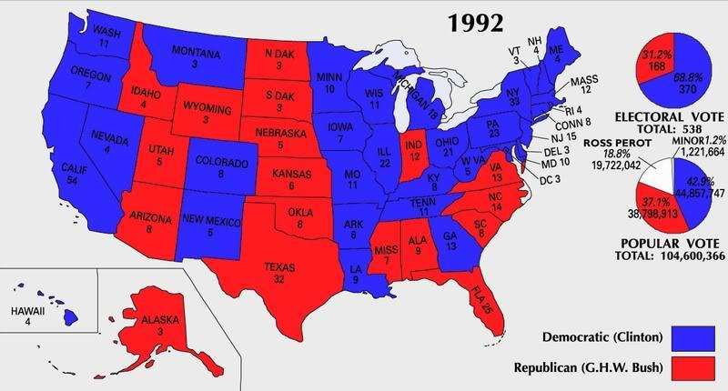
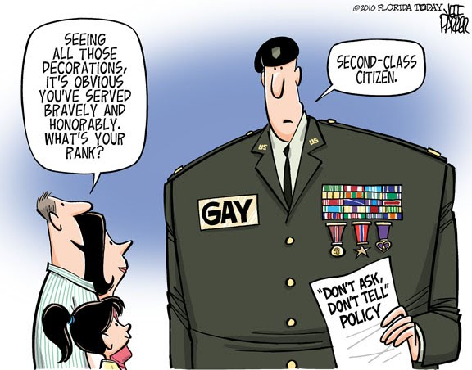
Clinton – Domestic Activity
Won due to a three party ticket – only 43% of the popular vote.
His philosophy – moderate in terms of liberal agenda (believed the “New Democrat” to be more “middle of the road”).
Ex: when confronted with the issue of gays and lesbians in the armed forces – created the “Don’t Ask Don’t Tell” policy to avoid the issue.
Ex: Signed (partly due to conservative congress) the Welfare Reform Bill – restricted welfare benefits and illegal immigration.
Decreased the deficit and balanced the budget – experienced great economy growth and prosperity!
The Lewinsky Affair tarnished the rest of his presidency – second president to go through the impeachment process.
Lied under oath – “I did not have sexual relations with that woman.”

Slide 3
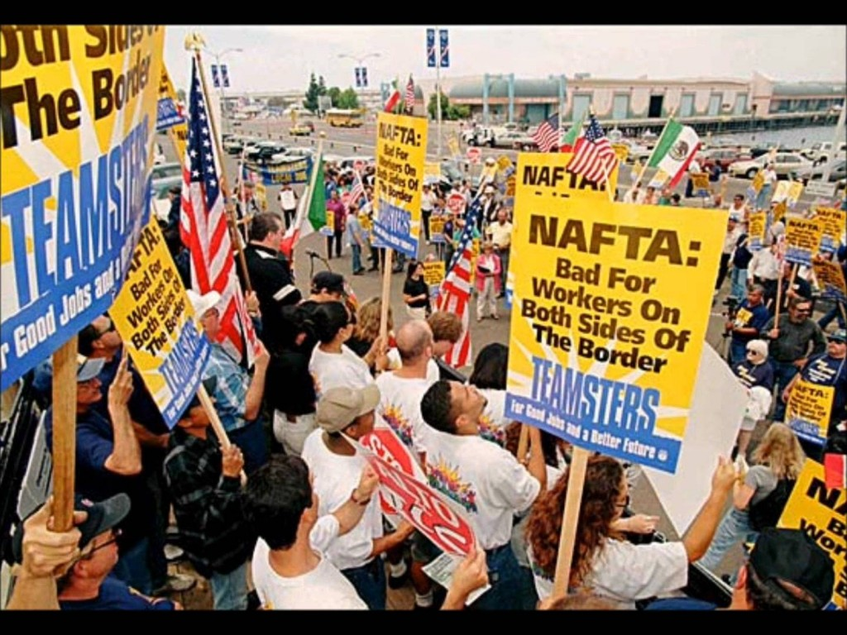
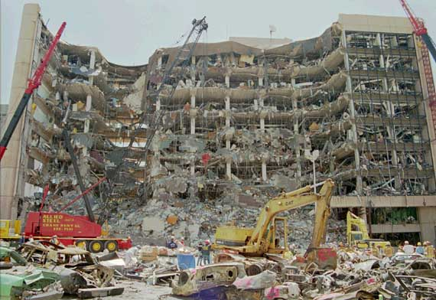
Clinton – Foreign Events
Globalization
Passed NAFTA (North Atlantic Free Trade Agreement) – free trade zone between Canada, US , and Mexico)
Accused of stealing US jobs as companies took their manufacturing to Mexico.
Also promoted the World Trade Organization (to promote free trade).
Conflict
Worked with NATO to send air strikes on Serbia during the Bosnia genocide.
Failed to act in the genocide in Rwanda.
Early signs of terrorism arise…
1993 Bin Laden World trade bombing attempt.
1995 McVey Oklahoma City Bombing.

