Slide 1
JFK’s Assassination
Chapter 36
Part Three

Slide 2
Assassination
Nov. 22, 1963
Kennedy assassinated by Lee Harvey Oswald in Dallas, Texas
Oswald arrested, murdered by Jack Ruby
Creates scandal and conspiracy theories
Lyndon B. Johnson becomes fourth president to succeed assassinated president
Americans shocked

Slide 3
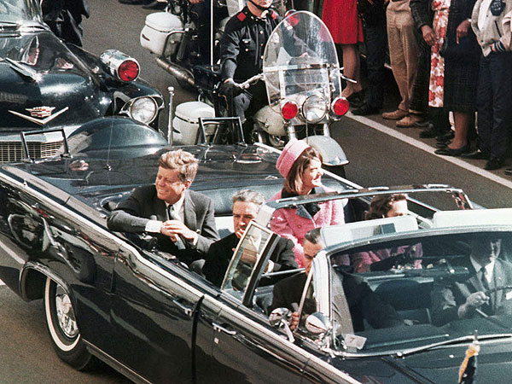

Slide 4
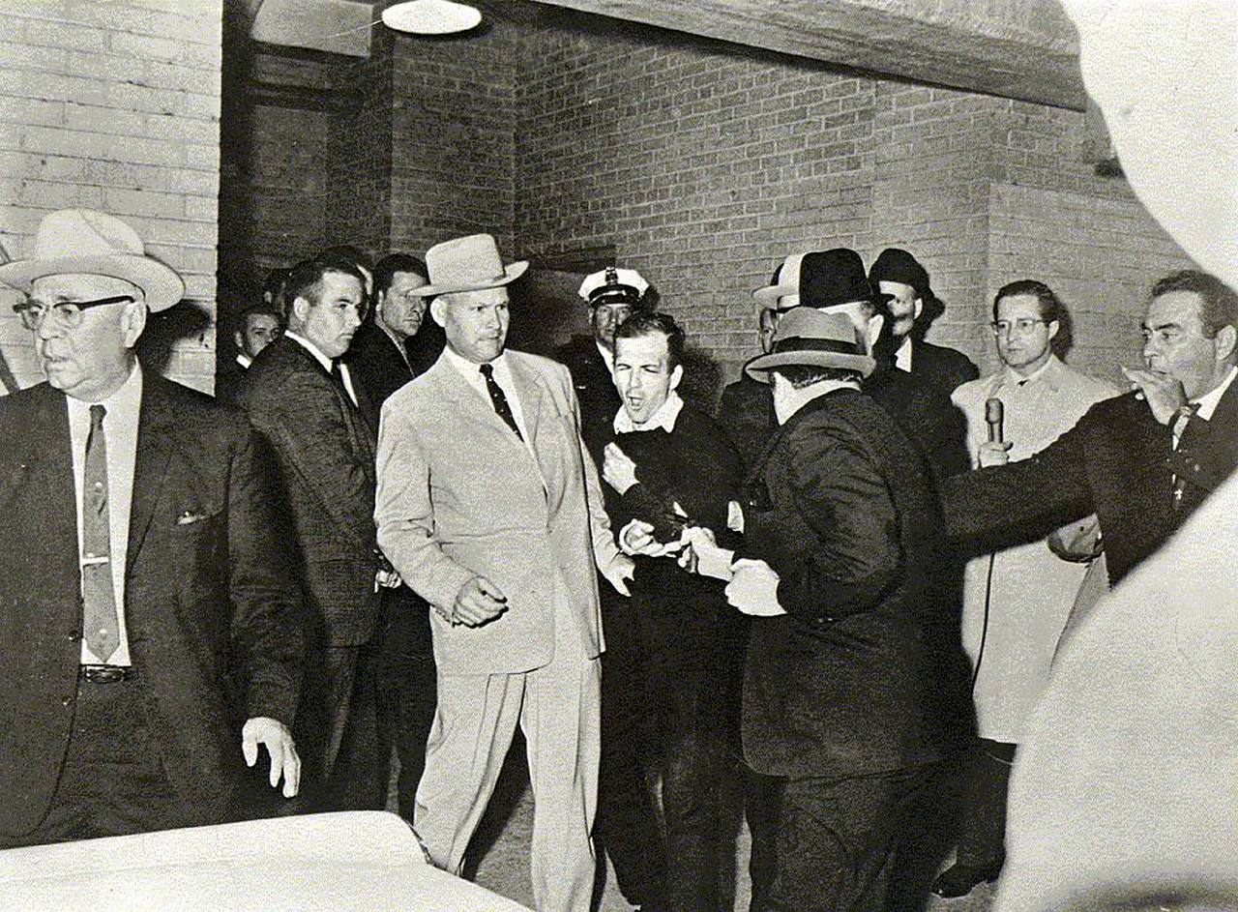

Slide 5
