Slide 1
Chapter 36
Part II

Slide 2
Trouble in Europe?
1961 – Soviets begin construction of Berlin Wall
Keep communists from escaping to prosperous, free western Europe
Western Europe
Common Market, precursor to EU
Lower barriers to trade and tariffs
Rejected by Charles de Gaulle, France
Tariff negotiations eased tariffs between Europe and US

Slide 3
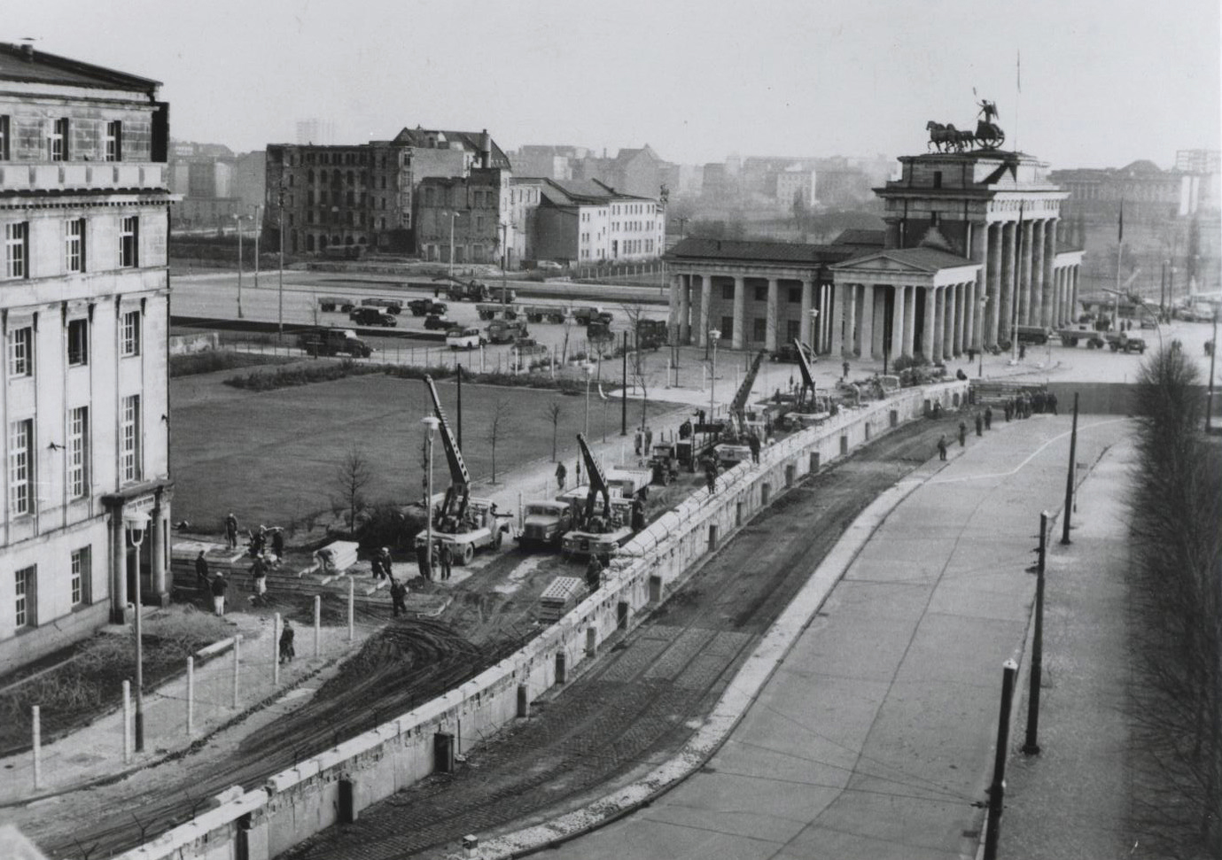

Slide 4
“Flexible Response”
De-colonization creates issues abroad
Congo erupts into violence in 1960 after Belgians leave
UN peacekeeping force dispatched
Laos gains independence from France in 54
Threatened by communism
Peace established at Geneva Conference in 62
McNamara pushes for “flexible response”
Array of military options to match gravity of situation
Green Berets, Navy Seals, other “special forces” established

Slide 5
The Vietnam Quagmire
Ngo Den Diem rules South Vietnam as dictator
Seizes wealth for family, persecutes Buddhist majority, torture of opponents
US aids Diem regime – anti-communists
675 U.S. Army “advisors” by 1960
Kennedy increases “advisors” to 16,000 by 1963
Purpose is to “maintain order” against Viet Cong led by Ho Chi Minh

Slide 6
The Cold War in Latin America
Alliance for Progress
“Marshall Plan for Latin America”
Aims to close rich-poor gap in Latin America
Stimulate Latin American economies
Prevent spread of Communism
Too little, too late

Slide 7
Bay of Pigs
Eisenhower approves plan in 1960
1400 Cuban exiles trained by CIA in camps in Guatemala
CIA believes invasion will be supported by Cuban people and military
Feb 1961 – Kennedy authorizes invasion plan
Night invasion in swamp
April 15 – US bombers painted as Cuban planes bomb Cuba
Miss targets, photos of planes surface, further raids cancelled
April 17 – invasion force lands, met by air attacks from Cuba, and 20000 troops
All captured or killed by April 19
Embarrassment for Kennedy
Destroys US/Cuba relations indefinitely

Slide 8
Cuban Missile Crisis
1962 – US spy planes find missile installations in Cuba
Nuclear missiles aimed at U.S.
90 miles from Florida
U.S. blockades Cuba
Threatens to sink Soviet ships transporting missiles
Khrushchev threatens war
13 day stand off
Khrushchev backs down, missiles return to Russia
Loses power shortly afterward
Soviets remove missiles from Cuba
U.S. agrees never to invade again and remove missiles from Turkey
In response “hot line” installed between Washington and Moscow
June, 1963 Kennedy urges better relations with Soviets
Détente – relaxed tension

Slide 9
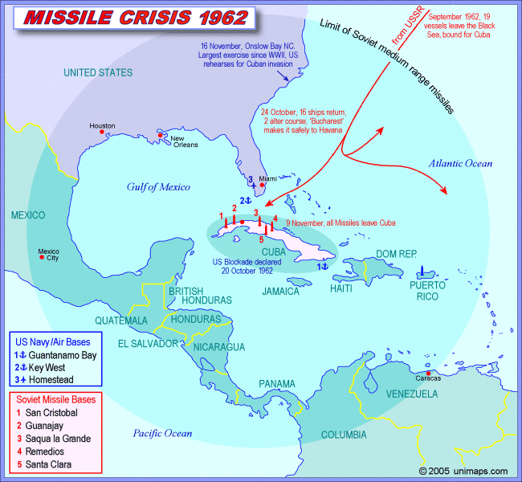

Slide 10
Civil Rights
Kennedy campaigns for black vote
Seems unwilling to support civil rights legislation
Freedom Riders
Chartered busses for trips through south to promote end to segregation
Often attacked by white southerners
Draws attention to civil rights issues
1962 – James Meredith, veteran tries to enroll at University of Mississippi
Kennedy sends 400 federal marshals and 3000 troops

Slide 11
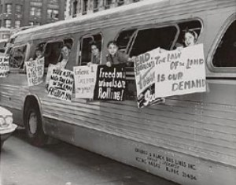
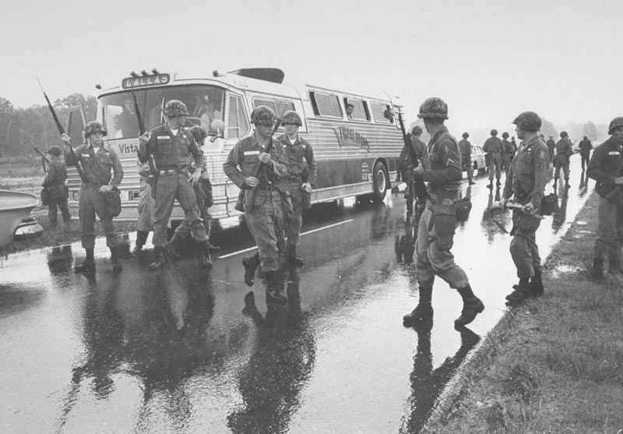
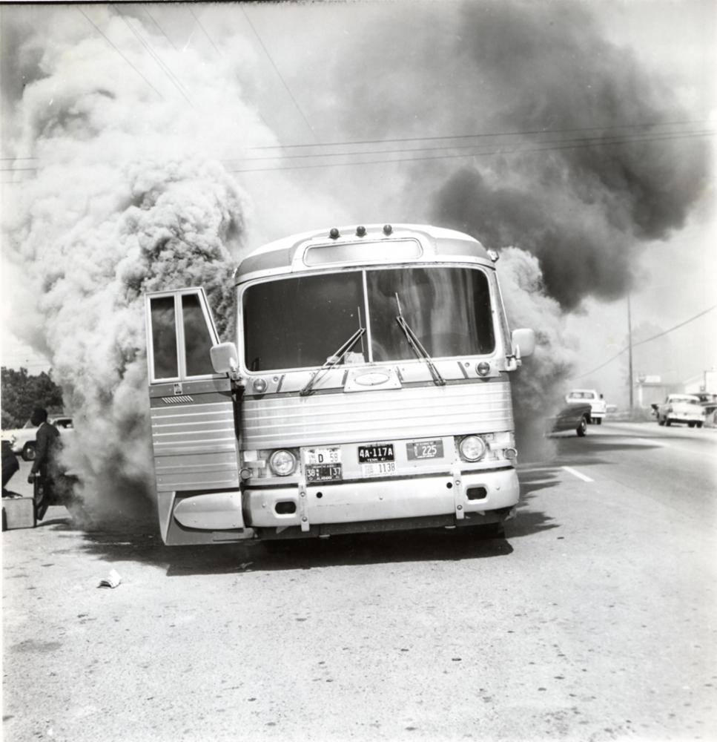
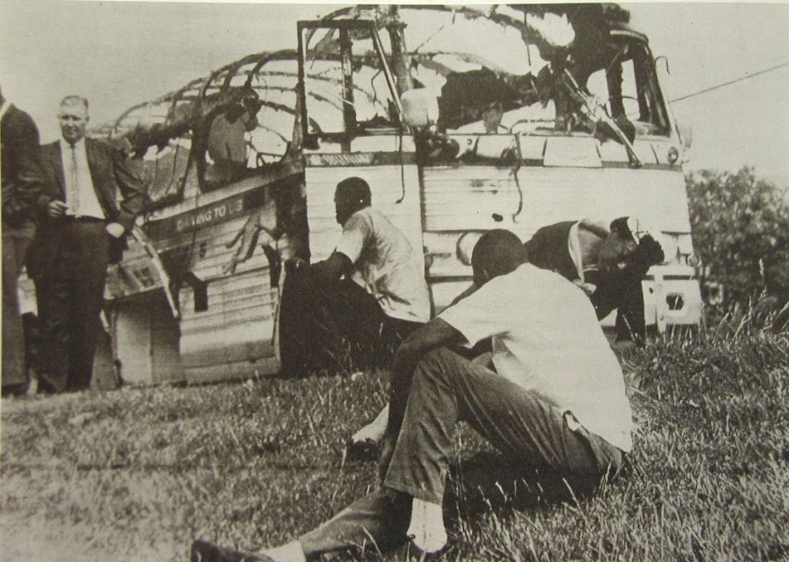

Slide 12
M.L.K. Jr.
Spring of 1963
Peaceful protests launched in Birmingham Alabama
Met with force by police
American public shocked by images of brutality shown on national TV
June 11, 1963
Kennedy urges immediate action on “moral issue”
Sept. 1963 – bomb kills four girls in black church in Birmingham
Civil Rights struggle continues

Slide 13
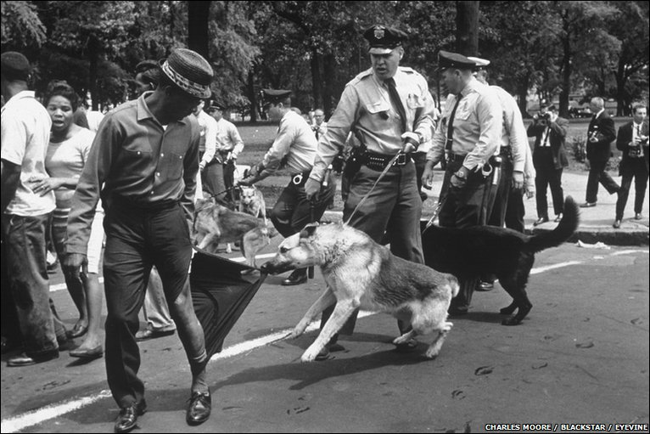

Slide 14
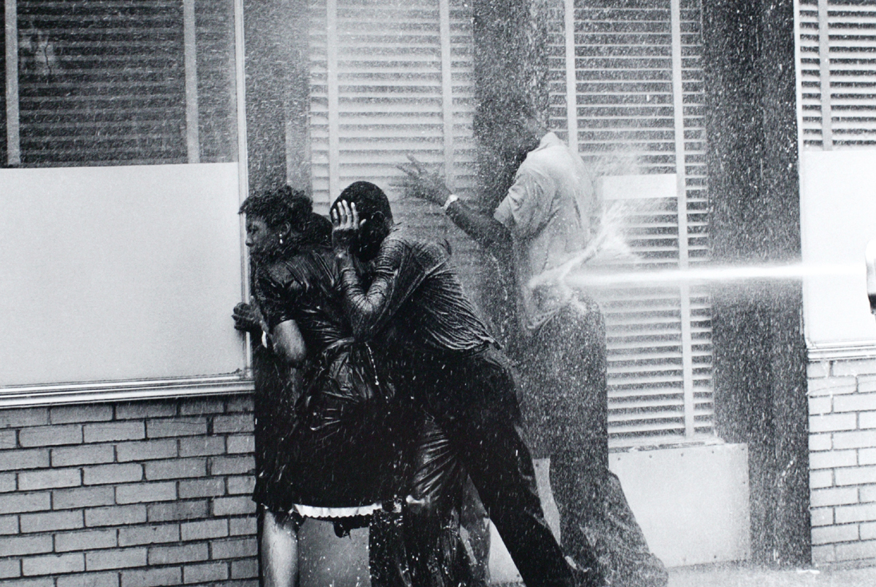

Slide 15
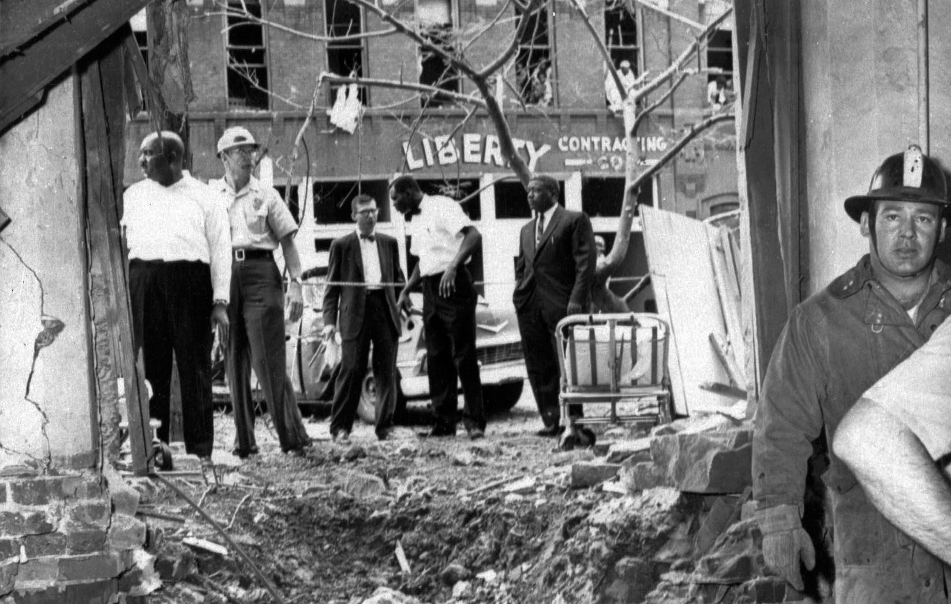

Slide 16
