Slide 1
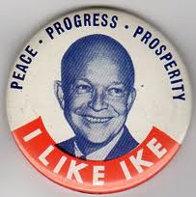
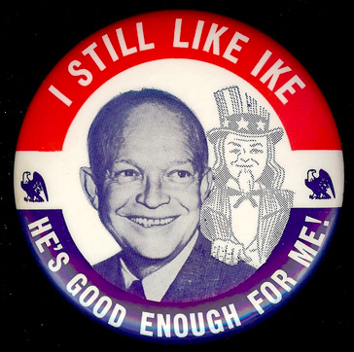
I like Ike!
Chapter 36

Slide 2
Affluent Society
Transistor
International Business Machines
Aerospace Industry
Boeing 707
1956 – “white-collar” workers outnumber “blue-collar” workers
Union membership peaks in 1954
Increasing number of women
40 million new jobs

Slide 3
The Feminist Movement
Betty Friedan
1963 – The Feminine Mystique
Best seller
Credited with beginning the modern feminist movement
Book points out unhappiness of housewives
Friedan helps found National Organization for Women in 1966

Slide 4
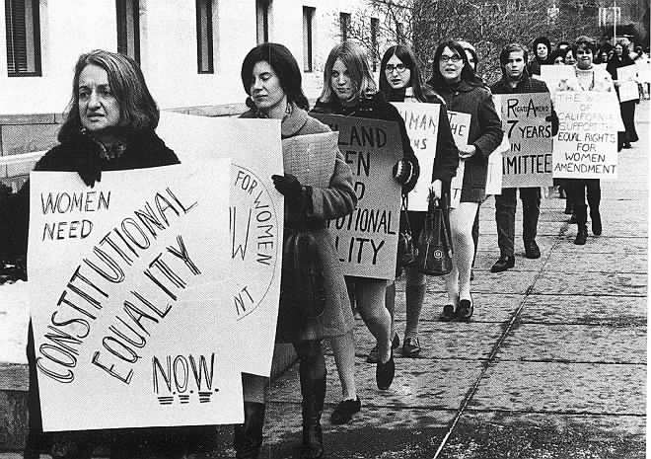

Slide 5
Consumer Culture
1950s
Diner’s Club credit cards, McDonald’s, Disneyland, television stations
Televangelists – Billy Graham, Oral Roberts, Fulton Sheen
Brooklyn Dodgers/New York Giants move to Los Angeles and San Francisco
Elvis Presley becomes pop sensation
Critics
Too much sexuality
John Kenneth Galbraith – The Affluent Society
Private wealth v. public good

Slide 6
Election of 1952
Democrats – Adlai Stevenson
Illinois Governor
Republicans – Dwight Eisenhower with Richard Nixon
Campaign
Eisenhower liked by most, campaigning left to Nixon
Attacks Stevenson as weak on Korea and Communism

Slide 7
Nixon
Nixon accused of financial corruption
Delivers “Checkers Speech” on national TV
Denies wrongdoing, speaks of family, cocker spaniel Checkers
New power of television
Eisenhower later answers questions in a studio
Spliced with audience
Helps curtail power of machines and party leaders

Slide 8
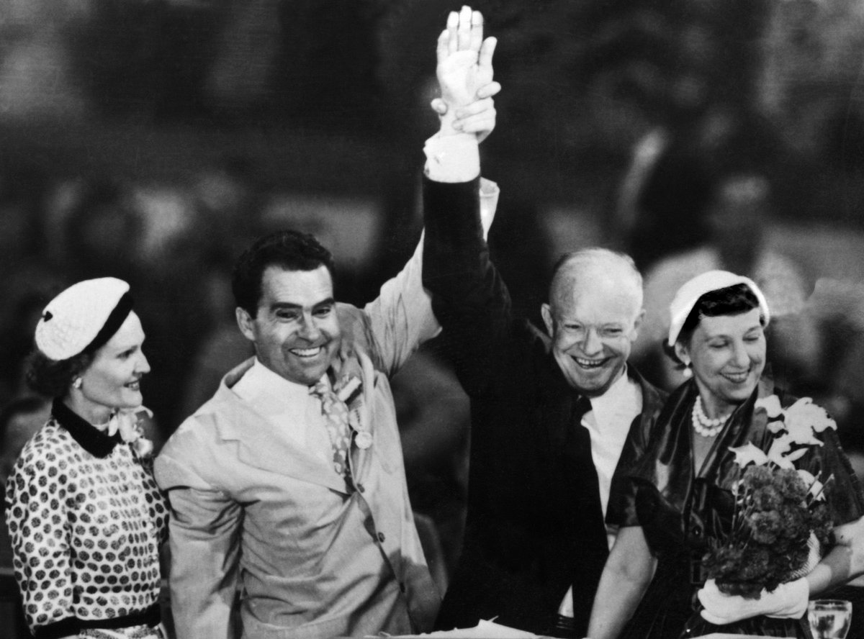

Slide 9
Ike Wins
442 – 89 in EC
Flies to Korea to move stalled negotiations
Fails
Seven months later
Nuclear weapons threat
Armistice signed
54000 Americans dead
Billions of dollars spent
Communism contained?
Eisenhower comes to embody cooperation
Weak record on civil rights

Slide 10
Seeds of Civil Rights
1946 – Black soldiers lynched in Georgia
Truman creates Commission on Civil Rights
Asks Congress to pass anti-lynching law
Truman issues Executive Order 9981
Armed forces desegregated
Eisenhower does little to support civil rights after Truman
Won’t support civil rights legislation

Slide 11
Desegregation
1947 – Jackie Robinson signs with Brooklyn Dodgers breaking racial barrier
Jim Crow in South
20% of blacks actually able to vote
Lynchings common
Gunnar Myrdal – An American Dilemma
US failed to achieve victory against racism

Slide 12
Early Efforts
1950 - NAACP – Sweatt v. Painter
Separate professional schools for blacks are not equal
1955 – Rosa Parks refuses to give up seat on bus
Martin Luther King, Jr. begins peaceful civil rights protests
Images of suffering and discrimination begin showing up in national media

Slide 13
The Supreme Court
Earl Warren – Supreme Court Chief Justice
Rules in favor of African-Americans
Brown v. Board of Education of Topeka
Reverses 1896 Plessy v. Ferguson
“separate but equal” inherently unequal
Schools ordered to integrate
Deep South attempts to delay/disobey
Real integration doesn’t occur until 1970

Slide 14
Eisenhower’s Domestic Policy
“Dynamic Conservatism”
Liberal with people, conservative with money
Reigning in the budget
Decreased military spending
Transfer control of offshore oil to states
Private company to take over for TVA

Slide 15
Dynamic Conservatism Continued
Cracked down on illegal Mexican immigration
1 million deported in 1954
Proposed return to Dawes Act for Indians
Abandoned after protest
Keeps Social Security and unemployment insurance
Signs Interstate Highway Act
Only balances budget 3 out of 8 years
1959 – biggest peacetime deficit in history to that point

Slide 16
Civil Rights
Eisenhower refuses to issue statement acknowledging Brown ruling
Privately complains about ending segregation
1957 – Gov. Orval Faubus of Arkansas refuses integration of schools
Calls up National Guard to prevent integration of nine students in Little Rock’s Central High School
Ike sends federal troops to escort children to classes
Congress passes Civil Rights Act (1957)
Civil Rights Commission established
Investigate violations
Federal injunctions to protect voting rights

Slide 17
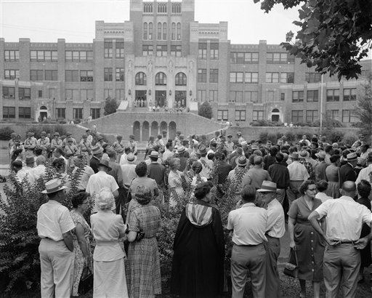

Slide 18
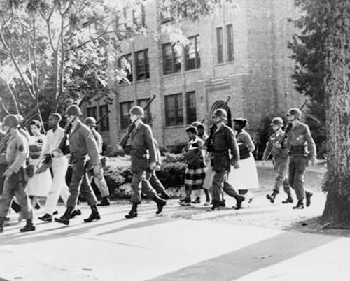

Slide 19
Growing Civil Rights Movement
Martin Luther King, Jr. founds Southern Christian Leadership Conference (SCLC)
Mobilize the power of black churches to advocate for civil rights
Feb. 1, 1960 – “sit-in” movement in Greensboro, NC
Four black college freshmen at Woolworth’s lunch counter
April 1960 – southern black students form Student Non-Violent Coordinating Committee (SNCC)
Focus civil rights efforts

Slide 20
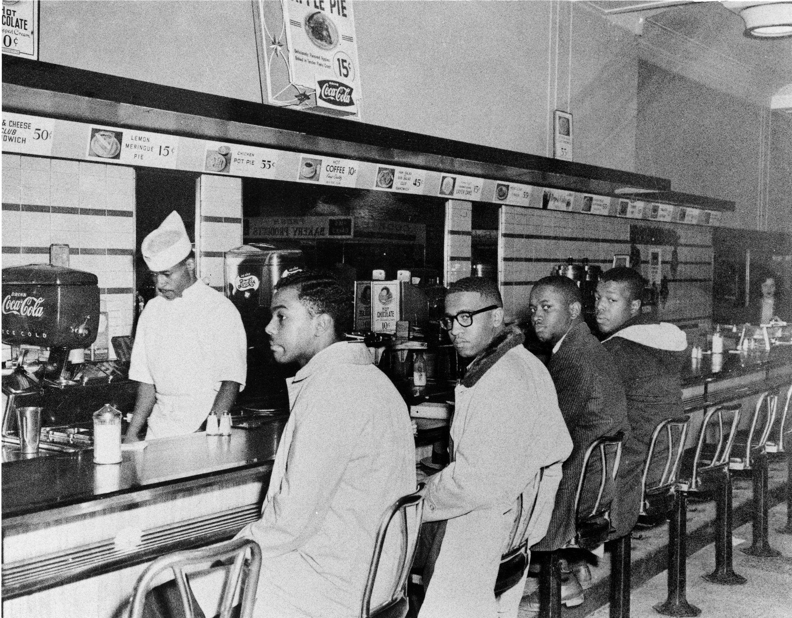

Slide 22
Foreign Policy
John Foster Dulles – Secretary of State
Containment not enough
“Rollback” of Communism
Advocates decreased defense spending by building fleet of bombers
Strategic Air Command
“Massive Retaliation”
Eisenhower Doctrine
Countries could request military or economic aid from US
Specifically applied to Middle East

Slide 23
Trouble in Vietnam
Ho Chi Minh – Revolutionary leader
Attempted to convince Woodrow Wilson to aid Vietnamese against French
Abandoned after becoming communist
Japanese occupy Vietnam during WWII
1954 – French forces trapped at Dienbienphu
Aids urge Ike to bomb Viet Minh guerillas
Ike refuses
Vietnamese win, split at 17th parallel
Ho Chi Minh supposed to allow free elections
North becomes communist, south democratic
Secretary Dulles creates Southeast Asian Treaty Organization (SEATO)
Largely ineffective

Slide 24
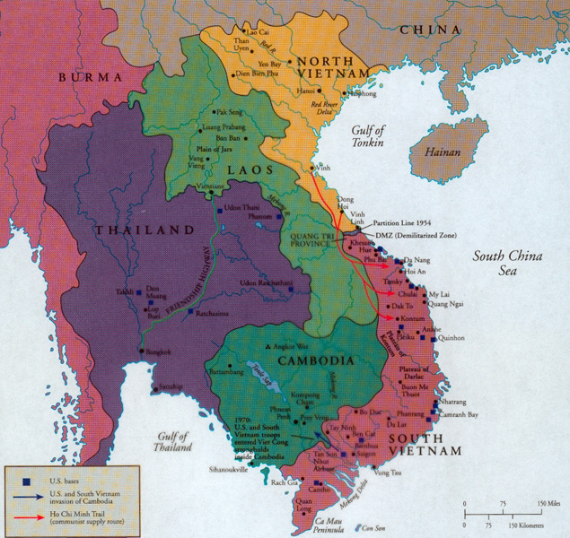

Slide 25
Cold War in Europe
1955 – Warsaw Pact formed as reaction to NATO
Eisenhower presses for arms reduction
Soviets seem cooperative
Khrushchev publicly denounces Stalin
1956 – Hungarian Revolt brutally crushed with massive bloodshed
US slackens immigration quotas
30000 Hungarians allowed into America

Slide 26
Cold War in the Middle East
1953 – CIA engineers coup in Iran
Shah Mohammed Reza Pahlevi installed as ruler
Increases tension with Arab population
Suez Crisis – 1956
Nasser, Egypt, needs money to build Aswan Dam
Approaches Soviets, Americans withdraw offer
Dam nationalized
Oct. Britain, France, Israel attack Egypt expecting US Support
Ike withholds oil, attack withdrawn
1960 – Saudi Arabia, Kuwait, Iraq, Iran, Venezuela form Organization of Petroleum Exporting Countries (OPEC)

Slide 27
The Space Race
Oct. 4, 1957 – Russians launch Sputnik I
Nov. Sputnik II launched
Demoralizing to Americans
Proves communist superiority in science
Fears of Soviets firing missiles from space
Critics say Truman hadn’t spent enough on missile programs
Science used for consumer products
Feb. 1958 – US launches first satellite
Concerns raised over state of US education
1958 – National Defense and Education Act (NDEA)
$887 million in loans to college students and grants for improving schools

Slide 28
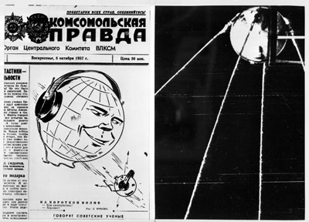

Slide 29
Cold War Continues
October 1958 – US and Soviets halt “dirty” testing of atomic weapons
No formal agreement
1959 – Khrushchev invited to U.S. by Ike
Talks of disarmament
Paris conference – 1960
Soviets angered by U-2 shot down over Soviet territory
Eisenhower takes responsibility
Tensions increase

Slide 30
The Cold War in Latin America
Latin American nations resent US aid to Europe and constant intervention
1959 – Fidel Castro overthrows Fulgencio Batista
Denounces US imperialism
Begins seizing US property
US stops importing sugar
More property seized
Diplomatic relations ended in 1961
Khrushchev threatens missile attack if Cuba attacked by US
Organization of American States created to fight communism in Americas
$500 million given to Latin American countries

Slide 31
Labor Unrest
Labor reform bill passed in 1959
Teamster “Dave” Beck imprisoned for embezzlement
Successor Hoffa gets Teamsters expelled from AFL-CIO
Later jailed for jury tampering , disappears while in prison
Landrum-Griffin Act passed
Tightening on financial corruption of labor leaders
Prevent bullying tactics
Outlaws certain types of picketing

Slide 32
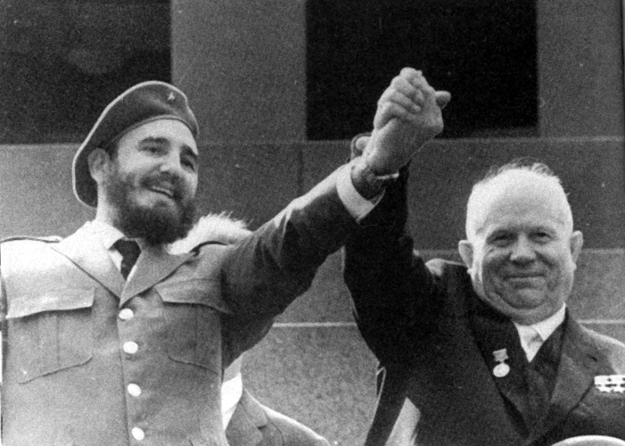

Slide 33
Election of 1960
Republicans chose Richard Nixon with Henry Cabot Lodge Jr.
Democrats nominate John F. Kennedy with Lyndon B. Johnson
Kennedy attacked for being Catholic
Defended himself
Loses some southern votes but gains northern votes
Four televised debates
Kennedy wear makeup, appears poised, charismatic
Nixon appears out of his element
Radio listeners say Nixon won debates
Kennedy becomes youngest elected president at 43

Slide 34
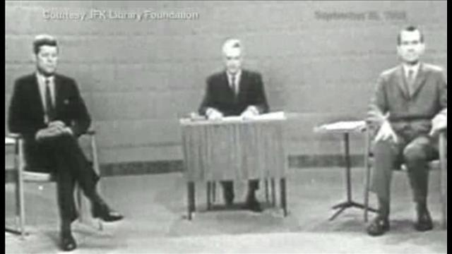

Slide 35
1960
1960 Election – Kennedy beats Nixon
Role of television?
Youngest elected president at 43
1960s Cultural Changes
Sexual revolution, civil rights movement, “youth culture,” Vietnam War, feminist movement
Inaugural address
“Ask not what your country can do for you, but what you can do for your country.”
Youthful Cabinet
Robert Kennedy, Robert McNamara

Slide 36
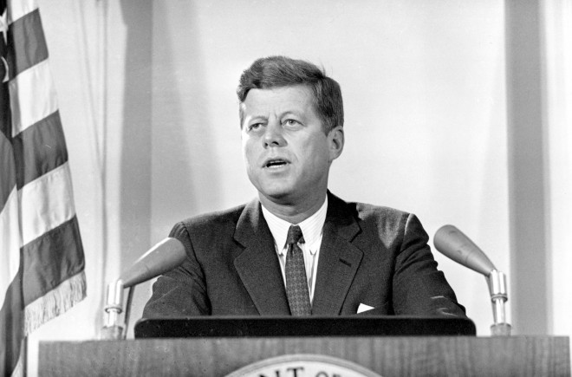

Slide 37
Kennedy’s “New Frontier”
Social program
Increased spending on health care/education
Opposed by conservatives
Bills stall in Congress
Maintain economic strength, limit inflation
Tax cuts to stimulate economy
Space Program
Goal of placing man on the moon

