Slide 1
The Beginnings of the Cold War 1945-1952
Chapter 35

Slide 2
Economic Troubles
WWII ends in 1945
Fears of new depression
Inflation shoots up, GNP sinks
Labor strikes
Taft-Hartley Act passed
Outlaws “closed” shops, holds unions liable for damages, requires non-communist oaths
Strike against organized labors

Slide 3
Economic Troubles
“Operation Dixie”
Unions fail to organize in South and West
Employment Act of 1946
“promote maximum employment, production, and purchasing power”
Servicemen’s Readjustment Act of 1944
GI Bill of Rights, free college education

Slide 4
Economic Boom 1950 - 1970
Roots of Prosperity
War forced massive production increase
Military Spending
Korean war, Vietnam War, Cold War, aerospace, plastics, electronics, R&D
Cheap Energy
New fertilizers
Production increases, farm pop. decreases

Slide 5
The Sunbelt
Growth of Sunbelt—15-state area:
From Virginia through Florida, Texas, Arizona, California
Had population growth rate twice that of Northeast
California by 1963 = most populace state in USA
South and Southwest a new frontier
Electronics and aerospace industry in California, Texas, and Florida
Laws more favorable to business owners
Political power grows

Slide 6
The Suburbs
White Flight
Whites flee cramped apartments in cities
FHA and VA guarantee cheap loans
Loans often refused to blacks due to “risk factor”
1960 25% of Americans live in suburbs
Levittown
Levitt brothers build monotonous cheap houses in planned neighborhoods

Slide 7
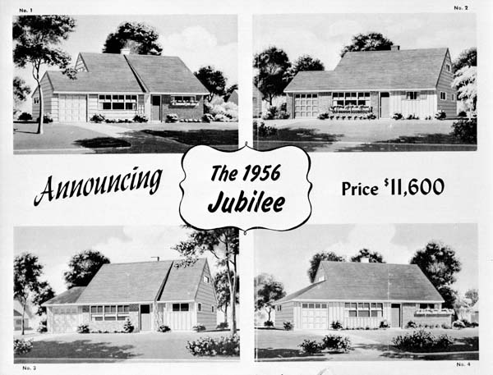

Slide 8
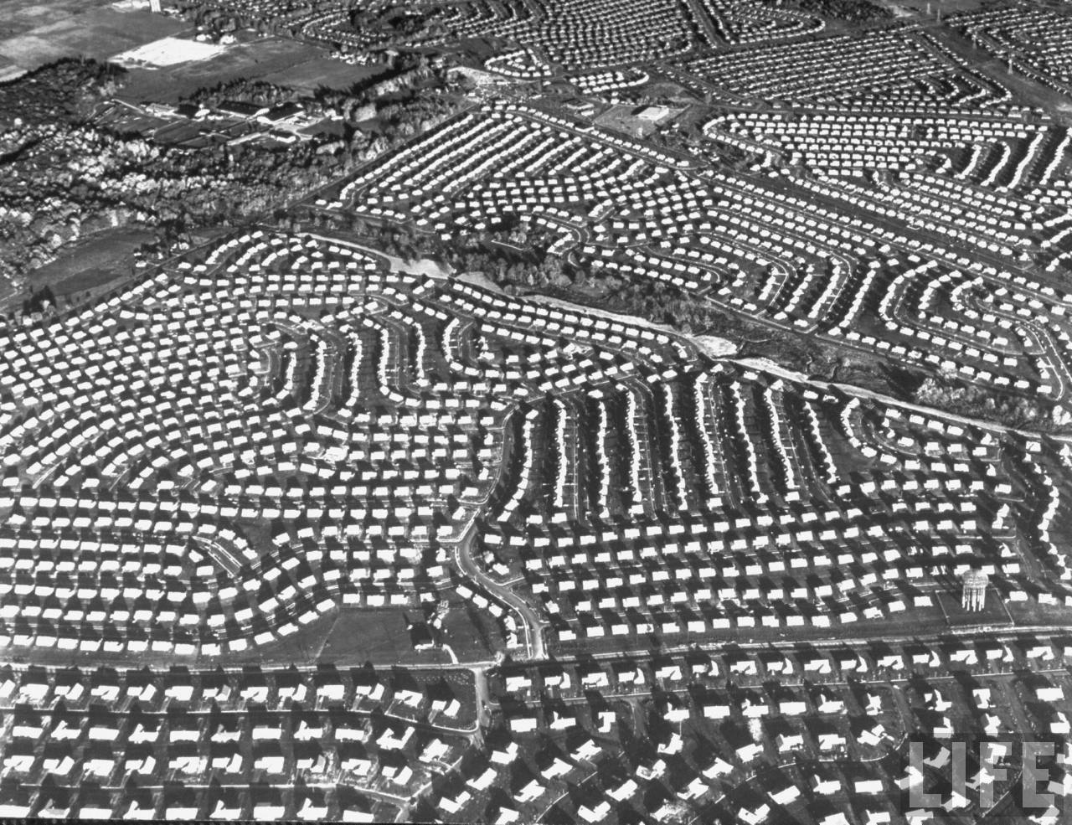

Slide 9
Baby Boom
Baby boom:
Huge leap in birthrate in fifteen years after 1945:
Record number of marriages at war's end
Began immediately to fill nation's empty cradles
Touched off demographic explosion adding 50 million to nation by end of 1950s
Crested in 1957
By 1973, fertility rates dropped below point necessary to maintain existing population without immigration

Slide 10
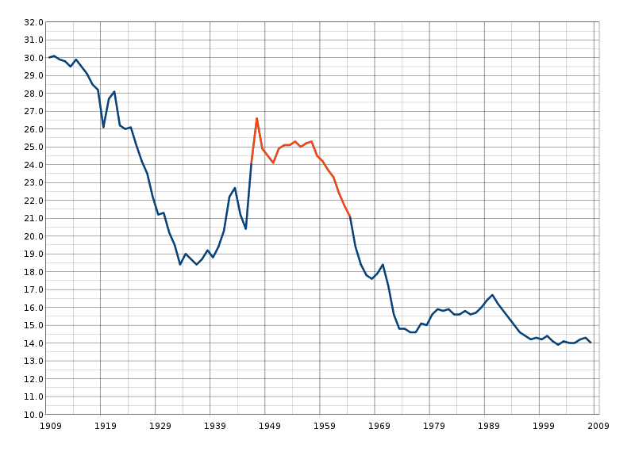
The Baby Boom

Slide 11
Truman
Becomes president after death of FDR in 1945
1st president in years without a college degree
Cabinet is “Missouri Gang”
Friends from Senatorial career in Missouri
Habit of sticking to decisions to prove decisiveness

Slide 12
Yalta Conference
Feb. 1945: Final meeting of “big three”
Stalin pledges representative gov. with free elections for Poland, Bulgaria, and Romania
Soviets agree to attack Japan
Granted control of railroads in Manchuria and privileges in Darien and Port Arthur
Critics claim FDR sells out Chiang Kai-shek
Supporters claim agreement limits Soviets

Slide 13
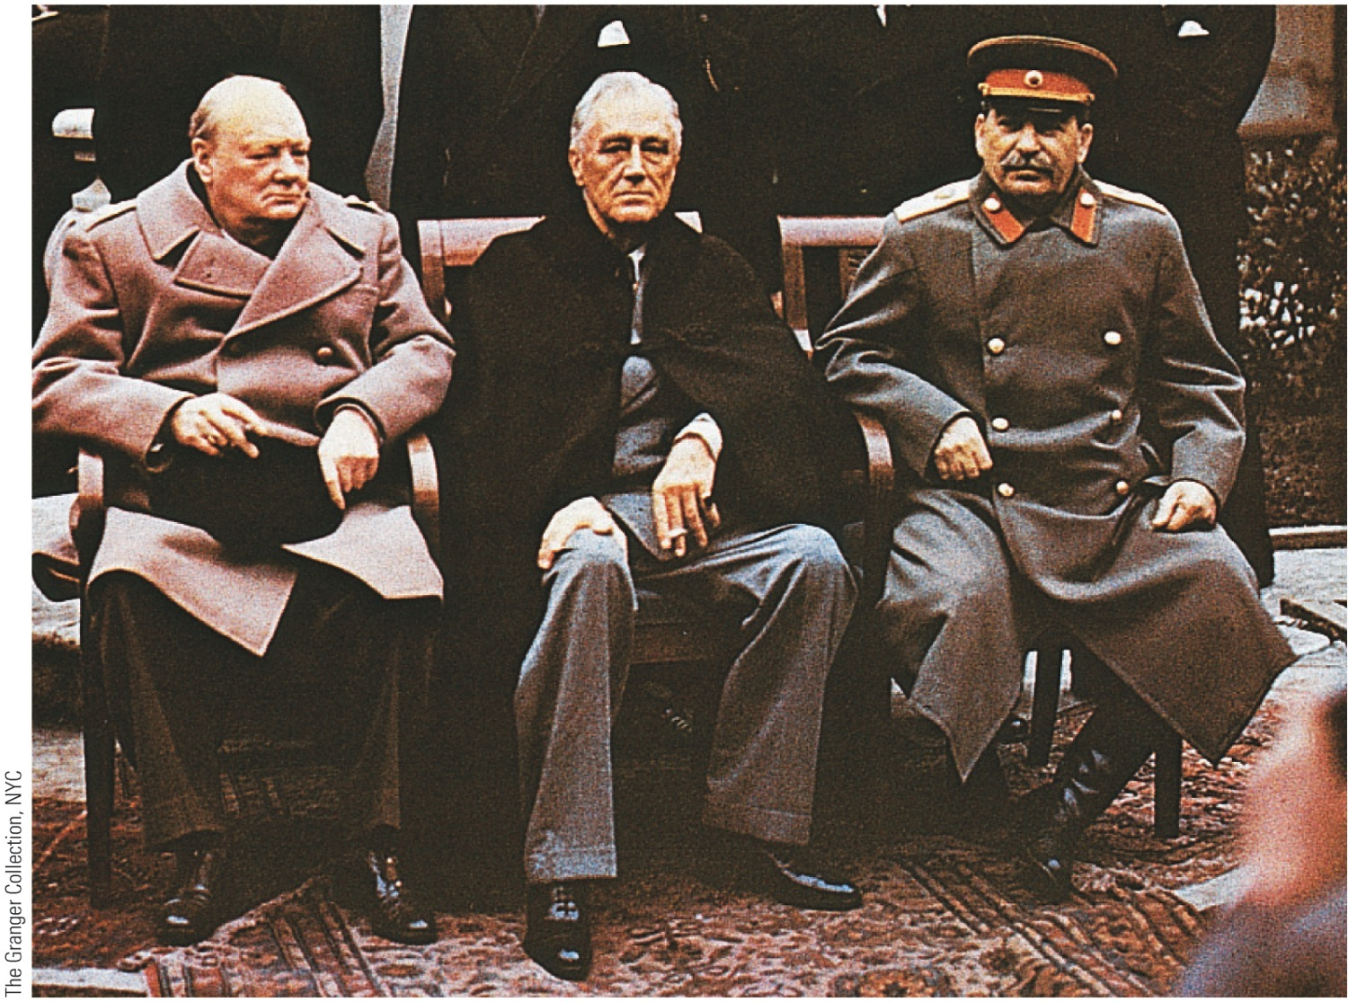
p821
Notes:
The Big Three From left to
right, Churchill, Roosevelt, and
Stalin sit somberly at their
fateful meeting at Yalta in
February 1945. Roosevelt was
only weeks away from death.

Slide 14
Potsdam
July 1945
Major Decisions
Korea divided at 38th parallel
Occupation zones set up for Germany
War Crimes Trials agreed upon
Destruction of German Economy
Stalin demands western “buffer”
Unconditional surrender demanded of Japan

Slide 15
U.S./Soviet relations
Soviet Union not recognized until 1933
Delay in opening 2nd front during WWII
Soviets not involved in atomic bomb
Lend-lease program ended in 1945
Denied $6 billion loan to Russia

Slide 16
The Postwar World
Bretton Woods, NH, 1944 – International Monetary Fund established
Regulating of currency exchange rates
United Nations – April 25, 1945
UN Charter written in San Francisco, to be located in New York
Security council (China, Soviet Union, Britain, France, U.S.A.) holds veto power
Senate overwhelmingly approves 89-2
Bernard Baruch calls for creation of agency to investigate nuclear sites immune to veto
Vetoed by Soviets
Israel created May 14, 1948

Slide 17
Problems in Germany
Nuremberg Trials
22 top Nazis punished for role in Holocaust
U.S. wants economically healthy Germany, Soviets want reparations
Divided into 4 occupation zones
1948 – Soviets blockade Berlin in attempt to drive allies out
Berlin Airlift feeds people of Germany, blockade ends

Slide 18
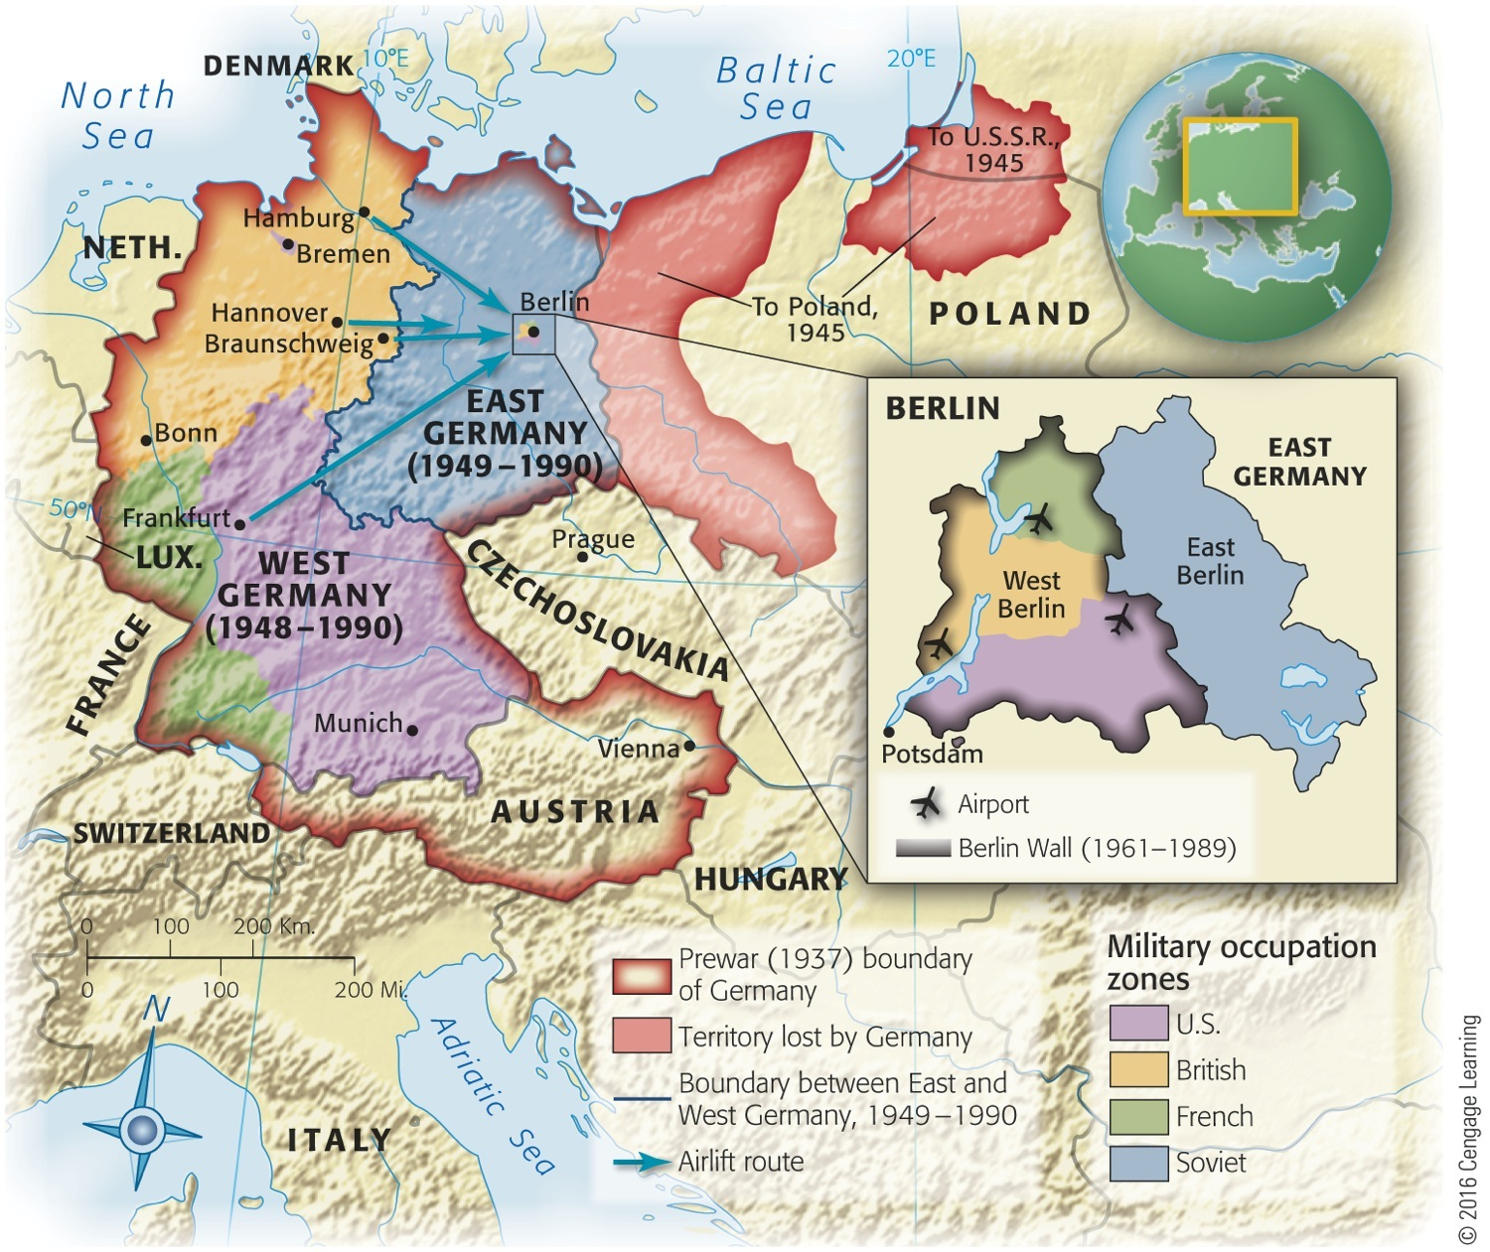
Map 35-1 p825
Notes:
Map 35.1 Postwar Partition
of Germany Germany lost
much of its territory in the east
to Poland and the Soviet Union.
The military occupation zones
were the bases for the formation
of two separate countries in 1949,
when the British, French, and
American zones became West
Germany, and the Soviet zone
became East Germany. (The two
Germanys were reunited in 1990.)
Berlin remained under joint fourpower
occupation from 1945 to
1990 and became a focus and
symbol of Cold War tensions.
© 2016 Cengage Learning

Slide 19
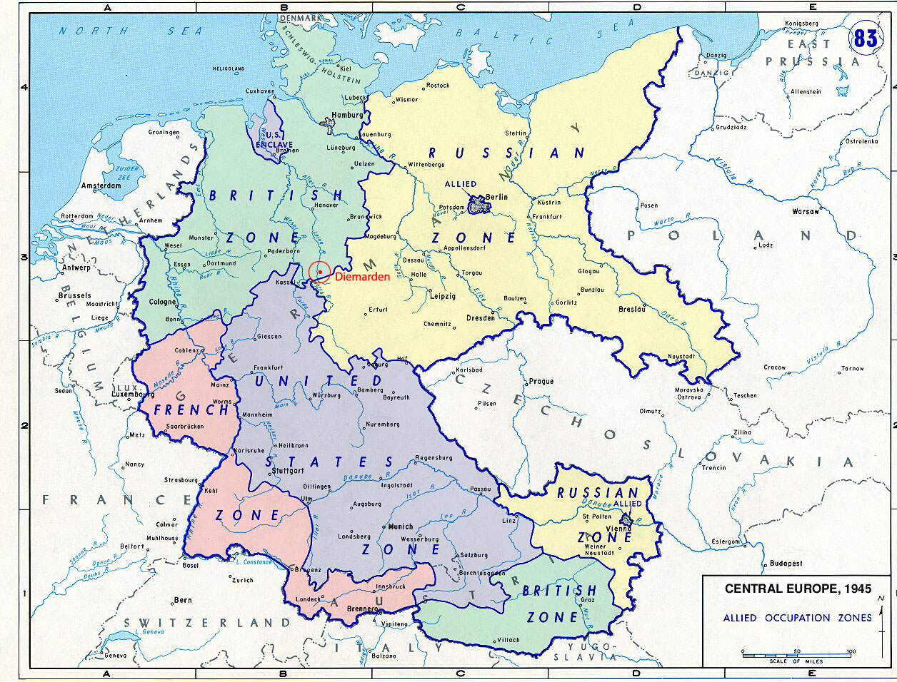

Slide 20
The Truman Doctrine
1946 – Stalin sends troops to aid Iranian Rebels
US protests
Truman adopts Kennan’s “containment policy”
March 12, 1947 - $400 million in aid requested for Turkey and Greece
US would aid any country fighting “communist aggression”

Slide 21
The Marshall Plan
Restart economies of Western Europe
Communism can’t spread in strong economies
$12.5 billion over four years
Congress resists until Soviet coup overthrows Czechoslovakian gov.
Aids 16 nations
Aid offered to Soviets and eastern Europe, but refused

Slide 22
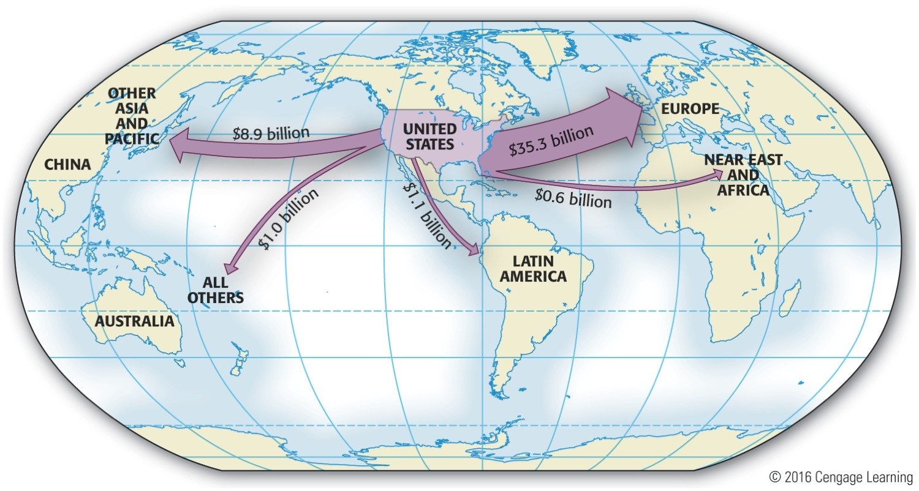
Map 35-2 p828
Notes:
Map 35.2 United States Foreign
Aid, Military and Economic, 1945–
1954 Marshall Plan aid swelled
the outlay for Europe. Note the
emphasis on the “developed” world,
with relatively little aid going to
“developing.” © 2016 Cengage Learning

Slide 23
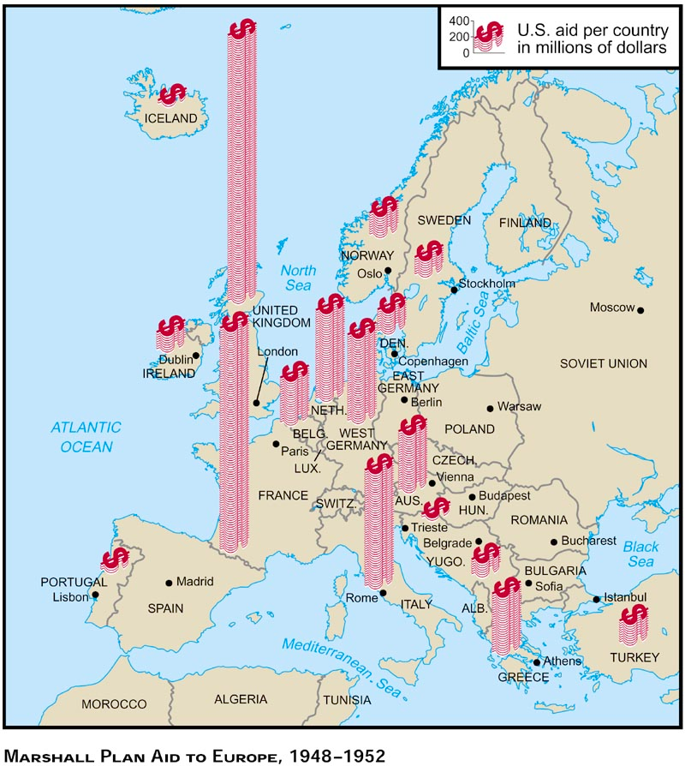

Slide 24
Cold War Deepens
Marshall Plan a spectacular success:
U.S. dollars assisted anemic Western European nations
“Economic miracle” drenched Europe in prosperity
Communist parties in Italy and France lost ground
Two countries saved from communism
Truman on May 14, 1948 officially recognized state of Israel on day of its birth
Antagonized oil-rich Arabs who opposed such a state in British mandate territory of Palestine
Decision greatly complicated USA-Arab relations

Slide 25
America Rearms
1947 – National Security Act
Creates Department of Defense
National Security Council to advise president
Central Intelligence Agency for spying
1948 – Congress authorizes “Voice of America.” It begins broadcasting to eastern Europe, draft restarted
North Atlantic Treaty Organization (NATO)
U.S., France, Britain, 10 other European countries
Attack on one is attack on all
Warsaw Pact formed by USSR in response
NATO grows to 15 countries by 1955

Slide 26
Reconstruction and Revolution in Asia
Douglas MacArthur commands reconstruction in Japan
Tries Japanese Criminals
Dictates constitution adopted in 1946, democratizes Japan
In China →Mao Zedong and communists defeat Chiang Kai-shek in 1949
¼ of world’s population now communist
Critics claim Truman didn’t do enough
Nationalists retreat to Taiwan

Slide 27
Nuclear Arms Race
1949 – Soviets detonate first atomic weapon
3 years before predicted by US experts
1951 – Julius and Ethel Rosenberg executed for selling nuclear secrets to Russians
1952 – U.S. detonates first hydrogen bomb
Soviets follow suit one year later
Race to build larger, more powerful nuclear weapons begins

Slide 28
Another Red Scare
Loyalty Review Board created
Investigates 3 million federal employees
Attorney General draws up list of 90 potentially non-loyal organizations
1949 – 11 communists charged with violating Smith anti-sedition Act of 1940.
Convictions upheld by Dennis v. US in 1951

Slide 29
McCarthyism
House established Committee on Un-American Activities (HUAC) in 1938 to investigate “subversion”
Alger Hiss prosecuted by Richard Nixon in 1948
1950 – Joseph McCarthy claims to have evidence of unknown communists in State Department
Ignites fears of communist infiltration
Initially popular but popularity fades after televised Army-McCarthy hearings.
Truman vetoes McCarran Internal Security Bill
Authority to arrest/detain during “internal security emergencies”

Slide 30
Election of 1948
Republicans win House in 1946
Nominate Thomas Dewey for president in 1948
Democrats nominate Truman
Eisenhower refuses nomination
Southern Democrats (Dixiecrats) nominate J. Strom Thurmond as State’s Rights Party nominee
Progressive Party nominates Henry Wallace

Slide 31
Dewey Defeats Truman
Democratic disorganization
Dewey seems destined to win
Chicago Tribune prints headline “DEWEY DEFEATS TRUMAN”
Truman wins election 303-189 in EC
Democrats retake control of Congress

Slide 32
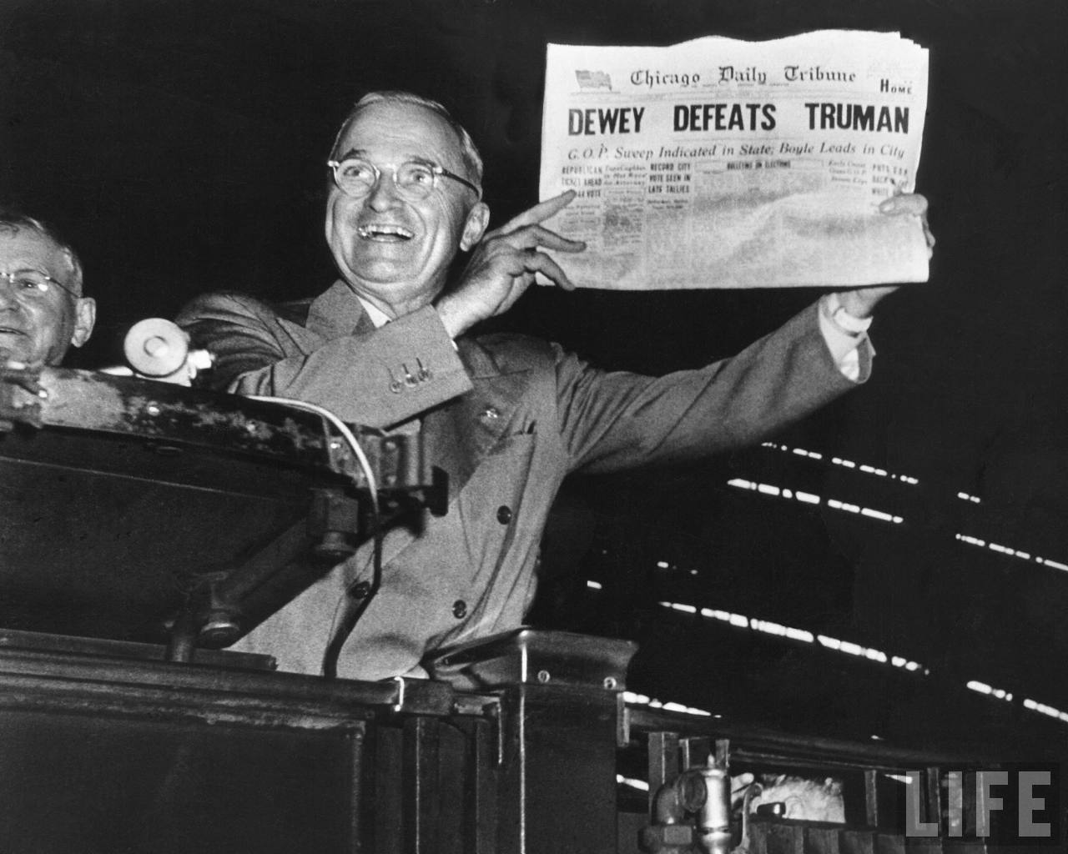

Slide 33
Truman’s Platform
“Point Four” program
Financial support of poor, and underdeveloped lands
Keep people from turning to Communism
“Fair Deal”
Improved housing, full employment, higher minimum wage, more farm subsidies, new TVA, extension of SS
Minimum wage raised, Public Housing Act of 1949, Social Security Act of 1950

Slide 34
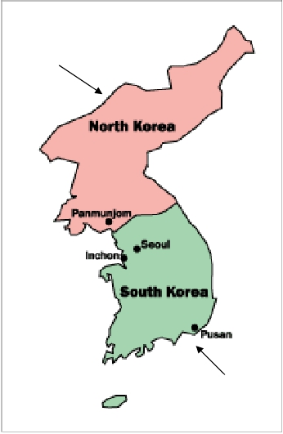
KOREAN WAR
Soviet
controlled
U.S.
controlled
Japan had taken over Korea in 1910 and ruled it until August 1945
As WW II ended, Japanese troops north of the 38th parallel surrendered to the Soviets
Japanese soldiers south of the 38th surrendered to the Americans
As in Germany, two nations developed, one communist (North Korea) and one democratic (South Korea)

Slide 35
Trouble in Korea
June 25, 1950 – Communist forces of North Korea crossed the 38th parallel and invade democratic South Korea
Quickly pushed back to Pusan
Truman orders military spending quadrupled
Soviet absence from U.N. allows labeling of North Koreans as aggressors
UN troops dispatched
MacArthur and US troops in Japan lead force

Slide 36
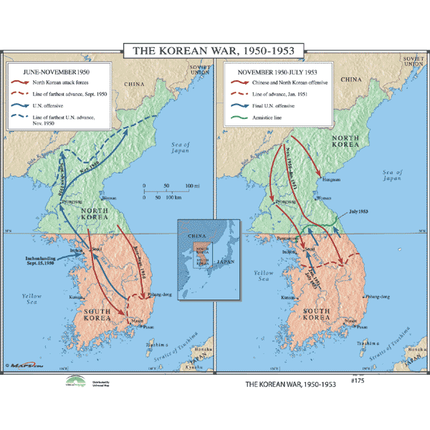

Slide 37
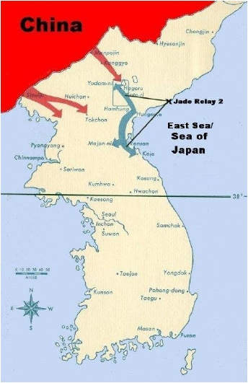
The Korean War
MacArthur lands invasion force at Inchon Sept. 1950, behind enemy lines
North Koreans driven back to 38th parallel.
“have the boys home by Christmas”
Nov. 1950 – Chinese army swarms across Yalu River
MacArthur forced to retreat

Slide 38
MacArthur
Plans to blockade China and bomb Manchuria
Truman doesn’t want to expand war
Publicly criticizes Truman
Talks about possibility of atomic weapons
Truman removes MacArthur on grounds of insubordination
Criticized as appeasing communists
1951 – truce negotiations begin
Stalled for over two years
Finally, in July 1953, an agreement was signed that ended the war in a stalemate (38th parallel)

Slide 39
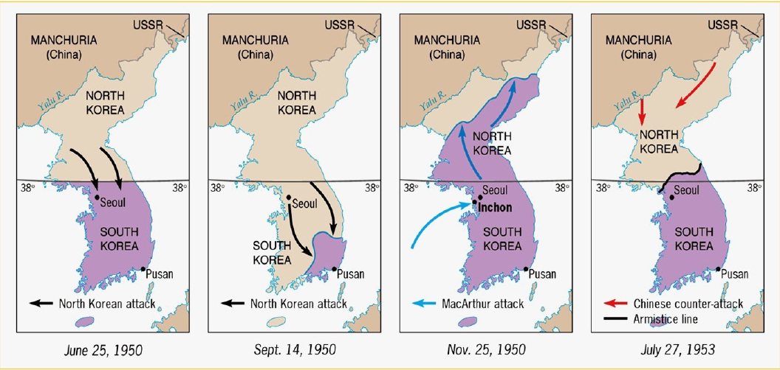
The Shifting Map of Korea
[1950-1953]

