Slide 1
American Pageant
Chapter 29
Wilsonian Progressivism in Peace and War, 1913-1920

Slide 2
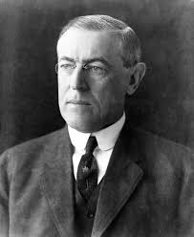
Woodrow Wilson

Slide 3
Wilson: The Idealist in Politics
(Thomas) Woodrow Wilson:
  Second Democratic president since 1861
    First president from one of seceded southern states since Zachary Taylor, 64 years earlier
    Wilson's admiration for Confederate attempt at independence inspired his ideal of self-determination
    His ideal of faith in masses—if they were properly informed—came from Jeffersonian democracy
    His inspirational political sermons reflected influence of his Presbyterian minster-father

Slide 4
Wilson: The Idealist in Politics
    Wilson convinced that Congress could not function properly unless president provided leadership
    Repeated relied on his eloquence to appeal over heads of legislators to the sovereign people
  Wilson suffered from serious defects of personality:
    Incapable of showmanship like Roosevelt, he lacked common touch

Slide 5
Wilson Tackles the Tariff
Wilson's programs:
  Called for assault on “the triple wall of privilege”: the tariff, the banks, and the trusts
  He tackled tariff first:
    Summoned Congress into special session in early 1913
    In precedent-shattering move, he did not send his message over to Capitol to be read
    He appeared in person before a joint session of Congress and presented his appeal with stunning clarity and force
    House soon passed major reductions in Underwood Tariff

Slide 6
Wilson Tackles the Tariff
When bill challenged in Senate by lobbyists:
  Wilson issued message to public urging them to hold their elected representatives in line
  Public opinion worked; in 1913 Senate approved bill Wilson wanted
  Provided for a substantial reduction of import fees

Slide 7
Wilson Tackles the Tariff
  Landmark in tax legislation:
    Using recent 16th Amendment, Congress enacted graduated income tax beginning with moderate levy on incomes over $3,000 (average wage earner's annual income only $740)
    By 1917, revenue from income tax shot ahead of revenue from tariffs

Slide 8
Wilson Battles the Bankers
Antiquated and inadequate banking and currency system
    Nation's financial structure creaked along under Civil War National Banking Act
      Most glaring defect was inelasticity of currency (1907 panic)
      Since most banks located in New York, hard to mobilize bank reserves elsewhere in times of panic
    Calls for reform supported by Louis D. Brandeis in book: Other People's Money and How the Bankers Use It (1914)

Slide 9
Wilson Battles the Bankers
    Wilson in June 1913 appeared personally before Congress again and called for sweeping bank reform:
      Endorsed Democratic proposal for decentralized bank in government hands
      Opposed Republican demands for huge private bank with fifteen branches
Federal Reserve Act (1913):
    Wilson appealed to the sovereign people
    Most important economic legislation between Civil War and New Deal

Slide 10
Wilson Battles the Bankers
Federal Reserve Board:
    Appointed by President
    Would oversee nationwide system of twelve regional reserve districts
    Each with its own central bank
    Final authority of Federal Reserve Board guaranteed a substantial measure of public control
    Board would be empowered to issue paper money
      “Federal Reserve Notes”—backed by commercial paper
      Thus amount of money in circulation could be swiftly increased as needed for legitimate requirements of business

Slide 11
The President Tames the Trusts
Wilson's third appearance before Congress led to Federal Trade Commission Act (1914):
  Presidentially appointed commission could research industries engaged in interstate commerce
  Commission could crush monopoly at source by rooting out unfair trade practices:
    Including unlawful competition, false advertising, mislabeling, adulteration, and bribery

Slide 12
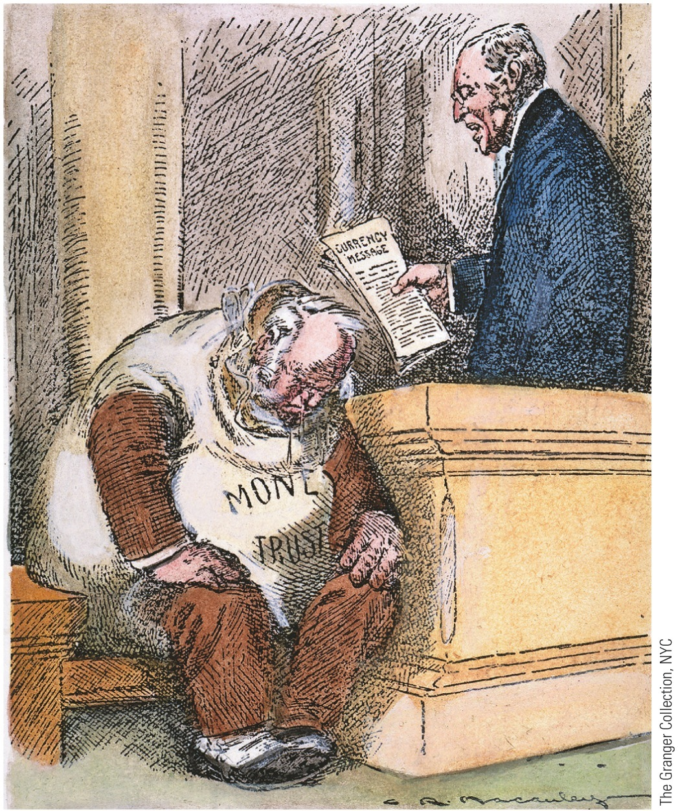
p665
Notes:
Reading the Death Warrant T his cartoon appeared in
a New York newspaper soon after Woodrow Wilson called
for dramatic reform of the banking system before both
houses of Congress. With the “money trust” of bankers and
businessmen cowed, Wilson was able to win popular and
congressional support for the Federal Reserve Act of 1913.

Slide 13
The President Tames the Trusts
  Clayton Anti-Trust (1914):
    Increased list of practices deemed objectionable:
      Price discrimination and interlocking directorates (where same individual served as director of supposedly competing firms)
      Achieved through holding companies
    Conferred long-overdue benefits on labor:
      Exempted labor and agricultural organization from anti-trust prosecution, while explicitly legalizing strikes and peaceful picketing
      Samuel Gompers, Union leader, hailed act as Magna Carta of labor

Slide 14
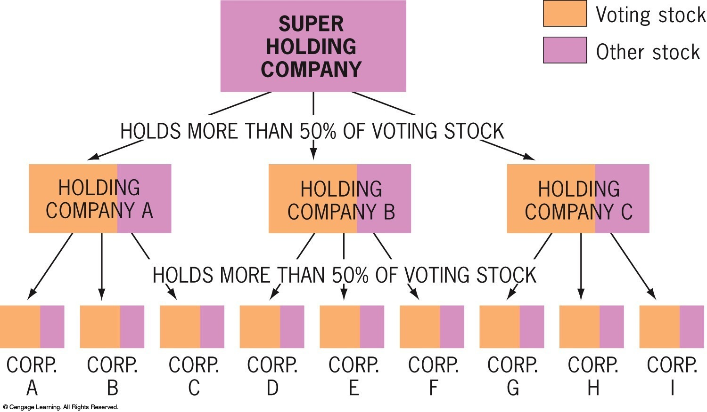
Figure 29-1 p665
Notes:
Figure 29.1 Organization of Holding Companies Keep
in mind that the voting stock of a corporation is often only a
fraction of the total stock. © 2016 Cengage Learning

Slide 15
Wilson at the Peak
Other progressive legislation:
  Federal Farm Loan Act (1916):
    Made credit available to farmers at low rates of interest—long demanded by Populists
  Warehouse Act (1916):
    Authorized loans on security of staple crops—another Populist idea
  Other laws benefited rural areas by providing for highway construction and establishment of agricultural extension work in state colleges

Slide 16
Wilson at the Peak
  La Follette Seaman's Act (1915):
    Required decent treatment and living wage on American merchant ships
  Workingmen's Compensation Act (1916):
    Granted assistance to federal civil-service employees during periods of disability
  1916: Wilson signed law restricting child labor on products flowing into interstate commerce (but Supreme Court later voided it)

Slide 17
Wilson at the Peak
Adamson Act (1916):
  Established eight hour day for all employees on trains in interstate commerce, with extra pay for overtime
Supreme Court:
  Wilson endeared himself to progressives when he nominated prominent reformer Louis D. Brandeis—first Jew to high court
Limit on Wilson's progressivism:
  Stopped well short of better treatment for blacks

Slide 18
New Directions in Foreign Policy
  Wilson's reaction to earlier foreign policies:
    In contrast to Roosevelt and Taft, he recoiled at first from aggressive foreign policy
    Hating imperialism, he was repelled by TR's big-stickism
    Suspicious of Wall Street, he detested Taft's dollar diplomacy
    In office only a week, he declared war on dollar diplomacy:
      Proclaimed government would not support American investors in Latin America and China

Slide 19
Review:
PRESIDENTIAL DIPLOMACIES
Roosevelt Corollary – US would intervene in Latin American Affairs when necessary to maintain economic & political stability
Big Stick Diplomacy – “Speak Softly and carry a big stick.” US did not intend to be a threatening presence, but it would not hesitate to forcefully protect its own interests

Slide 20
Review:
PRESIDENTIAL DIPLOMACIES
Dollar Diplomacy – a policy of joining the business interests of a country with its diplomatic interests abroad
Moral diplomacy - the system in which support is given only to countries whose moral beliefs are the same as ours.

Slide 21
New Directions in Foreign Policy
    Persuaded Congress to repeal Panama Canal Tolls Act of 1912 –
      It had exempted American coastwide shipping from tolls
      Thereby provoked sharp protests from injured Britain
    Jones Act (1916):
      Granted Philippines territorial status and promised independence as soon as a “stable government” could be established
      Wilson's racial prejudices did not expect this to happen for a long time
      On July 4, 1946—30 years later—United States accepted Philippine independence

Slide 22
New Directions in Foreign Policy
    Haiti's chaotic political situation caused Wilson to assume more active stance abroad
    Political turmoil climaxed in 1914-1915 when outraged populace literally tore to pieces brutal Haitian president
    Wilson dispatched marines to protect American lives and property

Slide 23
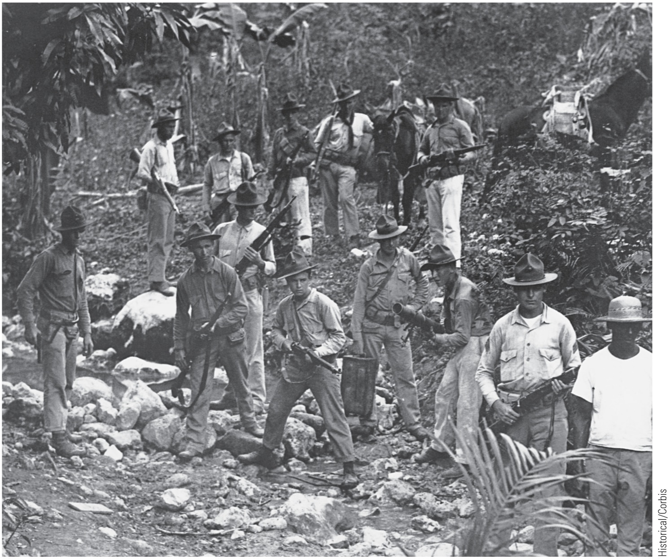
p666
Notes:
U.S. Marines in Haiti, 1919 The
United States sent the marines to
Haiti in 1915 to protect American
economic interests. They
remained for nineteen years.

Slide 24
New Directions in Foreign Policy
    Marines remained in Haiti for nineteen years making Haiti an American protectorate
      In 1916, Wilson used Roosevelt's corollary to Monroe Doctrine and concluded treaty with Haiti:
        Provided for U.S. supervision of finances and police
      In 1916, he sent marines to debt-cursed Dominican Republic
        Came under American control for eight years
      In 1917, United States purchased the Virgin Islands from Denmark
  *Uncle Sam tightening its grip in Caribbean Sea, with its vital approaches to Panama Canal

Slide 25
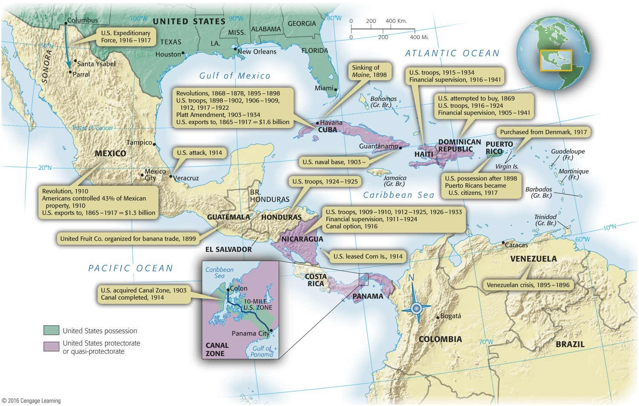
Map 29-1 p667
Notes:
Map 29.1 The United States in the Caribbean, 1898–1941 This map explains why
many Latin Americans accused the United States of turning the Caribbean Sea into a
“Yankee lake.” It also suggests that Uncle Sam was much less “isolationist” in his own
backyard than he was in faraway Europe or Asia. © 2016 Cengage Learning

Slide 26
Moralistic Diplomacy in Mexico
Mexican revolution (1913):
      Mexicans resented exploitation by foreign investors
      In 1913 new revolutionary president murdered and replaced by General Victoriano Huerta:
      Caused massive migration of Mexicans to United States
      More than a million Spanish-speaking newcomers came and settled in Texas, New Mexico, Arizona, California
      Built highways and railroads, followed fruit harvests as pickers
      Segregated in Spanish-speaking enclaves:
        Helped create unique borderland culture that blended Mexican and American folkways

Slide 27

Moralistic Diplomacy in Mexico
    Revolutionary bloodshed menaced American lives and property in Mexico:
      Hearst called for intervention in Mexico
      Wilson again refused to practice diplomacy of his predecessors:
        Deemed it “perilous” to determine foreign policy “in terms of material interest”
      Wilson tried to steer a moral course in Mexico
      Refused to recognize Huerta's bloody-handed regime
      In 1914 he allowed American arms to flow to Huerta's principal rivals, Venustiano Carranza and firebrand Francisco (“Pancho”) Villa
What do we call this policy?

Slide 28
Moralistic Diplomacy in Mexico
Tampico Incident:
  Mexico volcano erupted at Atlantic seaport of Tampico in April, 1914:
    Small party of American sailors arrested
    Mexicans released captives and apologized
    Refused demand by U.S. admiral for 21-gun salute
    Determined to eliminate Huerta, Wilson asked Congress for authority to use force against Mexico
    Before Congress could act, Wilson had navy seize port of Veracruz to block arrival of German weapons

Slide 29
Moralistic Diplomacy in Mexico
    Shooting conflict avoided by offer of mediation from ABC powers—Argentina, Brazil, and Chile
    Huerta collapsed in July 1914 under pressure from within and without
    Succeeded by his archival, Venustiano Carranza who resented Wilson's military meddling
    “Pancho” Villa, chief rival to President Carranza,
      Killed 16 American mining engineers traveling through northern Mexico in January 1916
      One month later, Villa and his followers crossed border into Columbus, New Mexico and murdered another 19 Americans

Slide 30
Moralistic Diplomacy in Mexico
  General John J. (“Black Jack”) Pershing ordered to break up bandit band
    His hastily organized force of several thousand mounted troops penetrated deep into Mexico
    Clashed with Carranza's forces
    Mauled Villistas but missed capturing Villa
    As tensions with Germany mounted, Wilson withdrew Pershing from Mexico in January 1917

Slide 32
Wilson & WWI

Slide 33
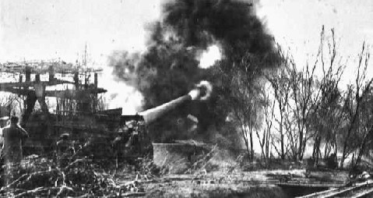
The Great War
1914 - 1919

Slide 34
Long Term Causes
The 3-“isms”
Nationalism -the belief that national concerns are more important than global ones
Imperialism -nations compete for control of colonies, raw materials, and markets
Militarism -buildup of the military, aggression of nations
and…
The Alliance System

Slide 35
Militarism
In the late 1800s and early 1900s, European countries like France, Germany, and Great Britain were engaged in an arms race.
France and Germany doubled the size of their armies during this period.
Great Britain and Germany fought for naval dominance by introducing battleships to the seas.

Slide 36
Entangling alliances
In the late 1800s and early 1900s, many European nations made alliances with each other to end conflicts.
Unfortunately, the alliance system caused some countries to feel an obligation to aid their allies in the event of war.

Slide 37
Alliances Before the War
Nations across Europe began making alliances with each other (often in an attempt to avoid war).
  These nations promised to protect each other if their ally was attacked (declare war).
  This often brought many nations into war because when nations went to war, their allies and their enemies’ allies joined as well.

Slide 38
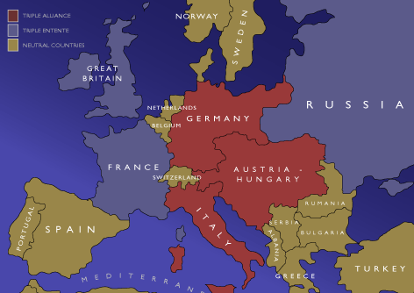
Major Alliances Before the War
  Triple Entente:
      France, Great Britain, Russia
        Russia also had an alliance with Serbia
  Triple Alliance:
      Germany, Austria-Hungary, Italy

Slide 39
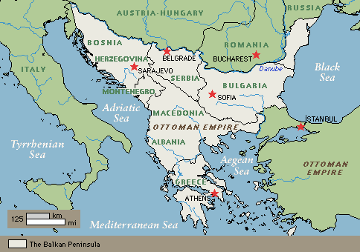
The Balkans
The Balkan Peninsula became an important location for many European nations because it was surrounded by seas (trade, resources).
  Nicknamed “The Powder Keg of Europe”…

Slide 40
Balkan Nationalism
The people of the Balkans believed that Bosnia should be part of a new Slavic state, but European powers placed Bosnia under Austro-Hungarian control.
Russia, which shared a common ethnic and religious heritage, secretly helped finance the assassination of Archduke Francis Ferdinand.
This event was a catalyst for WWI

Slide 41
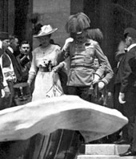
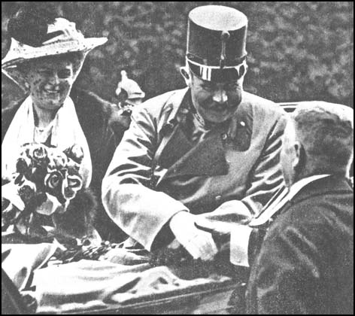
“The Spark”
June 28, 1914
  Archduke Franz Ferdinand (heir to Austrian throne) and his wife Sophie are visiting Sarajevo, Bosnia.
On the way to a reception, a bomb was thrown at the couple but they escaped unharmed. After the reception, the Archduke insisted on visiting those injured by the bomb…

Slide 42
“The Spark”
A young Serbian nationalist named Gavrilo Princip assassinated the royal couple (Archduke Franz Ferdinand) as they rode down the streets of Sarajevo.

Slide 43
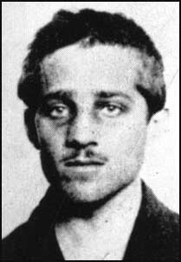
The Assassin
Gavrilo Princip was a member of the secret “Black Hand” society,
  radical nationalist group that favored an alliance between Bosnia and Serbia
  opposed Austria-Hungary’s annexation of Bosnia.

Slide 44
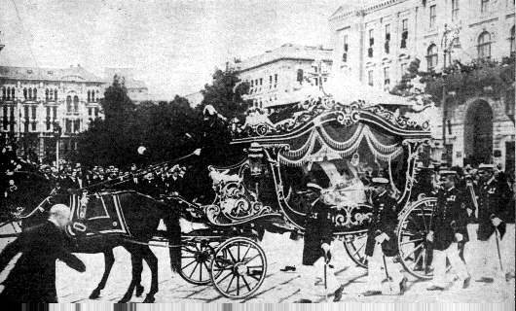
The Ultimatum
Funeral Procession of Archduke Franz Ferdinand
Austria-Hungary blamed Serbia for the assassinations and issued an ultimatum (gave Serbia 48 hours to respond):
  Serbia was to suppress all anti-Austrian newspapers/organizations
  Austrian police would help control rebellions in Serbia
  Austrian courts would help prosecute accused conspirators in Serbia
Serbia felt that the conditions were unfair and rejected the proposal

Slide 45
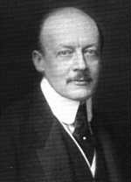
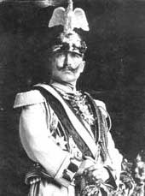
“Blank Check”
Germany issues a “blank check” to Austria-Hungary, offering unconditional support in the event of war.
On July 28, 1914 (exactly one month after the assassination), Austria-Hungary and Germany declare war on Serbia.
  The Alliance system of the previous years begins dragging other nations into the war as well…

Slide 46
Thunder Across the Sea
Great Britain, its coastline jeopardized by assault on Belgium, pulled into conflagration on side of France
Now Europe locked in fight to the death
Central Powers: Germany, Austria-Hungary, later Turkey and Bulgaria
Allies: France, Britain, and Russia, later Japan and Italy
Americans thanked God for ocean and congratulated themselves on having ancestors wise enough to have abandoned hell pits of Europe
America felt strong, snug, smug, and secure—but not for long

Slide 47
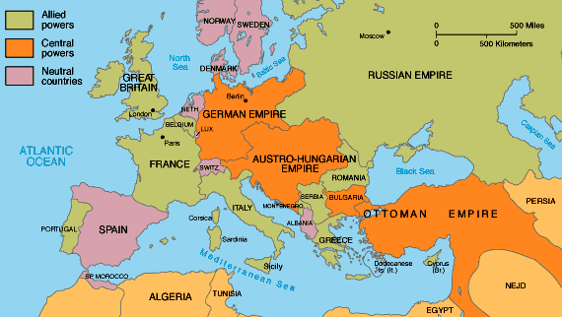
Nations Take Sides

Slide 48
Thunder Across the Sea
Wilson issued neutrality proclamation and called on Americans to be neutral in thought and deed
Both sides wooed U.S.A., great neutral in West
  British enjoyed:
    Cultural, linguistic, and economic ties with America
    Advantage of controlling transatlantic cables
    Their censors sheared away war stories harmful to Allies and drenched United States with tales of German bestiality
  Germans and Austro-Hungarians:
    Counted on sympathies of transplanted countrymen in America (some 11 million in 1914)

Slide 49
Thunder Across the Sea
  Some of these recent immigrants expressed noisy sympathy for fatherland
  Most simply grateful to be distant from fray (see Table 29.1)
Most Americans:
  Anti-German from outset
  Kaiser Wilhelm II seemed embodiment of arrogant autocracy
  Impression strengthened by German's ruthless strike at neutral Belgium

Slide 50
Thunder Across the Sea
German and Austrian agents further tarnished image of Central Powers when they resorted to violence in American factories and ports
German operative in 1915 absentmindedly left his briefcase on New York elevated car:
  Documents detailing plans for industrial sabotage discovered and quickly publicized
Further inflamed American opinion against Kaiser
Yet great majority of Americans earnestly hoped to stay out of horrible war

Slide 51
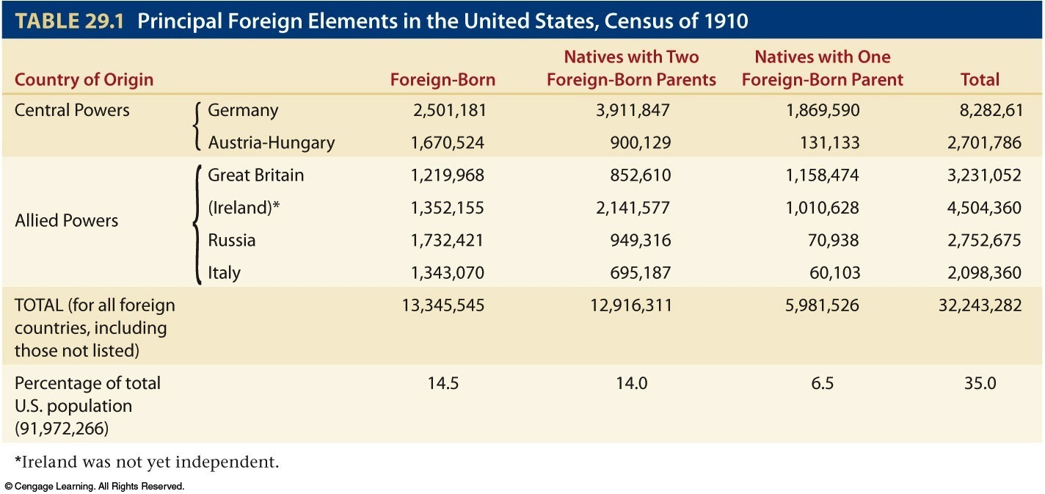
Table 29-1 p669

Slide 52
America Reacts
Overall, the United States’ loyalties remained with the Allies:
  Common Ties with Great Britain (including language, ancestry, etc.)
  Stronger Economic Ties to the Allies (trade)
  Germany was seen as a bully after they invaded neutral Belgium (early in the war)

Slide 53
America Earns Blood Money
When war broke out in Europe, U.S.A. in midst of recession:
  British and French war orders pulled U.S. industry onto peak of war-born prosperity (see Table 29.2)
  Part of boon financed by American bankers
  Notably Wall Street firm of J.P. Morgan and Company advanced to Allies enormous sum of $2.3 million during period of American neutrality

Slide 54
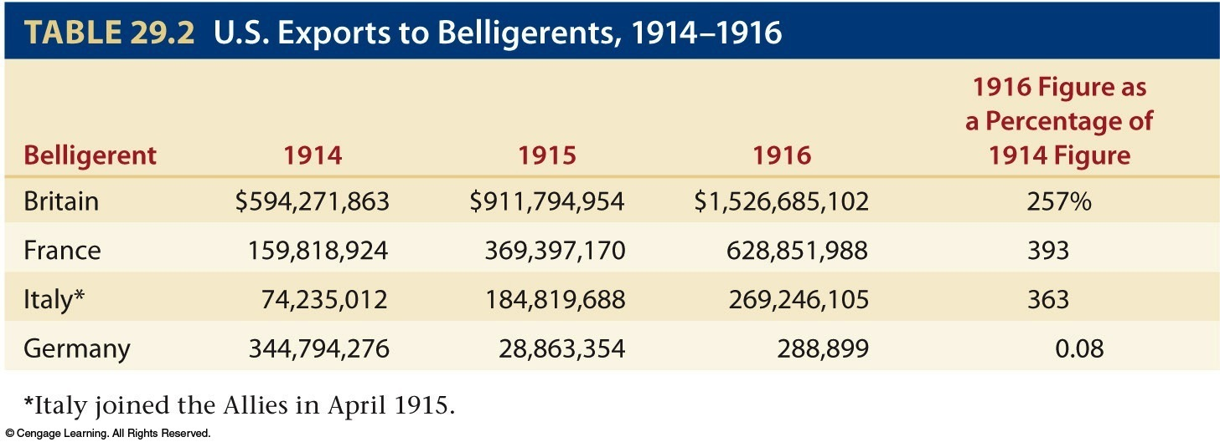
Table 29-2 p670

Slide 55
America Earns Blood Money
  Germany legally could have had same level of trade with United States
  Was prevented from doing so by British navy
  British imposed blockade with mines and ships across North Sea gateway to German ports
  Over protests from various Americans, British forced American vessels off high seas
  Harassment of American shippers highly effective as trade between Germany and United States virtually ceased

Slide 56
America Earns Blood Money
  Germany did not want to be starved out:
    Berlin announced submarine war area around British Isles (see Map 29.2)
    New submarines not fit existing international laws
    Posed threat to United States—so long as Wilson insisted on maintaining America's neutral rights
      Berlin officials declared they would try not to sink neutral shipping, but warned mistakes would probably occur
  Wilson decided on calculated risk:
    Claimed profitable neutral trading rights while hoping no incidents would cause war

Slide 57
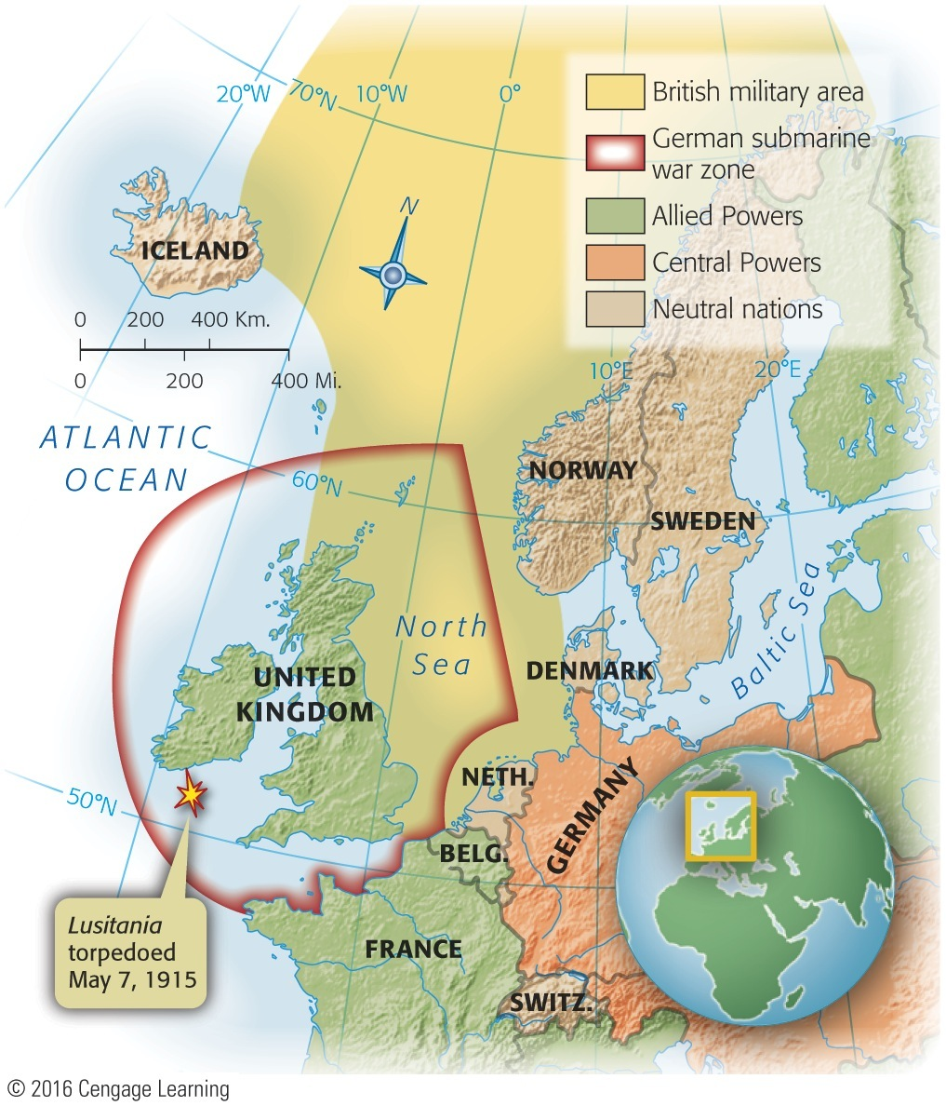
Map 29-2 p670
Notes:
Map 29.2 British Military Area (declared November 3,
1914) and German Submarine War Zone (declared
February 4, 1915) © 2016 Cengage Learning

Slide 58
America Earns Blood Money
German submarines (U-boats “undersea boat”) began deadly work
    In first months of 1915, sank 90 ships in war zone
    British passenger liner Lusitania torpedoed and sank off coast of Ireland, May 7, 1915:
      With loss of 1,198 lives, including 128 Americans
  Lusitania was carrying forty-two hundred cases of small-arms ammunition
    A fact Germany used to justify sinking
    Americans shocked and angered at act of “mass murder” and “piracy”

Slide 59
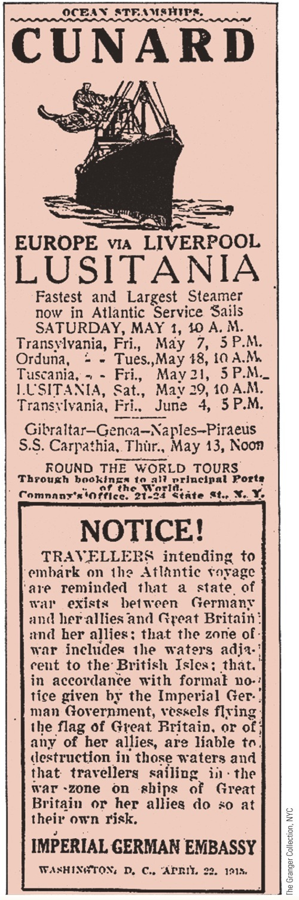
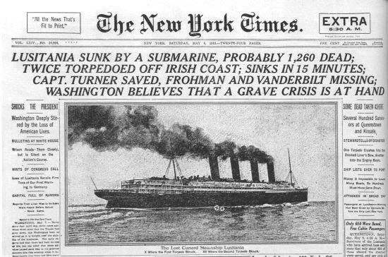
p671
Notes:
Advertisement from the New York Herald, May 1,
1915 Six days later the Lusitania was sunk. Note the
German warning.

Slide 60
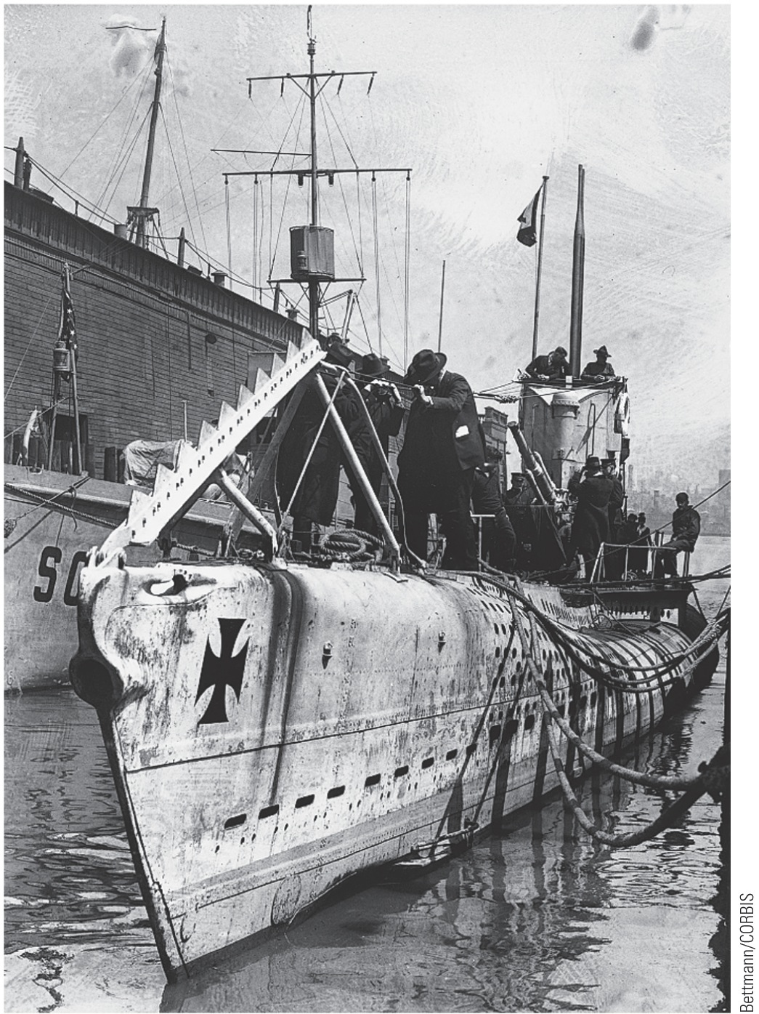
p671
Notes:
A German U-boat This deadly new weapon rendered
useless existing rules of naval warfare, eventually pushing
the United States to declare war against Germany in 1917.

Slide 61
America Earns Blood Money
  Talk of war from eastern United States, but not from rest of nation
    Wilson did not want to lead disunited nation into war
      By series of strong notes, Wilson attempted to take German warlords sharply to task
      Policy too risky for Secretary of State Bryan who resigned
      T. Roosevelt harshly criticized Wilson's measured approach
    British liner, Arabic, sunk in August, 1915:
      With loss of two American lives
      Berlin reluctantly agreed not to sink unarmed and unresisting passenger ships without warning

Slide 62
America Earns Blood Money
      Pledge appeared to be violated in March, 1916 when Germans torpedoed French passenger steamer, Sussex
      Infuriated, Wilson informed Germans:
        That unless they renounced inhuman practice of sinking merchant ships without warning, he would break diplomatic relations—almost certain prelude to war
    Germany reluctantly knuckled under Wilson's Sussex ultimatum:
      Germany agreed to not sink passenger and merchant ships without warning
        Attached long string to their Sussex pledge

Slide 63
America Earns Blood Money
    German Sussex pledge:
      United States would have to persuade Allies to modify what Berlin regarded as illegal blockade
      This obviously, was something that Washington could not do
      Wilson promptly accepted pledge, without accepting “string”
      Wilson won temporary but precarious diplomatic victory– precarious because:
        Germany could pull string whenever it chose
        And president might suddenly find himself tugged over cliff of war

Slide 64
Wilson Wins Reelection in 1916
Presidential campaign of 1916
  Bull moose Progressives and Republicans met in Chicago:
    Progressives nominated Theodore Roosevelt:
      TR, who loathed Wilson, had no intention of splitting Republicans again
      With his refusal, TR sounded death knell of Progressive party
    Republicans drafted Supreme Court justice Charles Evans Hughes, who had been governor of New York

Slide 65
Wilson Wins Reelection in 1916
    Republican platform condemned Wilson's:
      Tariff
      Assault on trusts
      Wishy-washiness in dealing with Mexico and Germany
    Wilson realized his 1912 win caused by Taft-TR split
      Used his first term to identify himself as candidate of progressivism and to woo bull moose voters into Democratic fold
  Wilson, nominated by acclamation at Democratic convention in St. Louis
  His campaign slogan, “He Kept Us Out of War”

Slide 66
Wilson Wins Reelection in 1916
  On election day:
    Hughes swept East
    Wilson went to bed prepared to accept defeat but rest of nation turned tide:
      Midwestern and westerners, attracted by Wilson's progressive reforms and antiwar policies, flocked to him
      Final result, in doubt for several days, hinged on California which Wilson carried with 3,800 votes out of about a million

Slide 67
Wilson Wins Reelection in 1916
  Final count:
    Wilson: 277 to 254 in Electoral College
    9,127,695 to 8,533,507 in popular column (see Map 29.3)
    Pro-labor Wilson received strong support from working class and from renegade bull moosers
    Wilson did not specifically promise to keep country out of war

Slide 68
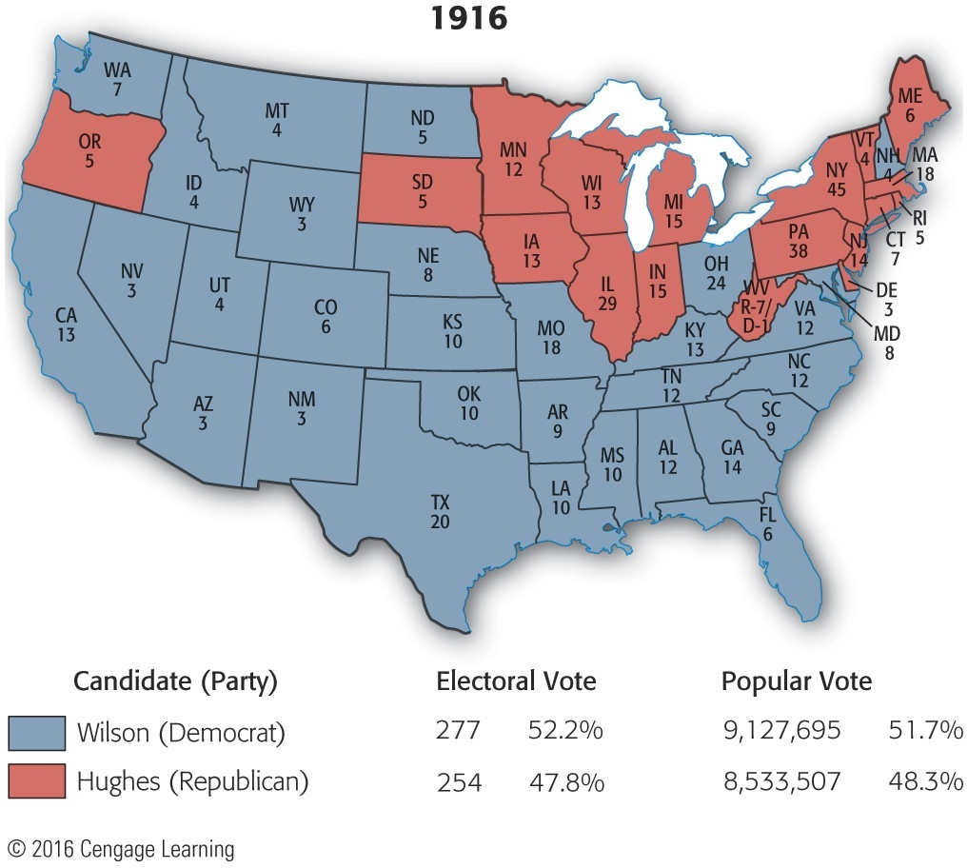
Map 29-3 p673
Notes:
Map 29.3 Presidential Election of 1916 (with electoral
vote by state) Wilson was so worried about being a lame
duck president in a time of great international tensions that
he drew up a plan whereby Hughes, if victorious, would be
appointed secretary of state, Wilson and the vice president
would resign, and Hughes would thus succeed immediately
to the presidency. © 2016 Cengage Learning

Slide 69
Conditions on the front
The western front of WWI was characterized by trench warfare between the German and French armies.
The use of trenches kept the two armies in nearly the same position for four years.
On the eastern front, Germany was able to defeat Russian and Serbian forces decisively. This allowed the German army to focus more attention on the western front.

Slide 70
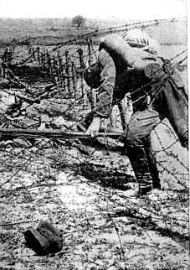
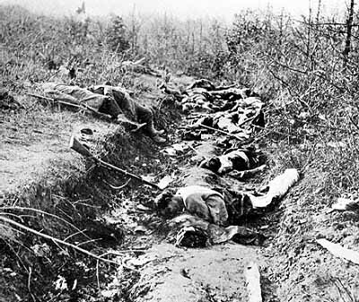
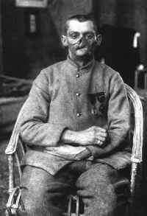

Slide 71
BATTLE OF THE MARNE
September 1914
Kept Germany from entering Paris
Ensured that a quick German victory was impossible
Four years of trench warfare
Two million fought- 500,00 killed or wounded

Slide 72
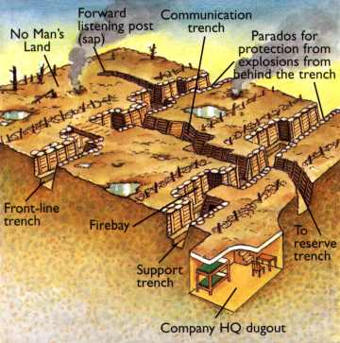
Trench Warfare
Exchange heavy casualties for very little land gains
  Battle of Verdun (Feb. – Dec. 1916) gained only 4 miles in 10 months
  Battle of the Somme (1916) -1/2 million casualties, gained only 5 miles

Slide 73
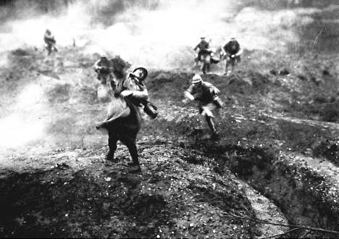
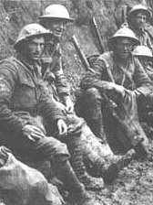
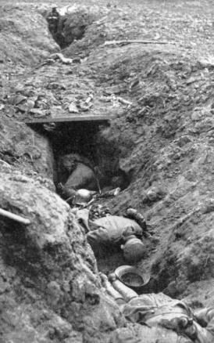
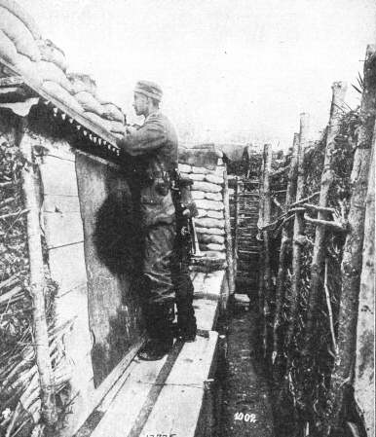
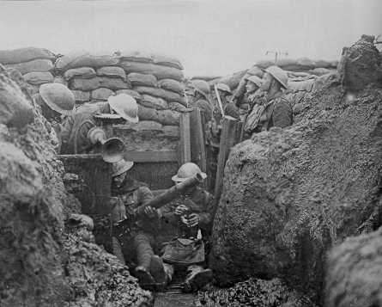
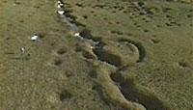
Trench Warfare

Slide 74
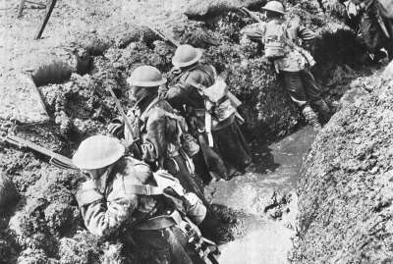
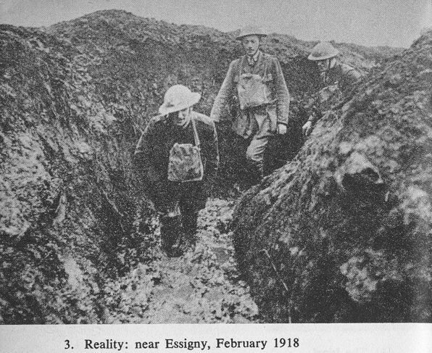
Trench Warfare
Conditions in the Trenches are horrible:
  Muddy (lots of rain)
  Lice-infested
  Rat-infested
  Disease
  “Trench Foot”

Slide 75
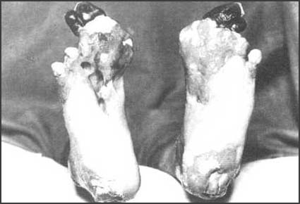
Trench Foot

Slide 76
War by Act of Germany
Wilson tried to mediate between two warring sides:
  January 22, 1917: restated U.S. commitment to neutral rights and called for “peace without victory”
Germany responded with mailed fist:
  Announced unrestricted sub warfare on Jan. 31
  Hoped to defeat Allies before U.S.A. entered war
Wilson broke diplomatic relations, but moved no closer to war unless “overt” by Germans

Slide 77
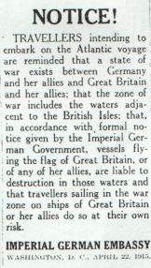
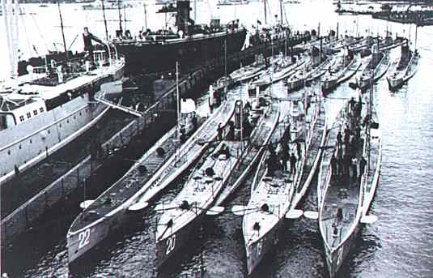
Unrestricted Submarine Warfare
German U-boats (Unterseeboot)

Slide 78
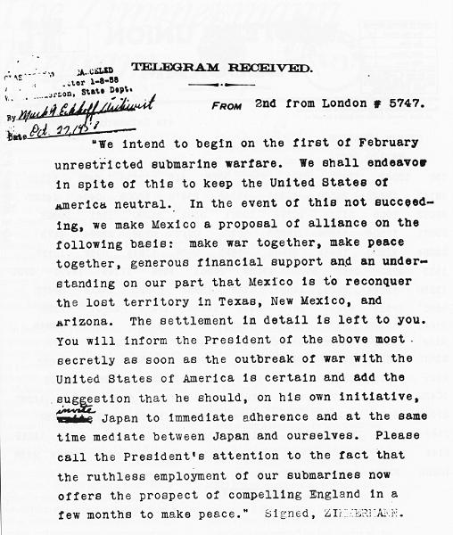
The Zimmerman Note
Great Britain intercepted a telegram from Germany to Mexico.
    German foreign secretary Arthur Zimmerman secretly proposed German-Mexican alliance

Slide 79
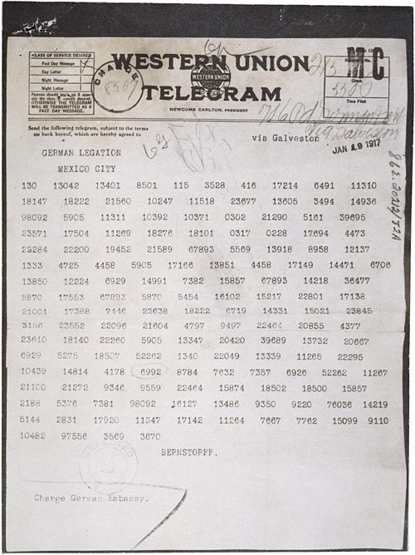
The Zimmerman Note
Germany proposed that Mexico invade the US to keep us of the war in Europe
In exchange, Germany would return any lands Mexico lost to the US during the Mexican War

Slide 80
War by Act of Germany
Long-dreaded “overt” act in Atlantic:
  German U-boats sank four unarmed American merchant vessels in first two weeks of March, 1917
Revolution in Russia toppled cruel regime of tsars:
  America could now fight for democracy on Allies' side, without Russian despotism in Allied fold

Slide 81
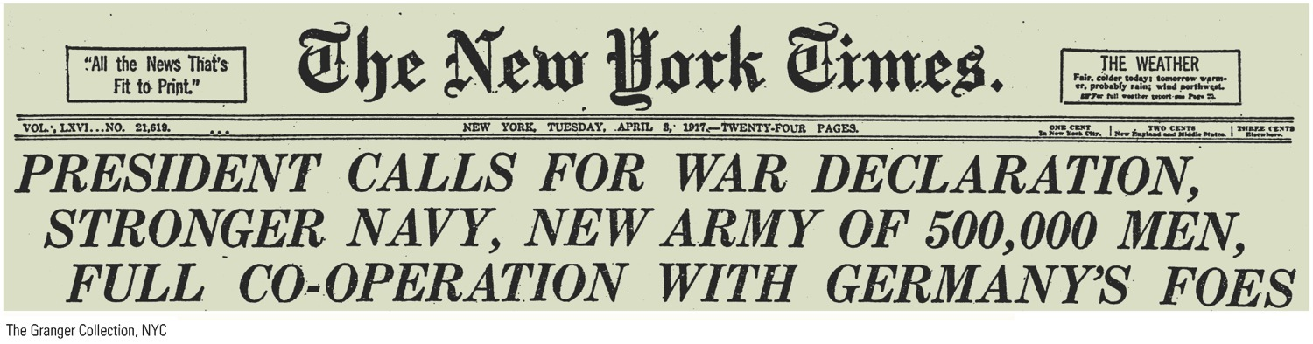
p674
Notes:
WAR! A ttacks by German submarines finally forced Wilson’s hand, and he asked Congress for
a declaration of war on April 2, 1917. Four days later, after considerable debate and with fifty-six
dissenting votes, Congress obliged the president. The Granger Collection, NYC

Slide 82
America Enters the War
Wilson, before joint session of Congress on April 2, 1917, asked for declaration of war:
  British harassment of U.S. commerce had been galling but endurable
  Germany had resorted to mass killing of civilians
  Wilson had drawn clear line against depredations of submarine
In figurative sense, war declaration on April 6, 1917 bore unambiguous trademark “Made in Germany”

Slide 83
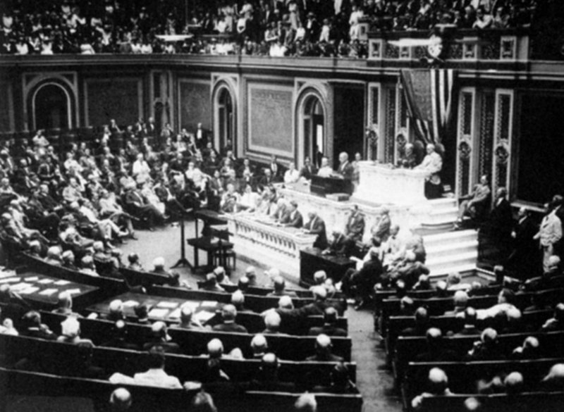
America Enters the War - Timeline
April 2nd – Wilson asks for declaration of war against Germany
April 4th – Approved by Senate
April 6th – Passed through House – Declared War on Germany
April 7th – Declared War on Austria- Hungary

Slide 84
Wilson's Fourteen Potent Points
Wilson soon recognized as moral leader of Allied cause
  On January 8, 1918, he delivered to Congress famed Fourteen Points.

Slide 85
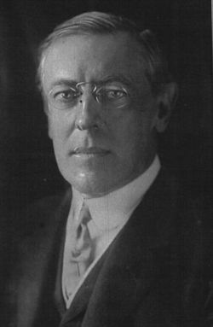
Wilson’s Fourteen Points
Wilson’s plan for peace:
  End secret treaties and alliances
  Allow free trade and freedom of the seas
  Reduction of militaries
  Boundary changes (to prevent countries from gaining too much power/territory)
  Self-determination (allow each nation to choose their own form of government)
  Creation of the League of Nations

Slide 86
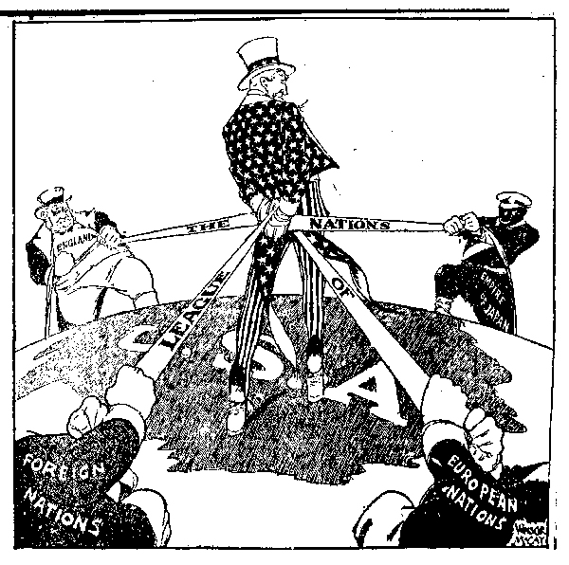
League of Nations
Wilson believed the League of Nations was the most important part of his proposed peace agreement
It’s purpose was to prevent war through diplomacy
Many Americans opposed the league, however, because they felt it would allow other nations to restrict our actions

Slide 87
Manipulating Minds and Stifling Dissent
Committee on Public Information:
  Purpose—mobilize people's mind for war
  Headed by young journalist, George Creel
  His job to sell America on war and sell world on Wilsonian war aims
  Employed 150,000 workers at home and abroad
    Sent out 75,000 “four-minute men” who delivered countless speeches containing much “patriotic pep”
  Creel's propaganda took varied forms:
    Posters splashed on billboards:
      “Battle of the Fences”

Slide 88
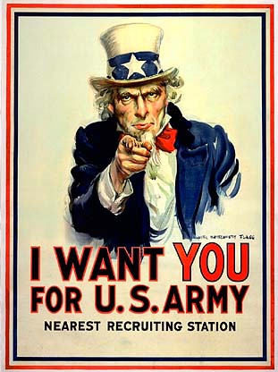
James Montgomery Flagg’s portrayal of Uncle Sam became the most famous recruiting poster in US history

Slide 89
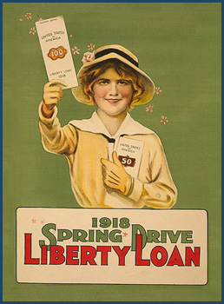
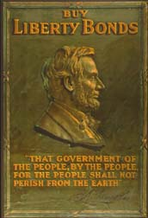
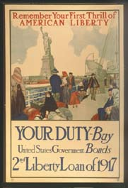
Propaganda
Encouraged Americans to support the Allies
and manufactured hate toward the Central Powers

Slide 90
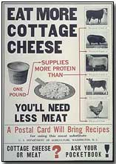
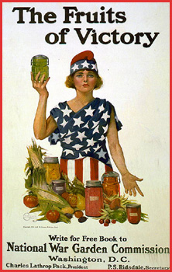
Propaganda

Slide 91
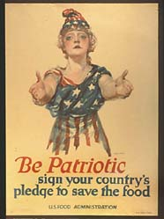


Propaganda

Slide 92



Propaganda

Slide 93


Propaganda

Slide 94

p675
Notes:
Anti-German Propaganda T he government relied
extensively on emotional appeals and hate propaganda
to rally support for the First World War, which most
Americans regarded as a distant “European” affair. This
poster used gendered imagery to evoke the brutal German
violation of Belgian neutrality in August 1914.

Slide 95

p676
Notes:
Patriotic Persuasion Worried about the public’s
enthusiasm for the war, the government employed all the
arts of psychology and propaganda to sustain the martial
spirit. The prewar song “I Didn’t Raise My Boy to Be a
Soldier” was changed to “I Didn’t Raise My Boy to Be a
Slacker,” which in turn inspired the cruel parody “I Didn’t
Raise My Boy to Be a Sausage.”

Slide 96
Manipulating Minds and Stifling Dissent
  German Americans—over eight million:
    Most proved to be dependably loyal to United States
    A few tarred, feathered, and beaten
    Hysterical hatred of Germans and things Germanic swept nation:
      Orchestras found it unsafe to present German-composed music
      German books removed from library shelves
      German classes canceled
      Sauerkraut became “liberty cabbage”
      Hamburger, “liberty steak”

Slide 97
Manipulating Minds and Stifling Dissent
Espionage Act 1917
  a United States federal law passed shortly after entering World War I, on June 15, 1917, which made it a crime for a person to convey information with intent to interfere with the operation or success of the armed forces of the United States or to promote the success of its enemies.

Slide 98
Manipulating Minds and Stifling Dissent
Espionage Act of 1917 and Sedition Act of 1918:
  Reflected fears about Germans and antiwar Americans
  1,900 prosecutions of antiwar Socialists and members of radical Industrial Workers of the World (IWW):
    Socialist Eugene Debs sentenced to ten years in federal penitentiary
    IWW leader William D. (“Big Bill”) Haywood and 99 associates also convicted
  Virtually any criticism of government could be censored and punished

Slide 99
Manipulating Minds and Stifling Dissent
Eugene V. Debs (American Union leader)
  He was a member of the Socialist Party of America.
  He ran for president at different times from 1900 to 1920.
  In 1918, Debs was arrested for having given a speech urging resistance efforts against the military drafts of World War I.
    This speech was considered dangerous, and Debs was sentenced to 10 years in prison under the terms of the Espionage Act of 1917.

Slide 100

p677
Notes:
Socialist Leader Eugene V. Debs Addresses an Antiwar Rally in 1918 For his denunciation of
World War I, Debs was convicted under the Espionage Act of 1917 and sent to federal prison. In his
courtroom speech defending himself against charges of disloyalty, he passionately declared, “While
there is a lower class, I am in it; while there is a criminal element, I am of it; while there is a soul in
prison, I am not free.” He ran as a presidential candidate in 1920 while still incarcerated in his cell and
received nearly a million votes.

Slide 101
Manipulating Minds and Stifling Dissent
In Schenk v. United States (1919):
  Supreme Court affirmed legality of restrictions
    Freedom of speech could be revoked when such speech posed “clear and present danger” to nation
  Prosecutions formed ugly chapter in history of American civil liberty:
    With peace—presidential pardons granted, including President Harding's to Debs in 1921
    A few victims remained in jail into 1930s

Slide 102

Forging a War Economy
A normally busy street on “gasless Sunday”
Major view was that most of the war would have to be won at home (by converting to a war economy)
  War Industries Board-companies must mass produce goods to increase efficiency
    Citizens are expected to cut out frivolous items such as long dresses, heeled shoes, silk stockings, etc.
    Must also conserve oil and gas by observing “gasless Sundays” and “lightless nights” (established Daylight Savings Time)

Slide 103
Forging a War Economy
Herbert Hoover headed Food Administration:
  Relied on voluntary compliance with propaganda, not compulsory edicts (i.e., ration cards)
  Thanks to wartime spirit, Hoover's voluntary approach worked as farm production increased

Slide 104

p678
Notes:
Food for Thought Wartime agencies flooded the
country with posters like this in 1917–1918, exhorting
women on the home front to “grow their own” and thus
ease the pressure on food supplies.

Slide 105
Forging a War Economy
Wartime restrictions on foodstuffs for alcohol accelerated wave of prohibition
1919: Eighteen Amendment banned alcohol
Wilson expanded federal government in size and power to meet needs of war:
  WIB set production quotas
  Allocated raw materials
  Set prices for government purchases

Slide 106
Workers in Wartime
6,000 strikes broke out in war years
1919 greatest strike in U.S. history rocked steel industry as more than 250,000 struck:
  Wanted right to bargain collectively, but management refused to negotiate
    Eventually steel strike collapsed after more than a dozen strikers killed
    Setback crippled union movement for more than a decade

Slide 107
Workers in Wartime
“Labor Will Win the War:”
  American workers sweated way to victory:
    Driven by War Department's “work or fight” rule:
      Threatened any unemployed male with immediate draft; powerful discouragement to strike
      Government tried to treat labor fairly
  Samuel Gompers and American Federation of Labor (AF of L) loyally supported war:
    Loyalty rewarded as membership doubled and real wages for many unionized workers rose more than 20%

Slide 108
Great Migration
The war created jobs in northeastern and mid-western cities.
African Americans, tired of living under the repression that was common in the South, moved to the North by the thousands and established themselves in ethnically distinct and culturally rich neighborhoods.
  Black workers entered steel mills in 1919
Movement of African Americans from the south to the North, Midwest, and West to escape racism and find work (7 million from 1910-1970)

Slide 109
Workers in Wartime
  Chicago Race Riot
  Interracial violence resulted, esp. in Chicago in July 1919
    15 whites and 23 blacks killed during two weeks of terror

Slide 111
Suffering Until Suffrage
Women heeded call of patriotism and opportunity:
  Thousands entered factories and fields left by men going to frontline
  War split women's movement deeply:
    Many progressive-era feminists were pacifists
      Found a voice in National Woman's party
      Led by Quaker activist Alice Paul
      Demonstrated against “Kaiser Wilson” with marches and hunger strikes

Slide 112
Suffering Until Suffrage
    Larger part of suffrage movement:
      Represented by National American Woman Suffrage Association
      Supported Wilson's war
      Argued women must take part in war effort to earn role in shaping peace
      Fight for democracy abroad was women's best hope for winning true democracy at home
    War mobilization gave new momentum to suffrage fight:
      Wilson endorsed suffrage as “vitally necessary war measure”
      In 1917 New York voted for suffrage at state level
      Followed by Michigan, Oklahoma, and South Dakota
      Whole U.S.A. followed with Nineteenth Amendment (1920)

Slide 113
Suffering Until Suffrage
  Women's wartime economic gains fleeting:
    Permanent Women's Bureau in Department of Labor created to protect women in workplace
    Most women workers gave up wartime jobs

Slide 114
Suffering Until Suffrage
    Congress supported traditional role as mothers:
      Passed Sheppard-Towner Maternity Act 1921:
        Provided federally financed instruction in maternal and infant health care
        Expanded responsibility of federal government for family welfare
    WWI foreshadowed future when women's wage-labor and political power would reshape American way of life

Slide 115
Making Plowboys into Doughboys
America's early role in war:
  Did not dream of sending large force to France
  Assumed naval power and material support would suffice
  By April/May 1917, Europeans running out of money and manpower
Huge American army needed to be raised, trained, and transported quickly or whole western front would collapse

Slide 116
Making Plowboys into Doughboys
  Conscription only answer to urgent need for men:
    Wilson disliked draft, but eventually accepted conscription as disagreeable and temporary necessity
    Immediately ran into problems with Congress
      Later grudgingly passed conscription
    Draft worked effectively overall
    Army grew to over four million men
    Women for first time admitted to armed forces:
      11,000 to navy and 269 to marines
      Army refused to enlist women

Slide 117
Making Plowboys into Doughboys
    Africans Americans served in strictly segregated units, usually under white officers
    Military authorities hesitated to train blacks for combat:
      Thus majority assigned to “construction battalions” or put to work unloading ships
    Recruits suppose to receive six months of training in America and two more overseas
    because of urgency, many doughboys put more swiftly into battle

Slide 118

Selective Service Act
The US drafts 24 million men into the army after war is declared.

Slide 119

Selective Service Act
The average US soldier was between the ages of 21-23.
  Married men and those with dependents were often exempt from the draft

Slide 120

Making Plowboys into Doughboys
US Soldiers are nicknamed “doughboys”
Able to turn the tide of the war, not only because of their numbers, but because of their freshness and enthusiasm.
  The other allies had been fighting in the trenches for 3 years and were worn out (discouraged)
  Russia dropped out of the war because of a revolution
  The allies were close to losing the war

Slide 121

Making Plowboys into Doughboys
The US had to build up the navy because it had severely declined prior to the war and we had been relying on foreign vessels to ship most of our goods.
  Also needed a larger Navy because of Germany’s Unrestricted Submarine Warfare policy

Slide 122

Making Plowboys into Doughboys
To accomplish this the US:
  Exempted shipyard workers from the draft
  Took control of ships already in production and converted them to war use

Slide 123

Convoy System
Merchant ships travel in large groups with a guard of destroyers and cruisers encircling them to protect against German U-boats.

Slide 124

p681
Notes:
In the Trenches and to the Polls Wars often bring opportunities and innovations as well as
danger and destruction. As U.S. Army nurses went into harm’s way at the fighting front in France,
the century-long struggle for women’s suffrage intensified on the home front, culminating in the
Nineteenth Amendment in 1920.

Slide 125
America Helps Hammer the “Hun”
  Massive German drive of spring 1918:
    Allies united under French marshal Foch
      Germans smashed to within 40 miles of Paris, May 1918
      Threatened to knock France out of war
      30,000 Americans sent to Chateau-Thierry, right in teeth of German advance
      First significant engagement of American troops in a European war
      America put decisive weight on scales (see Figure 29.2) to blunt German drive
      Americans joined in Second Battle of the Marine (July)
      Marked beginning of German withdrawal

Slide 126

American Expeditionary Force (AEF)
Commanded by General John J. Pershing
AEF were originally used as replacements for the other Allied forces, but Pershing fought to change that

Slide 127
America Helps Hammer the “Hun”
    General John J. Pershing assigned a front of 85 miles northwestward from Swiss border to French line:
      Pershing's army undertook Meuse-Argonne offensive:
        From September 26 to November 11, 1918
        Battle lasted 47 days
        Engaged 1.2 million American troops
        120,000 Americans killed or wounded
        Victory in sight

Slide 128
America Helps Hammer the “Hun”
Berlin ready to hoist white flag:
  Looked to Wilson in October 1918 for peace based on Fourteen Points:
    Wilson demanded Kaiser be removed before any armistice could be negotiated
      War-weary Germans took hint
      Kaiser fled to Holland, lived for his remaining 23 years “unwept, unhonored, and unhung”
  Exhausted Germans laid down arms at 11:00 on 11th day of 11th month, 1918

Slide 129


11 a.m., November 11, 1918
The Armistice is Signed!

Slide 130
America Helps Hammer the “Hun”
    Costs exceeded comprehension:
      9 million soldiers died
      20 million suffered grievous wounds
      30 million people died in influenza pandemic of 1918-1919
      more than 550,000 Americans—more than ten times number of U.S. combat casualties—died from flu

Slide 131

Figure 29-2 p684
Notes:
Figure 29.2 Approximate Comparative Losses in
World War I © 2016 Cengage Learning

Slide 132

p686
Notes:
Wilson in Dover, England,
1919 H ailed by many
Europeans in early 1919 as the
savior of the Western world,
Wilson was a fallen idol only
a few months later, when
Americans repudiated the
peace treaty he had helped
to craft.

Slide 133
An Idealist Amid the Imperialists
Treaty of Versailles handed to Germans in June 1919:
    Germany Had been excluded from negotiations in Paris
    Hoped for peace based on Fourteen Points
    Vengeance, not reconciliation, was treaty's dominant tone
    Loud and bitter cries of betrayal burst from Germans
      Charges Adolf Hitler would later use

Slide 134
Treaty of Versailles
This peace treaty signed at the Palace of Versailles near Paris ended WWI
One of the most important aspects of the treaty was the reparations required of Germany.(required Germany to pay for the damages the war had inflicted on the Allies.
This provision meant that Germany would have a difficult time recovering economically in the post-war period.

Slide 135
Major Provisions of the Treaty
Creates new nations-Austria, Hungary (split), Poland, Czechoslovakia, and Yugoslavia
League of Nations-established the peace-keeping organization (the US created, but never joined)
Demilitarized Germany-significantly reduced the size of the army, not allowed a navy or air force
Colonies-Germany lost land and colonies
War Reparations-Germany was forced to pay $33 billion in war damages to the Allies (rejected by the US)
War Guilt Clause-Germany is forced to take full responsibility for the war (rejected by the US)

Slide 136
Will we sign it?
The United States DOES NOT sign the Treaty of Versailles.
Congress does not approve it because of the League of Nations.

Slide 137
“Peace Built on Quicksand”
The treaty was supposed to bring peace, but it creates more anger and resentment
The treaty became one of the major causes for World War II
  Italy and Japan felt cheated in the land divisions
  Russia was ignored (gained nothing from the treaty)
  Too harsh on Germany (led to the rise of Adolf Hitler)

Slide 138


Post-War Germany
Germany’s economy was destroyed, their money worthless
Hitler blames the Jews (begins violating treaty soon after taking power and passing legislation to persecute the Jews and other “undesirable” groups)

Slide 139




Destruction of the War

Slide 140

The Division of Europe

Slide 141
Legacy of the War
Worldwide:
  Lasts 4 years and involved more than 30 nations
  26 million dead (1/2 are civilians), 20 million wounded
  10 million refugees
  $350 billion in war damages/debt
  European economies/lands are destroyed

Slide 142
Legacy of the War
United States
  Returns to Isolationism
  Women must give up jobs to returning soldiers
Becomes one of the dominant world powers (and the only nation that profits from the war)

