Slide 1
28

Slide 2
Bellwork
Imperialism Chart
Using your notes and knowledge complete the American Imperialism graphic organizer.

Slide 3
Life at the Turn of the Century
The average life expectancy was 47
only 14% of the homes had a bathtub
only 8% of the homes had a telephone. A 3 minute call from Denver to NYC cost $11.00
Maximum speed limit in most cities was 10 mph
Alabama, Mississippi, Iowa, and Tenn. were more heavily populated than California

Slide 4
Life at the Turn of the Century
The average wage in the U.S. was .22 cents an hour
the average worker made between $200 and $400 per year
More than 95% of all births in the U.S. took place at home
sugar cost 04 cents a pound; eggs cost 14 cents a dozen

Slide 5
Changes in Society
As the 1800s came to a close, only a handful of people enjoyed wealth and prosperity, while immigrants and poor laborers continued to live and work under harsh conditions.
RESULT:
Many citizens & gov’t officials demanded reforms in gov’t, business, and society in general.
Turn of century marked the Progressive Era: a time of political, social, and economic change in the U.S.

Slide 6
The Progressive Era

Slide 7
Essential Question:
How did the chaotic conditions of urban America in the Gilded Age contribute to “progressive” reforms in the early 20th century?
Notes:
Lesson Plan for Friday, January 4, 2007: Warm-up question, introduce Progressivism, Mindsparks for Progressives

Slide 8
SSUSH13: The student will identify major efforts to reform American Society and Politics in the Progressive Era
What were the problems in the Gilded Age?
Who were the muckrakers?
How did Upton Sinclair’s The Jungle impact federal oversight of food?

Slide 9
The Progressive Era
What is Progressivism?
From the 1890’s to 1914, progressives addressed the rapid economic and social changes of the Gilded Age
Progressive reform had a wide appeal but was not a unified movement with a common agenda.
Some reformers targeted local community problems, others aimed for state changes, & others wanted national reforms.

Slide 10
The Progressive Era
Progressive Reforms included:
Prostitution
Poverty
Child labor
Factory safety
Women’s rights
Temperance
Political corruption

Slide 11
d. Explain Ida Tarbell’s role as a muckraker
The Muckrakers
Wrote stories exposing abuse in government and big business
Given the nickname “Muckrakers” by President Theodore Roosevelt because they stirred up & uncovered much of the “muck” in U.S. society.
Examples:
Jacob Riis’ How the Other Half Lives (1890)
Upton Sinclair’s The Jungle

Slide 12
Muckrakers
Muckrakers: were journalists or novelists who attempted to expose abuses in business and corruption in politics.
Jacob Riis was a muckraker journalist

Slide 13
How the Other Half Lives
Read the excerpt of “How the Other Half Lives”
Using a highlighter, highlight who the other half is. (9-10 highlights)
Ex) The woman filling her pail by the hydrant.

Slide 14
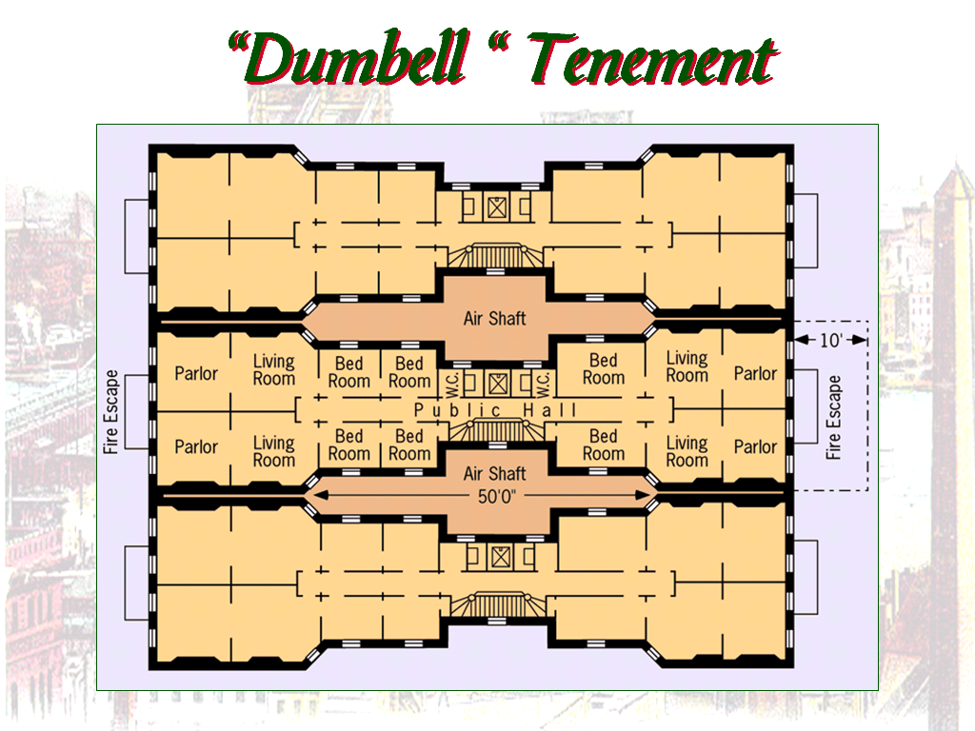
Jacob Riis’ “How the Other Half Lives” (1890) exposed the poverty of the urban poor

Slide 15
Upton Sinclair
Why did Upton Sinclair write The Jungle?
How was the term “muckrakers” coined?
Where was the largest meat-packing operation located?
Who worked in the meat-packing industry?
What were their hours like & how much did they make?
Who was Upton Sinclair? Describe his background.

Slide 16
Upton Sinclair
In 1906, Upton Sinclair wrote The Jungle
told of unsafe and unsanitary conditions in meat processing plants.
It’s readers included President Theodore Roosevelt.
Called for changes in the laws protecting food.
Called for the Pure Food & Drug Act of 1906.

Slide 17
Upton Sinclair The Jungle
The title reflects his view of the brutality he saw in the meat-packing business.
The story centered on a young man, Jurgis Rudkis, who had recently immigrated to Chicago with a group of relatives and friends from Lithuania.
Full of hope for a better life, Jurgis married and bought a house on credit. He was elated when he got a job as a "shoveler of guts" at "Durham," a fictional firm based on Armour & Co., the leading Chicago meat packer.

Slide 18
Jurgis soon learned how the company sped up the assembly line to squeeze more work out of the men for the same pay. He discovered the company cheated workers by not paying them anything for working part of an hour.
Jurgis saw men in the pickling room with skin diseases. Men who used knives on the sped-up assembly lines frequently lost fingers. Men who hauled 100-pound hunks of meat crippled their backs.

Slide 19
Workers with tuberculosis coughed constantly and spit blood on the floor. Right next to where the meat was processed, workers used primitive toilets with no soap and water to clean their hands.
In some areas, no toilets existed, and workers had to urinate in a corner. Lunchrooms were rare, and workers ate where they worked.

Slide 20
Almost as an afterthought, Sinclair included a chapter on how diseased, rotten, and contaminated meat products were processed, doctored by chemicals, and mislabeled for sale to the public. He wrote that workers would process dead, injured, and diseased animals after regular hours when no meat inspectors were around. He explained how pork fat and beef scraps were canned and labeled as "potted chicken.”

Slide 21
Sinclair wrote that meat for canning and sausage was piled on the floor before workers carried it off in carts holding sawdust, human spit and urine, rat dung, rat poison, and even dead rats. His most famous description of a meat-packing horror concerned men who fell into steaming lard vats:
. . . and when they were fished out, there was never enough of them left to be worth exhibiting,--sometimes they would be overlooked for days, till all but the bones of them had gone out to the world as Durham's Pure Leaf Lard!
Jurgis suffered a series of heart-wrenching misfortunes that began when he was injured on the assembly line. No workers' compensation existed, and the employer was not responsible for people injured on the job. Jurgis' life fell apart, and he lost his wife, son, house, and job.

Slide 22
Response to The Jungle
Pure Food & Drug Act of 1906
Mandated safe and sanitary conditions for food preparation and packaging.
It also put regulations on medicines.

Slide 23
Factory Inspection
Women campaigned for factory reform and temperance:
-Florence Kelley became State of Illinois's first chief factory inspector:
One of nation's leading advocates for improved factory conditions
Took control of new National Consumers League (formed in 1899)

Slide 24
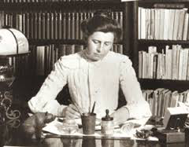
d. Explain Ida Tarbell’s role as a muckraker
Ida Tarbell
Revealed the abuses of the Standard Oil Trust
She called for reforms in U.S. business and campaigned against monopolies.

Slide 25
Optimism & belief in progress (“investigate, educate, & legislate”)
Social Gospel taught Christians that it was their duty was to end poverty & inequality
Progressive Themes
Looked to the government to help achieve goals
Desire to “humanize” industry & urbanization
Their actions impacted the entire nation; not regions like the Populists
Led by educated middle-class “experts” who developed “rational” solutions
Change the environment in order to change people (no Social Darwinism)

Slide 26
The Progressive Era
Progressive reform 1st began in cities in the 1890s to address factory, tenement, labor problems:
Early reformers realized that private charity was not enough to cure all social ills
The Social Gospel movement was a new religious philosophy that focused on improving society & saving individual souls

Slide 27
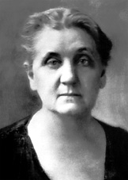
b. Identify Jane Addams and Hull House and describe the role of women in reform movements
Many of the reformers during the progressive movement were women.
Jane Addams – nicknamed the “mother of social work”

Slide 28
Jane Addams & The Hull House
Jane Addams opened the Hull House as a settlement house in Chicago.
Settlement houses were established in poor neighborhoods
Social activists would lie in these houses and offer assistance to immigrants and underprivileged citizens.

Slide 29
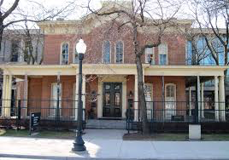
Jane Addams & The Hull House

Slide 30
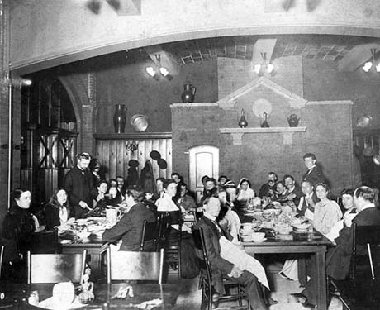
Jane Addams & The Hull House

Slide 31
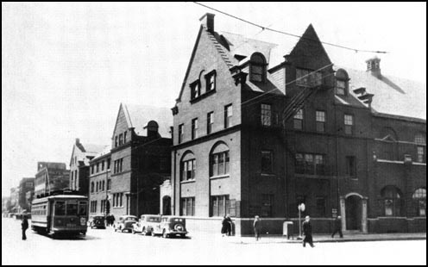
Jane Addams & The Hull House

Slide 32
Jane Addams & The Hull House
By 1910, there were more than 400 settlement houses in the United States.
Hull House activists launched investigations into economic, political, and social conditions in the city.
They also provided help and education for the poor and immigrants.
The fought for new child labor laws and other legislation to help those in need.

Slide 33
Jane Addams & The Hull House
Services they provided:
Kindergarten and day care
Employment bureau
Art gallery
Libraries
English and citizenship classes
Theater, music, and art classes
Later, more clubs and activities were added.

Slide 34
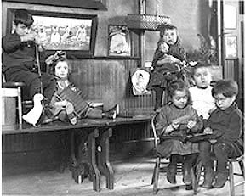
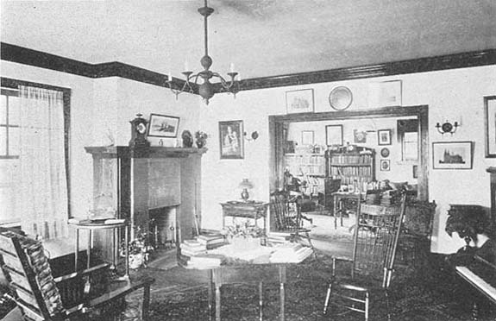
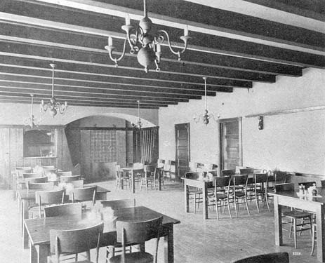
Jane Addams & The Hull House

Slide 35
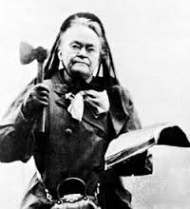
The Temperance Movement
The temperance movement was a movement to limit and eventually eliminate alcohol.
Many of the leaders of the temperance movement were women.
Carrie Nation
became well known for entering saloons (in her 50’s) and smashing liquor bottles with a hatchet while her supporters prayed and sang hymns.

Slide 36
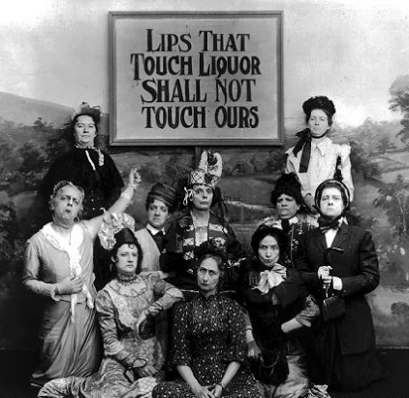
The Temperance Movement
Groups such as the WCTU were formed

Slide 37
The Temperance Movement
Groups such as the Women’s Christian Temperance Union (WCTU) were formed and helped to gain key reforms:
Prohibition – Shocking reports of alcohol abuse led 19 states to outlaw booze & the passage of the 18th Amendment (1920).
Prostitution – By 1915, almost all states banned brothels & the Mann Act banned the interstate transport of “immoral” women.

Slide 38
The Temperance Movement
Some states and counties passed “dry” laws to control, restrict, or abolish alcohol
Big cities generally “wet” because immigrants accustomed in Old Country to free flow of alcohol
By World War I (1914), nearly half of U.S. population lived in “dry” territory

Slide 39
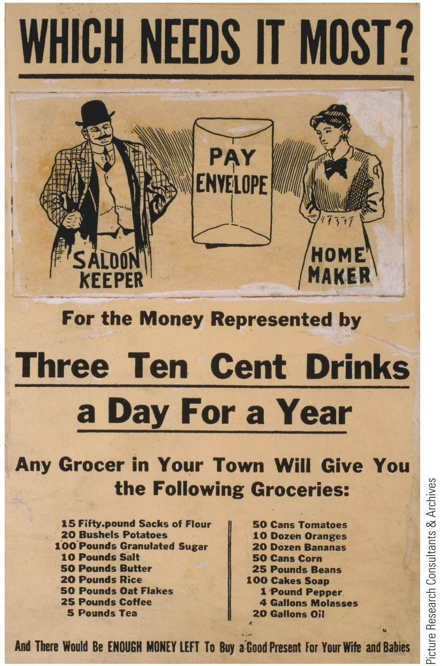
p647
Notes:
Saloon Keepers Versus Homemakers This Woman’s
Christian Temperance Union flyer, tallying the cumulative
costs of alcohol consumption to a drinking man’s family,
illustrates the influential role of women in the temperance
movement. Alcohol abuse threatened the stability and
economic well-being of the family, still predominantly considered
the “woman’s sphere” at the turn of the century.

Slide 40
The Temperance Movement
The 18th Amendment prohibited the making, selling, or transporting of any alcoholic beverage in the United States.
Commonly referred to as Prohibition, this amendment later proved to be a failure and was repealed. (21st amendment)

Slide 41
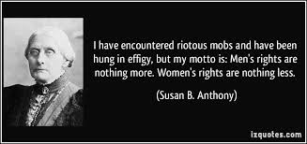
Women’s Suffrage
Ever since the Seneca Falls Convention of 1848, women had demanded suffrage (the right to vote)
Susan B. Anthony was one of the most recognized leaders of this movement.

Slide 42
Women’s Suffrage
Elizabeth Cady Stanton helped to found the National American Women’s Suffrage Association (NAWSA) which she led until 1900.
In 1920, Congress passed the 19th Amendment giving women the right to vote.

Slide 43
Women’s Suffrage Before 1900

Slide 44
Women’s Rights
In landmark case Muller v. Oregon (1908):
Louis D. Brandeis persuaded Supreme Court to accept laws protecting women workers by presenting evidence of harmful effects of factory labor on women's weaker bodies
Progressives hailed Brandeis's achievement as triumph over existing legal doctrines

Slide 45
Carrie Chapman Catt
A notable leader of the women's suffrage movement in the early 1900s
She and others won women's right to vote by holding meetings, protests, and speaking before government leaders.
Catt held the position of president for National American Woman Suffrage Association in 1900-1904 and 1915-1920.

Slide 46
Alice Paul
Organized suffragist parades for the sake of women's rights.
She was a bold woman who was imprisoned three times for her protests and led hunger strikes in prison.
In 1916, Paul formed the National Women's Party, which fought hard for a constitutional amendment that would extend suffrage to women.
In 1920, the 19th Amendment was passed, giving women the right to vote.

Slide 47
c. Describe the rise of Jim Crow, Plessy v. Ferguson, and the emergence of the NAACP.
What was the ruling in Plessy v. Ferguson? How did this impact life for African Americans?

Slide 48
African-American Reforms
By 1900, 80% of African-Americans lived in rural areas, most as Southern sharecroppers
Southern progressivism was for whites only; Keeping blacks from voting was seen as necessary:
Allowed for poll taxes, literacy tests, property qualifications (& grandfather clauses for whites)
Strengthened Jim Crow laws requiring separate theaters, restaurants, hotels, & schools
But did regulate RRs & industry

Slide 49
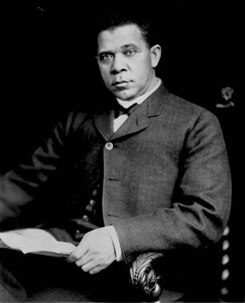
African American Reforms
Black leaders were divided on how to address racial problems
Booker T. Washington
Was the 1st president of Tuskegee University
His “Atlanta Compromise” stressed black self-improvement (not lawsuits or agitation against whites)

Slide 50
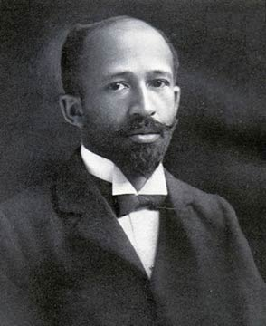
African American Reforms
W.E.B. DuBois
was more aggressive
He led the Niagara Movement in 1905 calling for immediate civil rights, integrated schools, U& promotion of the “Talented 10th” to be the next generation of black civil rights leaders

Slide 51
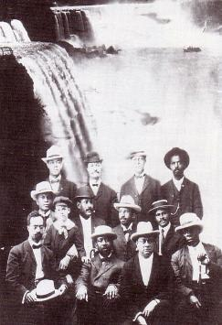
“[African-Americans] have a right to know, to think, to aspire… We must strive for the right which the world accords to man.”
—W.E.B. DuBois
Notes:
Washington vs. DuBois Reading
Compare view of Booker T Washington and WEB DuBois (CPUS book lesson 32): Have students read the passages and discuss their varying viewpoints on African-American civil rights

Slide 52
The Niagara Movement
In 1909, the National Association for the Advancement of Colored People (NAACP) was formed.
Created their official magazine The Crisis
DuBois was put in charge of The Crisis
NAACP victories:
Guinn v U.S. (1915) ended Oklahoma’s grandfather clause
Buchanan v. Worley (1917) ended KY housing segregation
But…“I have never seen the colored people so discouraged and so bitter as they are at the present time.”
—Booker T. Washington, 1913

Slide 53
e. Describe the significance of progressive reforms such as the initiative, recall, and referendum; direct election of senators; reform of labor laws; and efforts to improve living conditions for the poor in cities.
What was the living conditions like for the poor in the cities?

Slide 54
Labor Laws & Living Conditions
Jacob Riis wrote How the Other Half Lives
Described the cramped space, filthy conditions, and dangerous hazards in inner-city tenements (low-income apartments).
Jacob Riis’ efforts contributed to NY passing its first laws aimed at improving urban tenements.

Slide 55
Labor Laws & Living Conditions
Labor Laws were another area of concern
Wages were low
Men, women, & children worked long hours
Dangerous working conditions
Progressives called for shorter workdays, higher wages, and safer work environments for employees.

Slide 56
Labor Laws & Living Conditions
Reformers succceeded in convincing a number of states to pass minimum age laws.
Set limits on how young employees could be
Ages ranged from 12-16
Some states passed laws restricting the hours and occupations that women could work.
Legislatures also passed laws restricting work hours and requiring safer working conditions.

Slide 57
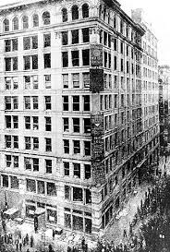
Triangle Shirtwaist factory fire
March 25, 1911 a fire broke out at the Triangle Shirtwaist Company in NYC.
Many of the exit doors to the factory were locked to prevent employees from stealing.

Slide 58
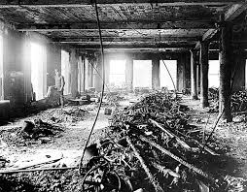
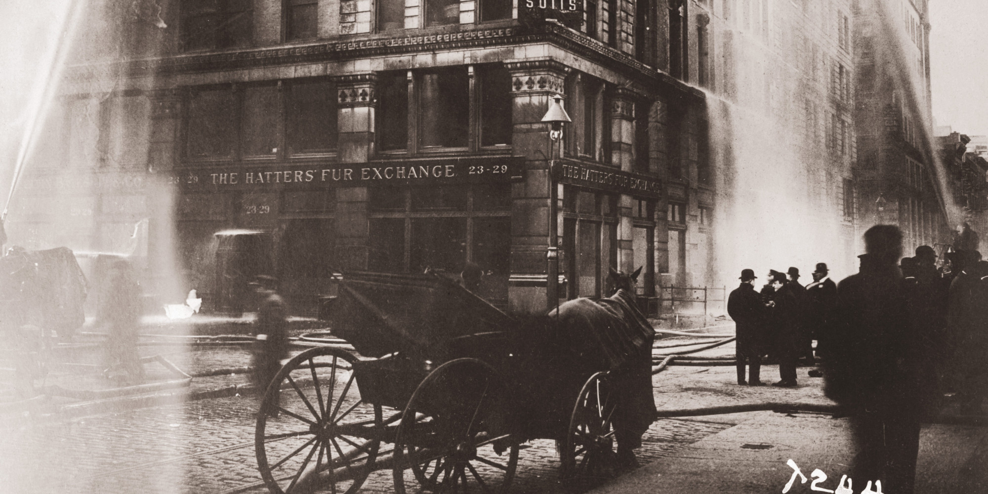
Triangle Shirtwaist factory fire
The fire killed 146 people and led to increased demands for safer working conditions.

Slide 59
Triangle Shirtwaist Factory Fire
CBS News – Remembering the Triangle Shirtwaist Fire
https://youtu.be/4ulaG9x4GpE

Slide 61
Essential Question:
How did progressives bring reform to local, state, and national governments?

Slide 62
Progressive Reform in the Cities
Most cities formed committees to focus on improving quality of life
Many cities used “gas & water socialism” to control public utility costs
Many mid-sized or small cities hired a non-partisan city manager to oversee the city bureaucracy
Political progressivism began in cities in response to corrupt political machines & deteriorating urban conditions
“Good government” reformers created the National Municipal League in 1894 to find ways to make city governments less political & less partisan
Galveston, Texas was the 1st city to use a city commission rather than a mayor & city council
These urban reforms were less democratic but much more efficient & less corrupt
Notes:
Many of city reforms based on problems created as a result of the depression of 1893

Slide 63
Progressive Reform in the States
Progressive reformers impacted state governments too:
A New York corruption scandal linked politicians & utility suppliers leading NY to form a utilities regulatory board
Most states created regulatory commissions to oversee state spending & initiate investigations

Slide 64
Progressive Reform in the States
Allowed citizens to create laws by petitioning to have an issue placed on a state ballot & allowing voters (not politicians) to decide
Progressives helped make state governments more democratic:
Western states were the 1st to allow public initiatives, referendums, & recalls
Allowed citizens to vote on an issue (such as tax increases) suggested by the state legislature
Allowed voters to directly remove an elected official by popular vote

Slide 65
Progressive Reform in the States
Passage of the 16th amendment in 1913 created a national income tax
Congress can collect taxes on the incomes of businesses and individuals
Passage of the 17th amendment in 1913 allowed for the direct election of Senators
Prior it was by state legislators, not the people.
Progressives believed there was too much corruption in gov’t and “buddies” would be given the favor of political office.

Slide 66
f. Describe the conservation movement and the development of national parks and forests; include the role of Theodore Roosevelt.
Theodore Roosevelt is often considered the “conservationist president.”
He saw the decimation of the bison and the eradication of elk, bighorn sheep, deer, & other game species and he felt compelled to protect our wildlife.

Slide 67
Theodore Roosevelt and Conservationism
After becoming President in 1901, he used his authority to protect wildlife & public lands.
He created:
The United States Forest Service (USFS)
150 national forests
51 federal bird reserves
4 national game preserves
5 national parks
18 national monuments

Slide 68
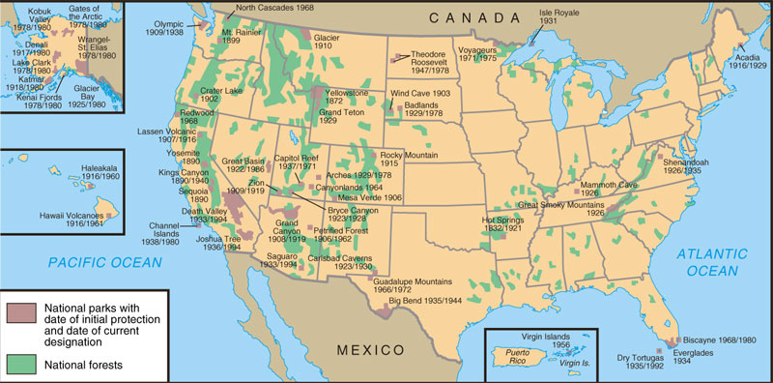
National Parks and Forests

Slide 69
Presidents of the Progressive Era
Complete the Chart on the Presidents and their actions during the Progressive Era.
Use pages 528-541 in American Vision Textbook.
Reference Chapters 28-30 in American Pageant Textbook

Slide 70
 | Teddy Roosevelt 1901-1909 “square deal” | Taft 1909-1913 | Wilson 1913-1921 “New Freedom”
Conserv. | Preserved 170 million acres of land Created National Parks | Ballinger-Pinchot Controversy | Not a conservationist
RR | Greatly strengthened RR legislation Elkins Act, Hepburn Act appealed to the press to get his leg. passed | Mann-Elkins Act | Adamson Act, 8 hr workday for RR workers
Labor Action/Leg. | Created the department of Labor and Commerce | Separated the Dept. of Labor and Commerce | The Kern-McGillcuddy Act – workers comp, Keating Owens Act – outlawed child labor, Adamson Act – guaranteed 8 hr. workday

Slide 71
 | Teddy Roosevelt | Taft |  | Wilson
Regulation of Trusts | Busted up Northern Securities (JP Morgan) Reign in / not destroy trusts | More than twice the anti-trust suits than TR |  | Established the FTC – not strong anti-trust Clayton Anti-Trust Act
Public Health | Pure Food & Drug Act
Tariff Proposals | Believed in expert tariff commission by businessmen, not politicians | Payne Aldrich Tariff Act |  | Underwood Simmons Tariff (reduced tariffs) 16th amendment – income tax
Banking Leg. | Aldrich Vreeland Act – put more money in circulation | Postal Saving Bank Act |  | Established Federal Reserve Act (bank of Banks)

Slide 72
Paragraph
How did the chaotic conditions of urban America in the Gilded Age contribute to“progressive” reforms in the early 20th century?
Be sure to cite specifics from the Gilded Age as well as specific changes as a result of the progressive movement.

