Slide 1
Empire and Expansion
1890 – 1909

Slide 2
Imperialism
Toward the end of the 1800’s, citizens in the U.S. believed in imperialism.
The belief that the U.S. needed to acquire more territory beyond its borders.
Reasons for expansion
it opened up new markets & great potential for economic growth
2. Help us to maintain national security
3. Believed it was our destiny (nationalistic spirit) to expand.

Slide 3
Isolationism
While more and more U.S. citizens were advocating imperialism, others preached isolationism.
The belief that it was NOT in the best interests of the U.S. to acquire and exercise control over foreign territories.
Why Isolationism?
It would keep us out of foreign conflicts
Believed it was not economically or politically wise to expand.
Believed it contradicted the principles of freedom and self-government

Slide 4
Isolationism
US ignored outside world in post Civil War years
In 1890s, policy changed
– US became involved in foreign affairs and gained an overseas empire

Slide 5
Reasons for Expansion:
Farmers and factory owners needed new markets
Excess production sold off overseas
Markets might relieve pressures of labor violence and farmers’ unhappiness

Slide 6
Reasons for Expansion:
“yellow press”
Joseph Pulitzer and William Randolph Hearst most famous publishers
Glorified overseas adventures

Slide 7
A “Yellow Kid” Cartoon

Slide 8
Reasons for Expansion:
Christian missionaries wanted new converts
Encouraged by Our Country: Its Possible Future and Its Present Crisis by Josiah Strong
Called on Americans to spread superior religion and civilization

Slide 9
Reasons for Expansion:
Social Darwinism
Earth belongs to the strong and fit
US had to compete with strong nations in Europe and Japan to take territory from weaker peoples

Slide 10
The Light of the World

Slide 11
World Colonial Empires, 1900

Slide 12
“Grab-Bag”

Slide 13
Reasons for Expansion:
Naval Dominance!
The Influence of Sea Power upon History, 1660 – 1783 by Captain Alfred Thayer Mahan (1890)
Argued sea power was key to world dominance
Stimulated naval arms race around world, including in US

Slide 14
America Turns Outward
Secretary’s of State James G. Blaine’s “Big Sister” policy
Latin America should follow US and open their markets to US companies
1889 – first Pan-American conference between US and other American nations

Slide 15
The Pacific

Slide 16
Monroe Doctrine, A Live Wire

Slide 17
America Turns Outward
Great Rapprochement (reconciliation)
– British began to work for better relations with US; ended 100 years of hostile relations between US and Britain

Slide 18
Spurning the Hawaiian Pear
Early contact with Hawaii
Early 1800s – islands used by sailors to re- supply
1820s – Christian missionaries arrived
Whites began planting and harvesting sugar
1840s – US warned other nations away from Hawaii
1887 – US made treaty for use of Pearl Harbor as naval base

Slide 19
Missionaries Preaching to Hawaiian Natives

Slide 20
Spurning the Hawaiian Pear
The issues of annexation
Hawaiian natives killed by white diseases to 1/6 of original size
Asians (Japanese and Chinese) imported to work on white plantations; came to outnumber both whites and natives
1890 – McKinley Tariff raised tariffs on sugar and hurt white planters in Hawaii
Whites push for annexation (making Hawaii exempt from tariffs)
Annexation opposed by Queen Liliuokalani and huge majority of Hawaiian people

Slide 21
Queen Liliuokalani

Slide 22
Spurning the Hawaiian Pear
1893 – whites organize revolt against queen
US troops land under (unauthorized) orders of the US minister to Honolulu
Grover Cleveland refused to annex Hawaii
Believed US had wronged Hawaii and should only annex it if people approved (which they did not)
Not until 1898 (under McKinley) was Hawaii annexed

Slide 23
Sanford Dole, Key Architect of the Hawaiian Revolution

Slide 24
Dewey’s May Day Victory at Manila
July 7, 1898 – resolution passed and signed annexing Hawaii
US wanted to prevent Japan taking islands while distracted in Philippines
Hawaii necessary for re-supply and fueling station for US Pacific fleet

Slide 25
The Importance of Hawaii

Slide 26
The Spanish-American War

Slide 27
Cubans Rise in Revolt
1895 – Cuban people rebel against Spanish misrule
Economy crippled by 1894 US tariff against sugar
Insurrectos burn sugar fields and mills and blow up trains to fight Spanish

Slide 28
Cuban Revolutionary Jose Marti

Slide 29
Cubans Rise in Revolt
US and the Cuban rebellion
US had $50 million invested and $100 million in annual trade with Cuba
US sympathized with Cuban rebels
Cuba seen as critical for controlling Gulf of Mexico (and therefore area of future Panama Canal)

Slide 30
Cuban Sugar Production

Slide 31
Out of the Frying Pan of “Spanish Misrule,” into the Fire of “Anarchy,” Unless the US Steps In

Slide 32
Cubans Rise in Revolt
1896 – Spanish sent General “Butcher” Weyler to end rebellion
Used reconcentration camps to stop population from helping insurrectos
Camps turned into dirty deathtraps, where many people died

Slide 33
General Valeriano Weyler

Slide 34
Victims of Spanish Concentration Camps in Cuba

Slide 35
Victims of Spain’s Reconcentration Camps

Slide 36
Cubans Rise in Revolt
“yellow journalism” (Hearst and Pulitzer) use Cuban rebellion to sell newspapers with “scoops”
Artist Frederic Remington sent to Cuba to draw pictures
“You furnish the pictures and I’ll furnish the war.” (Hearst)

Slide 37
Cubans Rise in Revolt
Maine incident
Early 1898 – USS Maine sent to Havana Harbor to evacuate Americans in case of hostilities
February 15, 1898 – Maine blew up, killing 260 sailors
US public (believing Spain attacked Maine) demanded war

Slide 38
USS Maine in Havana Harbor

Slide 39
Explosion of the Maine

Slide 40
Wreckage of the Maine

Slide 41
The USS Maine Headlines

Slide 42
Cubans Rise in Revolt
Investigations of the Maine incident
Spanish investigation found that explosion was internal and accidental
US Navy at the time found that the blast had been cause by an underwater mine
1976 US Navy investigation confirmed Spanish findings
Spontaneous explosion in a coal bunker near a storage area for gunpowder

Slide 43
Cubans Rise in Revolt
McKinley’s dilemma
US negotiators had gotten Spain to agree to shut down reconcentration camps and hold cease-fire with insurrectos
McKinley wanted Spain out of Cuba, without war
Americans were demanding war, with many attacking McKinley for indecisiveness

Slide 44
Pressure Was Placed on McKinley to go to War

Slide 45
Cubans Rise in Revolt
April 11, 1898 – McKinley sent war message to Congress
Much support from public and Congress
Claimed US would free Cuba from Spain
Teller Amendment – adopted by Congress with declaration of war
US promised to free Cuba after Spain was removed

Slide 46
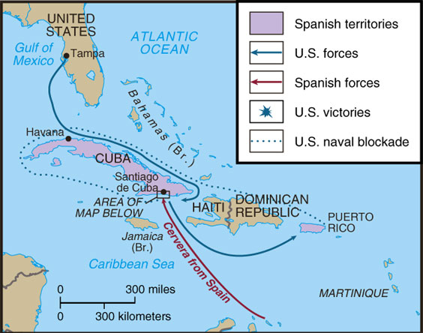
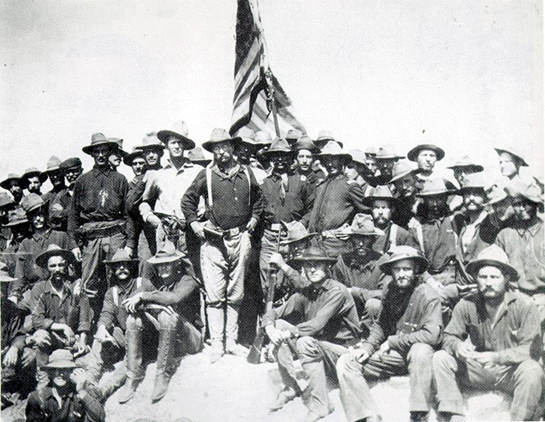
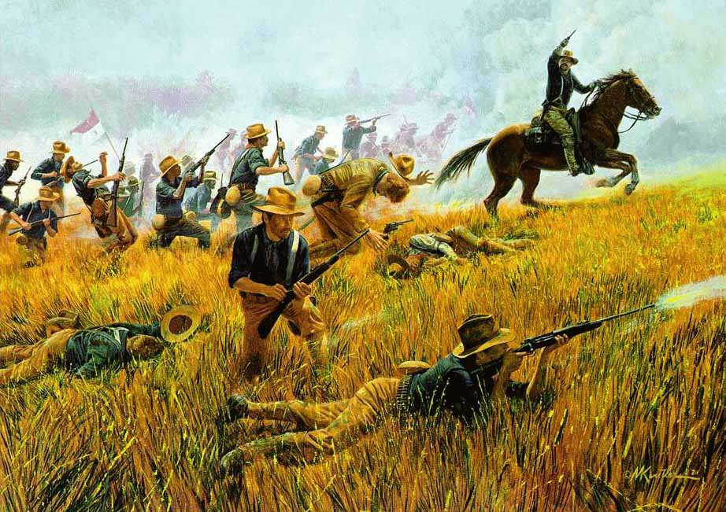
Spanish-American War was fought in 2 theaters: Cuba & the Philippines
Even the elite joined: Teddy Roosevelt led the Rough Riders in Cuba
“What a splendid little war.”
—John Hay, Secretary of State
under President McKinley
The war lasted only 113 days & resulted in 5,500 deaths (mostly from disease, only 379 died in battle)

Slide 47
Results of Spanish-American War
U.S. & Spain signed the Treaty of Paris on Dec 10, 1898:
Cuba gained independence
U.S. gained Puerto Rico & Guam
What to do with the Philippines? The U.S. did not want it, but Germany did, so the U.S. annexed the Philippines

Slide 48
War in the Philippines
The U.S. did not deem Filipinos “ready” for self-rule
Filipinos welcomed war with Spain & aided the U.S. in the Pacific, but they grew angry when the U.S. refused to grant independence
Emilio Aguinaldo led a guerilla-style rebellion that lasted 3 years:
Cost 4,300 U.S. lives & between 50,000 & 200,000 native lives
The U.S. resorted to Weyler-style brutality: torture, starvation, rape

Slide 49
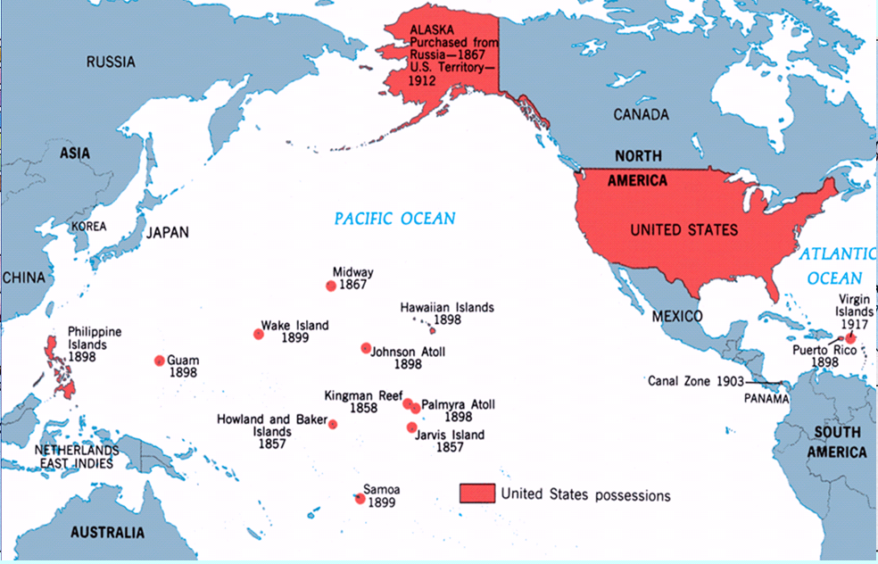
The “American Empire” in 1900
The Platt Amendment created a new Cuban constitution but forced Cuba to give up land for U.S. naval bases, pay off U.S. war debts, Cuba could not sign a foreign treaty that hurt the U.S., & the U.S. could intervene in Cuba at any time
How should the new lands in the new “empire” be governed? Citizenship? Voting?
Hawaii, Alaska, & Puerto Rico were made territories with appointed governors & granted U.S. citizenship
The navy controlled Guam & Samoa

Slide 50
Our Sphere of Influence

Slide 51
What the US has fought for

Slide 53
Conclusions: The USA as a New World Power

Slide 54
Impact of Spanish-American War
Just as the Depression of 1893 led to a shift in domestic policy, the Spanish-American War led to shift in U.S. foreign policy:
The U.S. gained overseas territories & was recognized as a legitimate “world power”
Increased the power of the American president

Slide 56
TR: Brandisher of the Big Stick
September 1901 - McKinley killed by an anarchist in Buffalo, New York
Teddy Roosevelt becomes President

Slide 57
TR: Brandisher of the Big Stick
Roosevelt’s background
Born to wealthy family in New York
Was weak and asthmatic as boy, but exercised fiercely to overcome physical weaknesses
Graduated from Harvard
Published over 30 books
Worked as ranch owner and cowboy in Dakotas before political life
5’10”, bespectacled, large teeth, droopy mustache

Slide 58
Theodore Roosevelt on Horseback

Slide 59
TR: Brandisher of the Big Stick
Roosevelt as politician
Loved outdoors and people
Traveled country meeting people
Motto for preparedness was “Speak softly and carry a big stick”
Always wanted to be the center of attention
Adored by most Americans

Slide 60
TR: Brandisher of the Big Stick
Roosevelt as president
Little respect for checks and balances of US system
President must take action in general interest of the people of the US, as long as it is not forbidden by the Constitution

Slide 61
Building the Panama Canal
Need for a canal across isthmus of Panama
Isthmus - a narrow strip of land, bordered on both sides by water, connecting two larger bodies of land
Had long been talked about
During Spanish-American War, battleship Oregon had traveled for weeks around South America to get to Caribbean
Would increase the strengthen the US Navy and help US defend recently-acquired territory (Hawaii, Philippines, Puerto Rico)

Slide 62
Building the Panama Canal
Negotiating the rights to the canal
1850 - Clayton-Bulwer Treaty between US and Britain
US could not get excusive rights to build canal
1901 - Hay-Pauncefote Treaty between US and Britain
Britain had problems in Europe and South Africa (Boer War)
Gave US right to build and fortify canal area

Slide 63
Building the Panama Canal
Where to build the canal?
American experts favored Nicaragua
French had tried before (1880s) across Panama
French (under Philippe Bunau-Varilla) offered to sell equipment to US for $40 million (previously had wanted $109 million)
June 1902 - Congress decided on Panama route (partly to get the French equipment)

Slide 64
Building the Panama Canal
Negotiating with Columbia
Columbia controlled Panama
US offered $10 million and yearly payment of $250,000 to Columbia for 6-mile wide strip of land
Columbian senate rejected offer because they believed they could get a better deal if they waited

Slide 65
Panama and Columbia

Slide 66
Building the Panama Canal
The Panamanians rebel
Panamanians fear they won’t get the canal (and resulting trade and prosperity)
Also had a history of rebellion against Columbian rule
French (especially Bunua-Varilla) fear losing $40 million payment from US
November 3, 1903 - Panamanians rebel
French and Panamanians worked together to plan the revolution
US navy ships prevented Columbian troops from crossing isthmus to put down rebellion

Slide 67
Roosevelt and Columbia

Slide 68
Building the Panama Canal
Roosevelt quickly makes Panama almost US outpost
Panama recognized by US only 3 days after revolution
15 days later - Hay-Bunau-Varilla Treaty signed in Washington
Bunau-Varilla was Panamanian ambassador (even though he was French)
US paid $10 million (with annual payment of $250,000), but US now got 10-mile wide strip of land (instead of only 6)
US paid French company $40 million for its equipment

Slide 69
Building the Panama Canal
Roosevelt and the revolution
Did not actively plot with revolutionaries
They did know that he would support them if they rebelled
Strong impression in Latin America that Roosevelt had been part of the revolution
Worsened relations between US and Latin America

Slide 70
The Man Who Can Make the Dirt Fly

Slide 71
Building the Panama Canal
Building the canal
Began in 1904
Many troubles - labor problems, landslides, tropical diseases
Colonel William C. Gorgas used modern pesticides to eliminate dangerous tropical diseases
Colonel George Washington Goethals finally completed canal in 1914
Cost $400 million to build

Slide 72
The Panama Canal Zone

Slide 73
Building the Panama Canal

Slide 74
TR’s Perversion of Monroe’s Doctrine
Debt problems in Latin America
Some countries (Venezuela, Dominican Republic) constantly behind in payments to Europe
Led to some attacks by European countries on Latin American countries
Roosevelt feared Germans or British might use debt repayment as excuse to stay in Latin America (violating the Monroe Doctrine)

Slide 75
TR’s Perversion of Monroe’s Doctrine
The Roosevelt Corollary
Corollary - a natural consequence or result
If there were future problems in Latin America with paying off debts, the US would intervene
US would take over parts of governments and pay off the debts, keeping Europe out
US became “policeman” of Latin America
1905 - first instance of putting Corollary into practice
US took over management of tariff collection in Dominican Republic to pay down its debts

Slide 76
The Roosevelt Corollary

Slide 77
TR’s Perversion of Monroe’s Doctrine
Effects of the Roosevelt Corollary
US believed they were protecting Latin America
But Latin America saw this as excuse for US to bully them
Used to justify interventions and landings of marines many times in Caribbean in future years

Slide 78
Activities of the United States in the Caribbean, 1898 to the 1930s

Slide 79
The Big Stick in the Caribbean

Slide 80
Asia

Slide 81
Hinging the Open Door in China
1900 - second Open Door note issued by Hay
Chinese territorial integrity to be upheld
Incorporated in Nine-Power Treaty (1922)
Violated by Japan (when Japan invaded Manchuria in 1930s)

Slide 82
Japan
Japan agrees to trade with the U.S.
Japan adopts western technology and launched their own industrial revolution.

Slide 83
Roosevelt on the World Stage
1904 - Russo-Japanese War broke out
Russia wanted access to ports in Manchuria (China), especially Port Arthur
Japan launched surprise attack on Russian fleet at Port Arthur (1904)
Japan then beat Russians in series of battles
Important because Europeans did not believe they could be beaten by non-Europeans

Slide 84
Roosevelt on the World Stage
As war dragged on, Japan grew short on men and money, so they approached Roosevelt to mediate a settlement
Roosevelt wanted to prevent Russian collapse so Russia could block Japan from expanding too much in Asia

Slide 85
Roosevelt on the World Stage
1905 - Roosevelt meets with Russia and Japan at Portsmouth, New Hampshire
Settlement reached that satisfied neither side
Japan especially angry because they felt they had won the war
Japan forced to give up demands for cash payment from Russia and Russian evacuation of Sakhalin Island
Japan did gain control over Korea (annexed in 1910)

Slide 86
Roosevelt Mediating the End of the Russo- Japanese War

Slide 87
Roosevelt Using His “Good Offices”

Slide 88
Roosevelt on the World Stage
Effects of Roosevelt’s involvement in the Russo-Japanese War
1906 - Roosevelt won the Nobel Peace Prize
For ending Russo-Japanese War, along with a conerence in Algerciras, Spain to end disputes in North Africa
US relations with Russia and Japan grew worse
Russia accused US of robbing it of military victory and because of massacres of Jews in Russia
Japan felt cheated by settlement US had worked out; US and Japan (who before had been friendly) came to be rivals in Asia

Slide 89
Japanese Laborers in California
Early 1900s - new wave of Japanese immigrants came from Japan
Came to escape war (with Russia) and high taxes
Californians feared “yellow peril” (even though Japanese were never over 3% of population

Slide 90
Japanese Laborers in California
1906 - San Francisco school board ordered segregation of all Asian (Japanese, Chinise, Korean) in special schools
– Done to free more space for whites after an earthquake and fire in the city (1906)

Slide 91
Japanese Laborers in California
Reaction to San Francisco’s actions
Japanese saw incident as national insult
War talk (because of irresponsible newspaper coverage) on both sides of Pacific

Slide 92
Japanese Laborers in California
Roosevelt fixed the problem with Japan
Invited the San Francisco school board and gets them to end the segregation
Japan agreed to “Gentlemen’s Agreement”
Secret agreement worked out in 1907 - 1908
Japan would stop flow of Japanese laborers to California by withholding passports

Slide 93
Japanese Laborers in California
1907 - the Great White Fleet sent out by Roosevelt
Didn’t want Japan to believe he had negotiated with them (over San Francisco incident) out of fear
Sent 16 white battleships around the world (from Virginia, around South America, around Australia, to Asia, through Middle East, and back to US across Atlantic)
Greeted warmly in Japan with thousands of schoolchildren waving US flags and singing Star Spangled Banner

Slide 94
Route of the ftreat White Fleet

Slide 95
The ftreat White Fleet

Slide 96
Japanese Laborers in California
1908 - Root-Takahira agreement
Between US and Japan
Both powers promised to respect each other’s territorial possessions in Pacific and uphold Open Door policy in China

Slide 98
PRESIDENTIAL DIPLOMACIES
Roosevelt Corollary – US would intervene in Latin American Affairs when necessary to maintain economic & political stability
Big Stick Diplomacy – “Speak Softly and carry a big stick.” US did not intend to be a threatening presence, but it would not hesitate to forcefully protect its own interests

Slide 99
PRESIDENTIAL DIPLOMACIES
Dollar Diplomacy – a policy of joining the business interests of a country with its diplomatic interests abroad
Moral diplomacy - the system in which support is given only to countries whose moral beliefs are the same as ours.

